Slide 1




ROSSMANN STORE SALES FORECASTING USING ML
Predicting daily sales using XGBoost and feature engineering
Samarth Tikotkar 202301060025
Harshal Nagalkar 202301060040
Prem Late 202301060031
Bhagvat Solanke 202301060037

Slide 2
INTRODUCTION
  Rossmann operates 3,000+ drug stores across Europe
  Business problem: High variation in daily sales across stores
  Goal: Predict daily sales to improve decision-making
  Dataset from the Kaggle Rossmann Sales Competition

Slide 3
PROJECT OBJECTIVES
  Build a machine learning model to predict daily store sales
  Combine store + sales data into one dataset
  Engineer features related to:
      Date & seasons
      Promotions
      Competition
  Evaluate models using RMSE
  Choose the best performing model for prediction

Slide 4
SDG ALIGNMENT
SDG 8: Decent Work & Economic Growth
  Better forecasting → better staff allocation
  Avoid overworking/understaffing days
SDG 9: Industry, Innovation & Infrastructure
  Use of ML for operational efficiency
  Supports smart retail systems & data-driven decisions

Slide 5
DATASET OVERVIEW
Files Used:
  train.csv — historical daily sales
  store.csv — store metadata
  test.csv — prediction dataset
Important Features:
  Sales, Customers, Promo, StoreType, Assortment
  CompetitionDistance, Promo2
  Date Features (Year, Month, Week)

Slide 6
DATA CLEANING & PREPROCESSING
  Removed closed-store rows (Open = 0)
  Handled missing values
  Scaled numerical features
  One-hot encoded categorical variables
  Engineered features:
      CompetitionOpen
      Promo2Open
      IsPromo2Month
      Year, Month, Day, WeekOfYear

Slide 7
EDA
Key Observations:
  Sales distribution is right-skewed
  Sales ↔ Customers: strong positive correlation
  Promotions significantly increase sales
  StoreType B & Assortment C have highest sales
  Seasonality patterns: March-April, June-July, Nov-Dec peaks
  Competition distance has mild effect

Slide 8
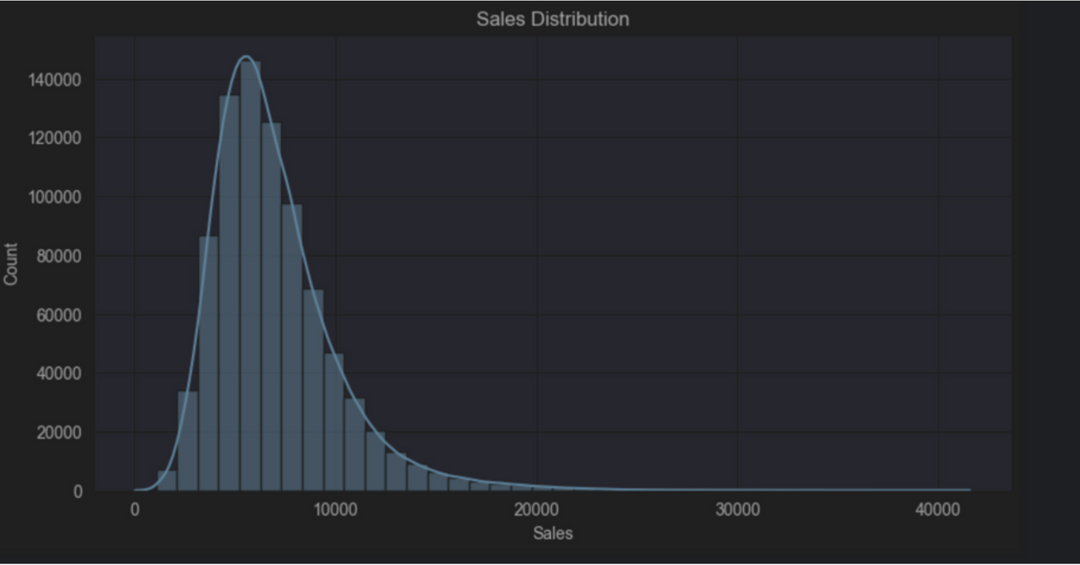
Findings:
The daily sales data is right-skewed, meaning that while most days have moderate sales, there are a few days with exceptionally high sales values that stretch the tail of the distribution to the right.

Slide 9
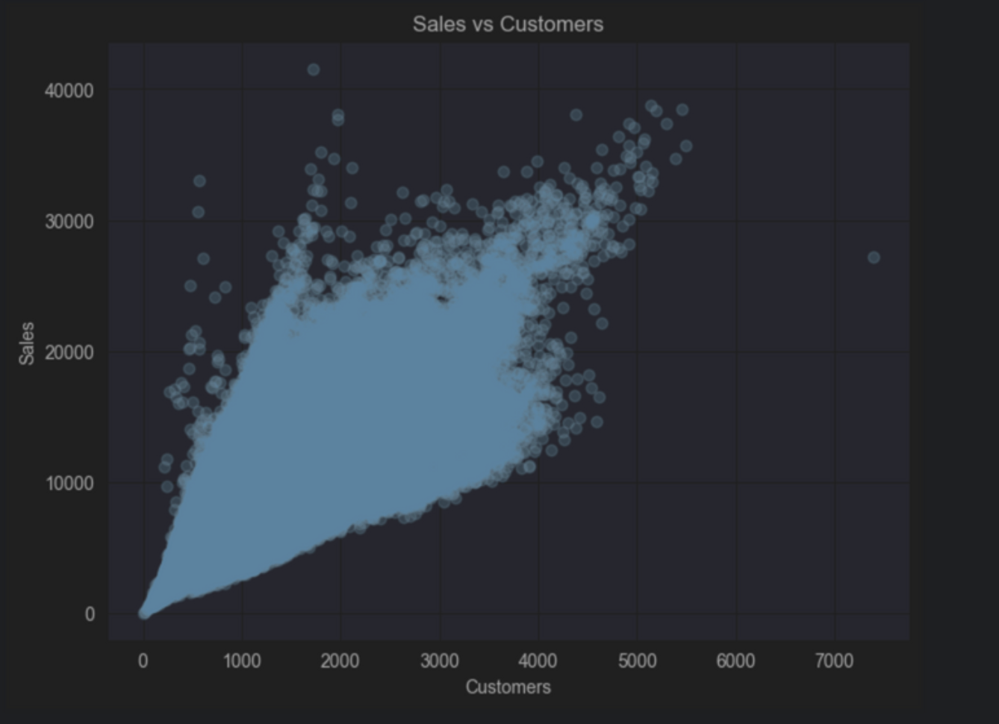
Findings:
There is a strong, positive correlation between the number of customers and daily sales, which is evident
from the tight, upward-sloping trend in the scatter plot.

Slide 10
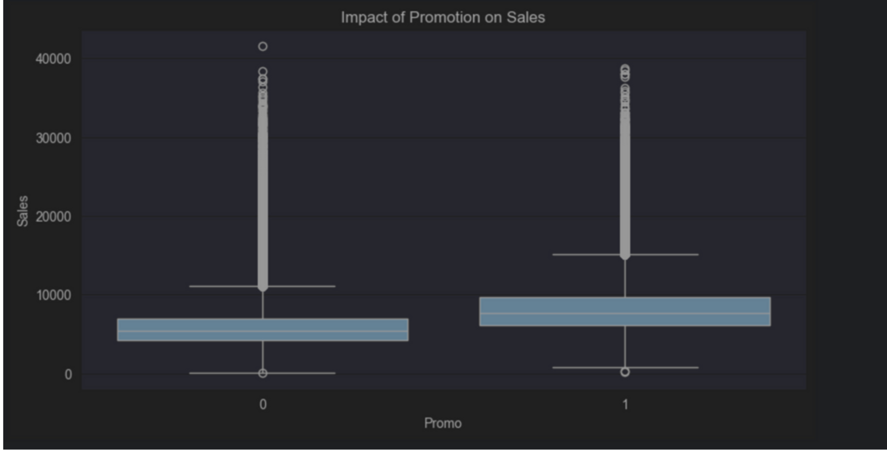
Findings:
Promotional activities have a substantial positive impact, as the average sales on days with a promotion
(Promo=1) are nearly double the sales on days without one (Promo=0).

Slide 11
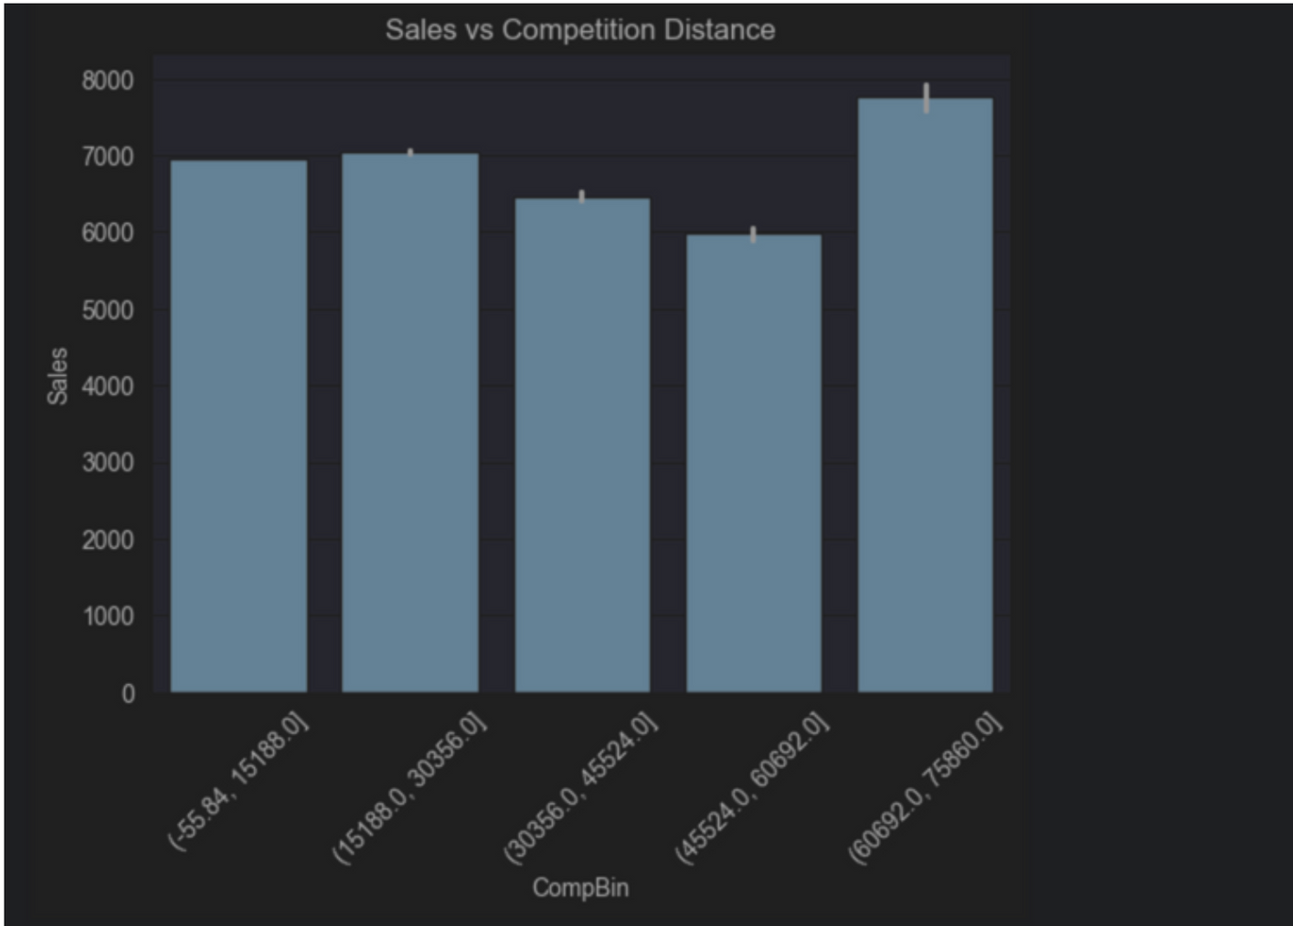
Findings:
Stores with far competition generally show higher sales Possible monopoly advantage

Slide 12
MODELING APPROACH
Models Used:
  Linear Regression (Baseline)
  XGBoost Regressor (Main Model)
Why XGBoost?
  Handles non-linear patterns
  Fast & accurate for tabular data
  Handles missing values
  Works well with engineered features

Slide 13
EVALUATION METRIC
RMSE (Root Mean Squared Error)
Used to measure error between predicted and actual sales.
Lower RMSE → Better model performance

Slide 14
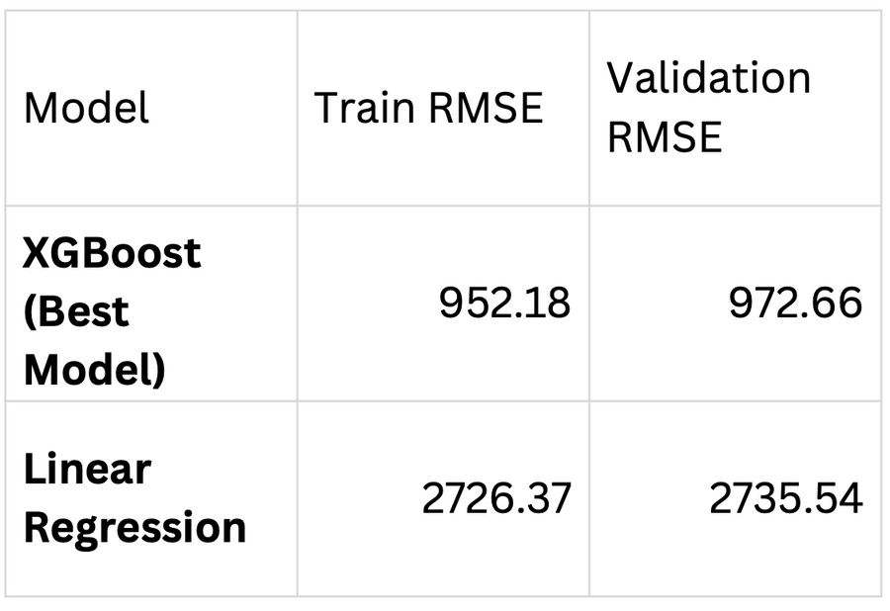
MODEL RESULTS
Interpretation:
  XGBoost clearly outperforms Linear Regression
  Captures effects of promotions, holidays, and store differences
  Lower error indicates better generalization

Slide 15
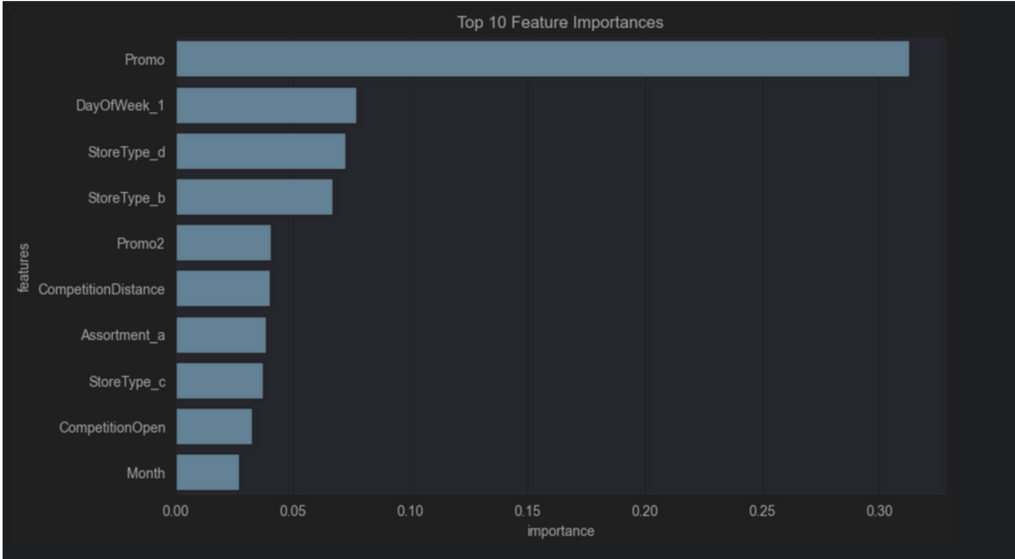
This confirms that promotional activities are the primary driver of sales variations. The
proximity of competitors, the inherent characteristic of an individual store, and the day
of the week also play critical roles.

Slide 16
CONCLUSION & FUTURE WORK
Conclusion:
  Successfully built a sales forecasting model using XGBoost
  Helps Rossmann optimize staffing, inventory, promotions
  Supports SDG 8 & SDG 9 (efficiency & innovation)
Future Work:
  Add weather and event data
  Deploy model as a web dashboard
  Interpret model using SHAP values
  Use Deep Learning time-series models (LSTM)

