Slide 1
‘Kaput’
By team ‘Modemas’

Slide 2
Relational database and EF

Slide 3
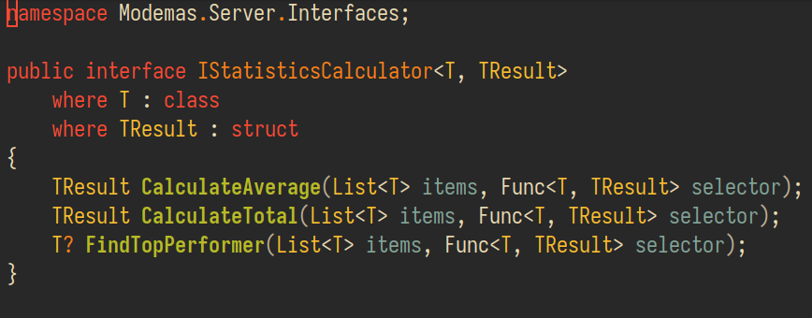
Generics

Slide 4
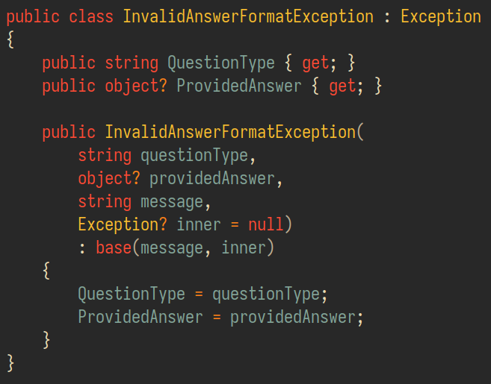
Exceptions

Slide 5
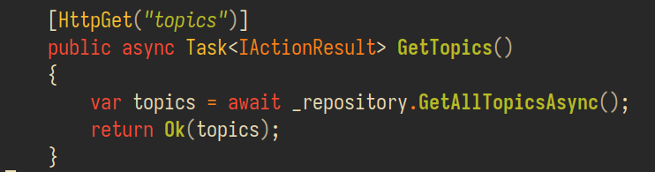
Async / await

Slide 6
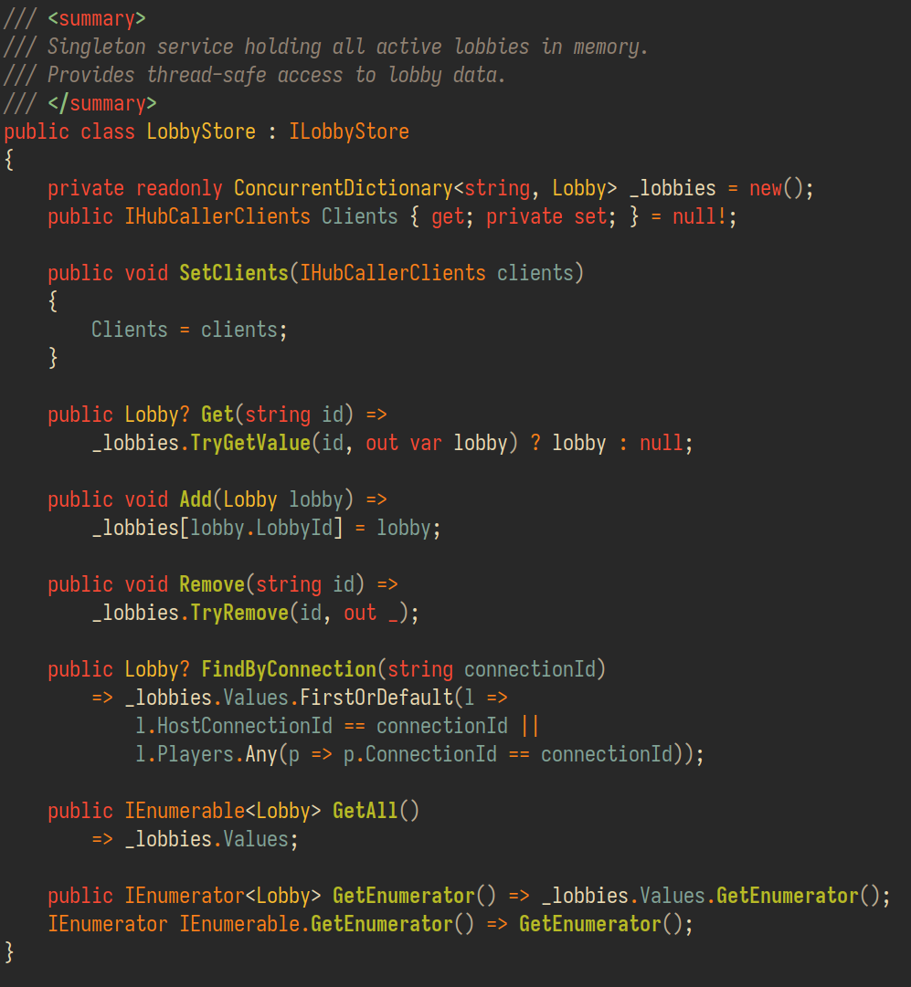
Concurrent collections

Slide 7
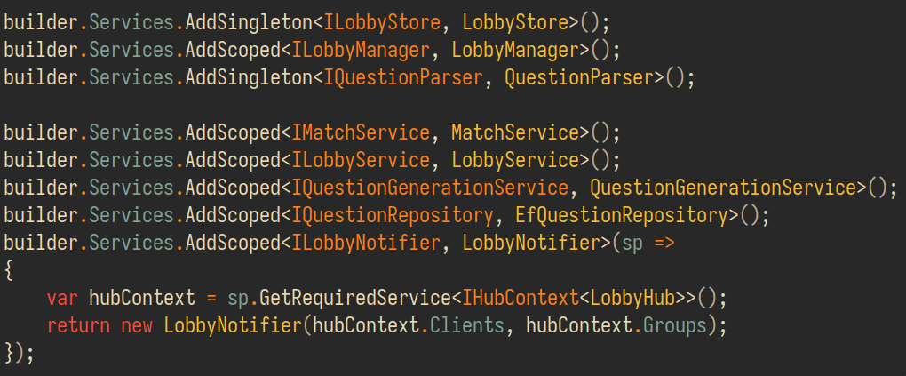
Dependency injection

Slide 8
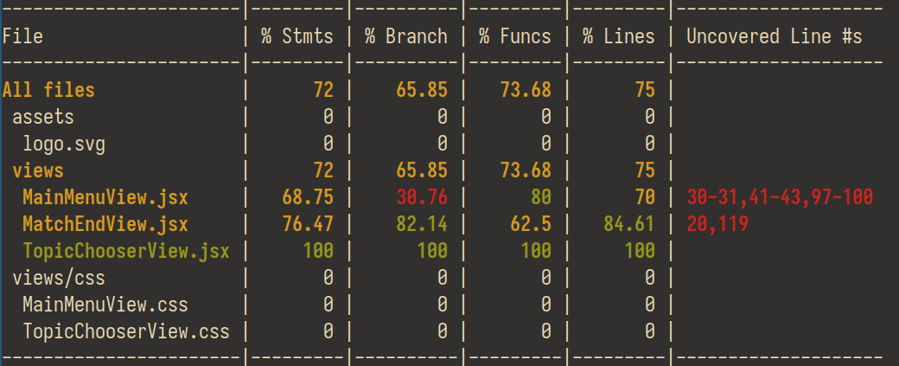
Tests

Slide 9
Thank you for listening!

