Slide 1
Kaput
By team ‘Modemas’

Slide 2
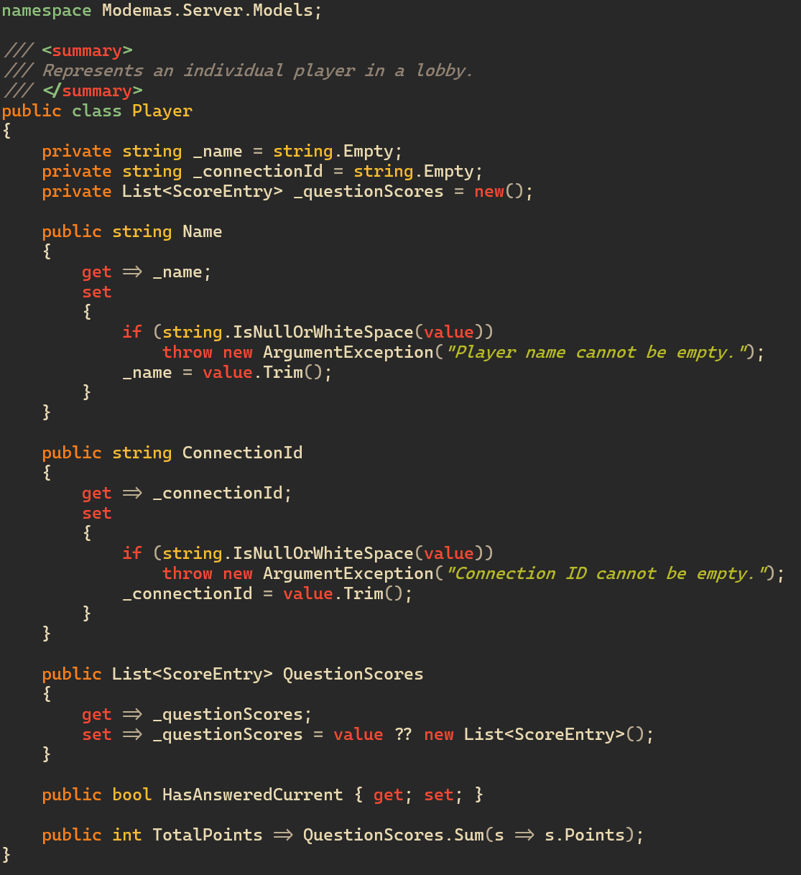
Class

Slide 3
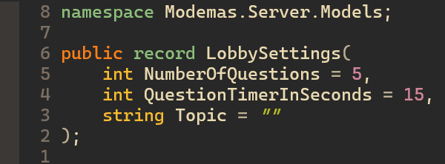
Record

Slide 4
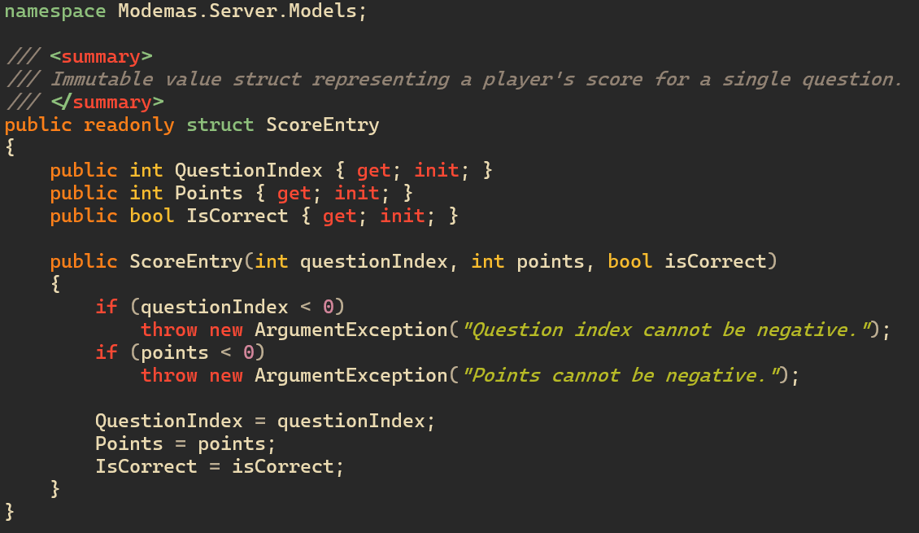
Struct

Slide 5
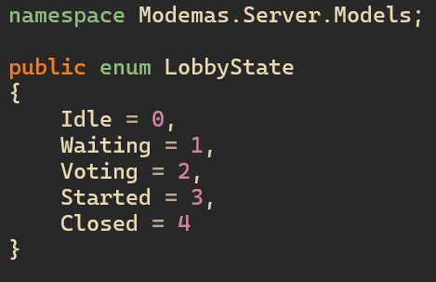
Enum

Slide 6
Arguments

Slide 7
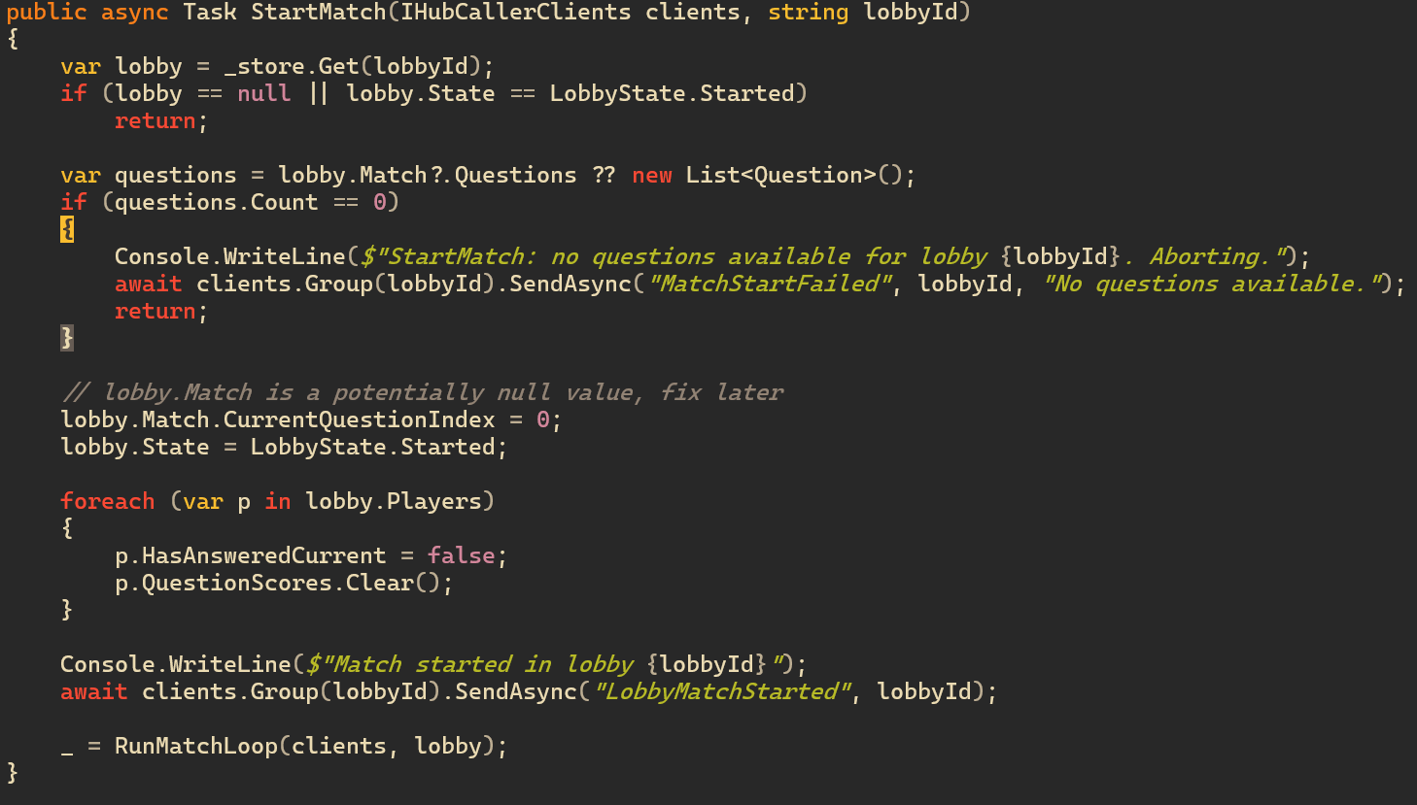
Iteration

Slide 8
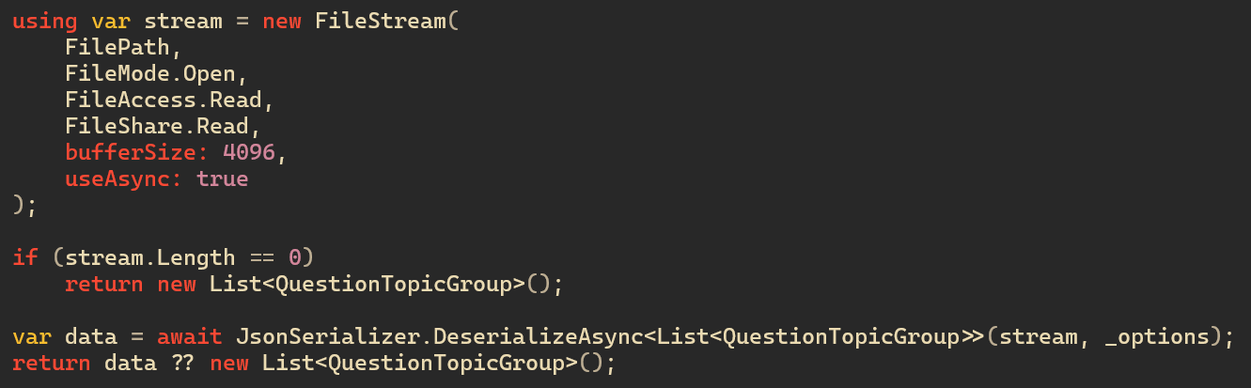
Stream

Slide 9
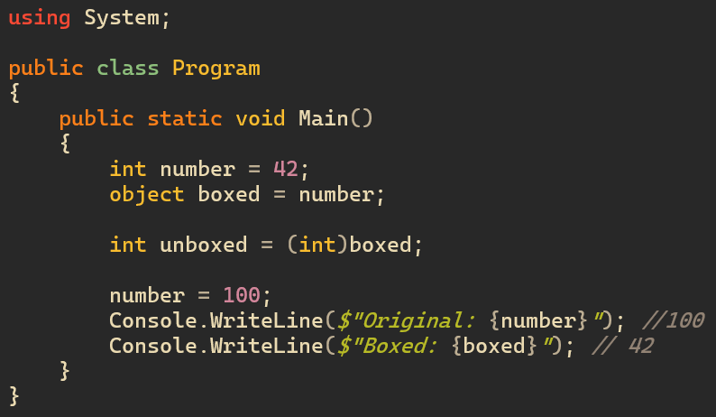
Boxing and unboxing

Slide 10
Linq to objects

Slide 11
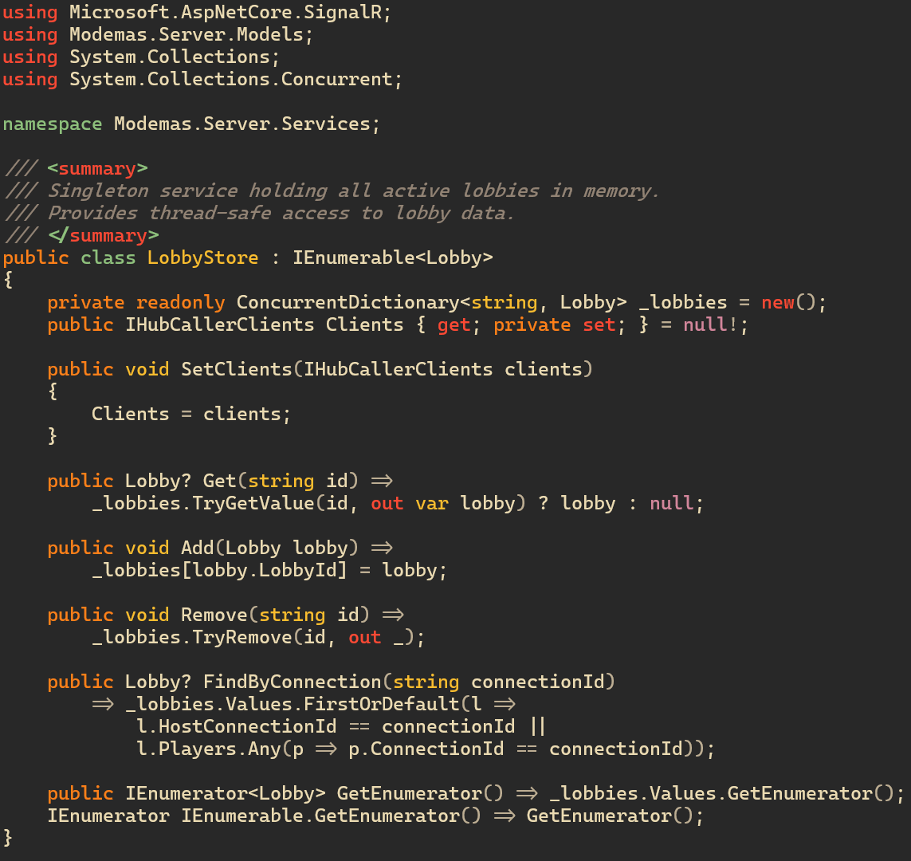
Interface

Slide 12
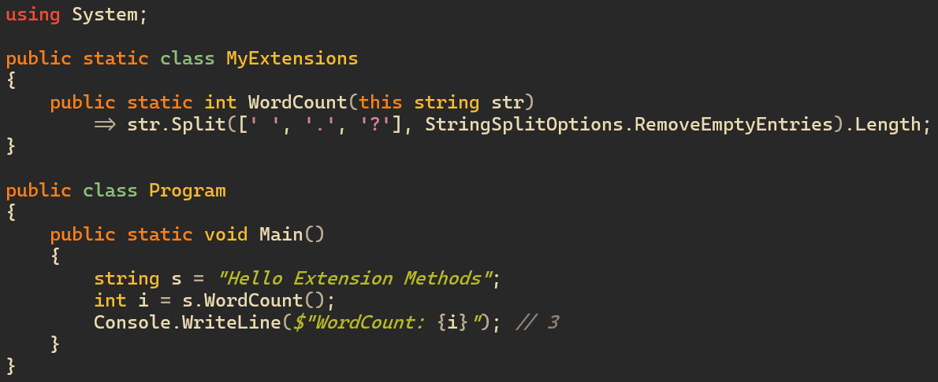
Extension method

