Slide 1

Filesystem Management System Design, Implementation, and Testing
Student Number: M00891519
Name: Ankit KC

Slide 2

Introduction
"Development of a simple filesystem management system with functionalities for file and directory operations.“
"This presentation covers the design, implementation, testing, and evaluation of the filesystem management system."

Slide 3



Project Overview : Goals
Implementing core filesystem functionalities including file and directory creation, deletion, reading, and writing.
Command-line interface, file handling with content writing/reading, directory navigation.

Slide 4
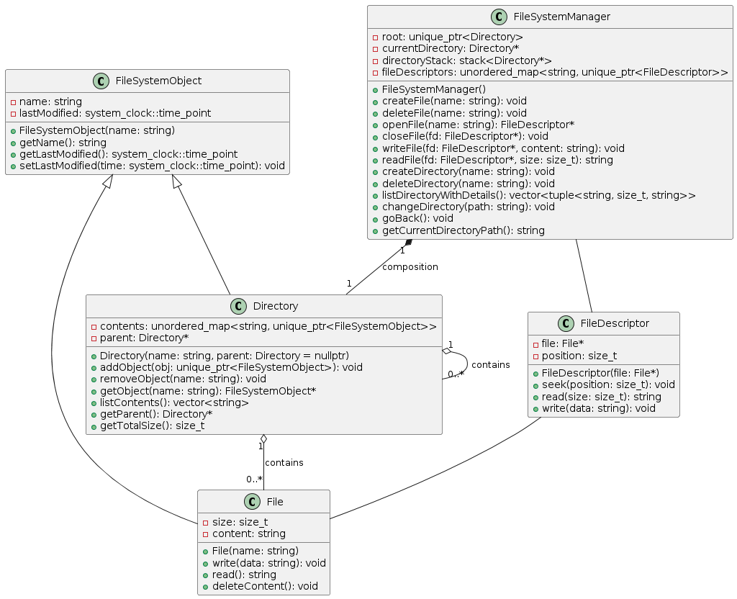
Class Diagram

Slide 5
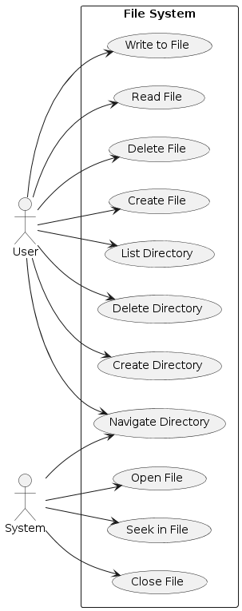
Use Case Diagram

Slide 6
Key Features
File creation and deletion
Directory management
Directory navigation
File reading and writing

Slide 7

Implementation Approach
Overview of the implementation approach:
Developed the filesystem management system in C++ using object-oriented programming principles.
Object-oriented design (OOD) was chosen for its ability to encapsulate data and behavior within classes, promoting modularity and reusability.
Leveraged C++ features such as classes, and inheritance to model filesystem objects like directories and files.
Separation of concerns was maintained through modular design, with distinct classes for different filesystem entities (e.g., FileSystemManager, Directory, File, FileDescriptor).

Slide 8
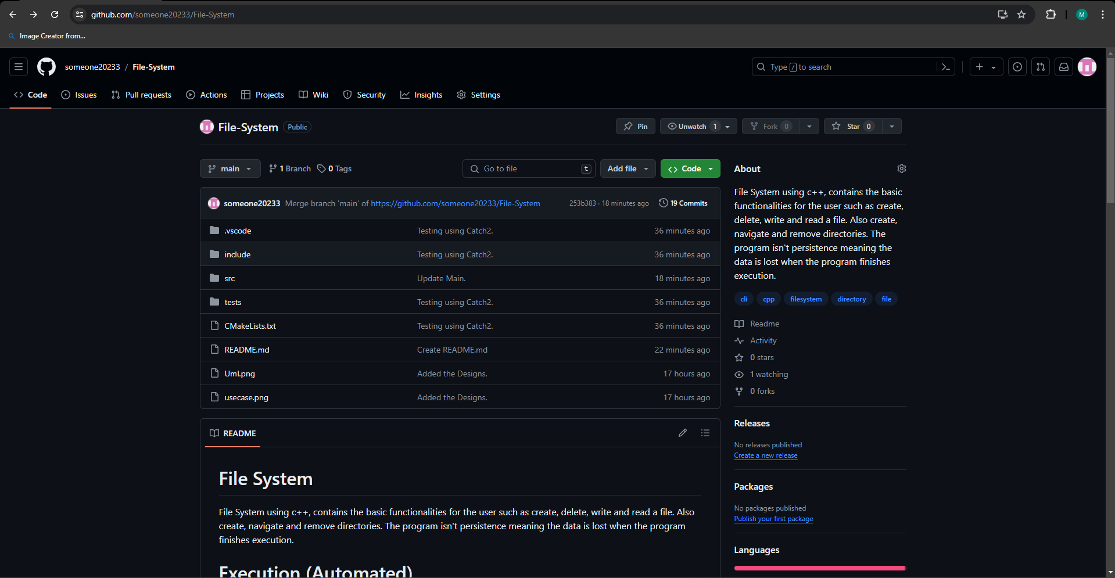
Make File & Version Control

Slide 9
Makefile & Version Control
Description of the Makefile:
The Makefile served as a build automation tool for compiling and linking the filesystem management system.
Defined compilation rules, dependencies, and build targets to streamline the build process across different platforms.
Managed complex build scenarios, ensuring that only modified source files were recompiled to optimize build times
Included targets for cleaning up object files (clean target) and rebuilding the entire project (all target) to maintain project cleanliness and integrity.
Description of version control with Git:
Git was used for version control to track changes made to the codebase over time.
Maintained a centralized repository on platforms like GitHub or GitLab for remote access and backup of the codebase.

Slide 10
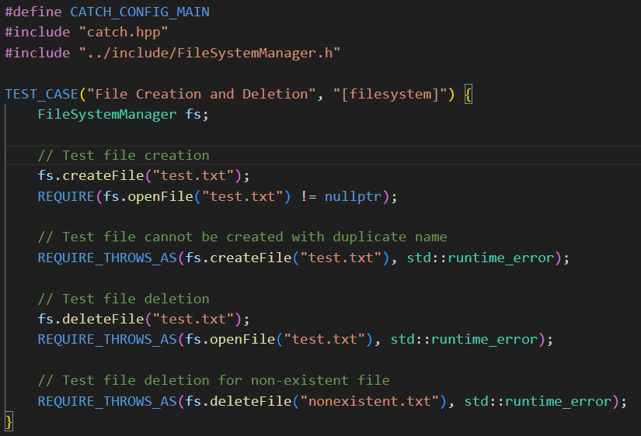
Testing Approach
Unit Testing: Implemented unit tests using Catch2, a C++ testing framework, to validate individual components like FileSystemManager, Directory, File, and FileDescriptor.
Coverage: Ensured comprehensive test coverage by testing various functionalities, including file creation, deletion, reading, writing, directory management, and navigation.
Edge Cases: Designed tests to handle edge cases such as empty files, non-existent files or directories, maximum file size limits, and nested directory structures.
Automation: Integrated tests into the build process using CMake and Makefile, enabling automated execution of tests to verify code functionality across different environments.

Slide 11
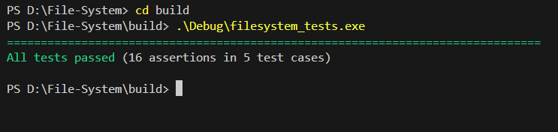
Testing Result
Test Suites: Created multiple test cases organized into logical test suites to systematically verify different aspects of the filesystem management system.
Assertions: Used Catch2 assertions (REQUIRE, REQUIRE_FALSE, etc.) to validate expected behaviors and outcomes, ensuring robustness and reliability of the codebase.
Test Execution: Executed tests regularly during development to catch regressions and ensure new code did not break existing functionalities.
Outcome: All critical functionalities passed tests successfully, demonstrating the system's correctness and adherence to specifications.

Slide 12
Challenges Faced
Memory Management: Ensuring proper memory management, especially with the use of smart pointers (unique_ptr) required careful attention to avoid memory leaks and dangling pointers.
Testing Across Platforms: Ensuring consistent behavior and performance across different platforms (Windows and Unix-based systems) during testing and deployment.
Exception Handling: Designing robust exception handling mechanisms to handle unexpected errors and edge cases gracefully without compromising system stability.

Slide 13

Conclusion
Summary of Work Done:
Developed a robust filesystem management system in C++ using object-oriented design principles.
Achievements: Successfully implemented core functionalities such as file creation, deletion, reading, writing, directory management, and navigation.
Reflections: Recognized the importance of modular design, thorough testing, and effective use of version control in maintaining code quality and project organization.
Limitations:
Acknowledged limitations in current implementation, such as lack of advanced features like file permissions (r, w), extensive error handling, and concurrency support.
Future Directions:
Proposed improvements for future iterations, including adding support for advanced features, enhancing performance optimizations, and integrating concurrency for multi-threaded operations.

Slide 14
References
https://github.com/catchorg/Catch2

Slide 15

Thank You!

