Slide 1

Servr
Team 2
Brandon Mabey, Haodong Tao, Tal Melamed, Tania Akter
Automated Shopping Cart Dispatch and Retrieval System

Slide 2
In Store Shopping Is Missing Something
Team 2
Currently shoppers are limited to just one cart.
Limits customer buying capability
Reduced store profits
Shoppers have to push their own cart
Requires effort
Notes:
Problem

Slide 3
Improve the shopping experience!
Team 2
Make the carts work for you.
They have had it too easy for too long
Notes:
Objective

Slide 4
System Overview
Team 2
Mobile app
Central control system
RoboDog™ Shopping cart robots
Position/cart nodes
Maintenance Station

Slide 5
Significant Features
Team 2
Automated cart driving
Central control system
Data analytics

Slide 6
Customer Validation
Team 2
Login Screen
Node Scanning successful
Call for cart to node
Customer receives cart
Out of carts state handling
No malicious user actions allowed
Stealing others carts

Slide 7
Typical Use Case
Team 2
Enter the store empty handed
Request an empty cart to your location
Receive empty cart and shop as normal
Send full cart to checkout
Request a new cart or go to checkout

Slide 8
Product Demo
Team 2
Automated Shopping Cart Dispatch and Retrieval System

Slide 9
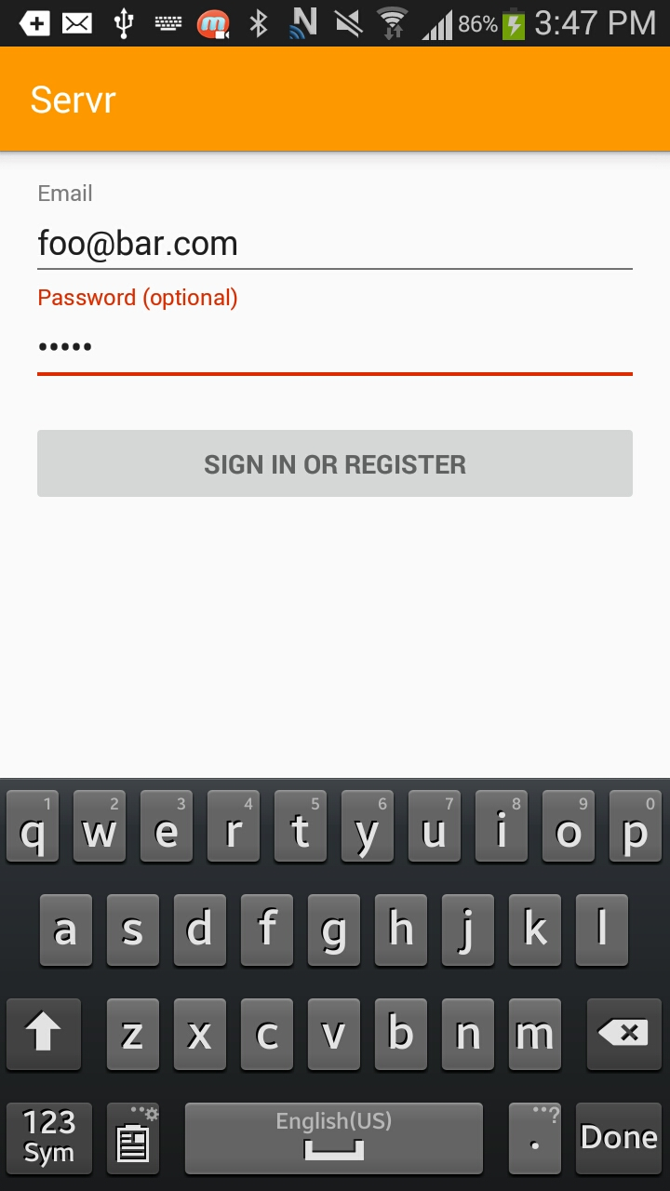
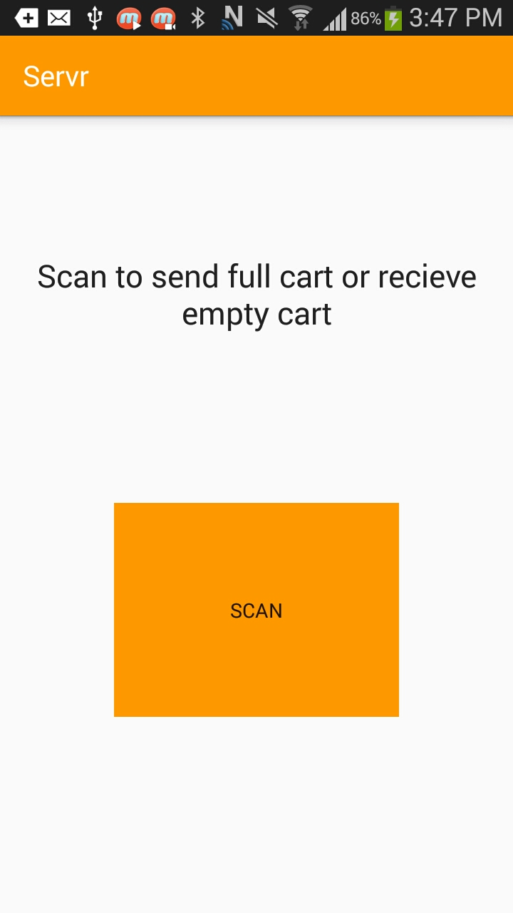
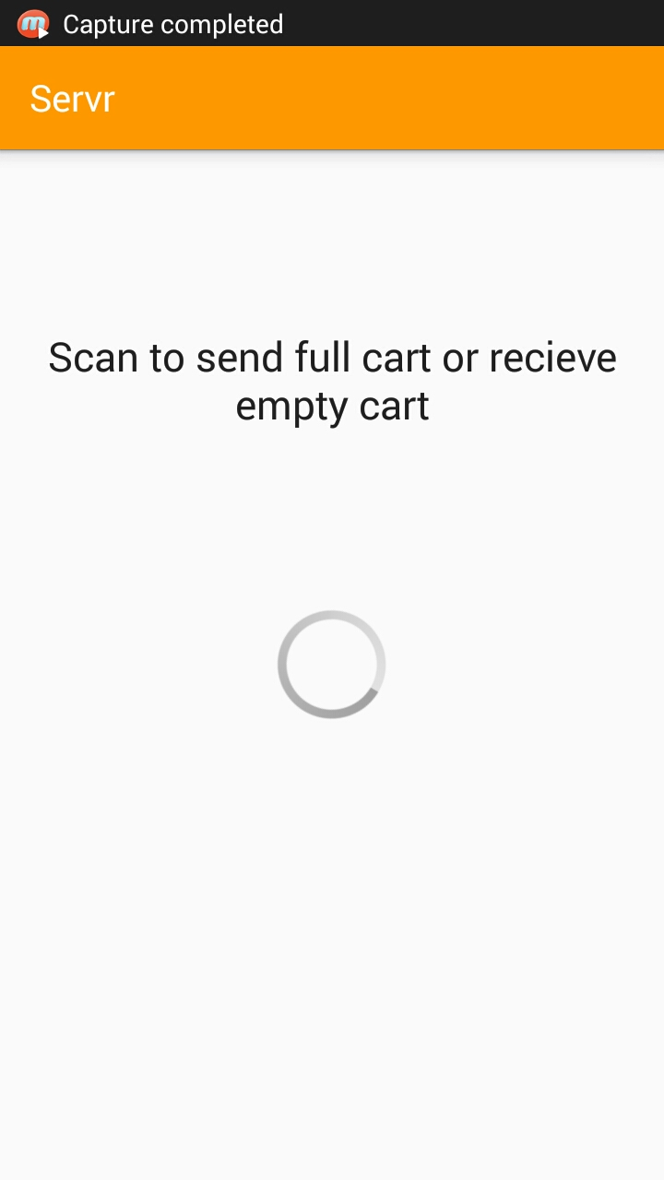
Team 2

Slide 10
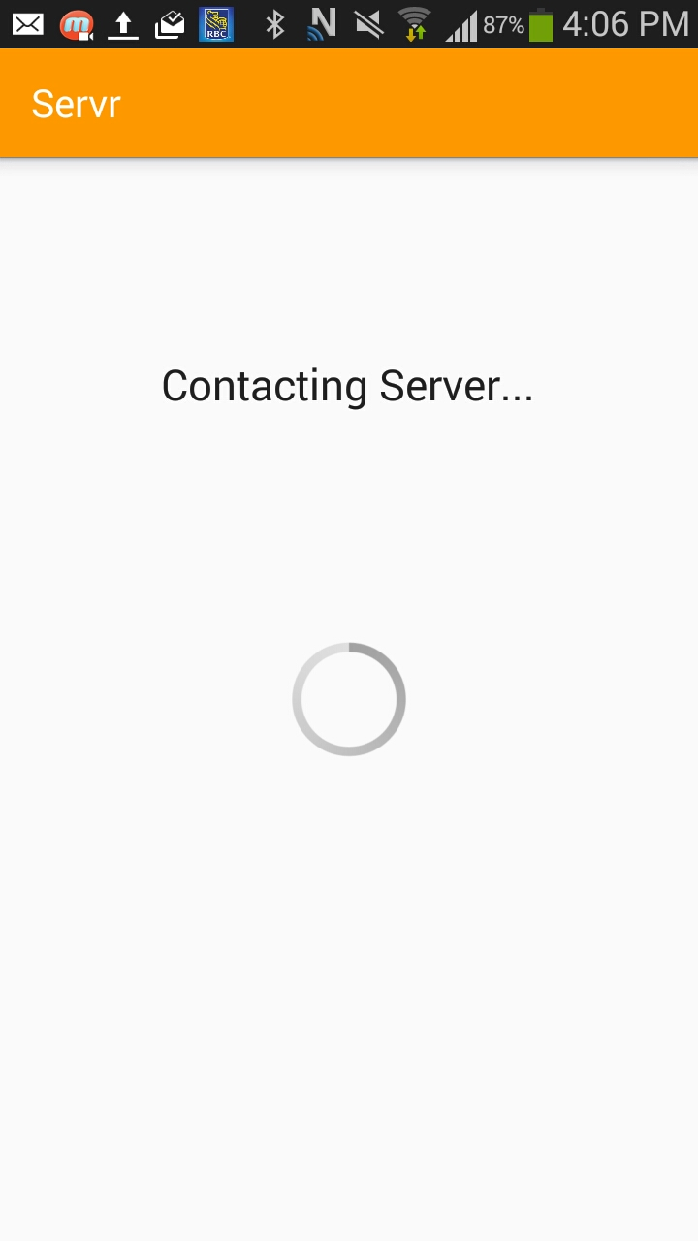
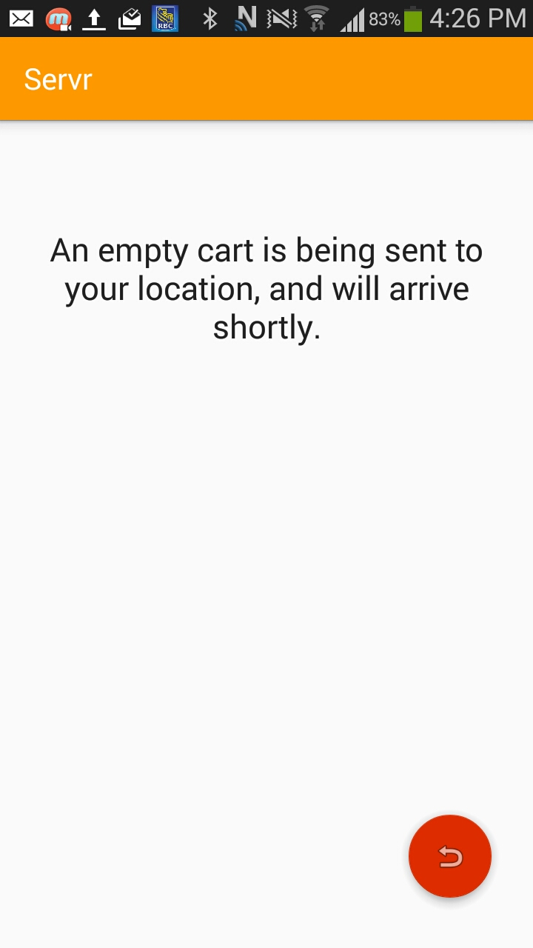
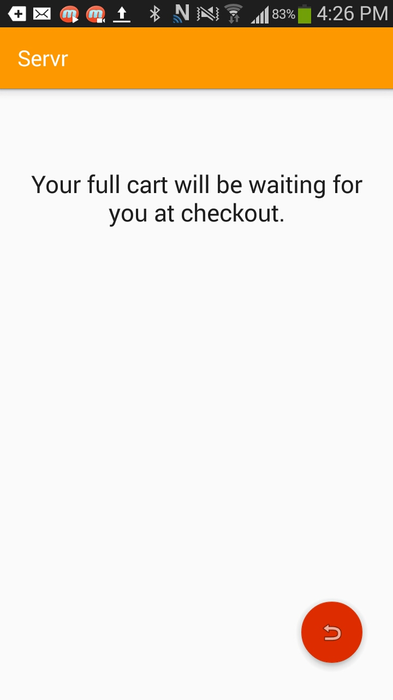
Team 2

Slide 11
