Slide 1

Servr
Brandon Mabey, Haodong Tao, Tal Melamed, Tania Akter
Automated Shopping Cart Dispatch and Retrieval System

Slide 2

In Store Shopping Is Missing Something
Currently shoppers are limited to just one cart.
Limits customer buying capability
Reduced store profits
Shoppers have to push their own cart
Requires effort
http://www.gettyimages.ca/search/photographer?excludenudity=true&family=creative&page=1&phrase=cart&photographer=photosindia&sort=best
Notes:
Problem

Slide 3
Improve the shopping experience!
Make the carts work for you.
They have had it too easy for too long
Notes:
Objective

Slide 4
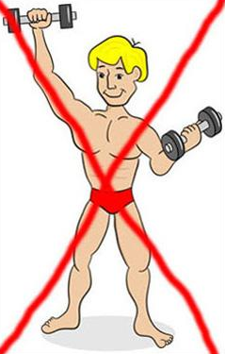
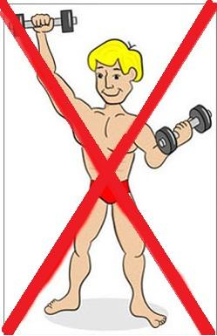
Make ‘it’ Better
No effort
Your physical body no longer limits how much you can buy
Feeling of control
http://www.burnthefat.com/7-day-transformation18.php
Notes:
Features

Slide 5

Store Efficiency
Gather additional analytics
Find hotspots in your store
Find ignored aisles
Increase efficiency
Automated cart return
http://www.techweekeurope.co.uk/news/it-spending-2013-gartner-103149/attachment/shutterstock_91924961

Slide 6
System Overview
Mobile app
Central control system
Shopping cart robots
Position/cart nodes
Maintenance Station

Slide 7

Mobile App
User interaction with the system
Available on Android Play store
Can send/recieve shopping carts
http://camranger.com/android-downloads/

Slide 8

Central Control System
Track cart location
Receive customer requests
Generate cart path
Avoid collisions
http://www.activistpost.com/wp-content/uploads/2013/06/SurveillanceStatePerson1.jpg

Slide 9
Shopping Cart Robots
Driving Mechanism
Collision Prevention
Receive commands from central control

Slide 10
Position/Cart Nodes
Used for position tracking
Placed in store aisles at regular intervals
Interacts with smartphones
Notes:
Can be NFC tags or QR codes placed on pillars around the store
Carts are send to node locations and customers claim the cart by scanning

Slide 11
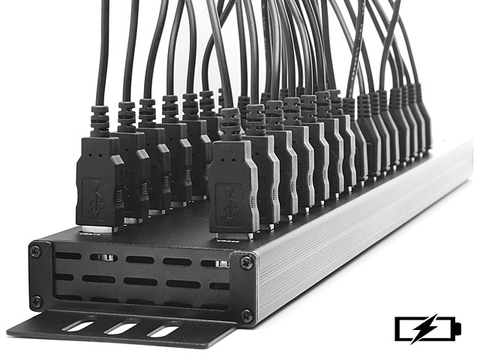
Maintenance System
Charges batteries
Acts as storage
https://usb.brando.com/30-port-usb-charging-station_p13189c0035d015.html
Notes:
carts need electric charging stations
the charging station acts as a storage facility for carts not in use

Slide 12
Plan for completion
Prototype coming soon
Demonstration March 31
Physical elements will not be implemented
Notes:
We are working on a prototype and are planning to demo it on March 30th
There are a lot of elements in the project that requires hardware implementation, such as building the automated carts and cart perimeter detection. They will not be within the scope of our project

Slide 13
Improvements
POS Integration
Allow customers to start checking out before they get to the checkout line
Home Delivery
Customization
Add to Apple Store
Notes:
Barebone system: Cart pathfinding and Customer-cart interface app
Future improvements: Point of sale integration. For example we can have the cart go directly to checkout and have items checked out before customer reach the checkout line.
Home delivery

