Slide 1
An Empirical Activity Model for WLAN Users
  Caleb Phillips¹ and Suresh Singh²
  ¹Computer Science Department, University of Colorado, Boulder
  ²Computer Science Department, Portland State University
  caleb.phillips@colorado.edu, singh@cs.pdx.edu

Slide 2
Problem
Develop a simple, measurement-driven, and protocol independent model for WLAN user activity.
Rigorously validate the effectiveness of this model.
Such a model would be useful for applications such as power-saving and load-balancing.

Slide 3
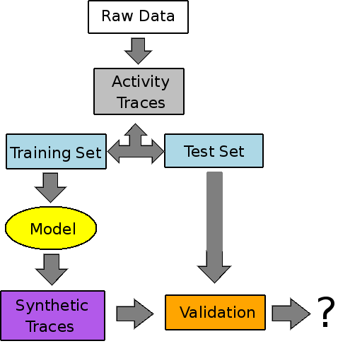
Outline

Slide 4


Data
5 locations, 131 distinct users:
  4 collected at public hotspots around Portland, Oregon [Phillips'07]
  1 collected by UW researchers at SigComm'04 [Rodrig'05]
All traces are available on CRAWDAD.

Slide 5
Data => Activity Traces
Map 802.11 actions to four discrete states: Active, Idle, Sleeping, or Gone.
Packets are grouped into one second buckets.

Slide 6
  Deriving and Using a Model
{
Transition Probability Matrix
Sleepless Category
Tx
Users are categorized as sleepy or sleepless.
Determine per-category transition probabilities
Trace Length from Pareto-distributed fit to Dartmouth data.
Synthetic traces created via Markov simulation

Slide 7
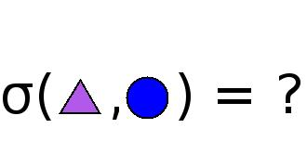
Validation
Cross validation
No straw-man...
Synthetic user traces are compared to test set using a stochastic similarity metric [Nechyba'98]

Slide 8
Stochastic Similarity
EM iteratively maximizes the probability of the i^{th} model ( ) given the i^{th} observations ( ):
The likelihood of a given observation given some model scaled by the observation length ( ):
Similarity between observations:

Slide 9
Validation Results (a Selection)

Slide 10
Conclusions
A simple, static, four-state Markov model is sufficient to model user activity at the granularity we have chosen to approach.
User activity exhibits alternating periods of activity and idle time, often several seconds long.
Stochastic similarity is a useful tool for model validation.

Slide 11
More Conclusions
Categorization of users can improve model fidelity.
Inter-trace similarity comparison shows that seemingly different venues yield similar traces.

Slide 12
Ongoing Work
Application of the model developed here to dynamic power-saving applications for WLAN devices [appearing at MobileHCI'08]
In future work, we would like to further investigate the application of similarity classification to a wide variety of measured trace-sets.

Slide 13
Questions?
Offline questions/comments? caleb.phillips@colorado.edu
Our data is available on CRAWDAD: http://crawdad.cs.dartmouth.edu/meta.php?name=pdx/vwave
Similarity implementation (Matlab) is available for download: http://www.cs.pdx.edu/~singh/software/similarity-0.1.tar.gz

