Slide 1
DIPLOMA PROJECT
ITUNES API TRACK COLLECTION (VARIANT 1)
Student: Roman Popov +79192462371
Cloud&DevOps Internship
Stream 24
2022

Slide 2








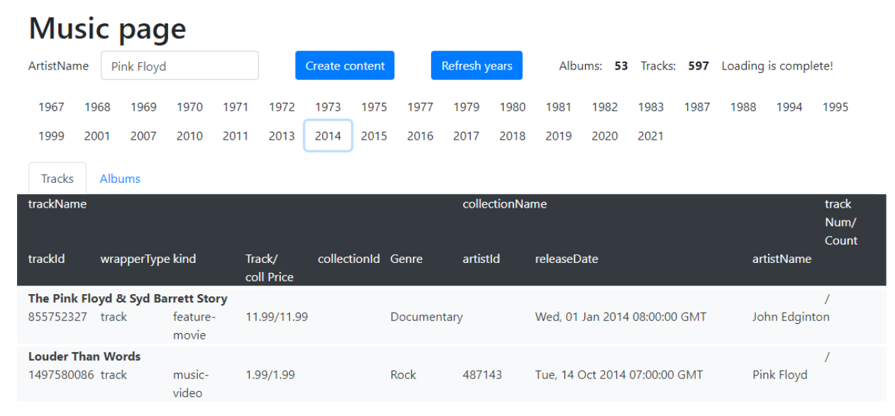











Application
Technology stack
Variant 1
Using API https://affiliate.itunes.apple.com/resources/documentation/itunes-store-web-service-search-api/ get all data about “Pink Floyd" and store it into your DB: kind, collectionName, trackName, collectionPrice, trackPrice, primaryGenreName, trackCount, trackNumber, releaseDate. Output the data for the year of releaseDate (the year is set) in form of a table and sort them by trackPrice in descending order.

Slide 3
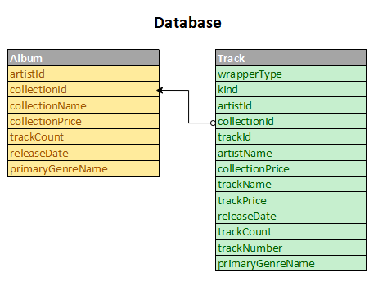
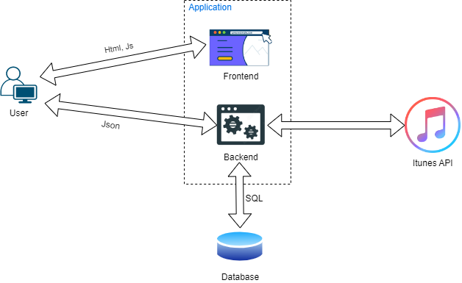
App architecture

Slide 4
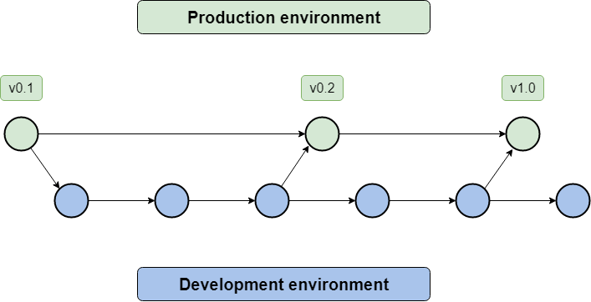
Branching strategy
https://gitlab.com/somerek/music_page

Slide 5
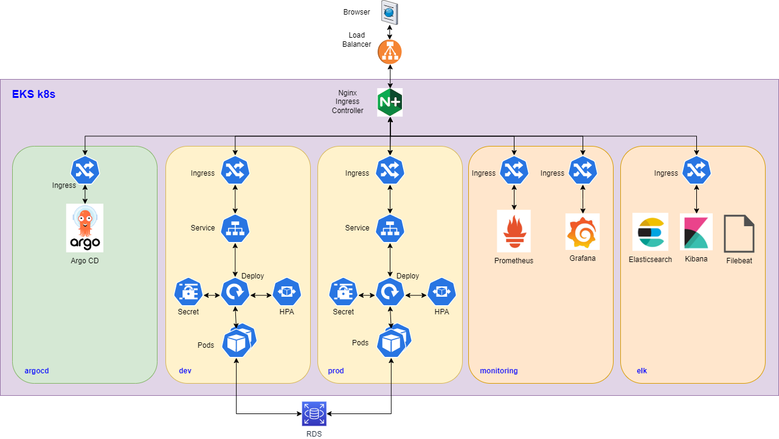
Infrastructure diagram

Slide 6
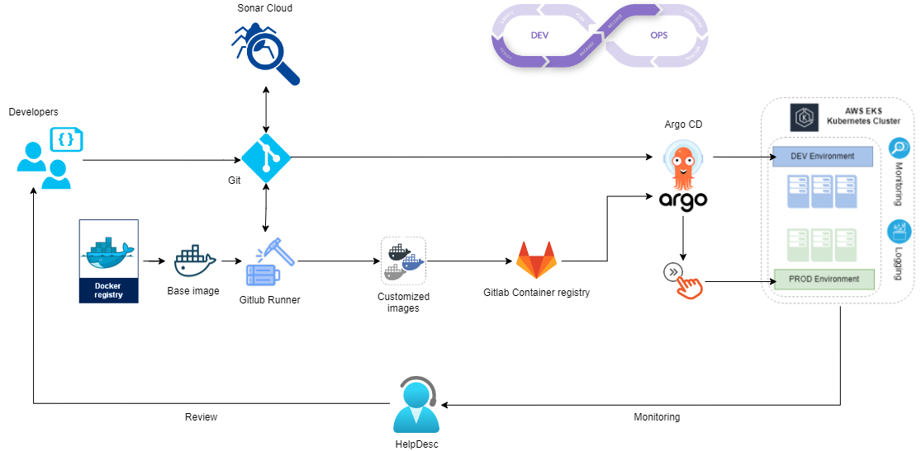
CI/CD diagram

Slide 7
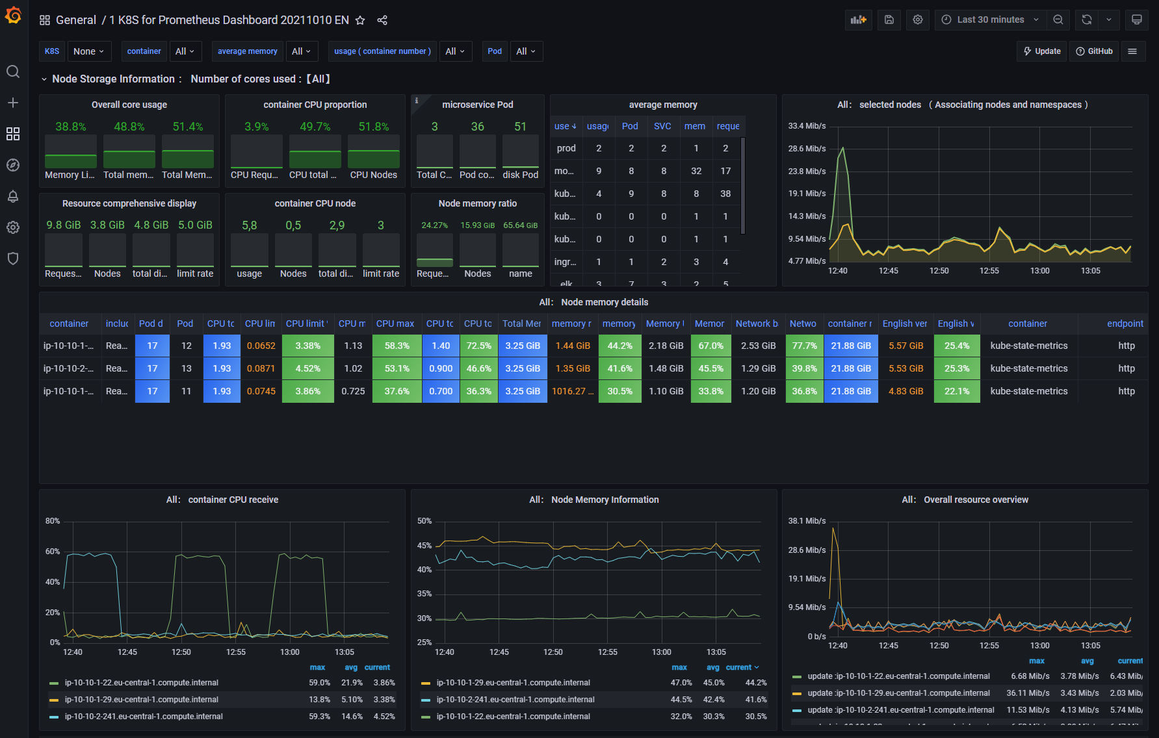
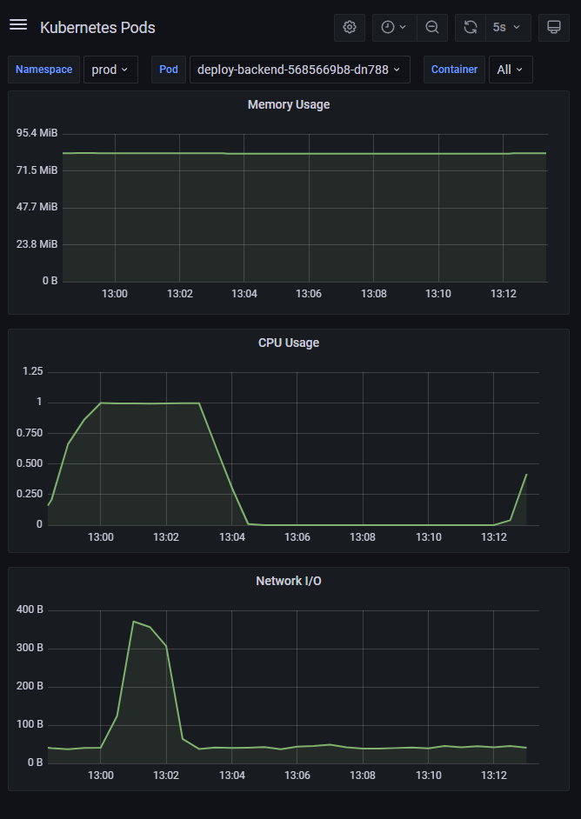
Monitoring

Slide 8
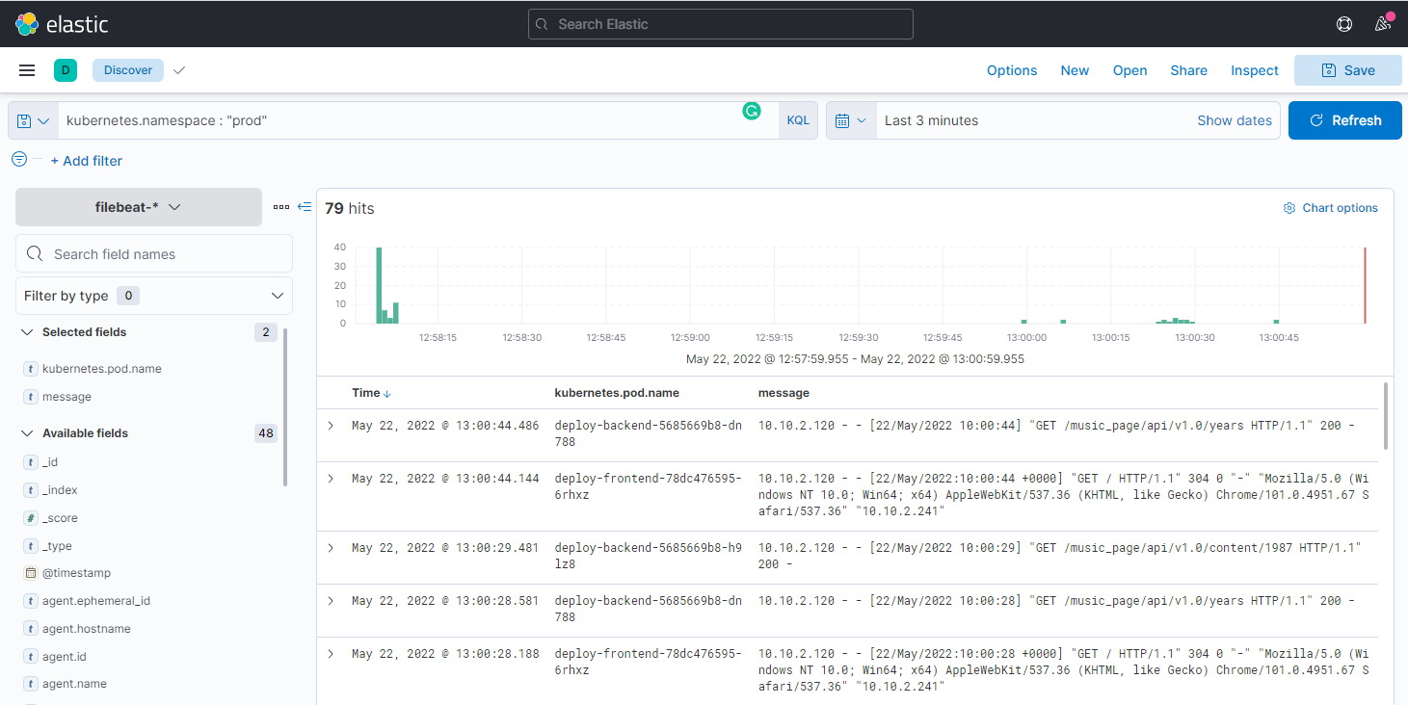
Logging

Slide 9
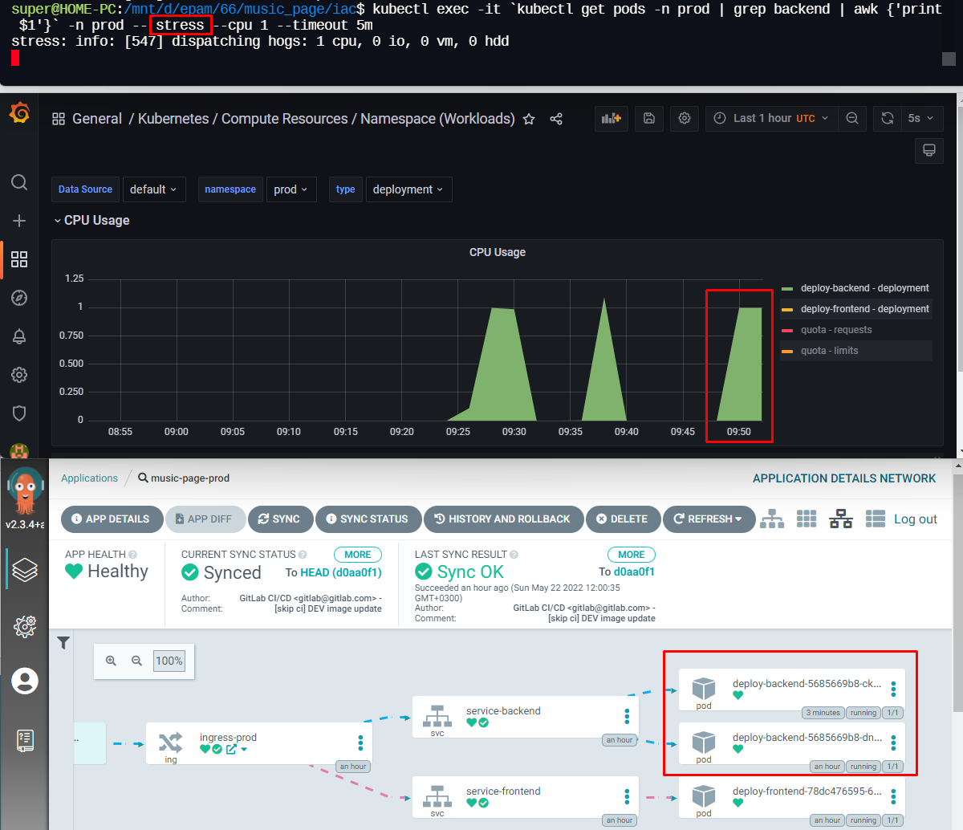
Scalability

Slide 10
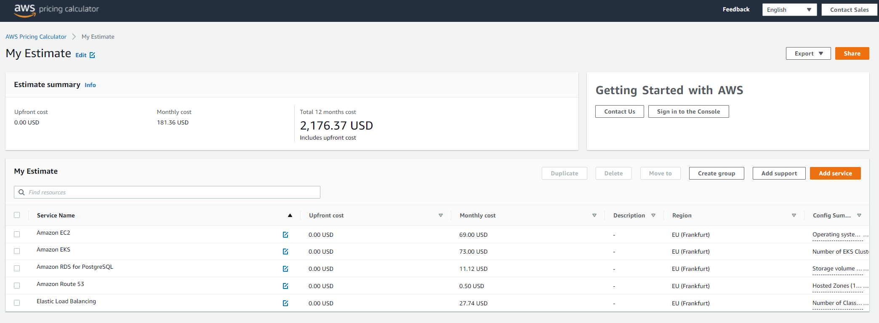
Cloud and Cost efficiency

Slide 11
Q&A
Student: Roman Popov (+79192462371)
Cloud&DevOps Internship
Stream 24
2022

