Slide 1


HEART DISEASE PREDICTION
SYSTEM
Notes:
Starting

Slide 2







-PROJECT BY-
SAYANTAN DAS
(4D-34)
Under The Guidance Of,
SOMERON BAKULI (4C-25)
PROF. ARUNABHA TARAFDAR
AMAR SARKAR
(4C-71)
SAPTORSHI DAS
(4C-72)
KOYEL DAS
(4C-81)
SUBHRAJYOTI SAHA
(4C-86)

Slide 3
ACKNOWLEDGEMENT
We would like to take this opportunity to thank everyone whose cooperation and encouragement throughout the ongoing course of this project remains invaluable to us.
We are sincerely grateful to our guide Prof. ARUNABHA TARAFDAR of the Department of Computer Science & Engineering, UEM, Kolkata, for his wisdom, guidance and inspiration that helped us to go through with this project and take it to where it stands now.
We would also like to express our sincere gratitude to Prof. Sukalyan Goswami, HOD, Computer Science& Engineering, UEM, Kolkata and all other departmental faculties for their ever-present assistant and encouragement.
Last but not the least, we would like to extend our warm regards to our families and peers who have kept supporting us and always had faith in our work.

Slide 4
ALL ABOUT HEART DISEASE

Slide 5
HEART ATTACK
HEART FAILURE
HEART BLOCKAGE
HEART STROKE

Slide 6
An estimated 17 million people die of CVDs, particularly heart attacks and strokes, every year

Slide 7

1990 – 1.3M
2016 – 2.8M

Slide 8
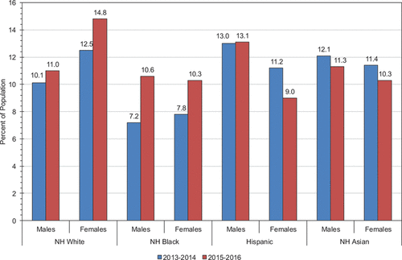

Slide 9
OBJECTIVE

Slide 10
The objective of the projective entitled "HEART DISEASE PREDICTION SYSTEM" is to provide a user friendly and easily understandable GUI to users to easily get instant guidance on their heart issues through an intelligent heart care system online. The main object of the system is to predict disease according to symptoms and also suggest list of doctors and hospitals accordingly.

Slide 11
GOAL OF OUR PROJECT

Slide 12
Doctors can attend to more patient.
Doctors can identify diseases fast and effectively.
Patients get the best treatment.
Improve medical communication.

Slide 13
METHODOLOGY

Slide 14
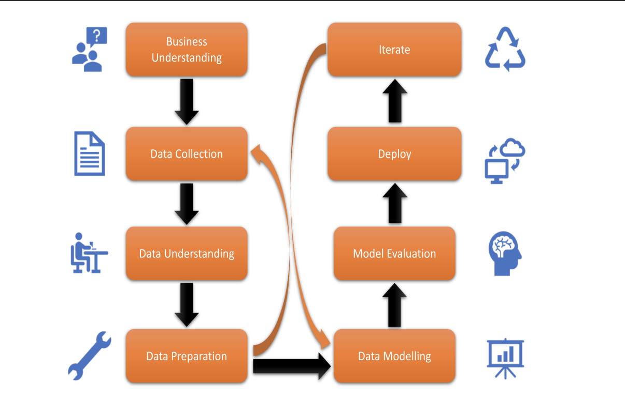
Project Life Cycle

Slide 15
DATA SOURCE
For this study, we have used dataset from Kaggle Machine learning repository. It comprises a real dataset of more than 1000 examples of data with 14 various attributes (13 predictors; 1 class) like blood pressure, type of chest pain, electrocardiogram result, etc. In this research, we have used three
algorithms to get reasons for heart disease and create a model with the maximum possible accuracy.

Slide 16
ALGORITHMS
1 : Logistic Regression
2 : Decision Tree
3 : Support Vector Machine

Slide 17
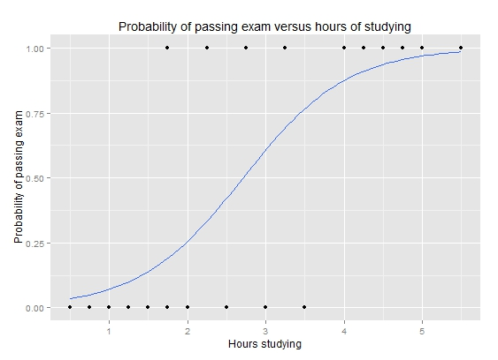
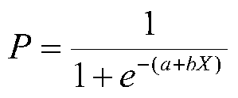
Logistic Regression

Slide 18
Logistic Regression
Confusion Matrix
21
7 100
Accuracy 86.341

Slide 19

Decision Tree
1 : Gini Impurity
2 : Entropy Calculation
3 : Information Gain

Slide 20
Decision Tree
Confusion Matrix
3
8 99
Accuracy 94.634

Slide 21
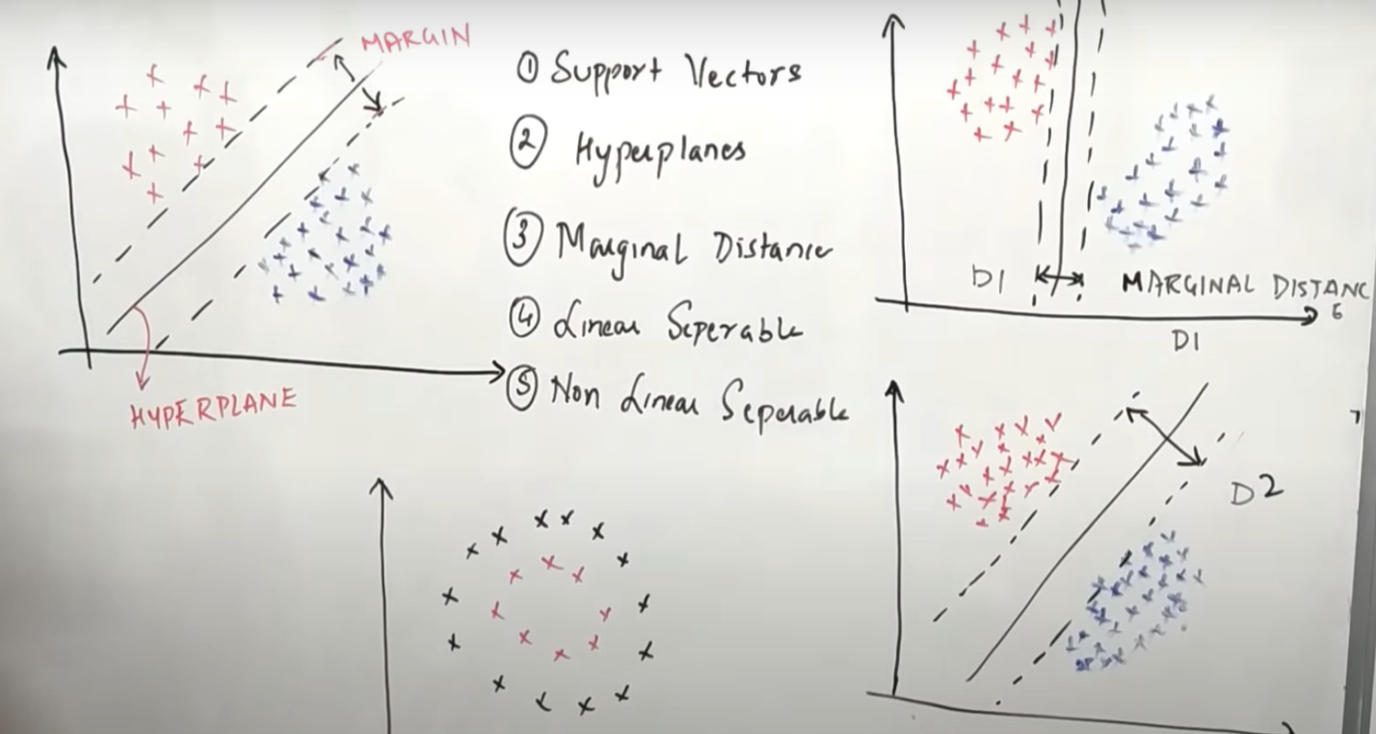
SUPPORT VECTOR MACHINE

Slide 22
Support Vector Machine
Confusion Matrix
4
0 100
Accuracy 98.048

Slide 23
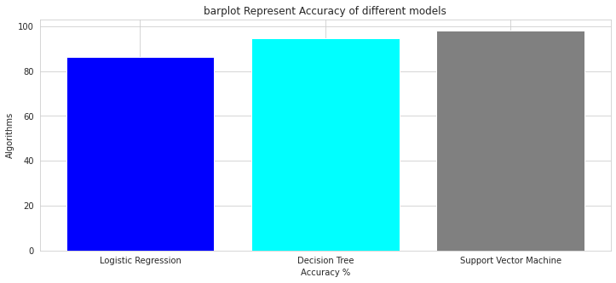
ALGORITHMS

Slide 24



FRONTEND (LANGUAGE USED)
HTML
CSS
JAVA
SCRIPT

Slide 25


BACKEND (LANGUAGE USED)

Slide 26
DFD
Front-End
Preprocessing
Back-end
prediction
Accuracy calculation
evaluation

Slide 27
DEMO

Slide 28






THANK
YOU

