Slide 1
Why Git ?
web2
web3
Job
Freelancing

Slide 2
Git
By Code Eater

Slide 3
What is Git ?
It is a distributed version control system which exist locally on your system.
Track the history of files
Collaboration

Slide 4
Git vs GitHub
Github is a company that lets you host your file using git.

Slide 5
Git Installation

Slide 6
Git Bash

Slide 7
Git username and email settings

Slide 8



How Git Works ?
Stagging
Area
Commit
History
Working Directory
Repository

Slide 9
How Git Works ?
Stagging
Area
Commit
History
Working Directory
Repository

Slide 10
How Git Works ?
Stagging
Area
Commit
History
Working Directory
Repository

Slide 11
Git
v1
v1
Code1
Code2
v1
v1
Code3
Stagging
Area
Commit
History
Working Directory
Repository

Slide 12
Git
v1
v1
v1
v1
Code1
Code2
v1
v1
v1
v1
Code3
Code4
Stagging
Area
Commit
History
Working Directory
Repository

Slide 13
Git
v1
v1
v1
v1
v1
v1
Code1
Code2
v1
v1
v1
v1
v1
v1
Code3
Code4
Stagging
Area
Commit
History
Working Directory
Repository

Slide 14
Git
v1
v1
v1
v1
v1
v1
Code1
Code2
v1
v1
v1
v1
v2
v2
Code3
Code4
Stagging
Area
Commit
History
Working Directory
Repository

Slide 15
Git
v1
v1
v1
v1
v1
v1
Code1
Code2
v2
v2
v1
v1
v2
v2
Code3
Code4
Stagging
Area
Commit
History
Working Directory
Repository

Slide 16
Git
v1
v1
v1
v1
v1
v1
Code1
Code2
v2
v1
v1
v1
v2
v2
Code3
Code4
Stagging
Area
Commit
History
Working Directory
Repository

Slide 17
What is a Branch ?
It is a pointer to a commit.
be8c02f
Master

Slide 18
What is a Branch ?
It is a pointer to a commit.
be8c02f
213ded1
Master

Slide 19
What is a Branch ?
It is a pointer to a commit.
be8c02f
213ded1
branch1
Master
Head

Slide 20
What is a Branch ?
It is a pointer to a commit.
be8c02f
213ded1
branch1
Master
Head

Slide 21
What is a Branch ?
It is a pointer to a commit.
be8c02f
213ded1
4499273
Master
branch1
Head

Slide 22
What is a Merge?
Incorporating the changes of one branch to another branch.
new1
new2

Slide 23
What is a Merge ?
be8c02f
213ded1
4499273
Master
branch1
Head

Slide 24
What is a Merge ?
be8c02f
213ded1
4499273
Master
Head

Slide 25
Three way merge

Slide 26
Fast Forward Merge
be8c02f
213ded1
branch1
Master
Head

Slide 27
Fast Forward Merge
be8c02f
213ded1
4499273
Master
branch1
Head

Slide 28
Fast Forward Merge
be8c02f
213ded1
4499273
Master
Head

Slide 29
Three way merge

Slide 30
Three way merge
Green color good.
green
Master
Head

Slide 31
Three way merge
Green color good.
green
Master
branch1
Head

Slide 32
Three way merge
Green color good.
Yellow color good.
green
yellow
Master
branch1
Head

Slide 33
Three way merge
Green color good.
Yellow color good.
green
yellow
Master
branch1
Head

Slide 34
Three way merge
Nice going.
Green color good.
Yellow color good.
green
yellow
Master
branch1
Head

Slide 35
Three way merge
Nice going.
Green color good.
Yellow color good.
green
yellow
blue
Master
branch1
Head

Slide 36
Three way merge
Nice going.
Green color good.
Yellow color good.
green
yellow
blue
Master
branch1
Head

Slide 37
Three way merge
green
yellow
blue
be8c02f
branch1
Master
Head

Slide 38
Three way merge
green
yellow
blue
be8c02f
branch1
Master
Head

Slide 39
Three way merge
green
yellow
blue
be8c02f
branch1
Master
Head

Slide 40
Three way merge with conflict

Slide 41
Three way merge with conflict
Green color good.
green
Master
Head

Slide 42
Three way merge with conflict
Green color good.
green
Master
branch1
Head

Slide 43
Three way merge with conflict
Green color good.
Yellow color good.
green
yellow
Master
branch1
Head

Slide 44
Three way merge with conflict
Green color good.
green
yellow
Master
branch1
Head

Slide 45
Three way merge with conflict
Green color good.
Blue color good.
green
yellow
Master
branch1
Head

Slide 46
Three way merge with conflict
Green color good.
Blue color good.
green
yellow
Master
branch1
Head

Slide 47
Three way merge with conflict
Green color good.
Blue color good.
green
yellow
blue
Master
branch1
Head

Slide 48
Three way merge with conflict
green
yellow
blue
be8c02f
branch1
Master
Head

Slide 49
Repositories
Local
Remote

Slide 50

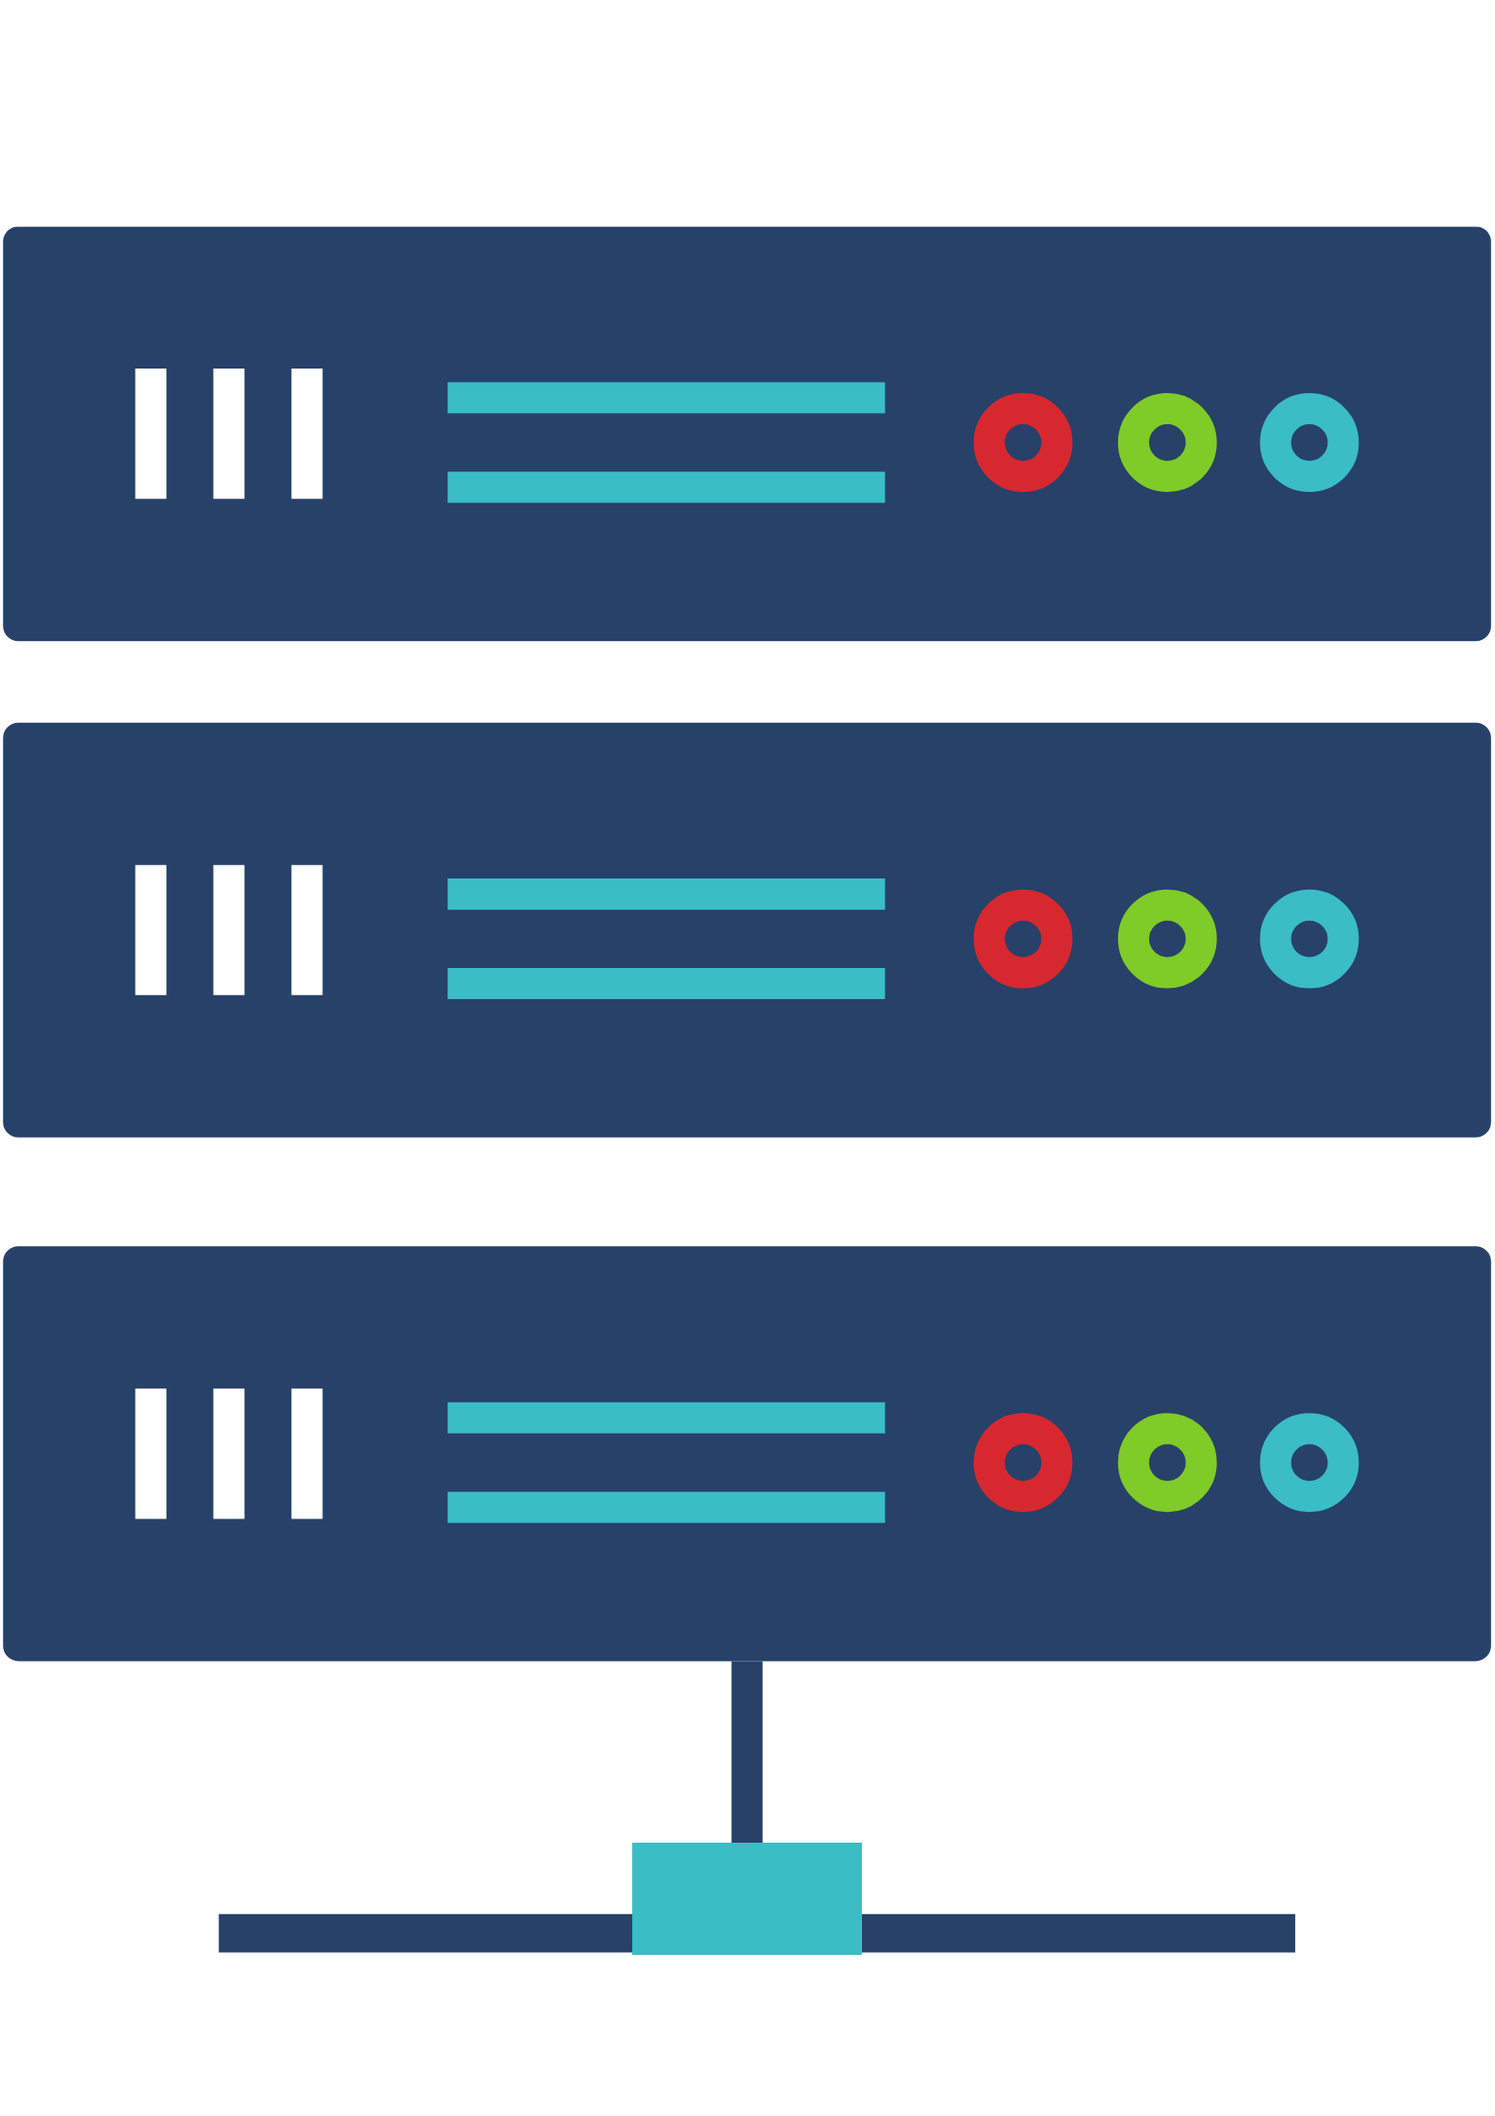


Repositories
Clone
Push

Slide 51

Repositories
Github
Local
master

Slide 52
Repositories
Github
Local
origin/master
master
master

Slide 53
Repositories
origin/master
master
master

Slide 54
Repositories
origin/master
master
master

Slide 55
Working With Others
Github
master
origin/master
A's Local Repo
master

Slide 56
Working With Others
Github
master
origin/master
A's Local Repo
B's Local Repo
master

Slide 57
Working With Others
Github
master
origin/master
origin/master
A's Local Repo
B's Local Repo
master
master

Slide 58
Working With Others
Github
master
origin/master
origin/master
A's Local Repo
B's Local Repo
master
master

Slide 59
Working With Others
Github
master
origin/master
origin/master
A's Local Repo
B's Local Repo
master
master

Slide 60
Working With Others
Github
master
origin/master
origin/master
A's Local Repo
B's Local Repo
master
master

Slide 61
Working With Others
Github
master
origin/master
origin/master
A's Local Repo
B's Local Repo
master
master

Slide 62
Working With Others
Github
master
origin/master
origin/master
A's Local Repo
B's Local Repo
master
master

Slide 63
Working With Others
Github
master
origin/master
origin/master
A's Local Repo
B's Local Repo
master
master

Slide 64
Working With Others
Github
master
origin/master
origin/master
A's Local Repo
B's Local Repo
master
master

Slide 65
Working With Others
Github
master
origin/master
origin/master
A's Local Repo
B's Local Repo
master
master

Slide 66
Working at the same time
Github
master
origin/master
origin/master
A's Local Repo
B's Local Repo
master
master

Slide 67
Working With Others
Github
master
origin/master
origin/master
A's Local Repo
B's Local Repo
master
master

Slide 68
Working With Others
Github
master
origin/master
origin/master
A's Local Repo
B's Local Repo
master
master

Slide 69
Working With Others
Github
master
origin/master
origin/master
A's Local Repo
B's Local Repo
master
master

Slide 70
Working With Others
Github
master
origin/master
origin/master
A's Local Repo
B's Local Repo
master
master

Slide 71
Working With Others
Github
master
origin/master
origin/master
A's Local Repo
B's Local Repo
master
master

Slide 72
Working With Others
Github
master
origin/master
origin/master
A's Local Repo
B's Local Repo
master
master

Slide 73
Working at the same time

Slide 74
Working at the same time

