Slide 1
Secure Programming for Application Development
PRESENTED BY:
SOMESH SAXENA
X18176895
MSc CYBERSECURITY

Slide 2
Contents:
Introduction
Programming Paradigm
Security Testing – State of the Art
Application Testing
Proposed Solution
Conclusion

Slide 3
Introduction
What is Security Testing?
SECURITY TESTING is a type of Software Testing that uncovers vulnerabilities, threats, risks in a software application, and prevents malicious attacks from intruders. The purpose of Security Tests is to identify all possible loopholes and weaknesses of the software system, which might result in a loss of information, revenue, repute at the hands of the employees or outsiders of the Organization.
In this presentation, we will discuss various application testing methodologies and how we have used them in our application testing.

Slide 4
Programming paradigm
Imperative Programming Paradigm
Procedural
Object-Oriented
Parallel Processing
Declarative Programming Paradigm
Functional
Logic
Database Driven

Slide 5
Security testing – state of the art
Top OWASP Methodologies for Application Security Testing:
Open Source Security Testing Methodology Manual (OSSTMM)
Information Systems Assessment Framework (ISSAF)
Penetration Testing Execution Standard (PTES)
Open Web Application Security Project (OWASP)
Metasploit Framework (MSF)
Static Application Security Testing (SAST)
National Institute of Standard Technology (NIST – Guidelines)
Penetration testing-based Java Coding Test Tool (PJCT)

Slide 6
Application testing
Well Known Techniques for Application Testing:
STATIC CODE ANALYSIS
DYNAMIC CODE ANALYSIS
WHITE-BOX TESTING

Slide 7
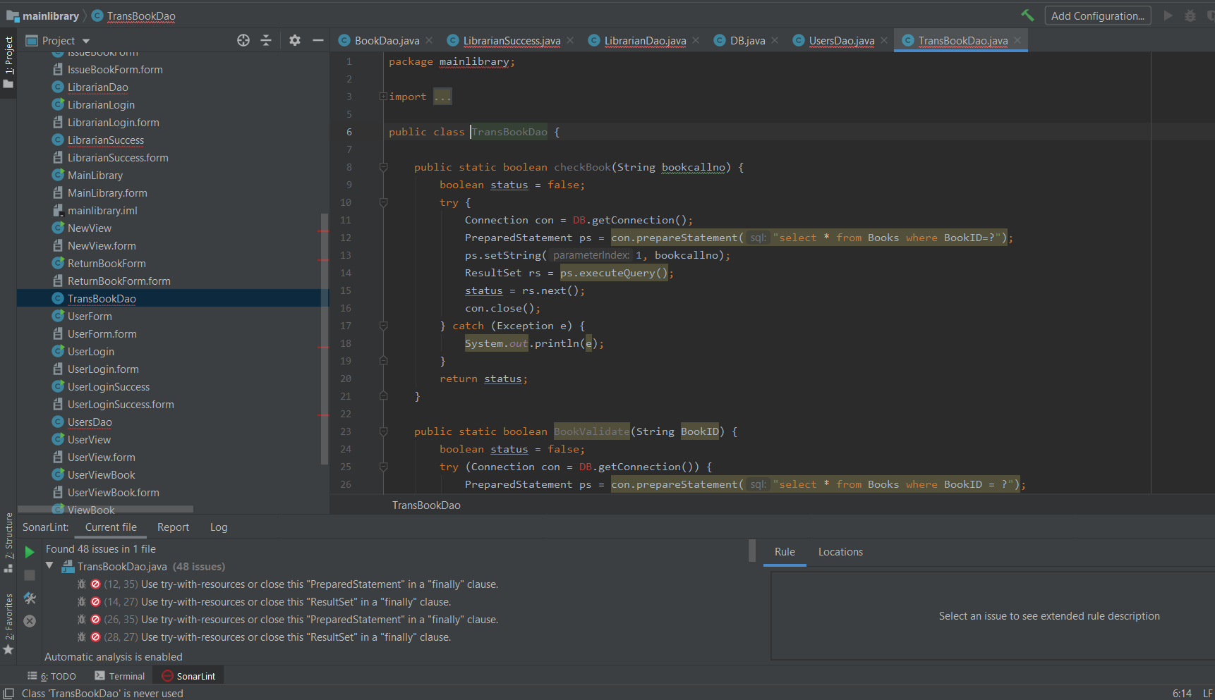
STATIC ANALYSIS - Using SonarLint

Slide 8
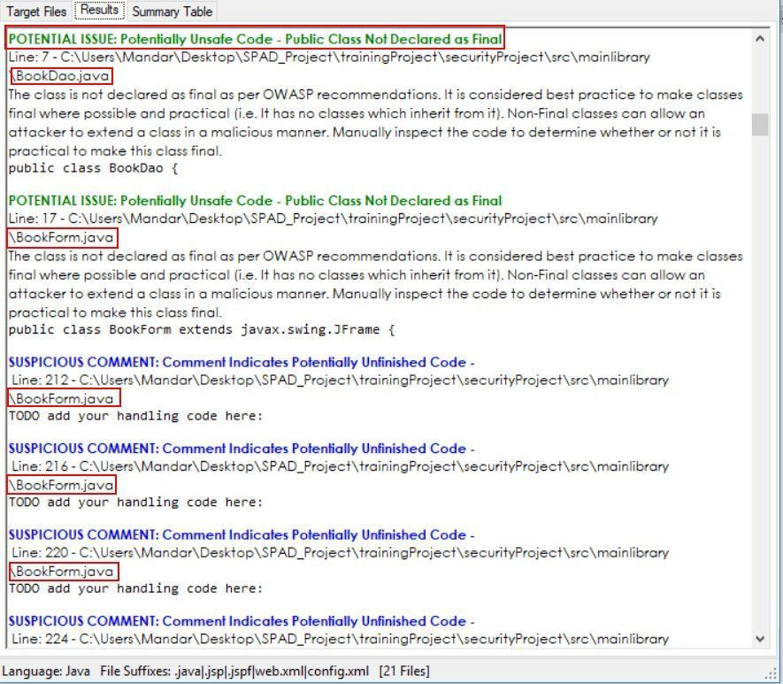
Visual Code Grepper

Slide 9
SOLUTIONS TO MITIGATE THE VULNERABILITIES
INPUT DATA VALIDATION and SANITIZATION
HASHING
ENCAPSULATION
SECURING LOGS AND EVENT LOGGING
EXCEPTION HANDLING (try-catch)
PASSWORD COMPLEXITY
CODE SIGNING

Slide 10
Conclusion
For this project, we have performed static analysis client application and reported the result. Nevertheless, dynamic code analysis is also needed to look for more nuanced bugs. Because the framework was two-tier thick client, it was impossible to do dynamic analysis of the source code. But we may still do dynamic analysis with the aid of test cases provided by OWAPS. Along with these we also provided various approaches to security testing which were discussed in their work. We cannot depend solely on such methods, however, because they do not have enough proof that it can capture all the complicated security in application. Thus, more precise security model for application security testing is required. While there is one present model called DIAMOND, which is the fusion of two features called risk-based protection testing and feature-based fuzzing, this feature is currently being tested. Through this project I studied the White box testing methodology, the Java code analysis and the automation technique using Visual Code Grepper (VCG) for security analysis.

Slide 11
THANK YOU

