Slide 1
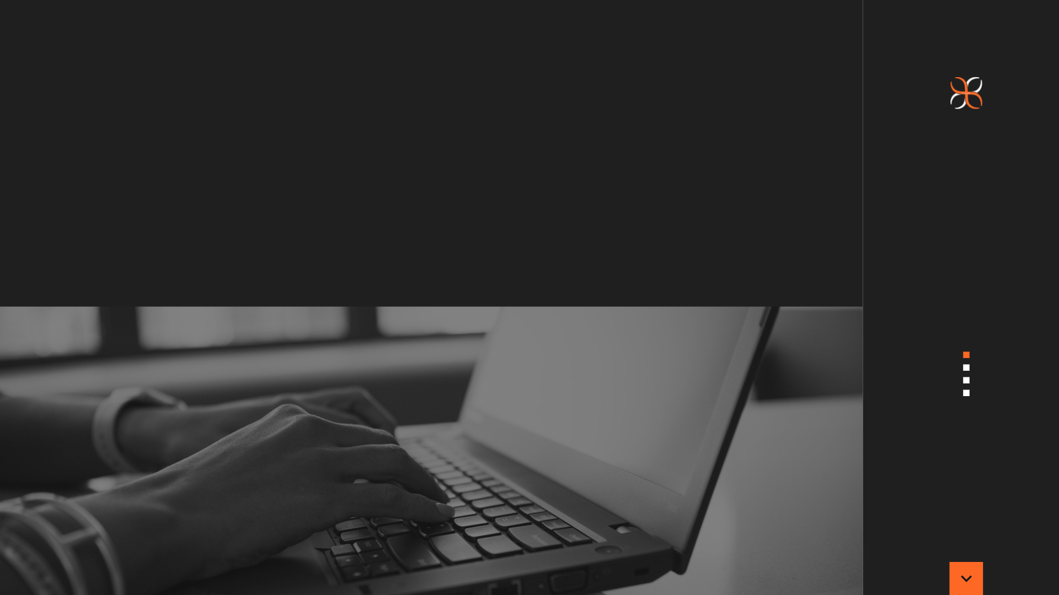


AUTOMATE GOOGLE MEET
USING TELEGRAM

Slide 2

INTRODUCTION
RESULTS
SET UP YOUR TELEGRAM BOT
FUTURE SCOPE
REFERENCES
A
G
E
N
D
A

Slide 3






MEET THE TEAM
Sumaan Ali
(12010877)
Somesh Alkanthi
(12010867)
Akshay Aadarsh
(12011364)
Shailesh Amane
(12011374)
Sarthak Akkarbote
(12011134)
Akash Singh
(12010233)

Slide 4
INTRODUCTION
In this project we have made a telegram web bot and automated it with Google Meet and Zoom to attend your online meetings and classes.
The project is built in python Programming language. In the current situation of lockdown we all are doing our work from home.
People are frequently using Google Meet and Zoom for attending meetings and classes. Sometimes multiple meet timings may clash.
In that case one can make a telegram bot attend the meet on his behalf.

Slide 5
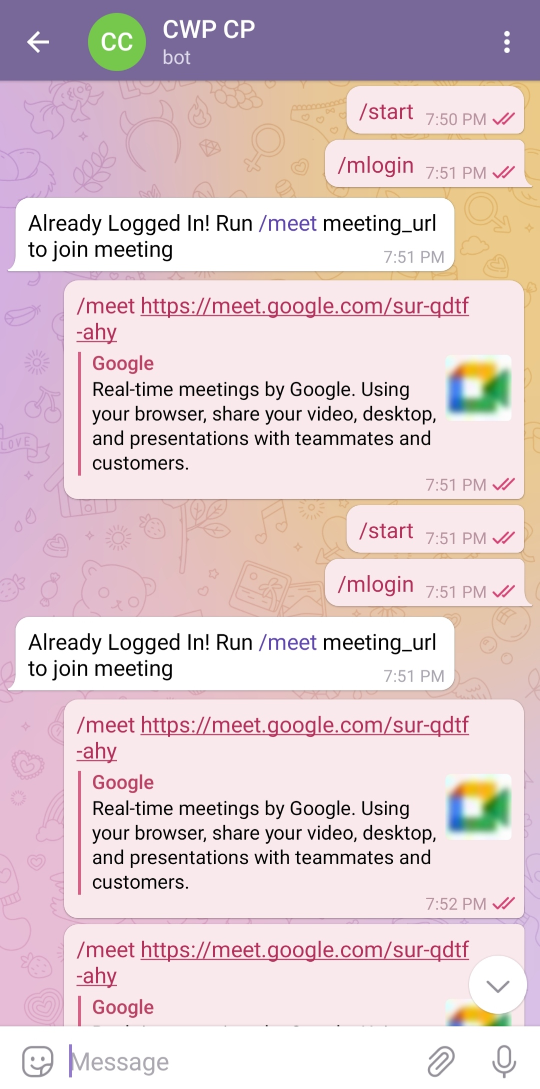
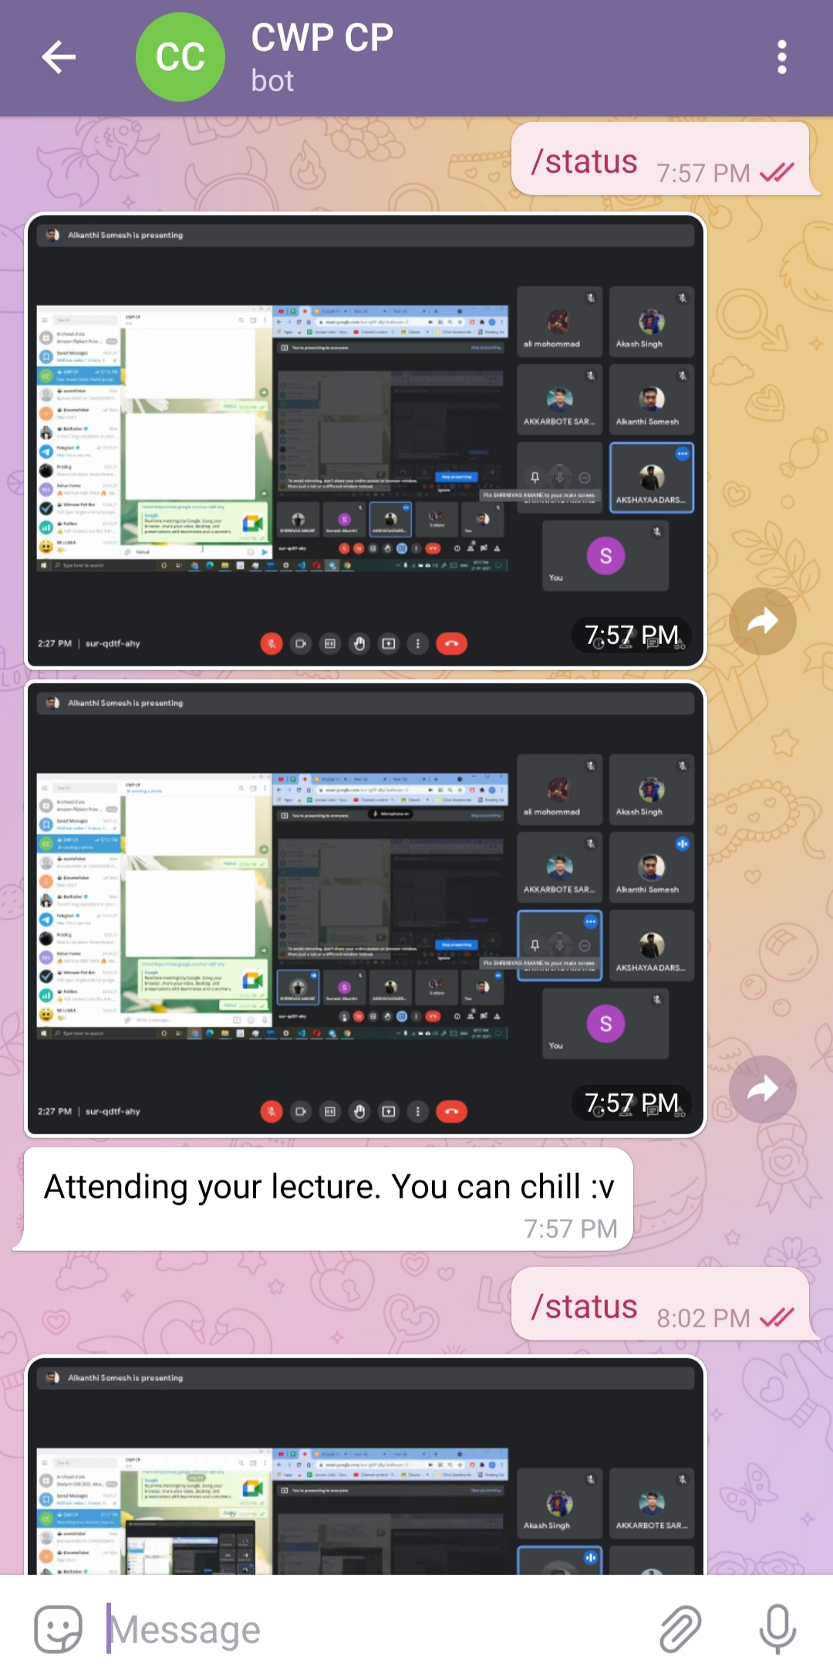
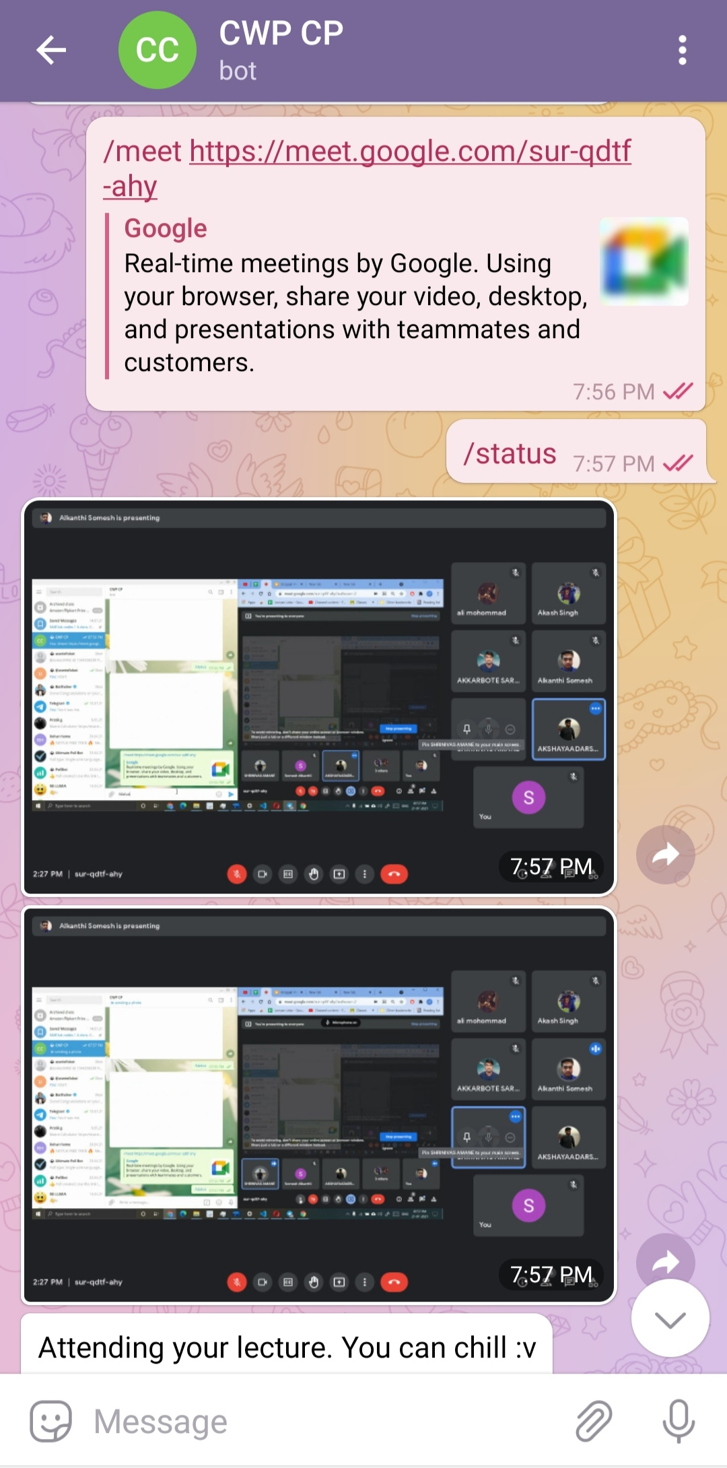
RESULTS

Slide 6
SET UP YOUR TELEGRAM BOT
Step 1. Find telegram bot named "@botfarther", he will help you with creating and managing your bot.
Step 2. Print “/help” and you will see all possible commands that the botfather can operate.
Step 3. To create a new bot type “/newbot” or click on it.
Step 4. Congratulations! You've just created your Telegram bot. You will see a new API token generated for it.
In sample above it's 270485614:AAHfiqksKZ8WmR2zSjiQ7_v4TMAKdiHm9T0
Copy your API token to the plugin.

Slide 7
FUTURE SCOPE
Currently our telegram bot is able to join , send screenshot , and end meet But in future we can also emulate chatbox .
In future we can also send voice message to bot and that can say in meet by turning on mic that is when roll number is called for attendance .
The bot can be also automated to start a new meet at scheduled time and end meet.
The bot can also be automated to answer to roll number when teacher calls.
In future we can also add AI to automate bot so that it can also answer to question asked by teacher.
This project for now works through Telegram messenger only. But further we could make it work with more messengers like WhatsApp Messenger.
It can further be made more easy to use or more convenient to communicate with bot through the messenger.
To attend meetings according to schedule: We can give the meet timings and link to the bot and it will automatically attend the meet at the time.

Slide 8
REFERENCES
YOUTUBE REFERENCE
WHAT IS SELENIUM :
https://youtu.be/Wd8SxdtIx4w
https://youtu.be/mOAXEQevCAE
HOW TO CREATE BOT ON TELEGRAM:
https://youtu.be/NwBWW8cNCP4
https://youtu.be/zh6yYlnjX7k

Slide 9
THANK YOU

