Slide 1


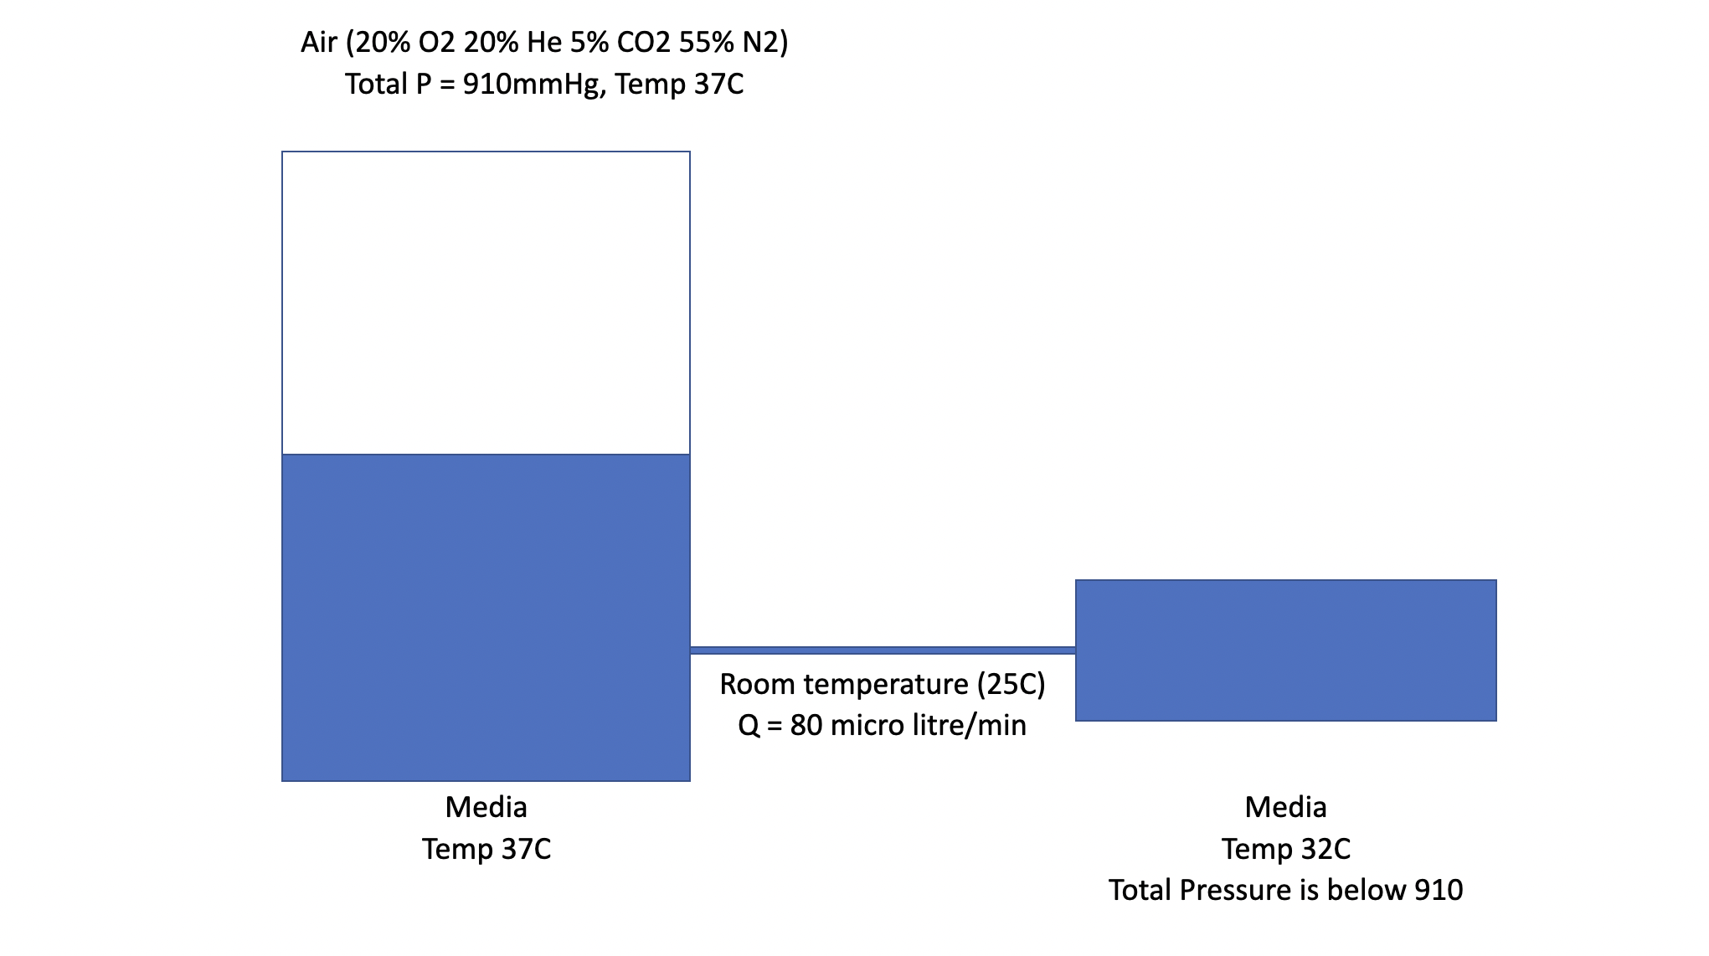
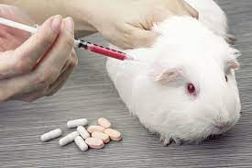
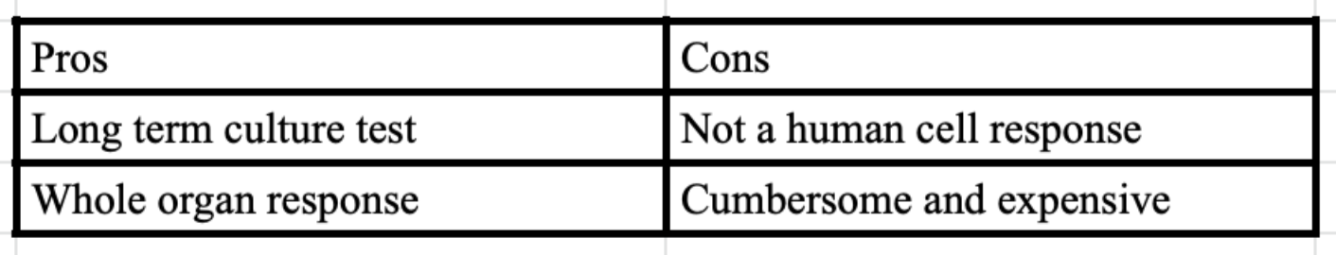
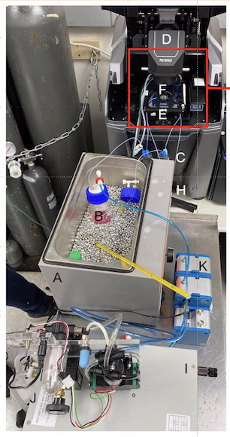
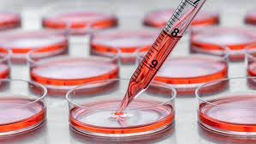
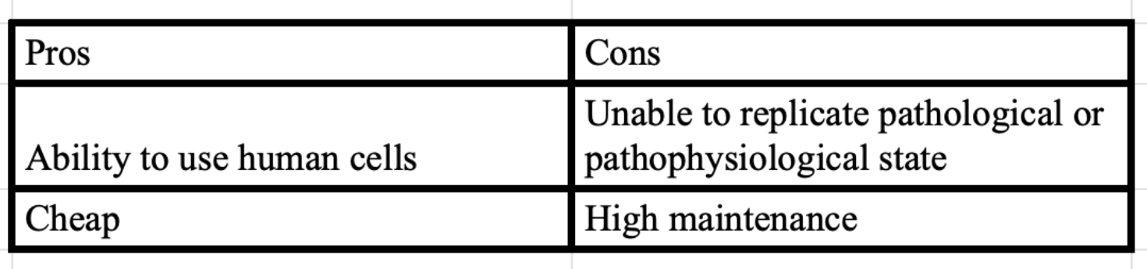
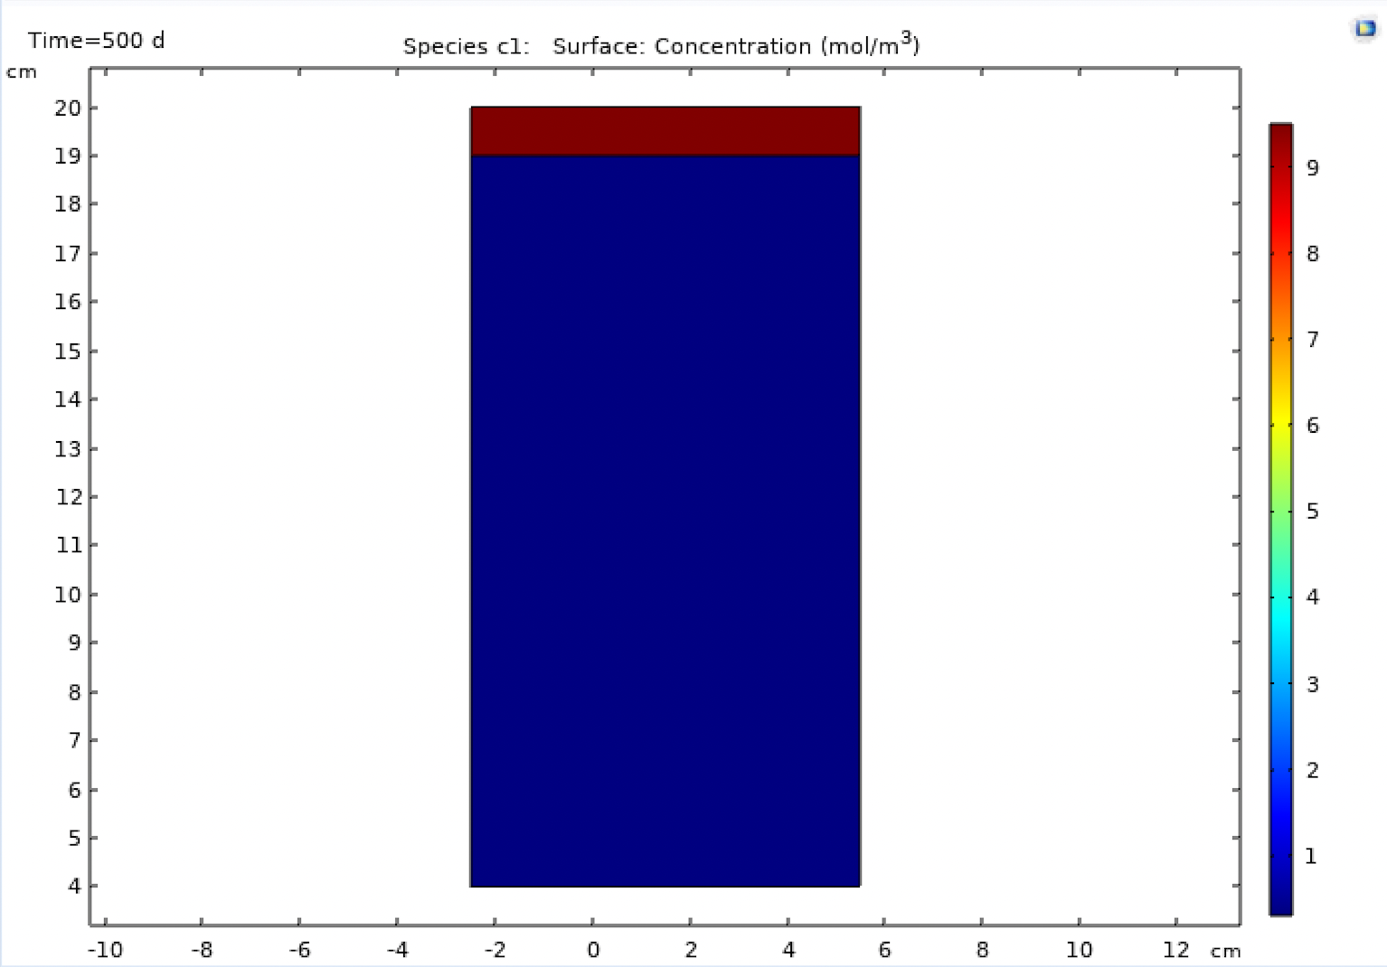
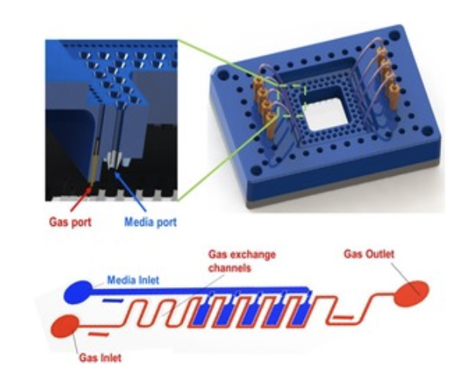
Modelling Pancreatic Islets on a Chip
Somesh Pratap Singh¹; Charles Alver Garcia²; Ashutosh Agarwal^{2, 3}
¹Department of Mechanical Engineering, Indian Institute of Technology Gandhinagar; ²Department of Biomedical Engineering, University of Miami; ³Diabetes Research Institute, University of Miami
Motivation
Experimental Setup
7. No slip condition is assumed at the walls of tube and the right beaker.
8. Concentration at the inlet of the tube is assumed to be constant throughout the experiment (quite unrealistic!).
It takes a drug more than 1 Billion USD and more than 15 years to come to the market and it can still have high chances of failure.
Presently, the testing is done in very simplistic cell cultures or in animals both of which are not predictive of human response.
What if we could mimic the human response by developing an organ on a chip!
Fundamental Concepts Involved
Diffusion of species in a medium.
Solubility of gases in liquids (Henry’s Law).
Fluid flow through a tube (Poiseuille equation, no slip condition, fully developed flow).
Movement of particles by convection.
No flux and constant concentration boundary conditions.
Animal model
Static Model
Results
Introduction
‘Organs on chip’ are microscale mimics of human organs. These help to get responses which are more replicative of human response to the drug.
‘Organs on a chip’ combine two of the modern cutting edge technologies of stem cell culture and nanotechnology. Stem cell culture technology allows us to get human relevant cells on the dish for testing. Nanotechnology allows to collect functional outcomes from the stem cells.
A major obstruction in developing cell replacement therapies for Type1 diabetes is the inability to sustain mature human beta cells in culture.
Aim is to develop a 3D niche that could support maturation, maintenance and monitoring of human beta cells.
Microfluidic devices provide intimate control over the cellular microenvironment by independently modulating liquid and gas phases.
We can then evaluate the effect of various niche parameters (soluble factors, niche microenvironments) on human islet maintenance.
Methodology
We model the solubility of molecular oxygen in the water solution using the ‘Transport of Diluted species module’ in Comsol Multiphysics.
For the tube and flow of liquid to the right beaker we use coupled multiphysics between two modules ‘Transport of diluted species’ and ‘Laminar flow’
Figure: Concentration field in left beaker
Assumptions
Conclusions and Future Work
1. Transport of species in the left beaker takes only due to convection and diffusion.
2. Concentration of Oxygen remains constant on the top surface of the left beaker. This can be maintained by a constant supply from atmosphere as some Oxygen goes and dissolves in the water solution.
3. Initial concentration of Oxygen in the water solution in left beaker, tube and the right beaker is assumed to be zero.
4. Henry’s Law constant has been assumed constant over the temperature changes (if occurring any).
5. A fully developed Poiseuille flow is assumed in the tube with the flow rate specified in the figure.
6. Pressure at the outlet for the right beaker is assumed to be atmospheric pressure.
Concentration of oxygen in the solution in the left beaker upon reaching equilibrium comes out to be 0.3 mol/m³.
This value was close to the one expected and related value has been found in the surveyed literature.
From the results of this work, one can move ahead to verify these values through experiments.
This simulation in a big picture would help in the design of pancreatic islets on a chip that would serve enhanced therapeutic causes for Type1 Diabetes.
Figure1: 3D niche with microfluidic device
Acknowledgement
I would like to thank IIT Gandhinagar for giving me the opportunity to participate in International Academic Internship Program. I would also like to thank Physiomimetic Microsystems Laboratory, University of Miami for giving me an enriching research experience.
Contact
References
Somesh Pratap Singh
IIT Gandhinagar
Department of Mechanical Engineering and
Computer Science and Engineering
somesh.ps@iitgn.ac.in
Place, T. L., Domann, F. E., & Case, A. J. (2017). Limitations of oxygen delivery to cells in culture: An underappreciated problem in basic and translational research. Free Radical Biology and Medicine, 113, 311-322
NCERT, Chemistry Part-1, Class 12 (2017)
Lewis, A. S. (2008). Eliminating oxygen supply limitations for transplanted microencapsulated islets in the treatment of type 1 diabetes (Doctoral dissertation, Massachusetts Institute of Technology).
Comsol reference manual (2019).

