Slide 1
FORGE THE FUTURE HACKATHON · TEAM SANDBOXED
Eyewitness
The incident response agent that saw it happen.
Mohit Paddhariya · lead · Rahil Mavani
Elastic · Amazon Bedrock · S3 · Sarvam

Slide 2
THE PROBLEM
The checkout is broken. The dashboard is green. The customer leaves.
Silent Place Order
Bag total stuck
Upload dropped
Handler returns early. No request, no error, no spinner. The shopper clicks three times and gives up.
Quantity goes 1, 2, 3, 4. The line price updates. The order total never moves.
Review photo shows as attached, review posts, the photo is never saved.
Backend sees: nothing
Backend sees: 200 OK
Backend sees: 200 OK
Session replay already recorded every one of these, frame by frame. Nobody watches it.
Thousands of sessions a day. The first signal is a support ticket, days later, if it comes at all.
EYEWITNESS · TEAM SANDBOXED · FORGE THE FUTURE HACKATHON

Slide 3
THE SOLUTION
A shrinking funnel: each stage costs more and sees less
1
4
2
4
3
4
4
2
5
2
Strugglers
Replay
AI watches
AI self-check
Ticket filed
One ES|QL query. Dead clicks, rage clicks, re-submits, 5xx, slow API.
Headless Chromium replays the rrweb session at real speed.
Bedrock vision model: did the user visibly fail? Most are fine.
Its only job: argue the finding is wrong. Survivors count.
Kibana Case with clip, second, trace, blast radius. kNN dedupe.
free
free
$0.19 / session
included
free
Counts are from a real run started from the operator page: 4 sessions flagged, 2 confirmed broken, 2 case updates, 556 seconds, $0.64.
The model is shown pixels and counts, never a story. It must cite the second.
EYEWITNESS · TEAM SANDBOXED · FORGE THE FUTURE HACKATHON

Slide 4
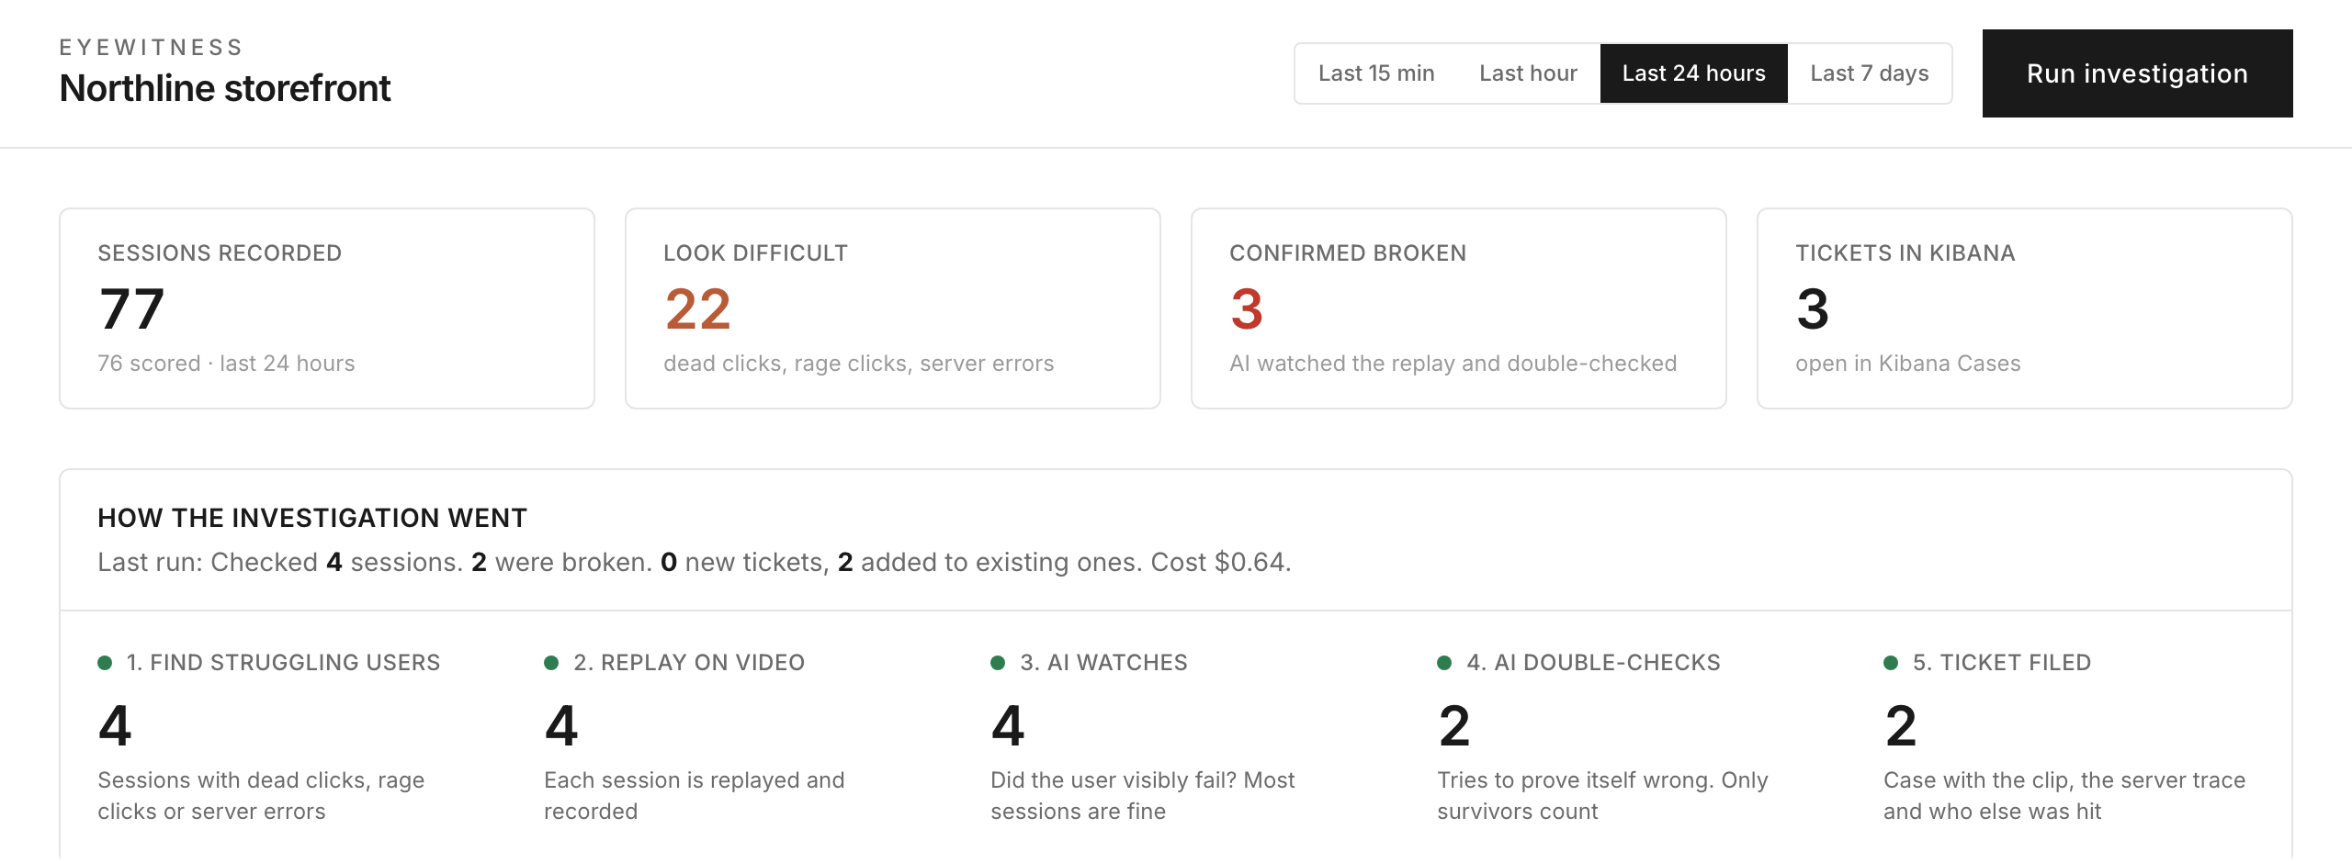
THE PRODUCT
One button. Watch it work. Read the answer.
Run investigation
Pick a window, press once. No terminal, no config.
Live pipeline
Five stages fill as they run. A plain sentence says what happened.
What is broken
Cards, not reports. Headline, the moment on screen, three steps.
The operator page after a run: four numbers, then the pipeline and its result sentence.
Every session
Journey, signals, score, status and a replay link.
EYEWITNESS · TEAM SANDBOXED · FORGE THE FUTURE HACKATHON

Slide 5
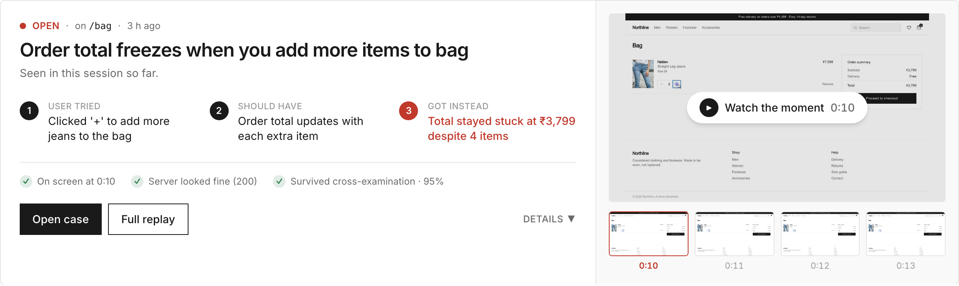
THE EVIDENCE
Not “the checkout looks broken.” This.
Plain-English headline
Watch the moment
The three steps
Three checks
Written by the model for a non-engineer, 60 characters or fewer.
The clip paused at the failing second. One click plays it.
Tried, should have, got instead. The third line is red.
Seen on screen. Server fine or failed. Survived review.
EYEWITNESS · TEAM SANDBOXED · FORGE THE FUTURE HACKATHON

Slide 6
PLATFORM DEPTH
Elastic is in the investigation at every stage
FOUR INDICES, ONE SESSION ID
RETRIEVAL, AND WHY
replay-events
ES|QL the sweep. Threshold and window retunable, no code.
raw rrweb event as a disabled object: stored, never indexed
terms + filter aggs backend signals for a thousand sessions in one round trip.
sessions
one summary per session, Painless upsert, signals object
bool + range the request within ±10 s of the failing second.
server-events
one doc per API call, session_id + trace_id keywords
kNN incident memory. Cosine gate at 0.85, backend evidence must agree.
incidents
dense_vector 1536 cosine, fingerprint, route, case id
Cases API, alerting, Vega the ticket, the pager, the operator dashboard.
AWS Bedrock Converse for triage, extraction, review · Bedrock embeddings · S3 presigned evidence · Sarvam Hindi and Tamil case summaries
EYEWITNESS · TEAM SANDBOXED · FORGE THE FUTURE HACKATHON

Slide 7
MEASURED ON THIS BUILD
What we can prove today
100%
80%
7 min
$0.27
precision
recall
to a ticket
per incident
0 false positives across 7 healthy sessions
4 of 5 injected faults. The miss had no signal at all.
median, session end to Kibana Case, 3.5 to 16 range
$0.19 per session watched. $2.13 across 3 runs.
12-session ground-truth run, 5 injected faults, 7 healthy, scored against the truth file. Small and controlled, not a production guarantee.
The number we are most proud of is the zero. Adversarial self-review is what keeps it there.
EYEWITNESS · TEAM SANDBOXED · FORGE THE FUTURE HACKATHON

Slide 8
MEASURABLE BUSINESS IMPACT
The value is the gap between “when it broke” and “when someone noticed”
10,000 checkouts a day · 2% silent failure · ₹2,499 average order
 | Support-led discovery | Eyewitness, 30-minute sweep
Affected checkouts before discovery | 400 to 600 over 2 to 3 days | about 4 per sweep interval
Order value exposed | ₹10 to 15 lakh | about ₹10,400 per interval
Engineer time to reproduce | 1 to 2 hours hunting for steps | 0, scrub to the second
Cost of detection | support headcount, churned customers | about $6 a day in model calls (USD)
Silent churn
Hours
UI insight
Autonomous QA
the 96% who never file a ticket become a count
reproduction goes to zero; the case opens on the second
the same signals are a friction report per release
a confirmed case is a structured bug report a coding agent can fix
EYEWITNESS · TEAM SANDBOXED · FORGE THE FUTURE HACKATHON

Slide 9
PRODUCTION READINESS · GO-TO-MARKET
Built to run tonight and to reuse tomorrow
READY
REUSABLE
✓
82 tests, lint, types, prod build
✓
Three-line integration
signals, scoring, ingest, admin API, Kibana, memory, renderer
mount the recorder, send the session id header, wrap API routes
✓
Resumable and scheduled
✓
Nothing knows about shopping
per-session checkpoints, scheduled repeats, doctor checks every key first
generic signals, one query, prompts about a session
✓
Cheap by construction
✓
Plugs into what you page on
the sweep discards most sessions before any model call
Kibana Cases, alerting rules, connectors
✓
Honest about limits
✓
Same funnel, any journey
signal-free failures escape; API events, not full OTel
bank onboarding, SaaS settings, insurance claims
EYEWITNESS · TEAM SANDBOXED · FORGE THE FUTURE HACKATHON

Slide 10
The evidence was always there.
Now something watches it, argues with itself, and files only what it can prove.
NEXT
Close the recall gap: compare the final screen to the expected outcome of the last action
The fix half of the loop: a coding agent opens the PR with the clip attached
Fargate renderer, Agent Builder over the indices, APM and RUM, ELSER over runbooks
github.com/someshwaranM/forge-sandboxed · pull request #1 · SUBMISSION.md
Team Sandboxed · Mohit Paddhariya, Rahil Mavani

