Slide 1
Weekly Report
Caixue He - 20260210

Slide 2
前情提要
- Paper Reading & Code Organizing
- Library Architecture Design

Slide 3
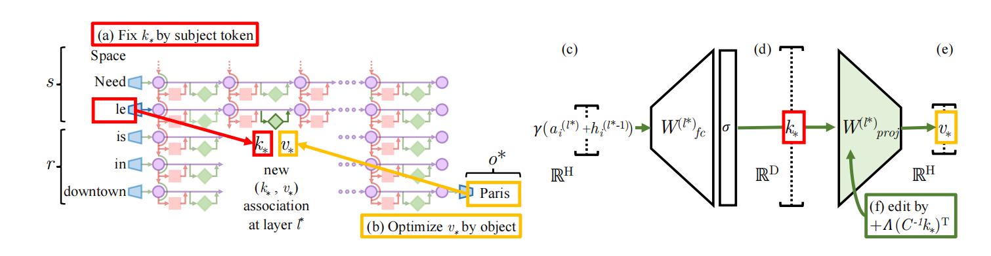
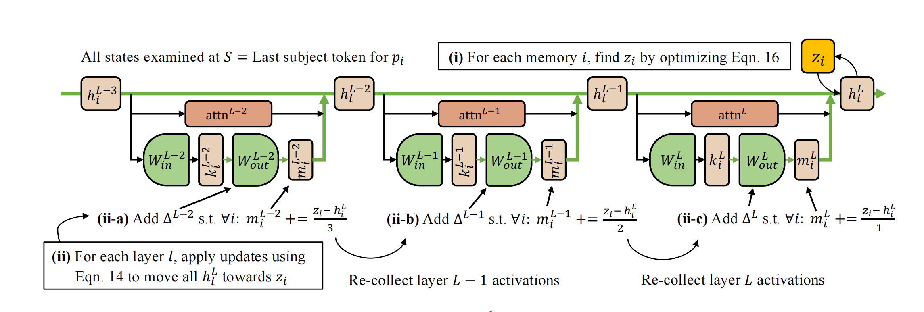
Current Knowledge Editing Method @博闻
(1)
Fig 1: ROME
(2)
Fig 2: MEMIT

Slide 4
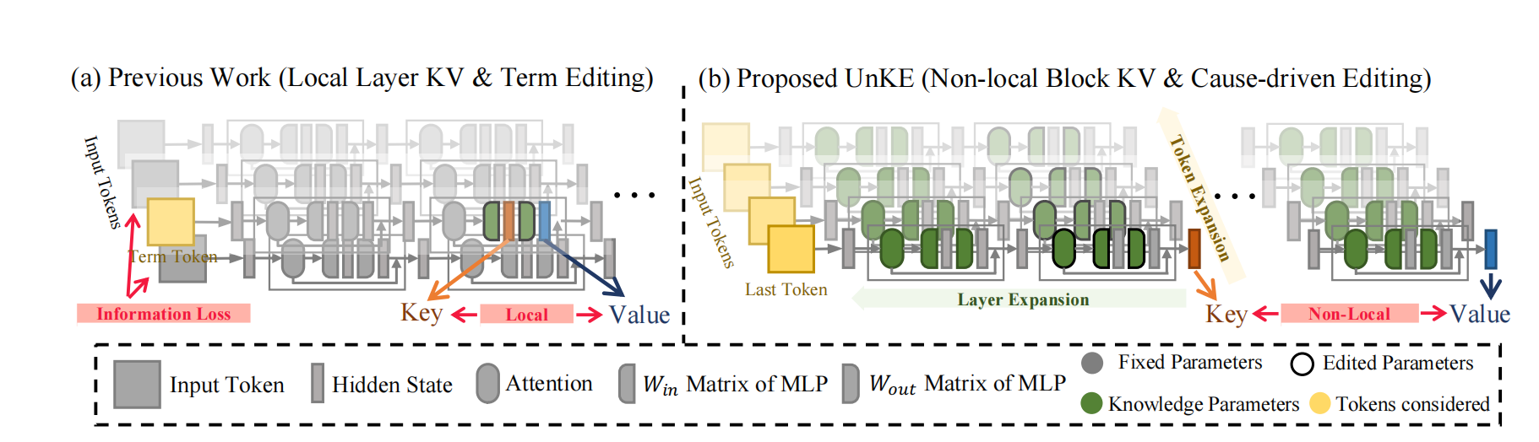
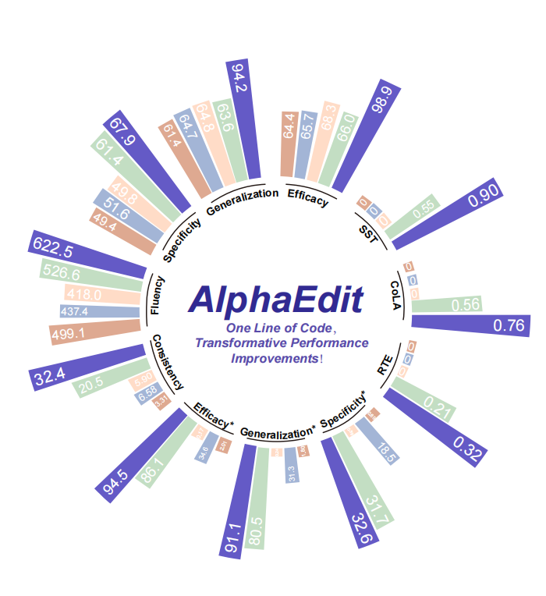
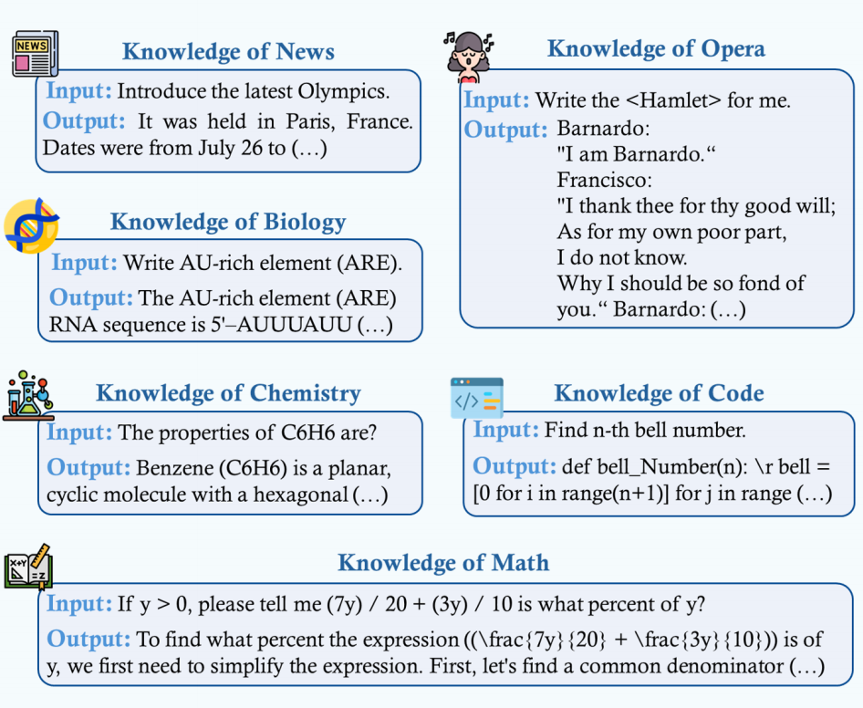
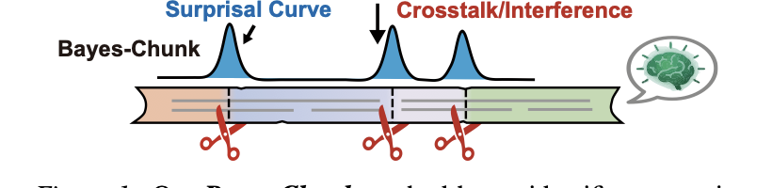
Current Knowledge Editing Method @博闻
(3)
(4)
Fig 3: MEMIT
Fig 4: UNKE
(5)
(6)
Fig 6: ANYEDIT++
Fig 5: ANYEDIT

Slide 5
Current Knowledge Editing Method @博闻
Existing Issues:
1.No multi-GPU / DataParallel support
2.Required Python package versions are old
3.No unified system to integrate these methods
4. Device are hardcoded
2022
ROME
ROME
MEMT
2023
Structural Editing
AlphaEdit
Time
Line
2025
Unke
Unke
AnyEdit
Unstructural Editing
2026
AnyEdit++
Fig 7: Code Reference Tree of Current Model Knowledge Editing

Slide 6
Knowledge Editing Libary Architeture Design @博闻
User API Call
User Layer
Command Line Interface
Object-Oriented API
Simple API
API Layer
Factory Class
Core Abstraction
Layer
Base Editor Class
Base HyperParams Class
Base Dataset Class
Implementation
Layer
MEMIT Editor
AlphaEdit Eitor
UNKE Editor
...
UNKE Dataset
CF Dataset
...
Utility Layer
Hook Tool
Text Generation
Statical Computation
Global Configration

Slide 7
Future Work
- 继续模型阅读知识编辑相关文章
- 基于设计的框架结构实现统一的知识编辑库

