Slide 1




Kindergartn System
Java project

Slide 2
Project idea
A kindergarten system software based on a SQL database with data of students , teachers , department and their timetable.
For students, it takes their (first_name ,second_name ,Id , phone_number,Age,Address).
You can search for a student using his id number.
In the database the primary key is (student_id) .
For teachers, the project takes their personal data (name , salary , phone number , Address,subject,Age).
The primary key is (teacher_id) .
In timetable, it stores everyday’s subjects and the department concerned with this week.
The primary key (week_id) and it is connected to department using foreign key (department_id).

Slide 3
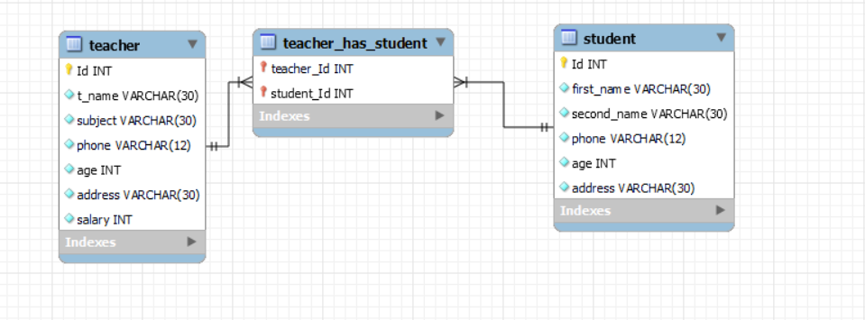
System erd

Slide 4

Home screen

Slide 5
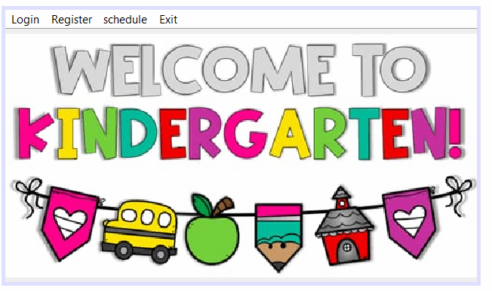
It is the opening frame.
In this frame you can go to any section you want in the program.
If you want to open the Login frame press on the panel “Login”.
If you enter the correct password you will go to “student” frame.
If you want to go “Teacher” frame press on button ”T_teacher” which on “student”frame.
If you want to open the schedule frame press on the panel “schedule”.
If you want to open the Register frame press on the panel “Register”.
Or you can exit the program from exit button right below.

Slide 6
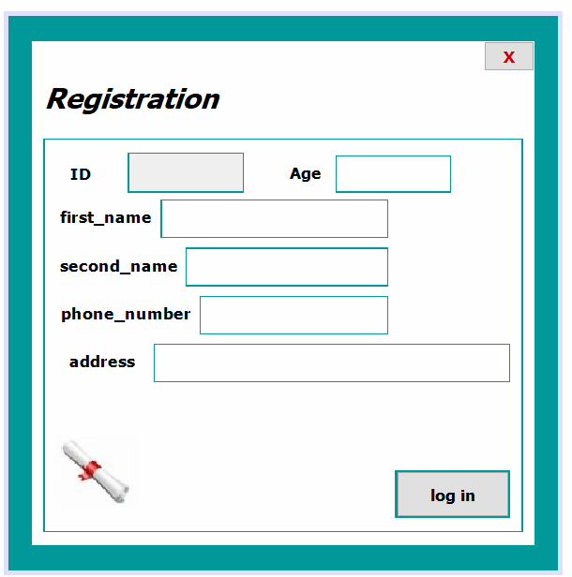
To add new student
Press “log in” button when you finish
Insertion of information.

Slide 7
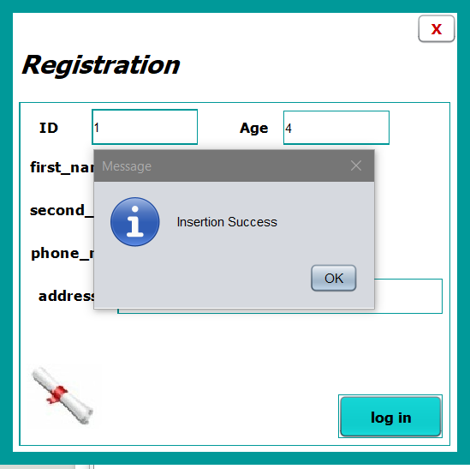
Register form:
When you press the button
A message will appear to show insertion success.

Slide 8
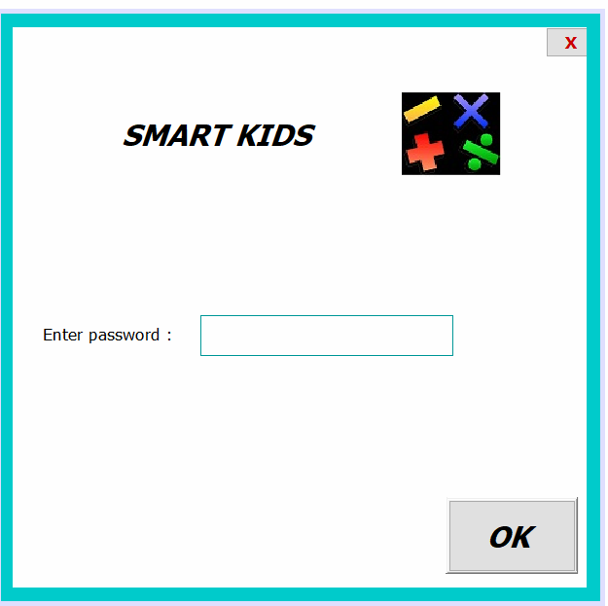
Log in frame

Slide 9
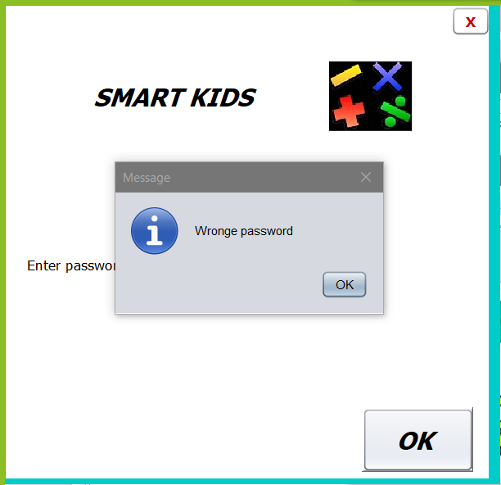
If you enter the wrong password:
A message will appear to show that the password is not correct.

Slide 10
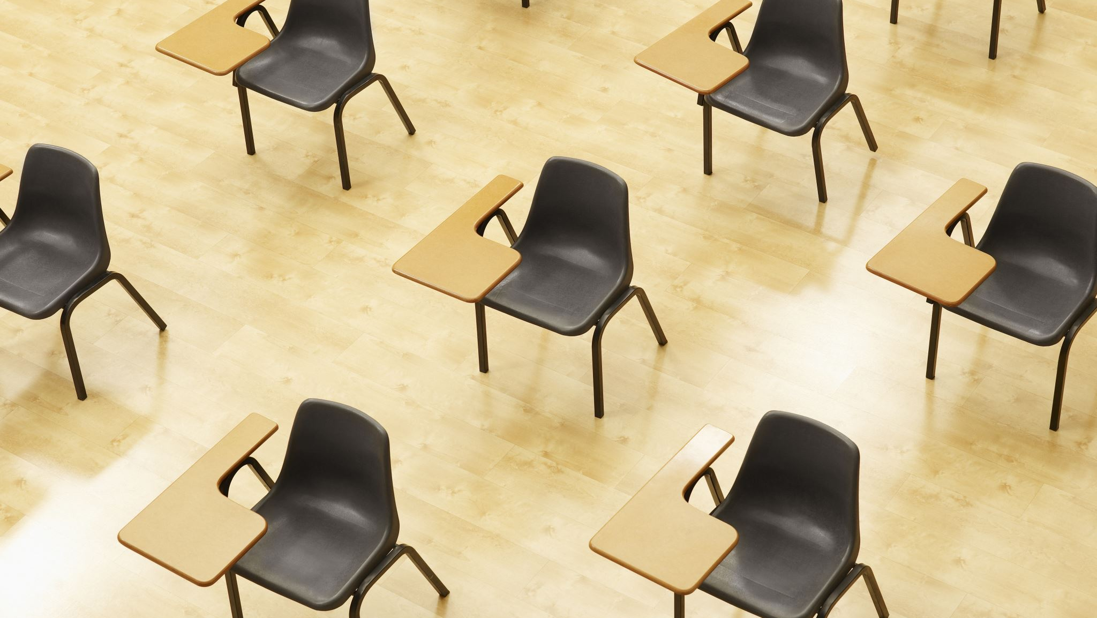
Students

Slide 11
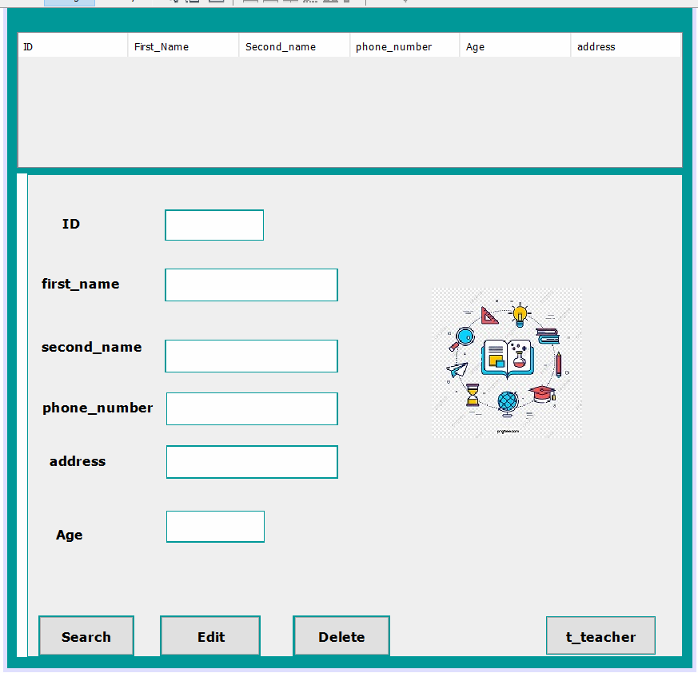
Student
If you enter correct password:
Here you can edit ,Search or delete his data
Student’s data is (id , first_name , second_name ,phone_number, address,Age).
You can show all the students data or hide it.
It contains a place where you can search for a student using id .
You can go to Teacher frame by pressing on “t_teacher” button.

Slide 12
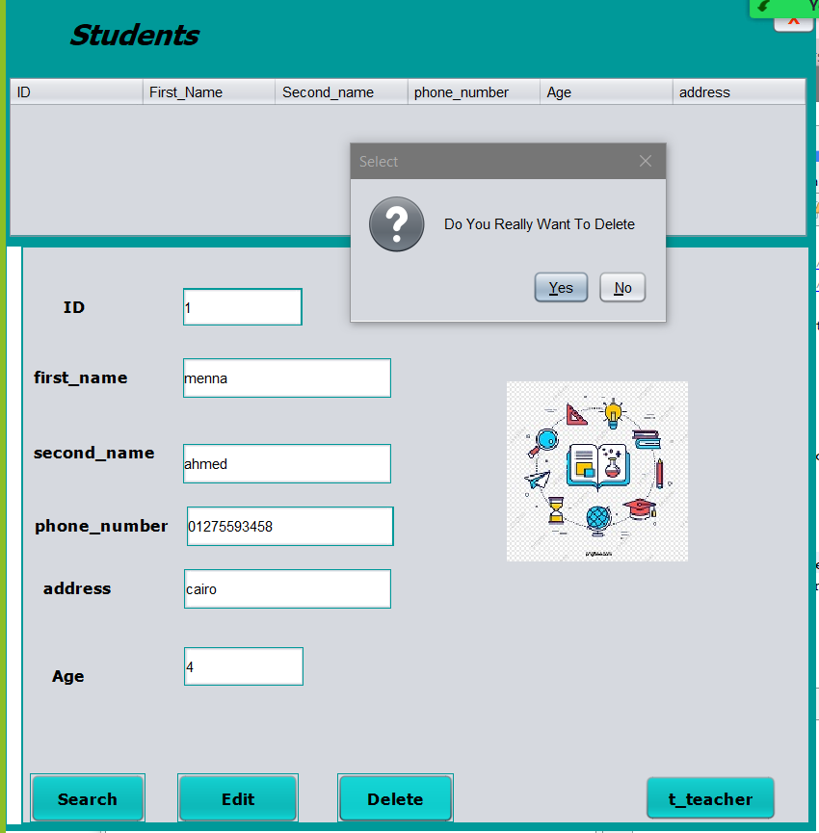
To delete student information:
Delete
you had to write id of student you want to delete
Then press “Delete” button.
A message will appear to ensure if you want to delete or not

Slide 13
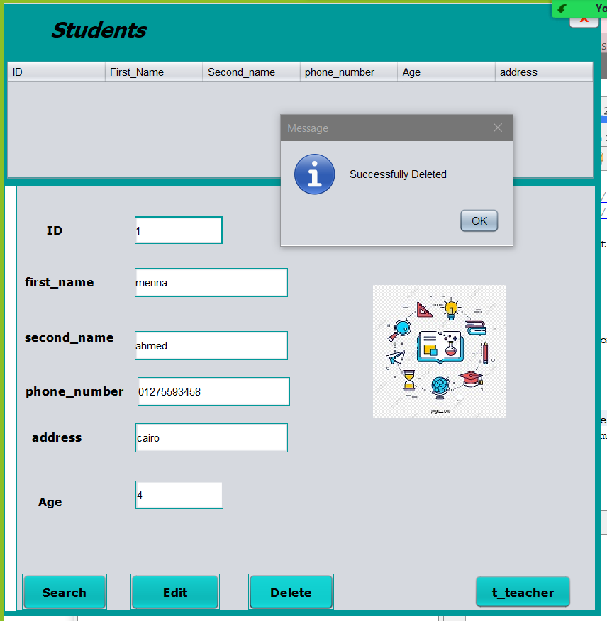
To delete student information:
. When you choose yes , a message appear to show”Sucessfuly Deleted”.

Slide 14
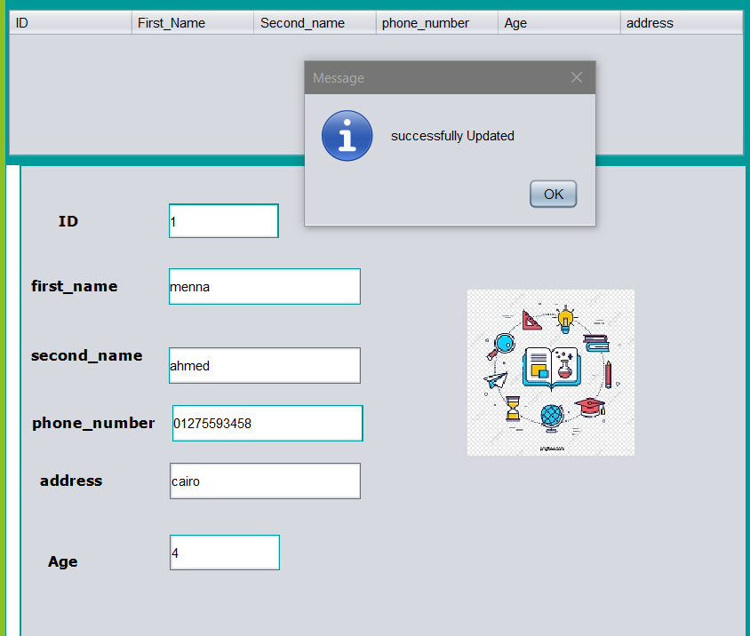
Edit
You enter the ID of student you want to update his information.
And change or update the information you want to update.
A message will appear to show that the Updated is done successfully.

Slide 15
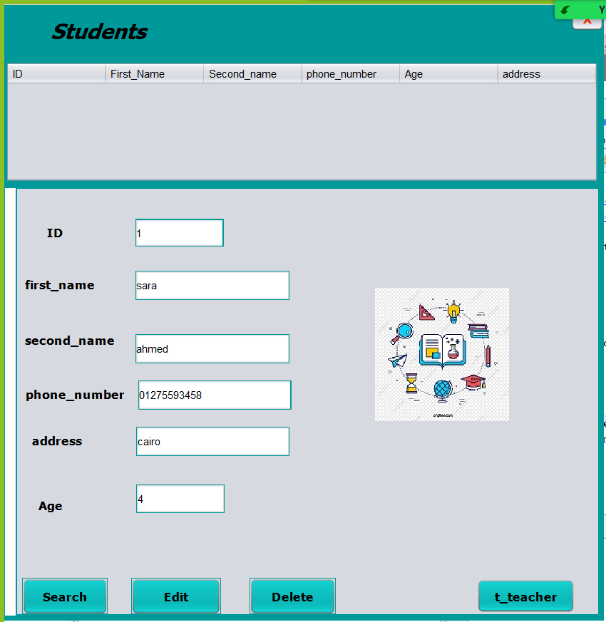
To search for student:
Search
By “Search” button you can get student information by his ID
The information will appear in the text boxes.

Slide 16
To go to teacher frame:
. By “t_teacher” button you can go to teacher frame

Slide 17

Teachers

Slide 18
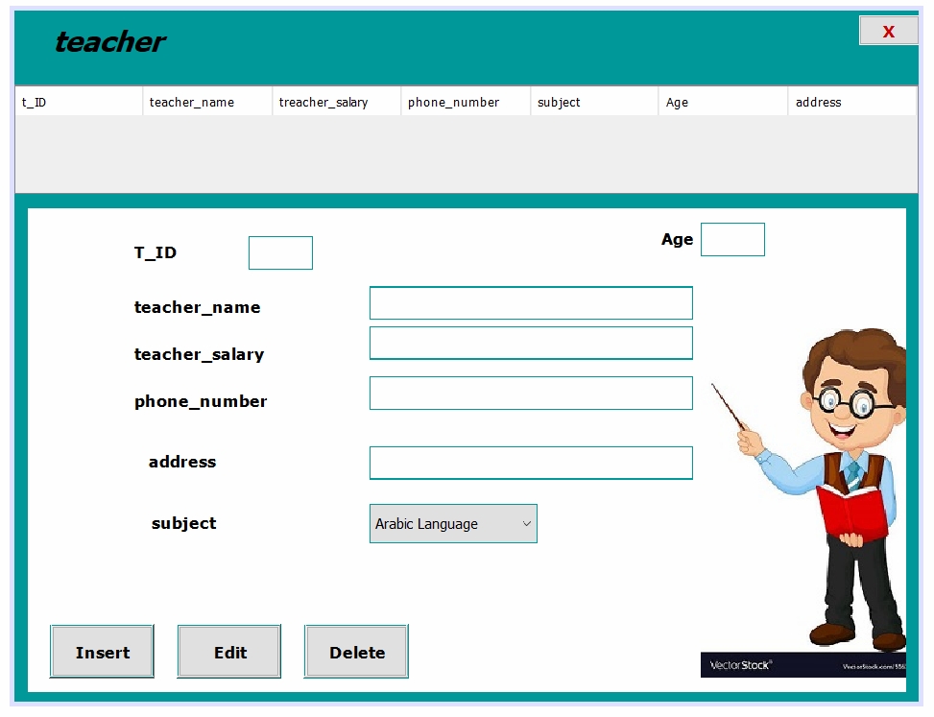
Teachers
Here you can insert to add a teacher , edit or delete his data
You can show all the teachers data.
Teacher’s data is (id,name,salary,age, phone number , address,subject).

Slide 19
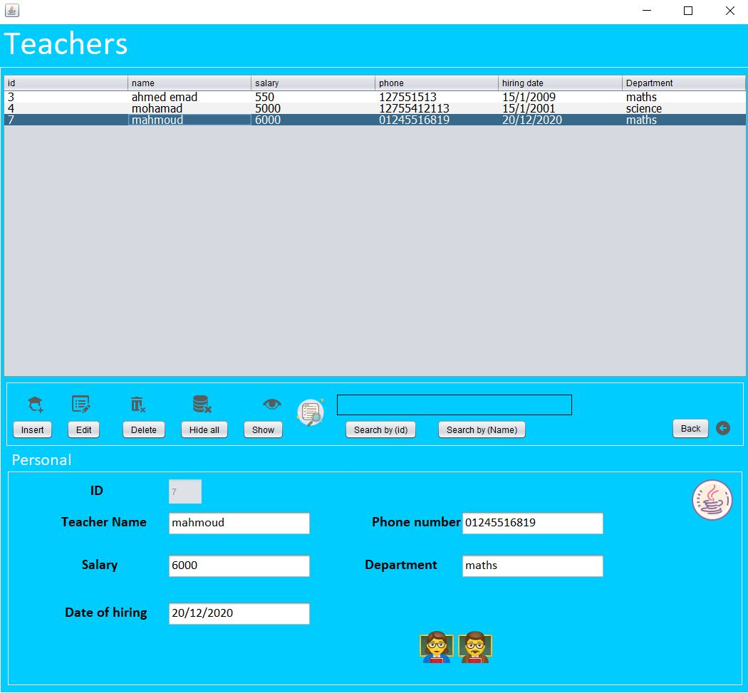
Delete
To delete a teacher you have to select the student you want to delete from the table.
Press on (Delete) button.

Slide 20
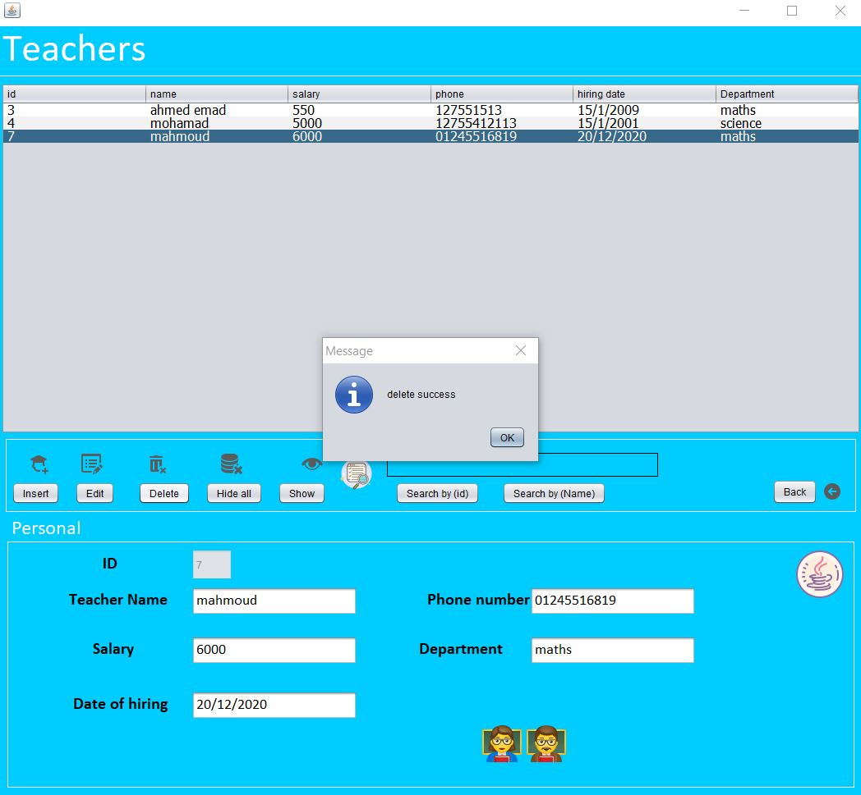
Delete
After pressing delete , a message will appear to show that the delete operation is done successfully.

Slide 21
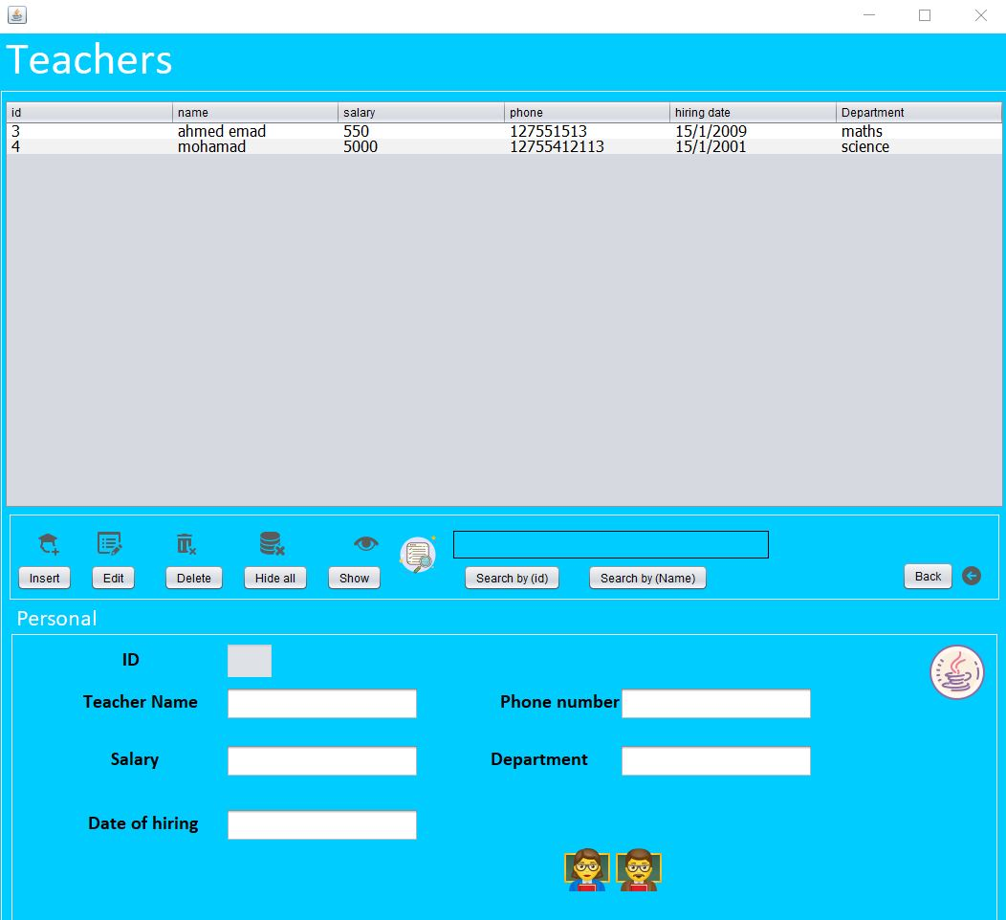
Delete
Row deleted successfully from the table

Slide 22
Delete
Row deleted successfully from the table

Slide 23

schedule

Slide 24
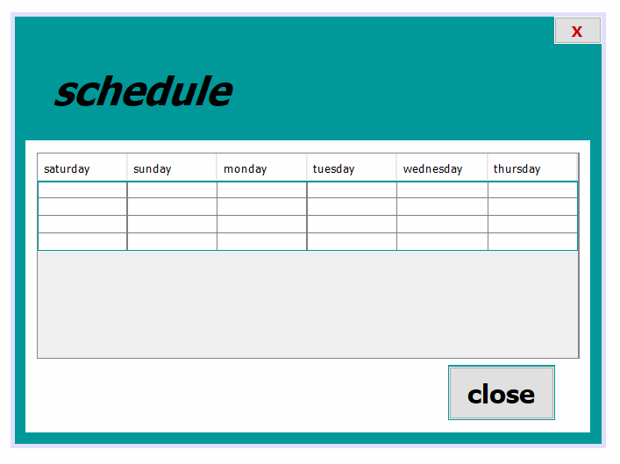

Slide 26

Thank you

