Slide 1




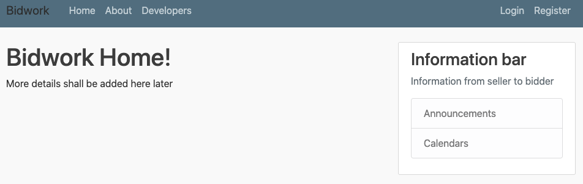
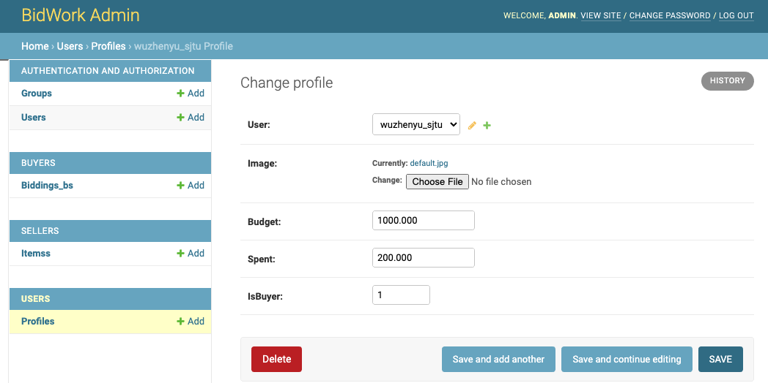
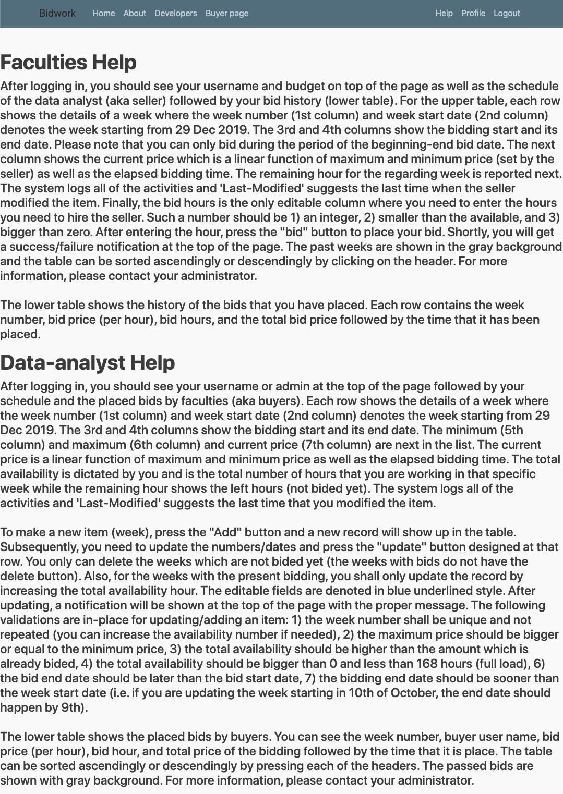
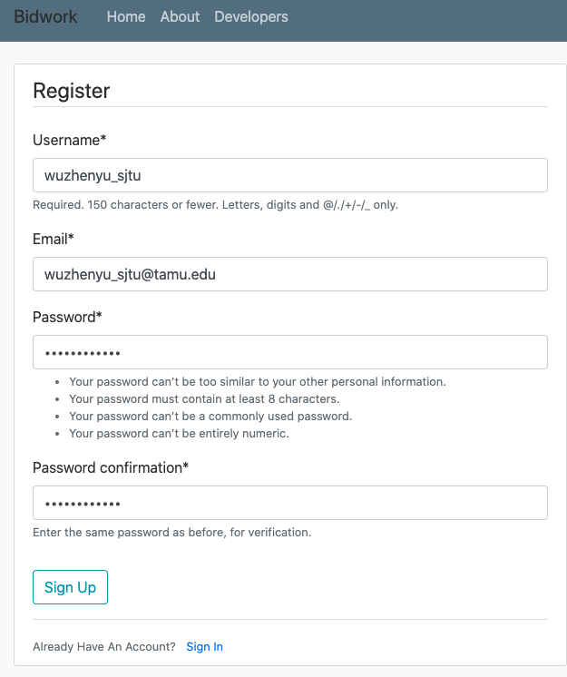
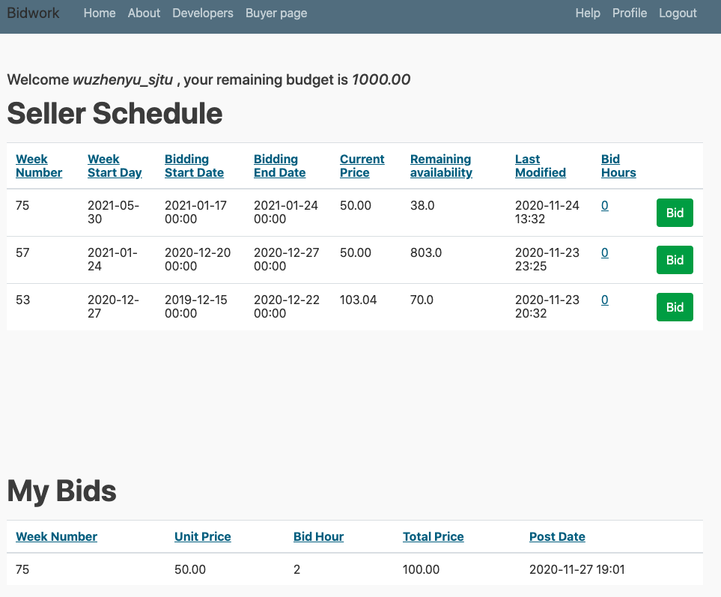
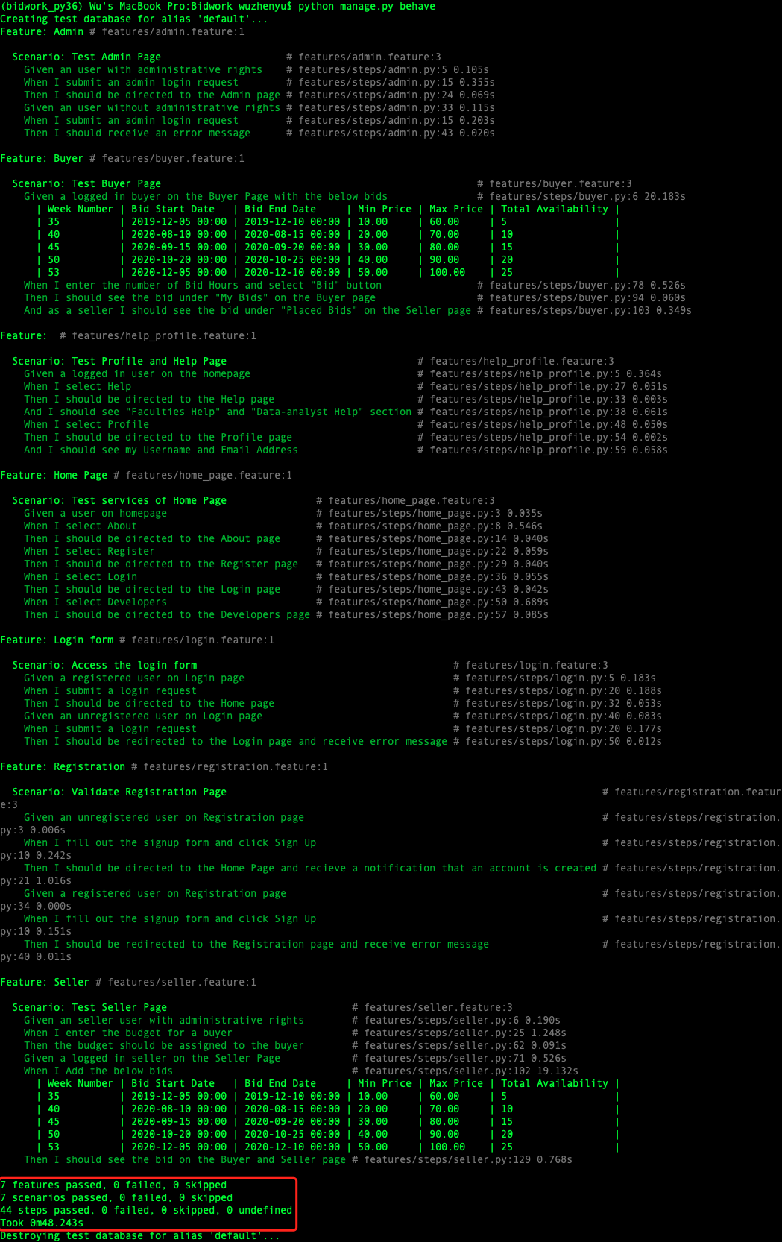
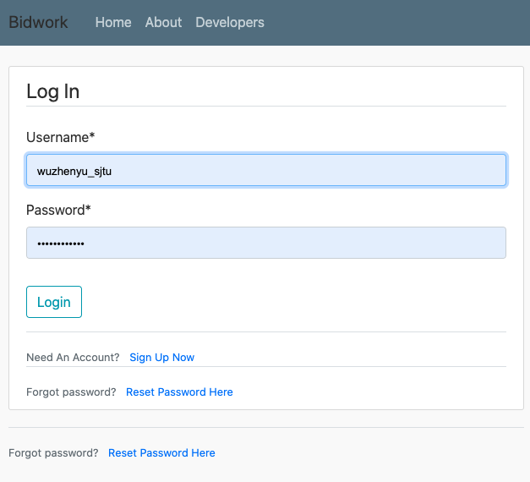
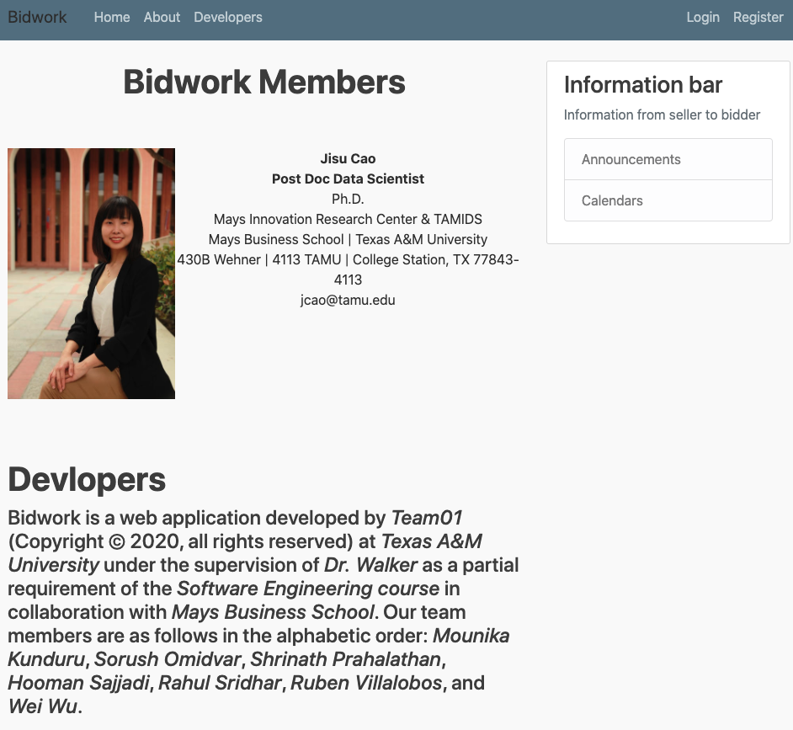
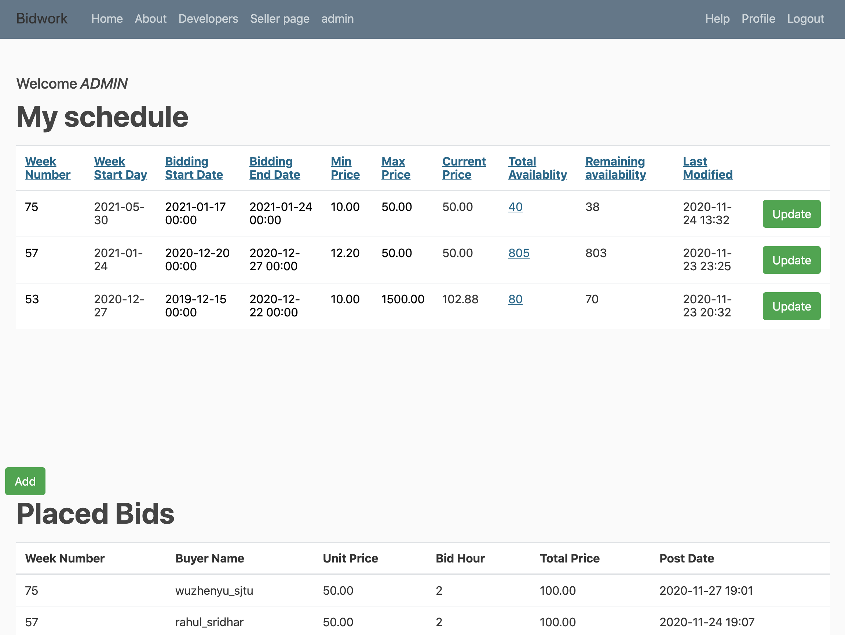
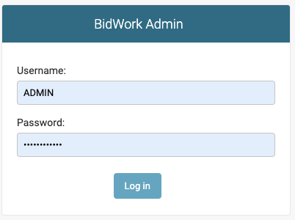
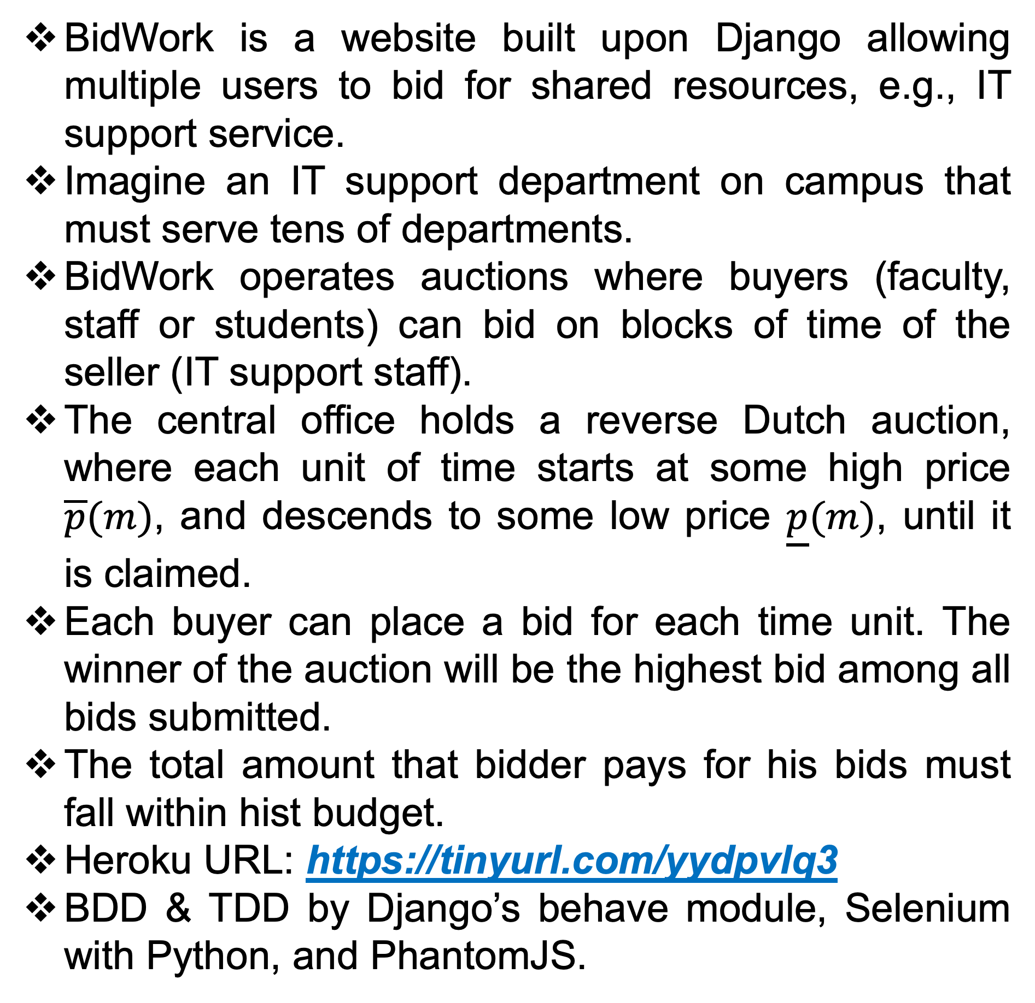
BidWork: A Bidding Website for Common Shared Resources
Mounika Kunduru, Sorush Omidvar, Shrinath Prahalathan, Hooman Sajjadi,
Rahul Sridhar, Ruben Alejandro Lopez Villalobos, Zhenyu Wu
Motivation
Organizations have shared resources to individuals, e.g., IT support service.
FCFS-based allocation suffers from selfish agents’ over-consumption.
A price mechanism can better allocate the shared resources.
We need a bidding website prototype where a single seller auctions blocks of time to multiple buyer.
Feature 2: Home page
Introduction
Feature 5-2: Admin panel page
BidWork is a website built upon Django allowing multiple users to bid for shared resources, e.g., IT support service.
Imagine an IT support department on campus that must serve tens of departments.
BidWork operates auctions where buyers (faculty, staff or students) can bid on blocks of time of the seller (IT support staff).
The central office holds a reverse Dutch auction, where each unit of time starts at some high price $\overline{p}(m)$, and descends to some low price $\underline{p}(m)$, until it is claimed.
Each buyer can place a bid for each time unit. The winner of the auction will be the highest bid among all bids submitted.
The total amount that bidder pays for his bids must fall within hist budget.
Heroku URL: https://tinyurl.com/yydpvlq3
BDD & TDD by Django’s behave module, Selenium with Python, and PhantomJS.
Feature 8: Help
BDD & TDD
Feature 3: Registration page
Feature 6: Buyer page
BidWork Features
Feature 4: Login page
Feature 7: Seller page
Feature 1: About page
Feature 5-1: Admin login page

