Slide 1
StudyBuddy
Team 1
Aung Ko Ko Khant
Aye Mya Phoo
Cheong Li Yuan
Khan Sher Mostafa Somik
Nyan Htet Win Maung
Xie Ting Ting
Zhao Ziyou

Slide 2
Background
Tackle difficult school topics together
Platform for live discussion
Schedule online meetups
Book recommendations for relevant topics
Available on React and Android

Slide 3
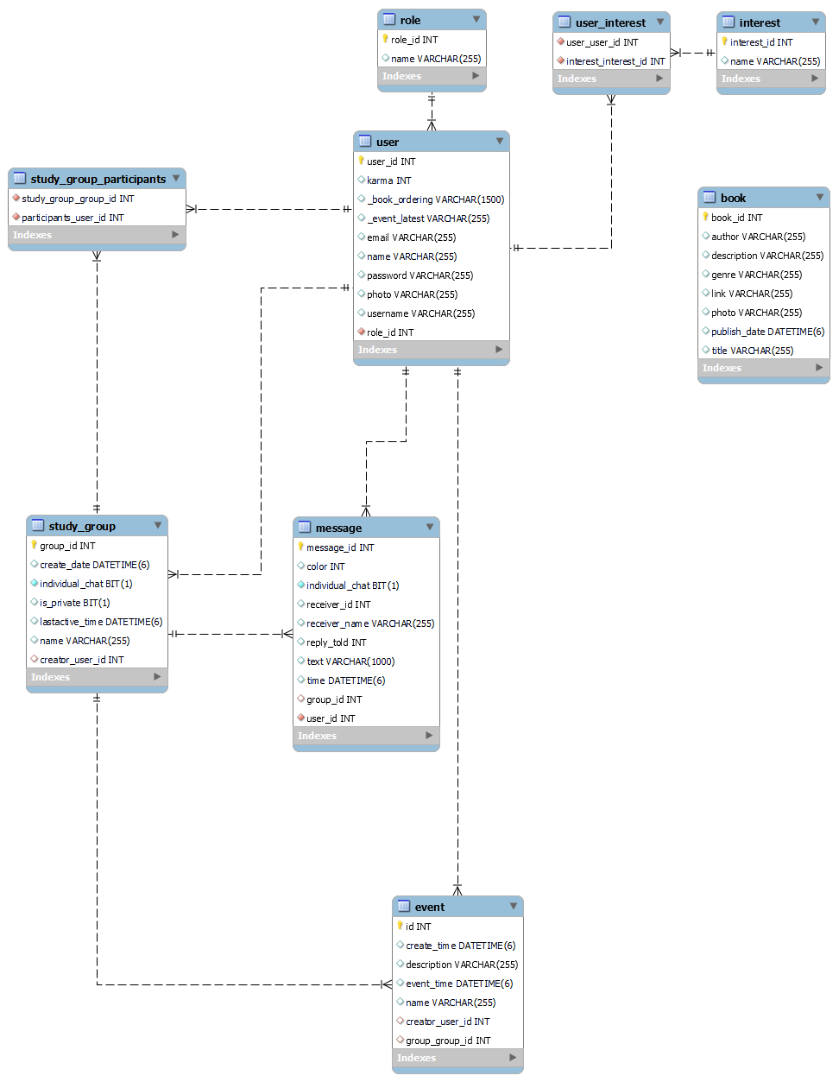
ERD

Slide 4
Android demo

Slide 5
React demo

Slide 6
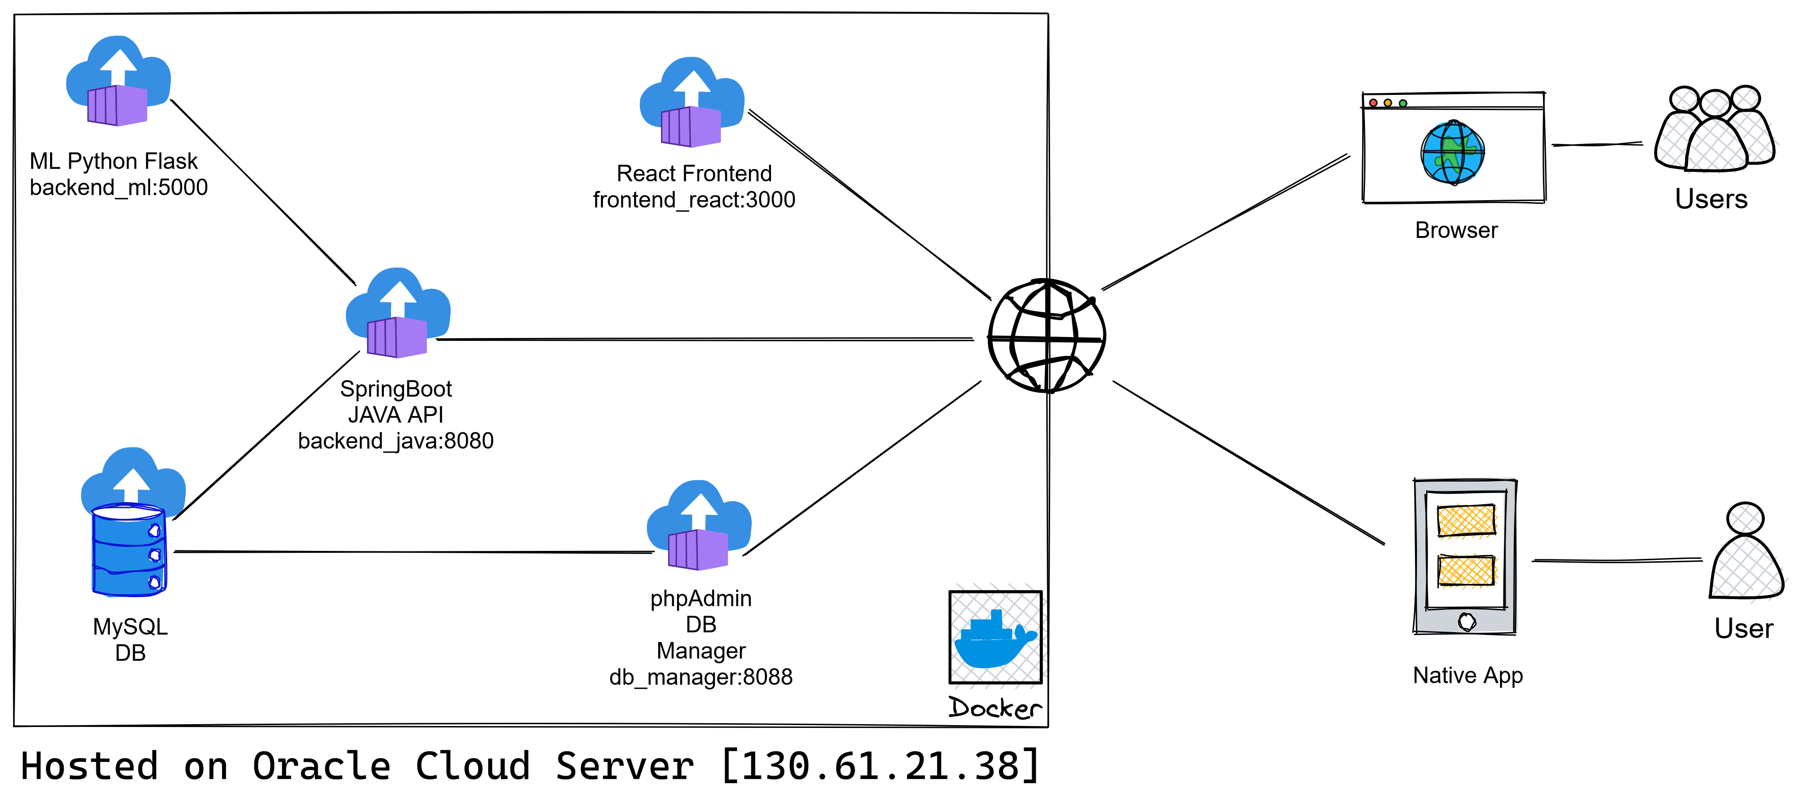
Architectural

Slide 7
Technical Challenges
JWT token?
Java Backend File upload handler controller
Android custom HTTP client with multipart file upload support
Android interact with other applications to receive files without direct access to filesystem
Android interact with Google Keyboard to receive images
Auto scroll chat history when there is new message especially image in React. When message is arrived, auto scroll will be triggered but image is still loading, and browser don't know exact height to be scrolled yet.
Notes:
Sharing one of technical challenge from each member?

Slide 8
Technical Challenges
RecyclerView for events(3 classes) and chat group(6 classes)
Glide caching
Web scraping code is 'manually selected' and might break if website layout changes
CORS issue will happen when server and client site are not in the same domain. Server will reject every request from client because of CORS issue.
React UI state management. To maintain single source of truth between Parent and Child component.

Slide 9
Future improvements
Ability to edit and delete messages
Filter and hide swear words
Dark mode on Android
Improve dashboard UI on React
Able to kick out user from group
Able to send GIF message on React

Slide 10
Thank You :)

