Slide 1
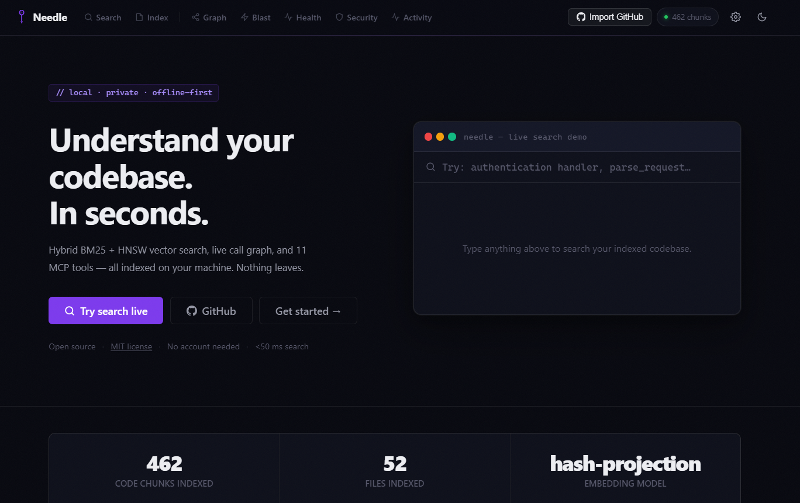
Developers waste
47%
of their time searching code.
We built the fix.
NEEDLE · Code Intelligence · Rust · Local-first · MCP-native · MIT License
Notes:
Hook: 47% of developer time is spent searching code.

Slide 2
THE PROBLEM
Three broken tools. One compounding cost.
Keyword-only search
23 min avg to locate one unfamiliar function
grep and regex find tokens, not meaning. Search "auth" → 400 results. Developer reads every one.
Cloud dependency
Enterprise teams blocked from using cloud search
Sourcegraph and GitHub Search send private code to external servers — a compliance blocker for enterprises.
Zero graph awareness
$84K / dev / year in navigation and onboarding waste
No tool shows who calls what. The call graph lives in senior devs' heads and vanishes when they leave.
Notes:
Three problems: keyword-only, cloud-dependent, graph-blind.

Slide 3
OUR SOLUTION
Needle
Find anything. Understand everything. Stay private.
Semantic Search
Graph-aware
AI-native MCP
100% Local
BM25 + HNSW via RRF
Call + import edges
14 tools / JSON-RPC
Zero cloud
3.89 ms
average end-to-end search time · measured on real hardware · no GPU
Built in Rust · MIT Licensed · Runs offline · Works in air-gapped environments
Notes:
Solution: BM25+HNSW, call graph, MCP, 100% local. 3.89ms average search.

Slide 4
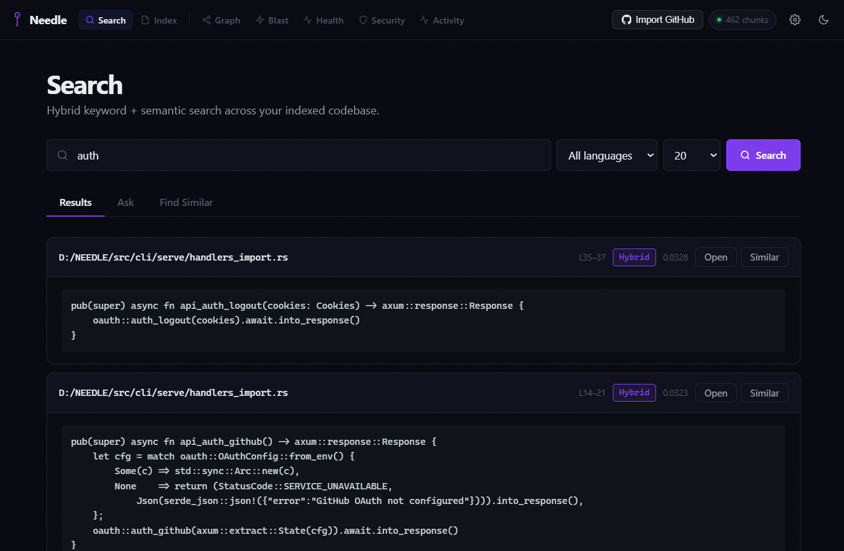
HOW IT WORKS
End-to-end pipeline — from source files to AI insights
Source
Files
Tree-sitter
Parser
Chunking
Engine
BM25
Index
HNSW
kNN
RRF
Fusion
Results
<4ms
10+ langs
AST extract
462 chunks
0.07ms
3.47ms
ranked
API/CLI/MCP
BM25 keyword + HNSW vector run in parallel — merged via Reciprocal Rank Fusion
Knowledge
Graph
MCP Server
14 tools
Health
100/100
Security
Scan
Blast
Radius
440 nodes
AI agents
Architecture
Vulns
Impact map
Notes:
Pipeline: Tree-sitter→chunks→BM25+HNSW(parallel)→RRF→<4ms→graph/MCP/health/security.

Slide 5
TECHNICAL INNOVATION
Four ideas that make Needle different
01
Reciprocal Rank Fusion
02
AST-aware Chunking
BM25 (0.07ms, keyword) and HNSW kNN (3.47ms, semantic) run in parallel. RRF merges their ranked lists — neither alone achieves the same relevance quality.
Tree-sitter parses into function/class/method boundaries with exact line numbers. No mid-function splits — every chunk is semantically complete.
03
Model Context Protocol
04
Zero-dep Embedding
14 tools over stdio JSON-RPC 2.0. Claude Code, Cursor, any custom agent gains full codebase awareness with one 5-line config — zero extra latency.
Hash-projection (384-d) ships inside the binary — no Python, no model download. Optionally upgrades to Ollama nomic-embed-text for higher recall.
Notes:
Innovations: RRF fusion, AST chunking, MCP protocol, zero-dep embedding.

Slide 6
LIVE RESULTS
Measured on real hardware — 52-file Rust codebase, no GPU
3.89
ms average end-to-end search
0 errors
under 50 concurrent requests
97.9ms
P50 at 50 concurrency
128ms
P99 worst case
100/100
codebase health score
Notes:
Results: 3.89ms avg, 0 errors at 50 concurrency, P50 97.9ms, P99 128ms, health 100/100.

Slide 7
COMPETITIVE LANDSCAPE
Nobody else combines all four — here's the proof
Feature
Needle
GitHub
Search
Sourcegraph
ripgrep
Codeium
Semantic vector search
✓
✗
✓
✗
~
Call graph / AST graph
✓
✗
✗
✗
✗
MCP / AI agent tools
✓
✗
✗
✗
✗
100% local / offline
✓
✗
✗
✓
✗
Health score + analysis
✓
✗
✗
✗
✗
Security scanner
✓
✗
✓
✗
✗
Open source (MIT)
✓
✗
~
✓
✗
✓ Full
~ Partial
✗ Not available
Notes:
Needle is the only tool combining: semantic search, call graph, MCP, local, health, security.

Slide 8
DEMO
90 seconds — six steps — full codebase intelligence
1
cargo install needle
~20 sec · single binary · Rust 1.75+ required
2
needle init .
0.2s · 52 files · 462 chunks · 440 graph nodes · 827 edges
3
needle serve
Browser at localhost:7700 · MCP server on stdio
4
Search: "query engine"
6 results · 2.6ms · exact file + line number
5
Graph → click node
Callers + callees panel · blast radius on hover
6
Health + Security tabs
Score 100/100 · 3 High · 11 Medium · 5 Low
Live demo running at https://needle-4kdk.onrender.com
Notes:
Demo: 6 steps, 90 seconds — install, index, serve, search, graph, health+security.

Slide 9
IMPACT
What changes for the developer
Locate a function
23 min
<4 ms
350,000×
Trace a call chain
45 min
1 click
instant
Security audit
4 days
3 sec
115,000×
Onboard new dev
2 weeks
4 hours
80×
47%
10×
$84K
Notes:
Impact: 350,000× faster lookup, instant call chain, 115,000× faster audit, 80× faster onboarding.

Slide 10
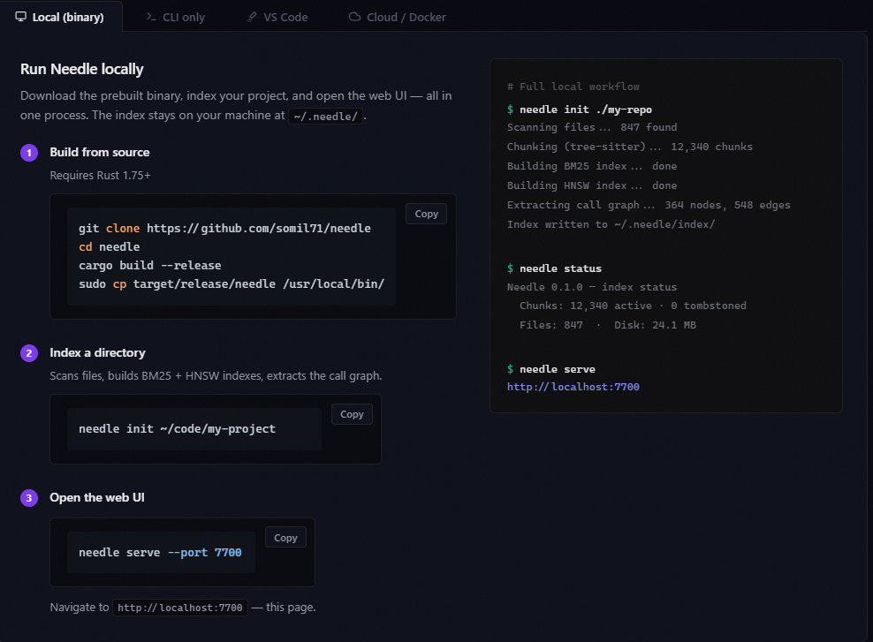
GETTING STARTED
30 seconds from zero to full codebase search
1
cargo install needle
~20s
Installs the binary from crates.io. Rust 1.75+ required.
2
needle init .
0.2s
Parses source, builds BM25 + HNSW indexes, extracts call graph.
3
needle serve
instant
Starts web UI at localhost:7700 and MCP server on stdio.
needle init . && needle serve
Notes:
Getting started: 3 steps, 30 seconds.

Slide 11
ROADMAP
Where we're going
v1.0 · Now
v1.5 · Q3 2025
v2.0 · Q4 2025
Enterprise · 2026
· Hybrid BM25+HNSW search
· RwLock parallel reads
· Multi-repo workspace
· SSO + RBAC
· Knowledge graph
· Result caching
· Team index sharing
· Org dashboards
· MCP · 14 tools
· VS Code extension
· CI/CD integration
· Custom embeddings
· Health score 100/100
· Live re-index watcher
· Diff-aware reindex
· Audit logging
Notes:
Roadmap: v1.0 → v1.5 Q3 2025 → v2.0 Q4 2025 → Enterprise 2026.

Slide 12
THE TEAM
Built by engineers who felt the pain firsthand
Project at a Glance
S
Language
Rust + TypeScript
License
MIT Open Source
Repo
github.com/SOMIL71/needle
Somil
Founder & Lead Engineer
Status
v1.0 · Production
Full-stack systems engineer. Built Needle end-to-end in Rust — from Tree-sitter AST chunking to the Axum HTTP server, HNSW index, Tauri desktop app, and MCP protocol layer.
Health
100 / 100
MCP Tools
14 tools (stdio)
Search
3.89ms avg
Index
0.2s for 52 files
Rust · Axum · Tauri · TypeScript · Tree-sitter
Notes:
Team: Somil, founder and lead engineer.

Slide 13
The age of code is the
age of understanding it.
<4ms
100/100
14 tools
100%
MIT
search time
health score
MCP server
local & offline
open source
cargo install needle && needle init . && needle serve
30 seconds from install to full codebase search.
github.com/SOMIL71/NEEDLE
Notes:
Closing: cargo install needle && needle init . && needle serve.

