Slide 1
Foundations of Data Science
Somil Bansal
CB.EN.U4CSE20261

Slide 2
Application-Shaadi.com
Analytical Questions
1. What is the person’s age?
2. Is the person Maanglik?
3. What is the caste of the person?
4. Where does the person work?
5. How tall is the person?

Slide 3
Application- Shaadi.com
Predictive Questions
1. Is the person rich?
2. Is the person trustworthy?
3. Is the person’s profile fake or real?

Slide 4
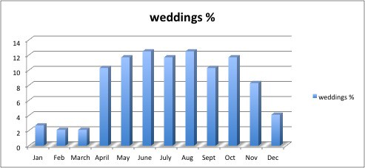
Visualization

Slide 5
Data Categorization
Nominal: Name-Age,Gender
Ordinal: Number of matches person has received(less than 10, more than 10 < 15, greater than 15)
Interval: Current earning salary
Ratio: number of kids wanted
Binary: smoker or not

