Slide 1
Programming an Adaptive Artificial Intelligence using the Monte Carlo Tree Search Algorithm for Turn-Based Games
Somil Govani

Slide 2
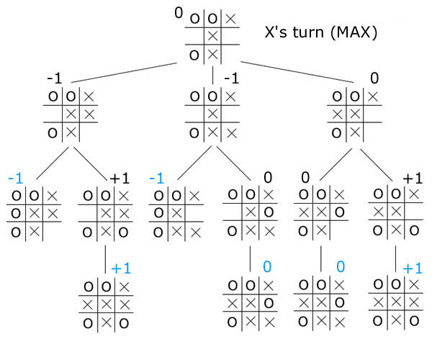
The Minimax Game Tree
A tree of all possible move sequences
Picks the branch that maximizes wins (current player) and minimizes losses (wins for other player)
Even moderately complex games can overwhelm computers

Slide 3
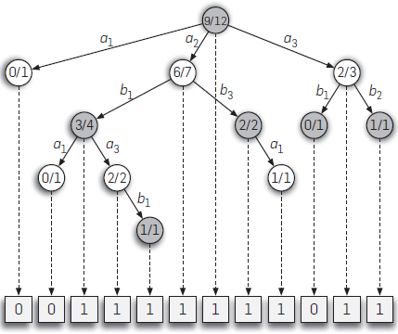
Monte Carlo Tree Search Algorithm
Monte Carlo Method makes conclusions based on statistical samples
MCTS samples game branches to reach conclusions
Requires much less memory/time to sample incomplete tree

Slide 4
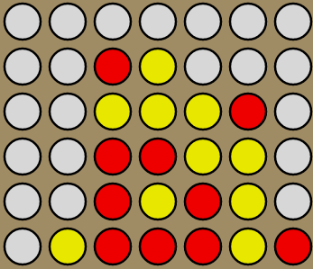
Connect Four
Classic two-player logic-based game
4,531,985,219,092 possible board permutations
Currently undetermined number of terminal board permutations
Current estimate is around 2,000,000,000
Tree too large for computer to find efficiently with minimax

Slide 5
Goal
Program an artificial intelligence that uses the Monte Carlo Tree Search Algorithm to make decisions on a turn-by-turn basis for the game Connect Four

Slide 6
Practical Applications
Improve knowledge on artificial intelligence in general
Improve real-time strategy board or video games’ AI
Simulate complex real life situations with perfect (or near perfect) information
Stock simulations
Robot decision making
Amino and Nucleic Acid polymerization simulation in bioinformatics

Slide 7
Materials & Tools
Java (JRE 1.7) Programming Language
Objected-Oriented Approach
Eclipse IDE Luna Release (4.4.0)
No external libraries used

Slide 8

Build / Update GameBoard
Run MCTS with GameBoard as parameter
Return value of each possible move (1-7)
Execute Move & Check for win/tie
Change player turn
Run for “x” number of iterations

Slide 9
Programming the GameBoard
| - | - | - | - | O | - | - |
-----------------------------
| - | - | - | - | X | - | - |
-----------------------------
| - | O | - | O | X | - | - |
-----------------------------
| X | O | - | X | X | - | - |
-----------------------------
| X | O | - | O | O | - | - |
-----------------------------
| X | O | - | O | X | - | - |
-----------------------------
Player O wins!
Stored piece position and type in multidimensional array
Iterated for lowest possible row each time piece is ‘dropped’ (column is chosen)
Capable of human or artificial input

Slide 10
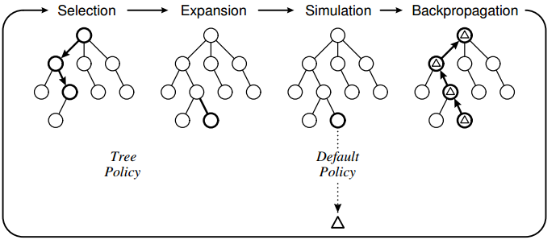
Monte Carlo Tree Search

Slide 11
Selection
R
L
Starting from root node, recursively select child nodes until a node has no previously visited children

Slide 12

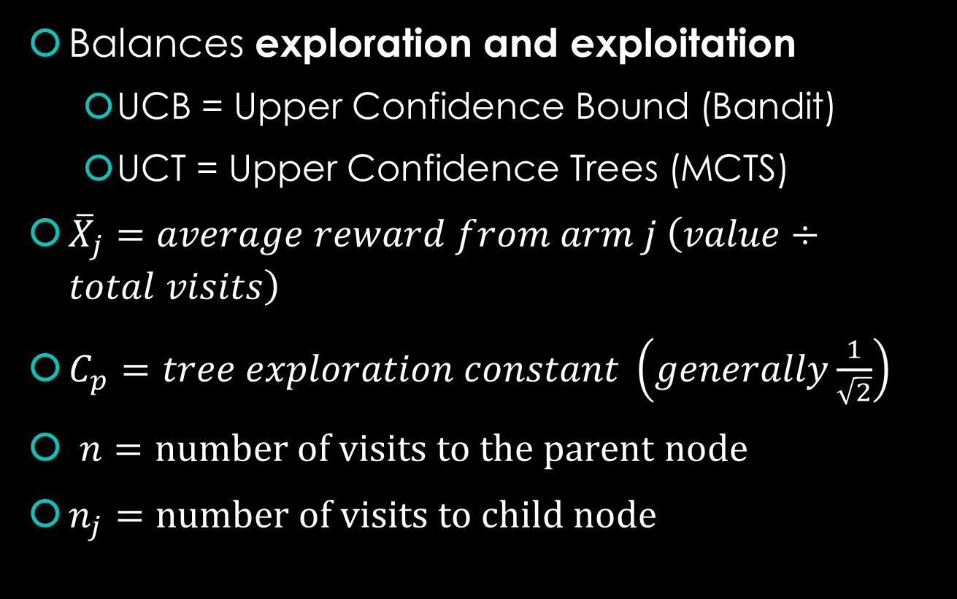
Selection: Bandit Policy (UCB/UCT)
Balances exploration and exploitation
UCB = Upper Confidence Bound (Bandit)
UCT = Upper Confidence Trees (MCTS)
${\overline{X}}_{j}=average reward from arm j \left(value÷total visits\right)$
$C_{p}=tree exploration constant \left(generally\frac{1}{\sqrt{2}}\right)$
$n=number of visits to the parent node$
$n_{j}=number of visits to child node$
$$UCT={\overline{X}}_{j}+2C_{p}\sqrt{\frac{2\ln{n}}{n_{j}}}$$

Slide 13
private Node select() //Upper Confidence Bound (Bandit Policy) implemented to select most optimal node based on exploration-exploitation balance
{
Node selected = null;
double bestUCB = 0;
for (Node childNode : children)
{
if (childNode == null){continue;} //for the special case of firstIteration children
// buffer prevents divide by 0 errors in the case of unvisited nodes
double ucbValue = childNode.nodeWins / (childNode.nodeVisits + buffer) //estimated value
+ (2/Math.sqrt(2)) * Math.sqrt(2 * Math.log(nodeVisits+1) / (childNode.nodeVisits + buffer))
+ randomNumb.nextDouble() * buffer; //adds small number to break ties between similar/unvisited
if (ucbValue > bestUCB)
{
selected = childNode;
bestUCB = ucbValue;
}
}
return selected;
}

Slide 14
Monte Carlo Tree Search

Slide 15
Expansion
R
L
C
Starting from a node with previously unvisited children, create children and choose one

Slide 16
public void expansion(char[][] boardState, List<Node> children)
{
for (int i = 0; i < GameBoard.columns; i++)
{
for (int j = GameBoard.rows - 1; j >= 0; j--)
{
if (boardState[j][i] == '-') //finds lower-most (if any) blanks spaces in each column to simulate move
{
char[][] tempBoard = new char [GameBoard.rows][GameBoard.columns];
boardClone(tempBoard, boardState);
tempBoard[j][i] = GameBoard.turn;
children.add(new Node(tempBoard));
break;
}
}
}
}

Slide 17
Monte Carlo Tree Search

Slide 18
Simulation
R
L
C
Starting from the child node created from expansion, simulate a random game until some end result (win, loss, tie) is reached

Slide 19
while (!GameBoard.checkWin(currentNode.boardState, 'O') //make sure node isn’t terminal
&& !GameBoard.checkWin(currentNode.boardState, 'X')
&& !GameBoard.checkTie(currentNode.boardState))
{
currentNode.expansion(currentNode.boardState, currentNode.children, firstIteration); //Expands a given node to create child nodes for the current players turn
currentNode.oppExpand(currentNode.boardState, currentNode.children); //Simulates all possible random opponent moves as children of players possible moves
currentNode = currentNode.select(); //selects a player child node to continue simulation (randomly since none of these nodes have been visited yet as they are newly made)
visitedNodes.add(currentNode);
if (!GameBoard.checkWin(currentNode.boardState, 'O') //make sure new node isn’t terminal
&& !GameBoard.checkWin(currentNode.boardState, 'X')
&& !GameBoard.checkTie(currentNode.boardState))
{
currentNode = currentNode.select(); //selects opponent child of player children randomly
}
}

Slide 20
Monte Carlo Tree Search

Slide 21
Backpropagation
R
L
C
Update each visited node with result

Slide 22
Backpropagation: Stats to Update
Add one visit to each node (to balance exploration for future selection)
Update value of node based on result of specific sequence (to balance exploitation for future selection)
Option 1: Consider a win as +1, and consider anything else as +0
Option 2: Win (+1), Tie (+0), Loss (-1)
Option 3: Win (+1), Tie (+0.5), Loss (+0)

Slide 23
if (GameBoard.checkWin(currentNode.boardState, GameBoard.turn))
{
for (Node visitedNode : visitedNodes)
{
//GameBoard.buildBoard(visitedNode.boardState, GameBoard.turn);
visitedNode.nodeVisits++;
visitedNode.nodeWins+=1; //adds 1 for a win
}
}
else if (GameBoard.checkWin(currentNode.boardState, opp))
{
for (Node visitedNode : visitedNodes)
{
visitedNode.nodeVisits++;
//visitedNode.nodeWins-=0; //adds nothing for a loss
}
}
else
{
for (Node visitedNode : visitedNodes)
{
visitedNode.nodeVisits++;
visitedNode.nodeWins+=0.5; //adds 0.5 for a tie
}
}
Won game
Lost game
Tied game

Slide 24
Monte Carlo Tree Search

Slide 25
Choosing the Move
max child: select the root child with the highest reward
robust child: select the most visited root child
max-robust child: select the root child with both the highest visit count and the highest reward

Slide 26
Goal
Program an artificial intelligence that uses the Monte Carlo Tree Search Algorithm to make decisions on a turn-by-turn basis for the game Connect Four

Slide 27
The Result
Player X's Turn
0: 2000.0 2000.0
0
| - | O | X | X | O | X | X |
-----------------------------
| - | X | O | X | X | X | O |
-----------------------------
| - | O | X | X | O | O | X |
-----------------------------
| - | X | O | O | X | O | O |
-----------------------------
| X | X | X | X | O | O | O |
-----------------------------
| O | X | O | O | O | X | O |
-----------------------------
Player O's Turn
0: 76.0 228.0
1: 136.5 341.0
2: 100.5 275.0
3: 90.0 255.0
4: 84.5 244.0
5: 216.5 483.0
6: 49.5 174.0
5
| - | - | - | - | - | - | - |
-----------------------------
| - | - | - | - | - | - | - |
-----------------------------
| - | - | - | X | - | - | - |
-----------------------------
| - | - | - | O | X | O | - |
-----------------------------
| - | - | X | X | O | O | - |
-----------------------------
| - | X | O | O | O | X | - |
-----------------------------

Slide 28
Testing the AI

Slide 29
Timing the AI

Slide 30
Conclusion
Successes
Areas of Development
Program is functional, AI is difficult to beat
AI is fast (relative to minimax)
Implementation is simple (doesn’t need any external information)
Asymmetric tree is efficient
Can still be sped up
Some reasonable moves apparent to the human player are overlooked due to magnitude of permutations and natural sampling error
Domain Knowledge – filter out implausible moves or urge very plausible moves to increase asymmetry

Slide 31
Bibliography
Browne, Cameron B. "A Survey of Monte Carlo Tree Search Methods." IEEE Transactions on Computational Intelligence and AI in Games 4.1 (2012). Print.
Chaslot, Guillaume. Monte-Carlo Tree Search: A New Framework for Game AI. Masstricht: Universiteit Maastricht. Print.
Kocsis, Levente. Bandit Based Monte-Carlo Planning. Budapest: Computer and Automation Research Institute of the Hungarian Academy of Sciences. Print.
Remi Munos. From Bandits to Monte-Carlo Tree Search: The Optimistic Principle Applied to Optimization and Planning. 2014.
Russell, Stuart J., Peter Norvig, and Ernest Davis. Artificial Intelligence: A Modern Approach. 3rd ed. Upper Saddle River: Prentice Hall, 2010. Print.

Slide 32
Programming an Adaptive Artificial Intelligence using the Monte Carlo Tree Search Algorithm for Turn-Based Games
Somil Govani
Thank You

