Slide 1

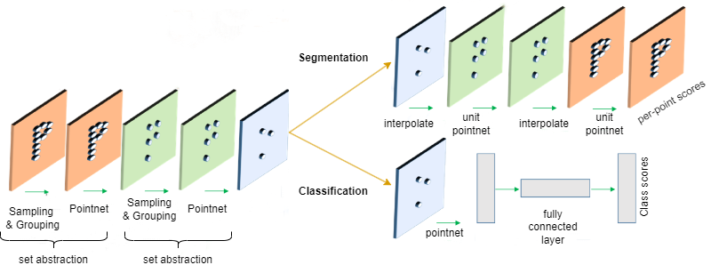
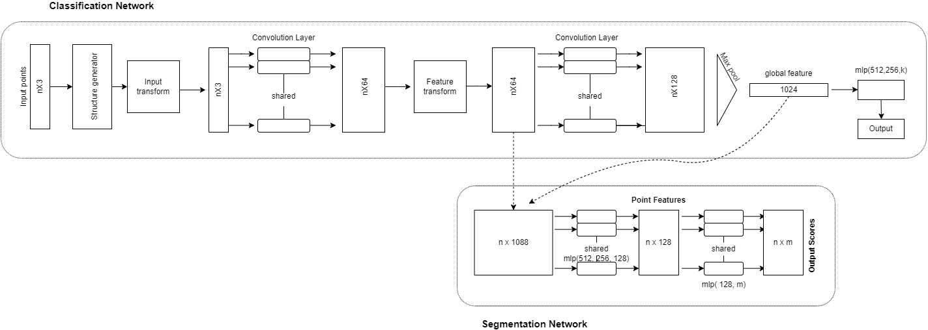
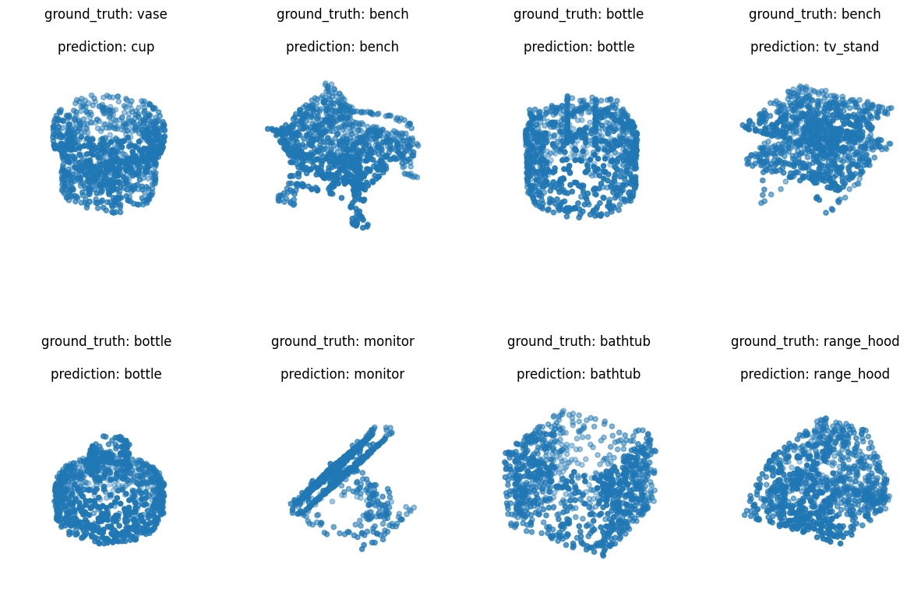
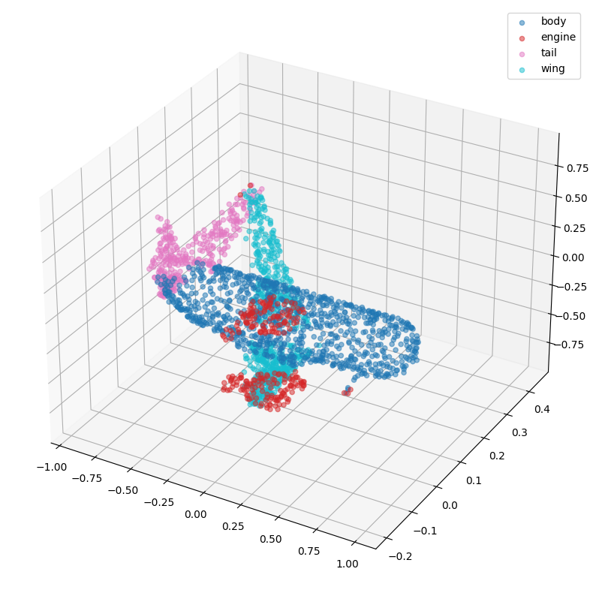
Mini Project 2023-24
Project title: Deep Learning for Classifying and Segmenting 3D Point Clouds
Team member name: Somil Yadav Harsh Kashyap Abhinav Anand Sanjana R. Habib
Guided by: Prof. Guruprasad Konnurmath
TM
Problem Statement
Architecture
Proposed work
Classification and Segmentation of a 3D Point Cloud Utilizing Convolutional Neural Networks (CNNs).
For 3D Point Cloud Classification, the focus is on optimizing convolutional and fully connected blocks while investigating batch size, learning rate, and regularization effects.
There is a priority on enhancing model interpretability through feature visualization, which provides valuable insights into decision-making processes.
Exploration of transfer learning aims to leverage knowledge from similar tasks.
Robustness assessments include variations in noise, occlusions, and object orientations.
Systematic hyperparameter tuning and scalability investigations are designed to find the optimal configuration for PointNet, ensuring efficiency with larger datasets and intricate point cloud structures.
Shifting to 3D Point Cloud Segmentation, the proposed work emphasizes fine-tuning and hyperparameter optimization, enhancing model predictions. Exploration of transfer learning potential involves pre-training on diverse datasets before fine-tuning on ShapeNet.
Advanced data augmentation techniques, such as random rotations and scaling, aim to improve the model's generalization capabilities. Model interpretability is enriched by understanding key contributors to segmentation decisions.
Lastly, benchmarking against state-of-the-art 3D point cloud segmentation models ensures a comprehensive evaluation of our model's performance relative to existing approaches.
Objectives
• Point Cloud Classification using PointNet and CNN.
• Point Cloud Segmentation with PointNet architecture.
• Generating 3D Point Cloud using PointNet architecture.
Methodology
1. ModelNet40 Classification:
Preprocessing includes normalization and centering of ModelNet40 data.
Architecture features T-net structures, convolutional blocks, Global Max Pooling 1D and dropout.
GPU acceleration optimizes training efficiency.
Orthogonal regularizer ensures matrix orthogonality.
Evaluation on a separate test set determines classification accuracy.
2. ShapeNet Segmentation:
ShapeNet dataset loading precedes data augmentation with random sampling and Gaussian noise.
PointNet segmentation model utilizes transformation blocks and orthogonal regularization.
Training involves Adam optimization and categorical cross-entropy loss.
Demonstrates deep learning versatility in processing diverse 3D point cloud data.
Showcases robust capabilities in both classification and segmentation tasks.
PointNet Architecture
Results/ Discussion
Conclusions
In conclusion, our machine learning models, incorporating PointNet-based segmentation and PointNet with CNN-based classification, have exhibited notable proficiency in handling 3D point cloud data. The segmentation model achieved a commendable accuracy of 86.4%, emphasizing its capability in precise segmentation, while the labels prediction for segmentation model excelled with a remarkable 95.26% accuracy in predicting airplane shapes. Furthermore, our PointNet model for ModelNet40 classification displayed promising results, achieving 73.0% accuracy on both validation and test sets, demonstrating effective learning.
Segmentation
Classification

