Slide 1

Deep Learning for Classifying and Segmenting 3D Point Clouds
Team Details
Team Number: C14
Sl. Num. | Student Name | USN | Roll Num. | Division
1. | Abhinav Anand | 01FE21BCS239 | 333 | C
2. | Harsh Kashyap | 01FE21BCS238 | 332 | C
3. | Somil Yadav | 01FE21BCS192 | 130 | A
4. | Sanjana Habib | 01FE21BCS020 | 302 | C
Guide: Prof. Guruprasad Konnurmath

Slide 2

Index
Introduction
Literature Survey
Problem Statement
Objectives
Dataset Description
Model Architecture
Results
Conclusion
Future Scope
References

Slide 3
Introduction
A "point cloud" is an important type of data structure for storing geometric shape data. Due to its irregular format, it's often transformed into regular 3D voxel grids or collections of images before being used in deep learning applications, a step which makes the data unnecessarily large. The PointNet family of models solves this problem by directly consuming point clouds, respecting the permutation-invariance property of the point data. The PointNet family of models provides a simple, unified architecture for applications ranging from object classification, part segmentation, to scene semantic parsing. Though simple, PointNet is highly efficient and effective. Empirically, it shows strong performance on par or even better than state of the art.

Slide 4
Literature Survey
PointNet, a groundbreaking deep neural network, is introduced in this paper to handle unordered point sets in 3D, showcasing its proficiency in 3D shape classification, shape part segmentation, and scene semantic parsing. Notably robust against input perturbations, PointNet outperforms current benchmarks in both speed and performance. The paper offers theoretical insights and empirical assessments, affirming the stability and efficiency of PointNet, establishing it as a superior choice for 3D point cloud processing tasks.[5]
In this study by Kejie Li, Trung Pham, Huangying Zhan, and Ian Reid, titled "Efficient Dense Point Cloud Object Reconstruction Using Deformation Vector Fields," presented at the 15th European Conference in Munich, Germany, the authors employ both synthetic and real datasets, featuring point cloud and voxel grid [2]representations. Their Convolutional Neural Network (CNN) is trained to predict a deformed depth map of an object from a single input image, facilitating efficient and accurate 3D geometry reconstruction.

Slide 5
Literature Survey
Leveraging point clouds over voxel grids enhances the reconstruction’s efficiency and precision, and the model surpasses prior state-of-the-art methods in single-view object reconstruction, showcasing its efficacy in dense point cloud-based object reconstruction tasks.[3]
In their 2019 paper "Image-based 3D Object Reconstruction: State-of-the-Art and Trends in the Deep Learning Era," Xian-Feng Han, Hamid Lag, and Mohammed Bennamoun explore recent advancements in image-based 3D object reconstruction with a focus on deep learning. Utilizing datasets such as ShapeNet and ModelNet, the paper categorizes state-of-the-art techniques into volumetric, surfacebased, and point-based methods, discussing their input types, network architectures, and training mechanisms, including stereo-based and shape-from-silhouette approaches.[4]
The paper "Pixel2point: 3D Object Reconstruction From a Single Image Using CNN" introduces a CNN-based model trained on ShapeNet and Pix3D datasets. It generates accurate point clouds, outperforming PSGN and Pixel2Mesh in reconstructing 3D object structures from single images. [5]

Slide 6
Problem Statement
Classification and Segmentation of a 3D Point Cloud Utilizing Convolutional Neural Networks (CNNs).
Objectives
Generating 3D Point Cloud using PointNet architecture.
Point Cloud Segmentation with PointNet architecture and CNN.
Point Cloud Classification using PointNet architecture and CNN.

Slide 7
Dataset Description
ModelNet40 Dataset:
Purpose: ModelNet40 is designed for 3D object recognition and understanding, particularly focusing on a variety of object categories.
Format: ModelNet40 dataset contains 12,311 pre-aligned shapes from 40 categories, which are split into 9,843 (80%) for training and 2,468 (20%) for testing. The CAD models are in Object File Format (OFF). Matlab functions to read and visualize OFF files with total of 185,100 point clouds.
Data Structure: Each CAD model is represented as a 3D point cloud, providing spatial coordinates for points on the object's surface.
ShapeNet Dataset:
Objective: ShapeNet focuses on providing a comprehensive and large-scale dataset for 3D object understanding, including tasks like segmentation and recognition.
Extensiveness: It encompasses a vast collection of 3D models spanning over 16 categories.
Point Clouds: ShapeNet represents objects as point clouds, offering a detailed spatial representation for effective learning.
Applications: Widely utilized for training and evaluating models in tasks such as 3D label classification, part segmentation, and retrieval.

Slide 8
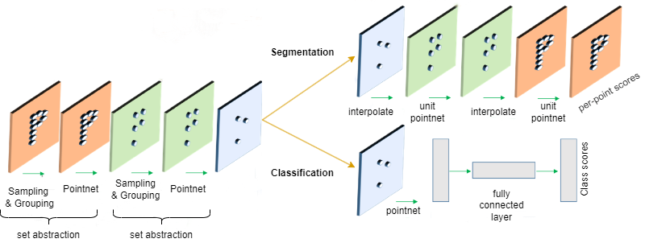
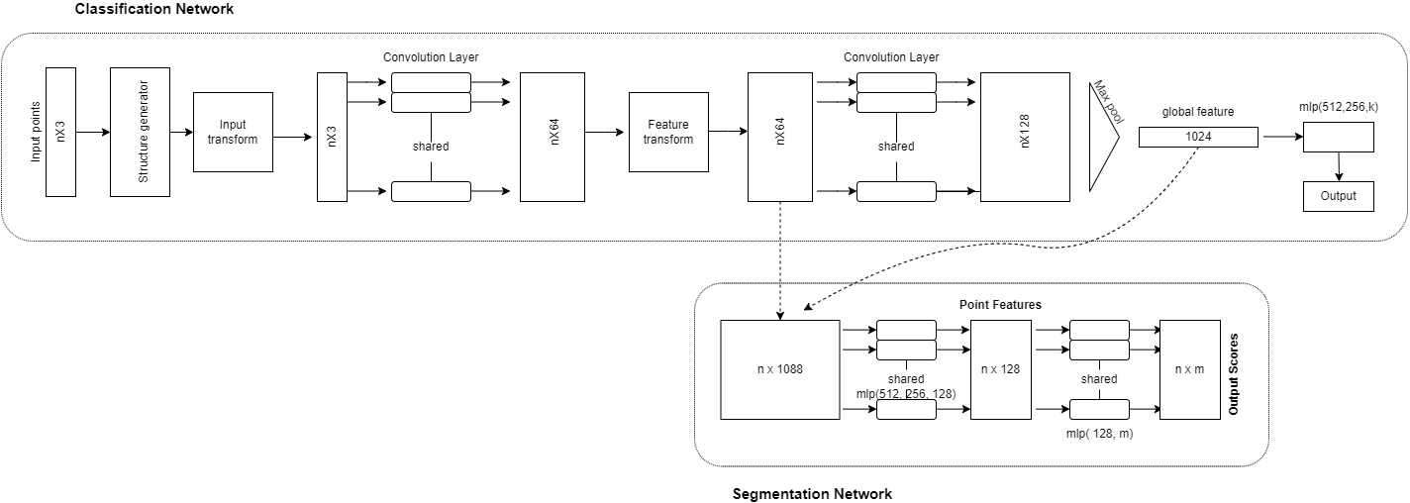
Model Architecture
Fig 1. PointNet Architecture

Slide 9
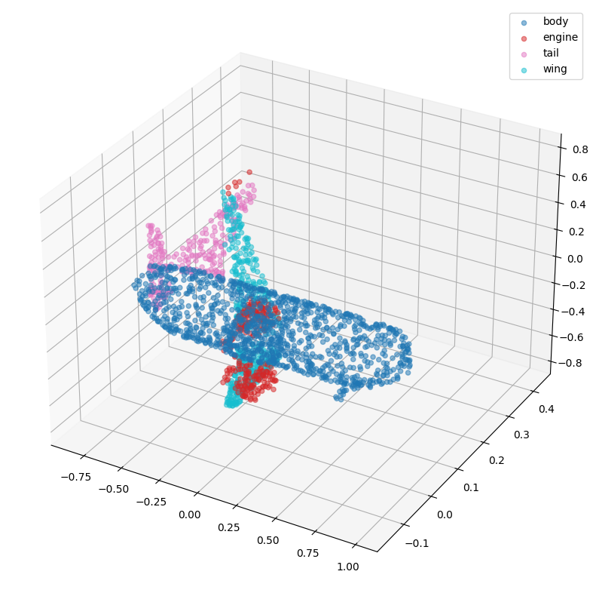
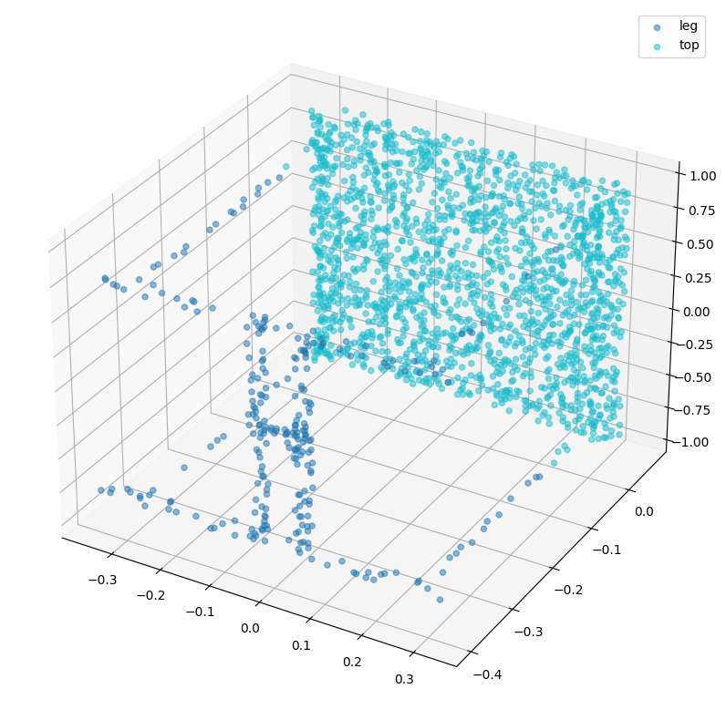
Results
Segmentation
Airplane
Fig. 2
Table
Fig. 3
Fig. 2 and Fig. 3 depict the generation of a 3D point cloud for segmentation.

Slide 10
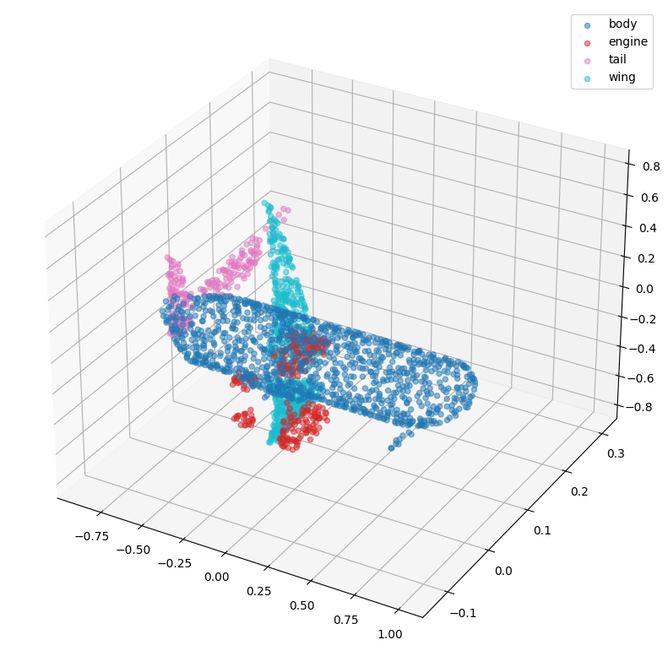
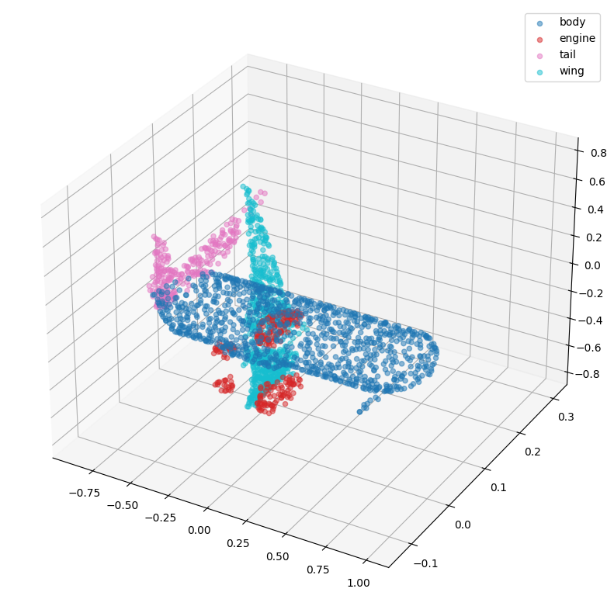
Results
Labels Prediction with Segmentation
Fig. 4
Fig. 5
Ground Truth Labels: ['body', 'body', 'engine', 'body', 'body', 'wing', 'body', 'body', 'wing', 'wing', 'body', 'tail', 'wing', 'wing', 'wing', 'body', 'body', 'tail', 'body', 'body', 'body', 'body', 'wing', 'tail', 'body', 'tail', 'tail', 'body', ......................................................
'wing' 'body', 'body', 'body', 'body', 'body', 'body', 'engine']
Predicted Labels: ['tail', 'body', 'engine', 'body', 'body', 'wing', 'body', 'body', 'wing', 'wing', 'body', 'tail', 'wing', 'wing', 'wing', 'body', 'body', 'tail', 'wing', 'body', 'body', 'tail', 'wing', 'tail', 'body', 'tail', 'tail', 'body', 'engine', 'tail', 'body', 'body', 'wing', 'wing', 'body',
…......................................................
'body', 'body', 'body', 'body', 'body', 'body', 'engine']
In Figure 4, the ground truth labels are illustrated, while Figure 5 displays the corresponding predicted labels.

Slide 11
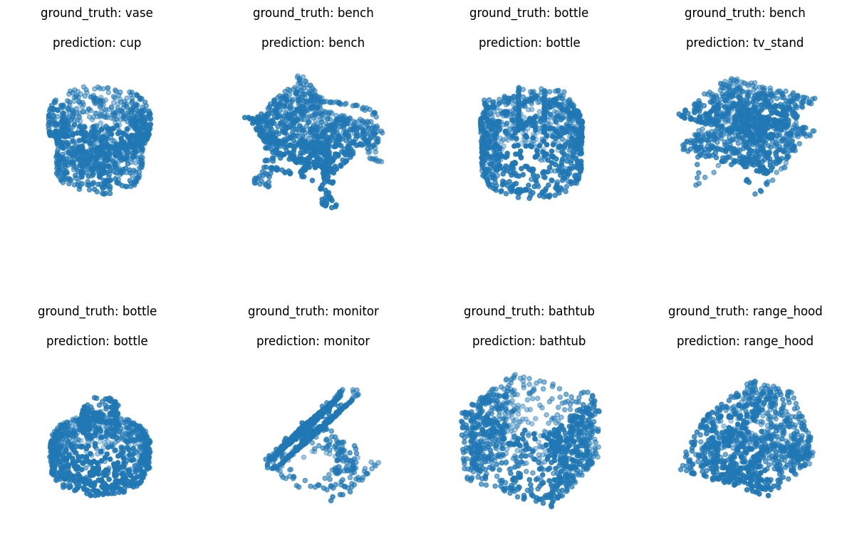
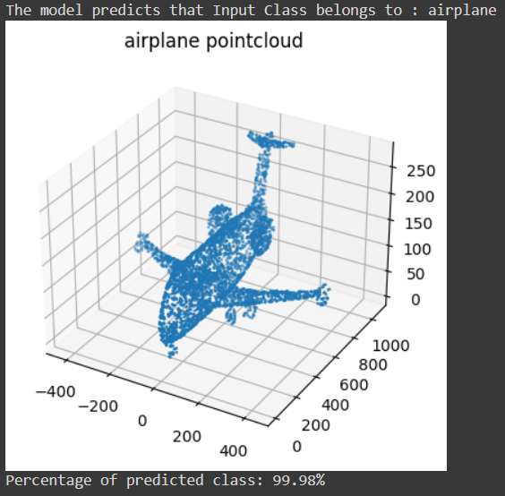
Results
Classification
Fig. 5
Fig. 6
For classification, both the ground truth and predicted labels are visualized in Fig. 6.
The predicted output, along with the associated percentage, is presented in Fig. 7 for the input point cloud.

Slide 12
Conclusion
In conclusion, our machine learning models, incorporating PointNet-based segmentation and PointNet with CNN-based classification, have exhibited notable proficiency in handling 3D point cloud data. The segmentation model achieved a commendable accuracy of 86.4%, emphasizing its capability in precise segmentation, while the labels prediction for segmentation model excelled with a remarkable 95.26% accuracy in predicting airplane shapes. Furthermore, our PointNet model for ModelNet40 classification displayed promising results, achieving 73.0% accuracy on both validation and test sets, demonstrating effective learning. These findings underscore the robustness and versatility of our models, showcasing their potential for diverse real-world applications in 3D shape analysis.

Slide 13
Future Scope
This project can further be extended to:
Developing model to learn deep point set features efficiently and robustly.
Classification of the text present on the objects by improving accuracy.
Feature extraction for object detection in 3D point clouds.

Slide 14
References
[1] Kaichun Mo Leonidas J. Guibas Charles R. Qi, Hao Su. Pointnet: Deep learning on point sets for 3d classification and segmentation. https://arxiv.org/abs/1612.00593.
[2] Yujun Lin Song Han Zhijian Liu, Haotian Tang. Point-voxel cnn for efficient 3d deep learning. https://proceedings.neurips.cc/paper/2019/hash/ 5737034557ef5b8c02c0e46513b98f90-Abstract.html.
[3] Huangying Zhan Ian Reid Kejie Li, Trung Pham. Efficient dense point cloud object reconstruction using deformation vector fields. https://openaccess.thecvf.com/content_ ECCV_2018/papers/Kejie_Li_Efficient_Dense_Point_ECCV_2018_paper.pdf.
[4] Mohammed Bennamoun Xian-Feng Han, Hamid Laga. Image-based 3d object reconstruction: State-of-the-art and trends in the deep learning era. https://arxiv.org/ abs/1906.06543.
[5] Olaf Hellwich Jannes Magnusson, Toufique A. Soomro. Pixel2point: 3d object reconstruction from a single image using cnn and initial sphere . https://ieeexplore.ieee. org/stamp/stamp.jsp?tp=&arnumber=9305196.

Slide 15
Thank You

