Slide 1

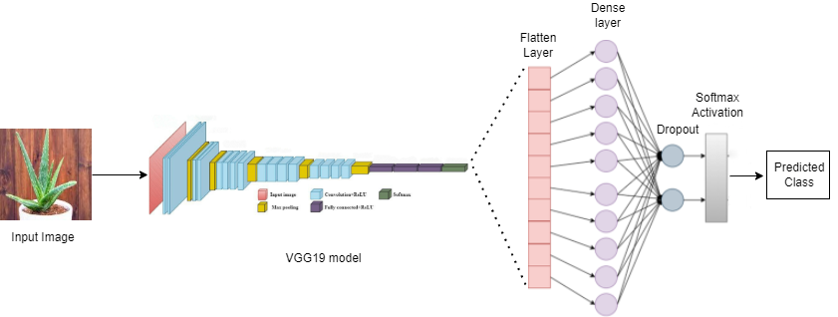
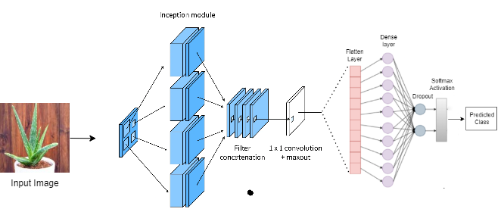
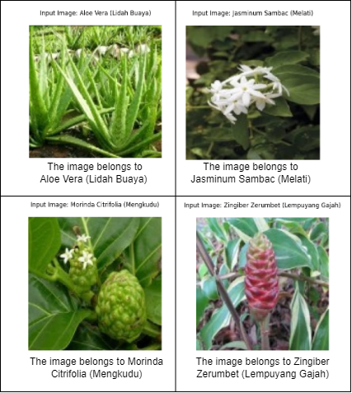
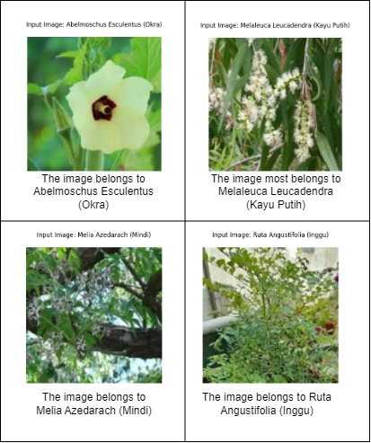
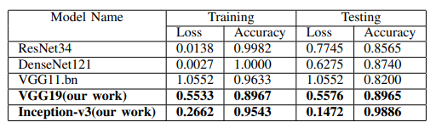
Mini Project 2022-23
Indonesia Medicinal Plant Recognition using Deep Learning: A Computational Study
Team member names: Prachi S Anushl Boratti Varsha S H Somil Yadav
Guided by: Anupama P Bidargaddi
TM
Problem Statement
Architecture
Proposed work / Algorithm
To develop a medicinal plant image classification system using deep learning models such as VGG19 and Inceptionv3, leading to a comprehensive computational study.
Transfer learning from ImageNet-pretrained architectures enhances pattern discernment in medicinal plant images.
Additional layers in VGG19, like rescaling, batch normalization, and fully connected layers, refine features and classification accuracy.
In InceptionV3, the Flatten layer and dense layers refine hierarchical features.
Dropout aids in regularization, promoting a robust model and mitigating overfitting.
Harnessing well-established architectures like VGG19 and InceptionV3 tailors them to medicinal plant classification.
Integration of diverse layers optimizes feature extraction, capturing nuanced plant characteristics.
Utilization of pre-trained models minimizes computational resources and data, ensuring accuracy and efficiency.
Overall, this approach is a sophisticated and efficient strategy for achieving high accuracy in medicinal plant classification.
.
VGG19
Objectives
Develop an image classification system capable of accurately identifying different species of medicinal plants from images.
Implementing the VGG19 and InceptionV3 convolutional neural network architectures for feature extraction and classification of medicinal plant images, comparing their performance against alternative models.
INCEPTION-V3
Methodology
Results/ Discussion
Images are preprocessed using 'tf.keras' preprocessing function 'image_dataset_from_directory' for both VGG19 and InceptionV3 models.
Data augmentation is not applied, and the dataset is prepared for training.
Model compilation includes Adam optimizer, sparse categorical cross-entropy loss, and accuracy as the evaluation metric.
VGG19 utilizes a custom architecture with frozen base layers and additional layers, while InceptionV3 freezes pre-trained layers and adds a custom classifier.
Early stopping is employed to prevent overfitting during training.
Validation and test sets are used to evaluate the models, with final performance metrics reported post-training.
Conclusions / Reference
The examination of the Indonesian herbal plant dataset shows that the pretrained Inception-V3 model outperforms other models, attaining a remarkable accuracy of 98.86%, while the VGG19 model obtains the accuracy of 89.65 %. With the exception of Inception-v3, the pretrained VGG19 model outperforms other models like resnet, densenet, and vgg11.
INCEPTION-V3
VGG19

