Slide 1

Indonesia Medicinal Plant Recognition using Deep Learning: A Computational Study
Team Number: 06
Sl Num. | Student Name | USN | Roll Num. | Division
1 | Prachi S | 01FE21BCS091 | 111 | A
2 | Varsha S H | 01FE21BCS084 | 152 | A
3 | Anushl Boratti | 01FE21BCS026 | 103 | A
4 | Somil Yadav | 01FE21BCS192 | 130 | A
Guide: Anupama P Bidargaddi

Slide 2
Outline of Presentation
• Project Overview
•Literature Survey
•Problem Statement
•Objectives
•Dataset Description
•Model Architecture
•Results
•Future Scope and conclusion
•References

Slide 3
Project Overview
Deep learning techniques, particularly VGG19 and Inceptionv3 models, are employed for classifying images of medicinal plants into distinct species.
The dataset is preprocessed before training the model, and evaluation metrics such as accuracy, loss, confusion matrix are utilized to assess the model's performance.
Sample images are subjected to classification, and the model's performance is visualized through training and validation curves.
Comparative analysis with ResNet34, DenseNet121, and VGG11 models reveals that previous models achieved accuracies up to 87.4%.
However, the proposed approach achieves higher accuracy, with VGG19 reaching 89.65% accuracy and Inception-V3 achieving an outstanding 98.86% accuracy on the Indonesian medicinal plant dataset.

Slide 4
Literature Survey
IndoHerb: Indonesia Medicinal Plants Recognition using Transfer Learning and Deep Learning
The research on Indonesian medicinal plants aims to create a computer vision system that can quickly and accurately identify these plants. This system uses deep learning to recognize medicinal plants in Indonesia.
The study evaluates a CNN model for the identification of medicinal plants to increase accuracy using computer vision techniques.
Data from two datasets are used: one from Vietnam (20,000 photographs, 200 classes) and another from Indonesia (10,000 images, 100 classes).
Preprocessing involves standardizing images to 128 by 128 pixels and augmenting them using techniques like horizontal and vertical flipping to boost model performance.
For model selection, pretrained models like ResNet34, DenseNet121, and VGG11 bn are utilized to facilitate transfer learning.
The model's accuracy in categorizing photos of herbal plants is evaluated by comparing it to earlier studies that used SIFT, SURF, Naive Bayes, K-Nearest Neighbour, and Multi-Layer Perceptron as benchmarks.
In tests conducted with transfer learning, DenseNet121 obtains the best accuracy, scoring 87.4% for the Indonesia Medicinal Plant Dataset.

Slide 5
Problem Statement
To develop a medicinal plant image classification system using deep learning models such as VGG19 and Inceptionv3, leading to a comprehensive computational study.

Slide 6
Objectives
Develop an image classification system capable of accurately identifying different species of medicinal plants from images.
Implement the VGG19 convolutional neural network architecture to explore its effectiveness in feature extraction and classification tasks for medicinal plant identification.
Utilize the InceptionV3 convolutional neural network architecture to assess its efficiency in classifying medicinal plant images and compare its performance against alternative models.

Slide 7
Dataset Description
The dataset comprises a diverse collection of images depicting various species of medicinal plants, with each image accompanied by its corresponding species label. These images are sourced from a wide range of botanical resources, ensuring a comprehensive representation of medicinal flora. Captured under varying environmental conditions and viewpoints, the images showcase the distinct characteristics of each plant species.
Key Attributes:
Number of Classes: 100
Number of Images per Class: 100
Total Number of Images: 10,000

Slide 8
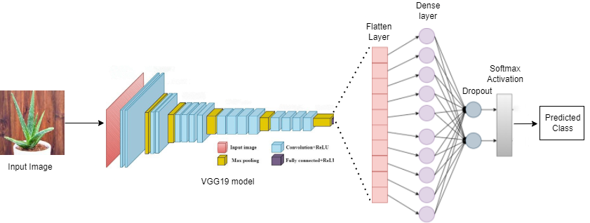
Model Architecture
VGG19
VGG19 is a deep convolutional neural network with 19 layers, including 16 convolutional layers and 2 fully connected layers.
VGG19 is specifically designed for image recognition and classification tasks.

Slide 9
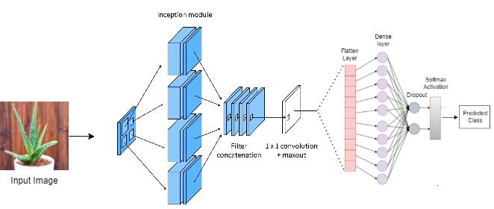
Model Architecture
Inception-V3
InceptionV3 is a deep convolutional neural network architecture .
It consists of 48 layers, including convolutional layers, pooling layers, and fully connected layers.

Slide 10
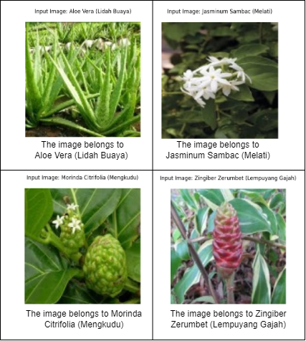
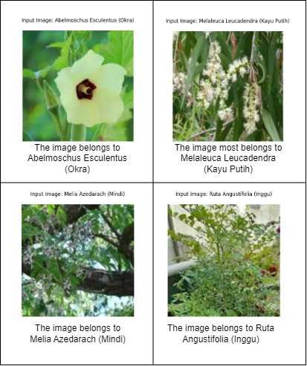
Results
Classification of InceptionV3 model
Classification of VGG19 model

Slide 11
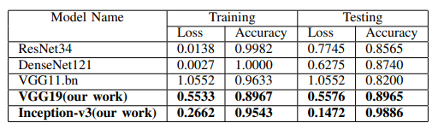
Results

Slide 12
Conclusion
The examination of the Indonesian herbal plant dataset reveals that the Inception-V3 model outperforms other models, achieving an impressive accuracy of 98.86%. However, the VGG19 model also demonstrates strong performance with an accuracy of 89.65%. Interestingly, apart from Inception-V3, the VGG19 model surpasses other architectures such as ResNet, DenseNet, and VGG11 in terms of accuracy.

Slide 13
Future Scope
The proposed paradigm for Indonesian herbal plant identification will be developed and improved, with advanced data augmentation techniques and hyperparameter optimization. Collaboration with traditional medicine practitioners and mobile platforms will be beneficial. The model should be regularly updated, incorporating geographic information systems, ethnobotanical research, and environmental impact assessments.

Slide 14
References
[1] Musyaffa, Muhammad Salman Ikrar, Novanto Yudistira, and Muhammad Arif Rahman. "IndoHerb: Indonesia Medicinal Plants Recognition using Transfer Learning and Deep Learning." arXiv preprint arXiv:2308.01604 (2023).
[2] Jafar Abdollahi. “Identification of medicinal plants in ardabil using deep learning: identification of medicinal plants using deep learning”. In: 2022 27th International Computer Conference, Computer Society of Iran (CSICC). IEEE. 2022, pp. 1–6.
[3] Zhenping Qiang, Libo He, and Fei Dai. “Identification of plant leaf diseases based on inception V3 transfer learning and fine- tuning”. In: International Conference on Smart City and Informatization. Springer. 2019, pp. 118–127. [21] Trung Nguyen Quoc and Vinh Truong Hoang. “Medicinal Plant identification in the wild by using CNN”. In: 2020 International Conference on Information and Communication Technology Convergence (ICTC). IEEE. 2020, pp. 25–29.
[4] Sai Kumar TS, A Prabalakshmi, et al. “Identification of indian medicinal plants from leaves using transfer learning approach”. In: 2021 5th International Conference on Trends in Electronics and Informatics (ICOEI). IEEE. 2021, pp. 980–987.
[5] Cheng Wang et al. “Pulmonary image classification based on inception-v3 transfer learning model”. In: IEEE Access 7 (2019), pp. 146533–146541. [27] Xinyang Wang et al. “A Recognition Method of Ancient Architectures Based on the Improved Inception V3 Model”. In: Symmetry 14.12 (2022), p. 2679.
[6] Xiaoling Xia, Cui Xu, and Bing Nan. “Inception-v3 for flower classification”. In: 2017 2nd international conference on image, vision and computing (ICIVC). IEEE. 2017, pp. 783–787.

Slide 15
Thank You

