Slide 1

Arrays vs ArrayLists
This slide demonstrates that arrays and ArrayLists have more in common, than they don't.
Feature | array | ArrayList
primitives types supported | Yes | No
indexed | Yes | Yes
ordered by index | Yes | Yes
duplicates allowed | Yes | Yes
nulls allowed | Yes, for non-primitive types | Yes
resizable | No | Yes
mutable | Yes | Yes
inherits from java.util.Object | Yes | Yes
implements List interface | No | Yes
COMPLETE JAVA MASTERCLASS
Arrays vs. ArrayLists

Slide 2
Instantiating without Values
Instantiating Arrays | Instantiating ArrayLists
An array of 10 elements is created, all with null references. The compiler will only permit Strings to be assigned to the elements.
An empty ArrayList is created.
The compiler will check that only Strings are added to the ArrayList.
On this slide, I show the differences, when creating a new instance of an array, compared to a new instance of an ArrayList.
An array requires square brackets in the declaration.
In the new instance, square brackets are also required, with a size specified inside
An ArrayList should be declared, with the type of element in the ArrayList, in angle brackets.
COMPLETE JAVA MASTERCLASS
Arrays vs. ArrayLists

Slide 3
Instantiating without Values
Instantiating Arrays | Instantiating ArrayLists
An array of 10 elements is created, all with null references. The compiler will only permit Strings to be assigned to the elements.
An empty ArrayList is created.
The compiler will check that only Strings are added to the ArrayList.
We can use the diamond operator, when creating a new instance in a declaration statement.
You should use a specific type, rather than just the Object class, because Java can then perform compile-time type checking.
COMPLETE JAVA MASTERCLASS
Arrays vs. ArrayLists

Slide 4
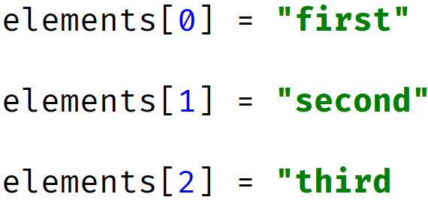
Instantiating with Values
Instantiating Arrays | Instantiating Lists and Array Lists
An array of 3 elements is created, with
An ArrayList can be instantiated by passing another list to it as we show here.
We can use the List.of() factory method, which uses variable arguments, to create a pass through immutable list.
Alternately, we can use this array initializer (anonymous array).
You can use an array initializer, to populate array elements, during array creation.
This feature lets you pass all the values in the array, as a comma delimited list, in curly braces.
COMPLETE JAVA MASTERCLASS
Arrays vs. ArrayLists

Slide 5
Instantiating with Values
Instantiating Arrays | Instantiating Lists and Array Lists
An array of 3 elements is created, with
An ArrayList can be instantiated by passing another list to it as we show here.
We can use the List.of() factory method, which uses variable arguments, to create a pass through immutable list.
Alternately, we can use this array initializer (anonymous array).
When you use an array initializer in a declaration statement, you can use what's called the anonymous version, as I show here.
You can use an ArrayList constructor, that takes a collection, or a list of values, during ArrayList creation.
COMPLETE JAVA MASTERCLASS
Arrays vs. ArrayLists

Slide 6
Instantiating with Values
Instantiating Arrays | Instantiating Lists and Array Lists
An array of 3 elements is created, with
An ArrayList can be instantiated by passing another list to it as we show here.
We can use the List.of() factory method, which uses variable arguments, to create a pass through immutable list.
Alternately, we can use this array initializer (anonymous array).
The List.of method can be used to create such a list, with a variable argument list of elements.
COMPLETE JAVA MASTERCLASS
Arrays vs. ArrayLists

Slide 7



Element information
 | Accessing Array Element data | Accessing ArrayList Element data
Index value of first element
Index value of last element
Retrieving number of elements:
Setting (assigning an element)
Getting an element
Example Array:
Example ArrayList:
The number of elements is fixed, when an array is created.
We can get the size of the array from the attribute, length, on the array instance.
Array elements are accessed with the use of square brackets, and an index, that ranges from 0, to one less than the number of elements.
COMPLETE JAVA MASTERCLASS
Arrays vs. ArrayLists

Slide 8
Element information
 | Accessing Array Element data | Accessing ArrayList Element data
Index value of first element
Index value of last element
Retrieving number of elements:
Setting (assigning an element)
Getting an element
Example Array:
Example ArrayList:
The number of elements in an ArrayList may vary, and can be retrieved with a method on the instance, named size().
ArrayList elements are accessed with get and set methods, also using an index ranging from 0, to one less than the number of elements.
COMPLETE JAVA MASTERCLASS
Arrays vs. ArrayLists

Slide 9
Getting a String representation for Single Dimension Arrays and ArrayLists
Array | ArrayList
Array Creation Code
ArrayList Creation Code
Printing Array Elements
Printing ArrayList elements
ArrayLists come with built-in support, for printing out elements, including nested lists.
Arrays don't though, so you need to call Arrays.toString, passing the array as an argument.
This slide shows examples of single dimension arrays and ArrayLists.
COMPLETE JAVA MASTERCLASS
Arrays vs. ArrayLists

Slide 10
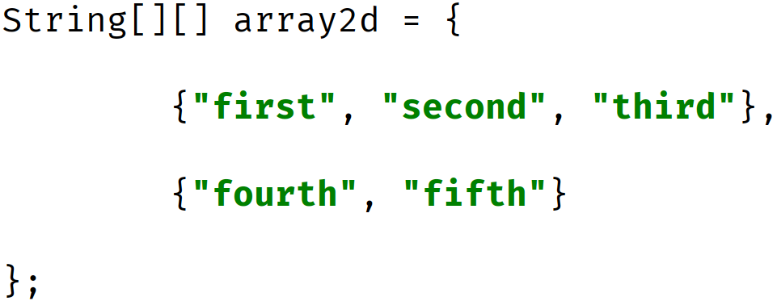
Getting a String representation for Multi-Dimensional Arrays and ArrayLists
Array | ArrayList
Array Creation Code
ArrayList Creation Code
Printing ArrayList elements
Printing Array Elements
Here I show examples of multi-dimensional arrays and ArrayLists, and how to print the elements in each.
A multi-dimensional ArrayList simply has a type, which in itself is an ArrayList.
COMPLETE JAVA MASTERCLASS
Arrays vs. ArrayLists

Slide 11
Getting a String representation for Multi-Dimensional Arrays and ArrayLists
Array | ArrayList
Array Creation Code
ArrayList Creation Code
Printing ArrayList elements
Printing Array Elements
For a multi-dimensional array, you need to call the Arrays.deepToString method, passing the array as an argument.
For nested ArrayLists, we can still just pass the ArrayList instance directly, to System.out.println, as shown here.
COMPLETE JAVA MASTERCLASS
Arrays vs. ArrayLists

Slide 12
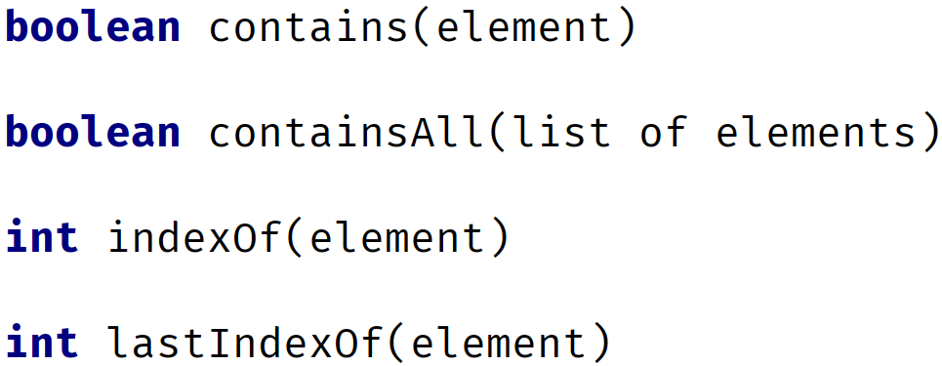
Finding an element in an Array or ArrayList
Arrays methods for finding elements | ArrayList methods for finding elements
** Array MUST BE SORTED
Not guaranteed to return index of first element if there are duplicates
For arrays, we can use the binarySearch method, to find a matching element, although this method requires that the array be sorted first.
In addition, if the array contains duplicate elements, the index returned from this search is not guaranteed, to be position of the first element.
For the ArrayList, we have several methods.
COMPLETE JAVA MASTERCLASS
Arrays vs. ArrayLists

Slide 13
Finding an element in an Array or ArrayList
Arrays methods for finding elements | ArrayList methods for finding elements
** Array MUST BE SORTED
Not guaranteed to return index of first element if there are duplicates
We can use contains or containsAll, which simply returns a boolean, if a match or matches were found.
In addition, like the String and StringBuilder, we have the methods, indexOf and lastIndexOf, which will return the index of the first or last match.
When a -1 is returned from these methods, no matching entry was found.
COMPLETE JAVA MASTERCLASS
Arrays vs. ArrayLists

Slide 14
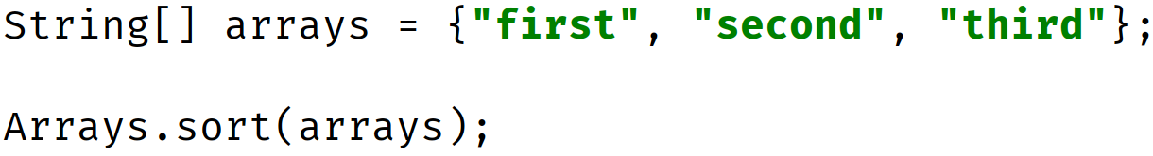
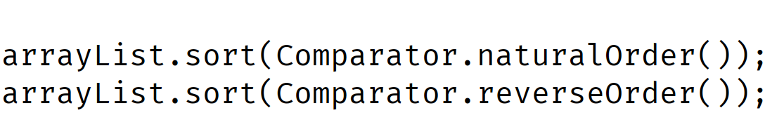
Sorting
Array | ArrayList
You can only sort arrays of elements that implement Comparable.
We'll be discussing this in a future section. Character Sequence classes, like String and StringBuilder meet this requirement.
You can use the sort method with static factory methods to get Comparators.
Sorting seems like a simple concept, when you think about sorting numbers and Strings.
We know there is a natural order, for numbers, and even for Strings.
COMPLETE JAVA MASTERCLASS
Arrays vs. ArrayLists

Slide 15
Sorting
Array | ArrayList
You can only sort arrays of elements that implement Comparable.
We'll be discussing this in a future section. Character Sequence classes, like String and StringBuilder meet this requirement.
You can use the sort method with static factory methods to get Comparators.
We can use the Arrays.sort method, for arrays with numeric primitive types and wrapper classes, as well as Strings and StringBuilders.
For the ArrayList, we can use the sort method, again for numeric wrapper classes, Strings and StringBuilders.
COMPLETE JAVA MASTERCLASS
Arrays vs. ArrayLists

Slide 16
Sorting
Array | ArrayList
You can only sort arrays of elements that implement Comparable.
We'll be discussing this in a future section. Character Sequence classes, like String and StringBuilder meet this requirement.
You can use the sort method with static factory methods to get Comparators.
We pass ArrayList's sort method, a Comparator type argument, that specifies just how to sort.
We call static methods on the Comparator type, to get a Comparator for either a natural order, or reverse order sort.
COMPLETE JAVA MASTERCLASS
Arrays vs. ArrayLists

Slide 17
array as an ArrayList
There are times, when you'll want to switch between an Array, and an ArrayList, and we find support for this, on both the Arrays class, and the ArrayList class.
The Arrays.asList method returns an ArrayList, backed by an array.
Here, I show the creation of a three element array.
Then the code uses the Arrays.asList method, passing it the array, and assign it to a variable, using the var keyword, to a variable named originalList.
COMPLETE JAVA MASTERCLASS
Arrays vs. ArrayLists

Slide 18
array as an ArrayList
You can think of this conceptually, as putting an ArrayList wrapper of sorts, around an existing array.
Any change made to the List, is a change to the array that backs it.
This also means that an ArrayList, created by this method, is not resizable.
COMPLETE JAVA MASTERCLASS
Arrays vs. ArrayLists

Slide 19
Creating Special Kinds of Lists
Using Arrays.asList | Using List.of
Returned List is NOT resizeable, but is mutable. | Returned List is IMMUTABLE.
This slide demonstrates two ways to create a list from elements, or from an array of elements.
Both are static factory methods on types.
The first is the asList method on the Arrays class, and it returns a special instance of a List, that is not resizable, but is mutable.
The second is the of method on the List interface, and it returns a special instance of a List, that is immutable.
COMPLETE JAVA MASTERCLASS
Arrays vs. ArrayLists

Slide 20
Creating Special Kinds of Lists
Using Arrays.asList | Using List.of
Returned List is NOT resizeable, but is mutable. | Returned List is IMMUTABLE.
Both support variable arguments, so you can pass a set of arguments of one type, or you can pass an array.
We show examples of both here, first using variable arguments, and second, passing an array.
COMPLETE JAVA MASTERCLASS
Arrays vs. ArrayLists

Slide 21
Creating Arrays from ArrayLists
This slide shows the most common method to create an array, from an ArrayList, using the method toArray().
This method takes one argument, which should be an instance of a typed array.
This method returns an array of that same type.
If the length of the array you pass, has more elements than the list, extra elements will be filled with the default values for that type.
If the length of the array you pass, has less elements than the list, the method will still return an array, with the same number of elements in it, as the list.
In the example shown here, we pass a String array with zero as the size, but the array returned has three elements, which is the number of elements in the list.
COMPLETE JAVA MASTERCLASS
Arrays vs. ArrayLists

