Slide 1
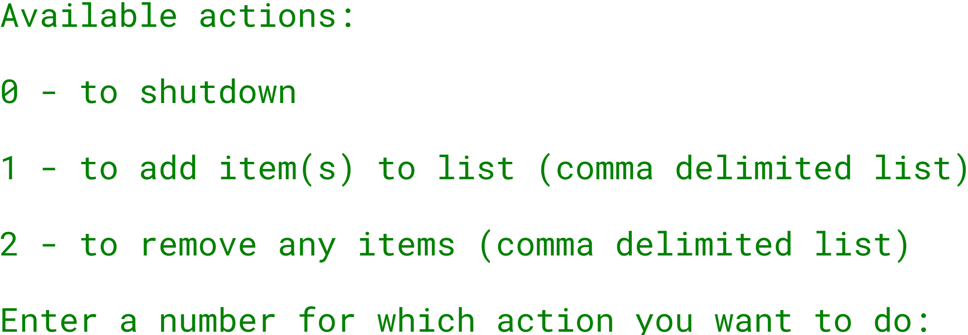

The ArrayList Challenge
The challenge is to create an interactive console program.
And give the user a menu of options as shown here:
Using the Scanner class, solicit a menu item, 0, 1 or 2, and process the item accordingly.
COMPLETE JAVA MASTERCLASS
ArrayList Challenge Part 1

Slide 2
The ArrayList Challenge
Your grocery list should be an ArrayList.
You should use methods on the ArrayList, to add items, remove items, check if an item is already in the list, and print a sorted list.
You should print the list, sorted alphabetically, after each operation.
You shouldn't allow duplicate items in the list.
COMPLETE JAVA MASTERCLASS
ArrayList Challenge Part 1

