Slide 1

What's an Iterator?
So far, we've mainly used for loops to traverse, or step through elements, in an array or list.
We can use the traditional for loop and an index, to index into a list.
We can use the enhanced for loop and a collection, to step through the elements, one at a time.
But Java provides other means to traverse lists.
Two alternatives are the Iterator, and the ListIterator.
COMPLETE JAVA MASTERCLASS
Iterators

Slide 2
How does an Iterator work?
If you're familiar with databases, you might be familiar with a database cursor, which is a mechanism that enables traversal, over records in a database.
An iterator can be thought of as similar to a database cursor.
The kind of cursor we're referring to here, can be described as an object, that allows traversal over records in a collection.
COMPLETE JAVA MASTERCLASS
Iterators

Slide 3
How does an Iterator work?
The Iterator is pretty simple.
When you get an instance of an iterator, you can call the next method, to get the next element in the list.
You can use the hasNext method, to check if any elements remain to be processed.
In the code, you can see a while loop, which uses the iterator's hasNext method, to determine if it should continue looping.
In the loop, the next method is called, and its value assigned to a local variable, and the local variable printed out.
This would just print each element in a list, but do it through the iterator object.
COMPLETE JAVA MASTERCLASS
Iterators

Slide 4
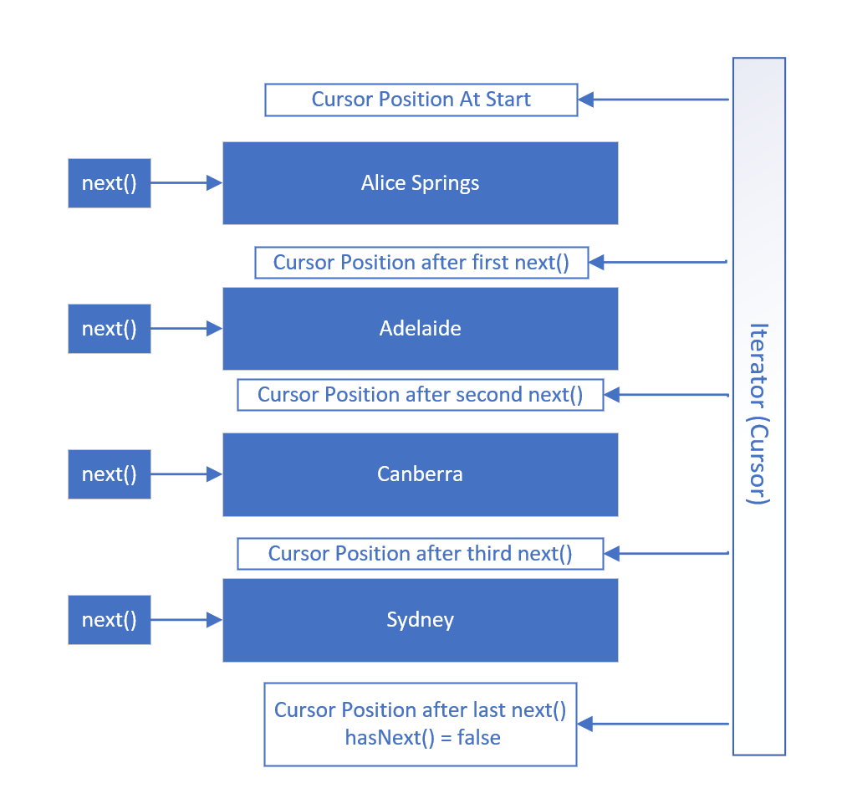
How does an Iterator work?
This slide shows visually how an Iterator works, using the PlacesToVisit List.
When an iterator is created, its cursor position is pointed at a position before the first element.
The first call to the next method gets the first element, and moves the cursor position, to be between the first and second elements.
Subsequent calls to the next method moves the iterator's position through the list, as shown, until there are no elements left, meaning hasNext = false.
At this point, the iterator or cursor position is below the last element.
COMPLETE JAVA MASTERCLASS
Iterators

Slide 5
Iterator vs. ListIterator
An Iterator is forwards only, and only supports the remove method.
A ListIterator can be used to go both forwards and backwards, and in addition to the remove method, it also supports the add and set methods.
COMPLETE JAVA MASTERCLASS
Iterators

Slide 6
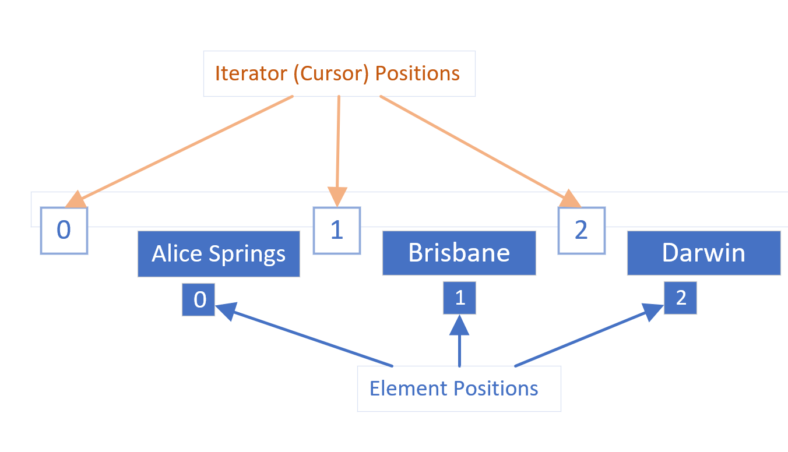
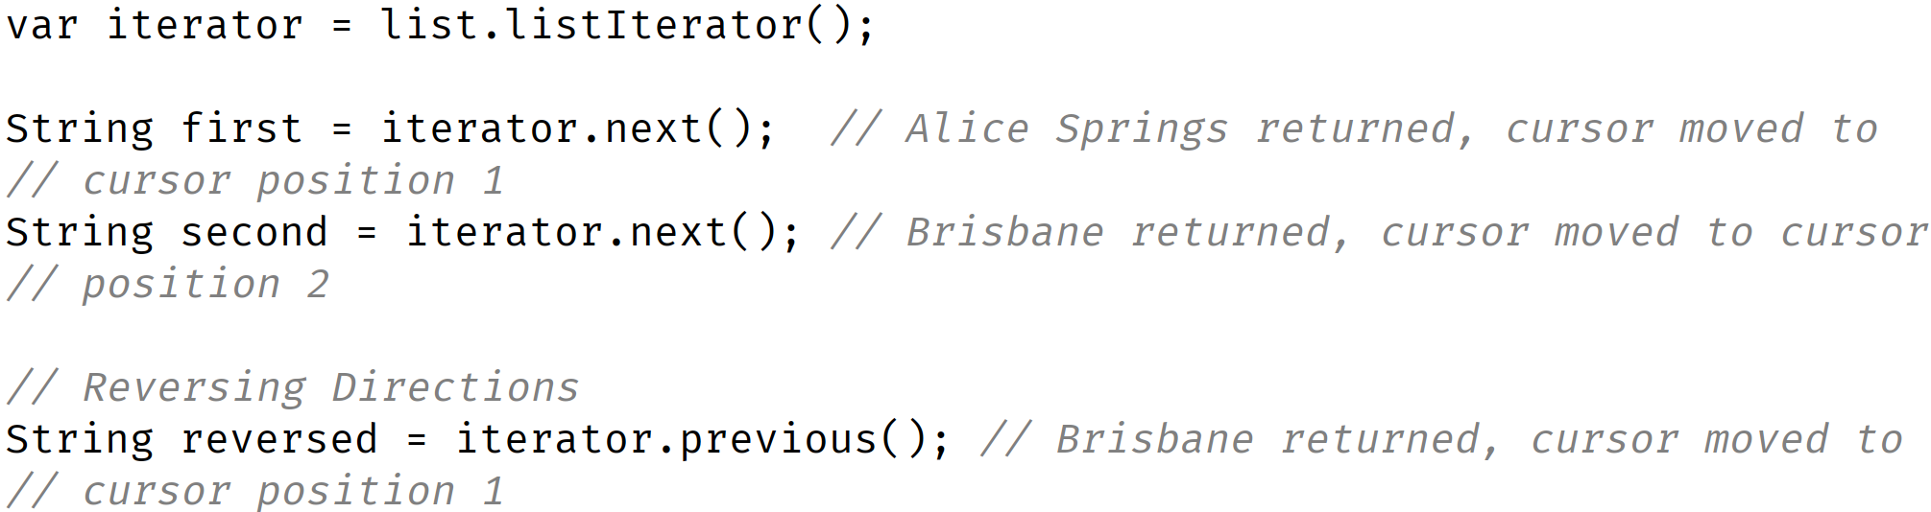
Iterator positions vs. Element positions
It's really important to understand that the iterator's cursor positions, are between the elements.
COMPLETE JAVA MASTERCLASS
Iterators

