Slide 1
CN101
Lecture 2-3
Input, Processing, and Output

Slide 2
Topics
Designing a Program
Input, Processing, and Output
Displaying Output with print Function
Comments
Variables
Reading Input from the Keyboard
Performing Calculations
More About Data Output
Named Constants

Slide 3
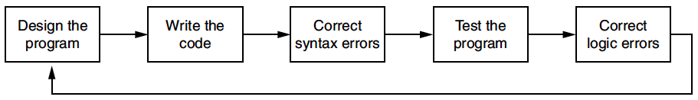
Designing a Program
Programs must be designed before they are written
Program development cycle:
Design the program
Write the code
Correct syntax errors
Test the program
Correct logic errors

Slide 4
Designing a Program (cont’d.)
Design is the most important part of the program development cycle
Understand the task that the program is to perform
Work with customer to get a sense what the program is supposed to do
Ask questions about program details
Create one or more software requirements

Slide 5
Designing a Program (cont’d.)
Determine the steps that must be taken to perform the task
Break down required task into a series of steps
Create an algorithm, listing logical steps that must be taken
Algorithm: set of well-defined logical steps that must be taken to perform a task

Slide 6
Pseudocode
Pseudocode: fake code
Informal language that has no syntax rule
Not meant to be compiled or executed
Used to create model program
No need to worry about syntax errors, can focus on program’s design
Can be translated directly into actual code in any programming language

Slide 7
Pseudocode (cont’d.)
For example, suppose you have been asked to write a program to calculate and display the gross pay for an hourly paid employee.
Here are the steps that you would take:
Input the hours worked
Input the hourly pay rate
Calculate gross pay as hours worked multiplied by pay rate
Display the gross pay

Slide 8
Flowcharts
Flowchart: diagram that graphically depicts the steps in a program
Ovals are terminal symbols
Parallelograms are input and output symbols
Rectangles are processing symbols
Symbols are connected by arrows that represent the flow of the program
Notes:
Oval (สัญลักษณ์รูปไข่) เป็นจุดเริ่มต้นและสิ้นสุด
Parallelograms สี่เหลี่ยมด้านขนาน
Rectangles สี่เหลี่ยมผืนผ้า
Arrow

Slide 9
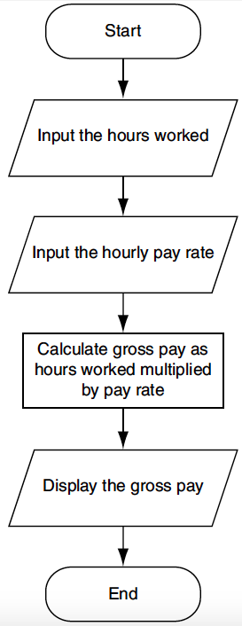

Slide 10
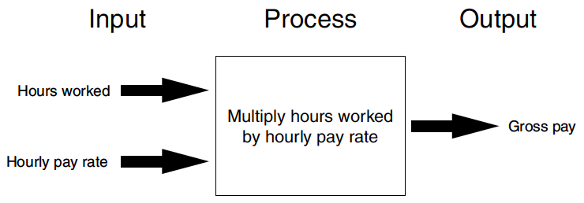
Input, Processing, and Output
Typically, computer performs three-step process
Receive input
Input: any data that the program receives while it is running
Perform some process on the input
Example: mathematical calculation
Produce output

Slide 11
Codes and Characters
Each character is coded as a byte
Most common coding system is ASCII (Pronounced as-key)
ASCII = American National Standard Code for Information Interchange

Slide 12
ASCII Features
7-bit code
8th bit is unused (or used for a parity bit)
2⁷ = 128 codes
Two general types of codes:
95 are “Graphic” codes (displayable on a console)
33 are “Control” codes (control features of the console or communications channel)

Slide 13
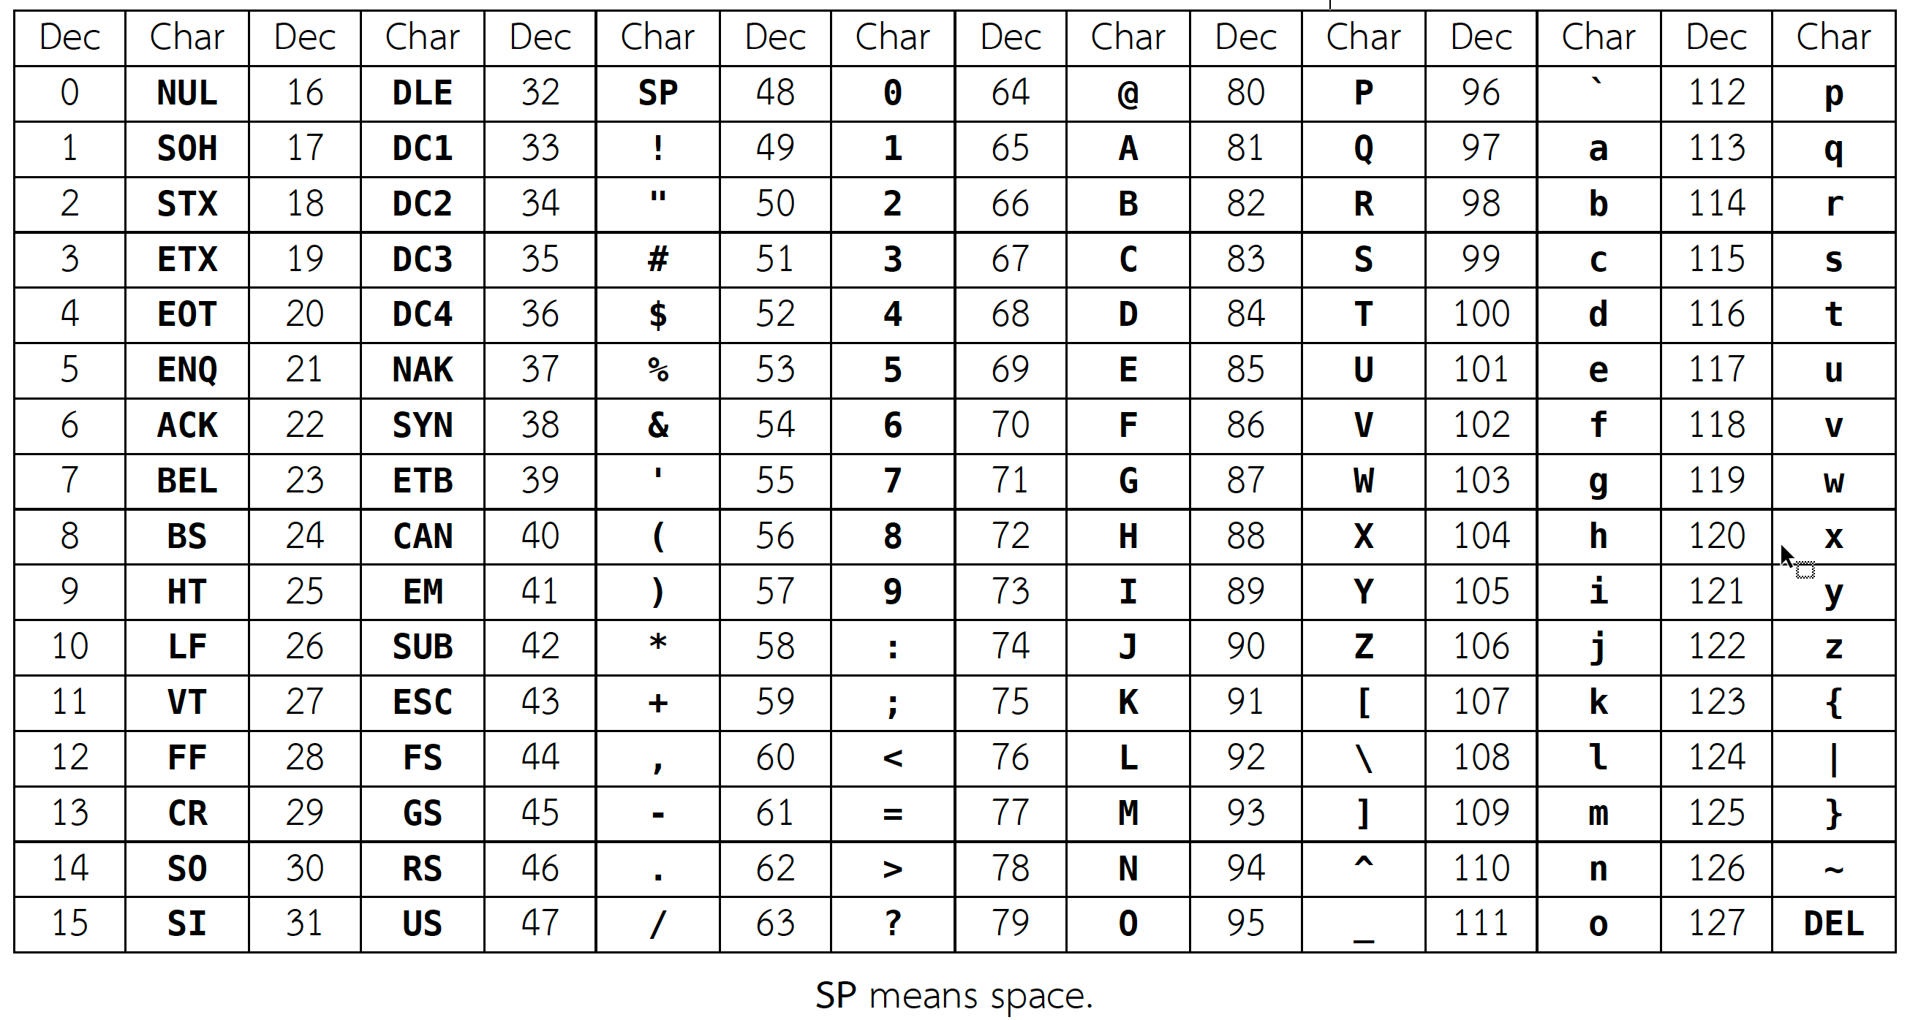
Standard ASCII code (in decimal)
Standard ASCII code (in decimal)

Slide 14
Standard ASCII code (in decimal)
95 Graphic codes

Slide 15
Standard ASCII code (in decimal)
33 Control codes

Slide 16
Displaying Output with the print Function
Function: piece of prewritten code that performs an operation
print function: displays output on the screen
Argument: data given to a function
Example: data that is printed to screen
Statements in a program execute in the order that they appear
From top to bottom

Slide 17

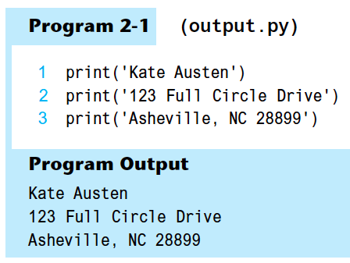
Displaying Output with the print Function (cont’d)
In interactive mode
Script mode

Slide 18
chr(n) and ord(str) functions
Functions chr(n) and ord(str) access ASCII values
print(chr(65)) displays the letter A
print(ord(' A' )) displays the number 65
>>> print(chr(65))
A
>>> print(ord('A'))
65
>>>
Enter
Enter
Notes:
ord stands for “ordinal”

Slide 19
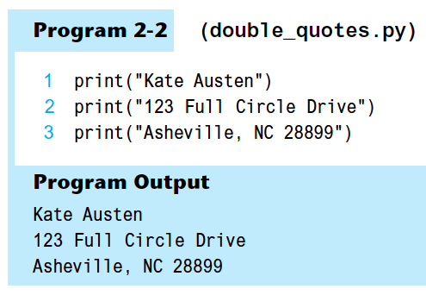
Strings and String Literals
String: sequence of characters that is used as data
String literal: string that appears in actual code of a program
Must be enclosed in single (') or double (") quote marks

Slide 20
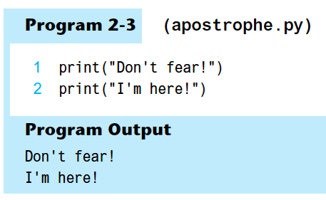
Strings and String Literals (cont’d)
If you want a string literal to contain either a single-quote or an apostrophe as part of the string, you can enclose the string literal in double-quote marks

Slide 21
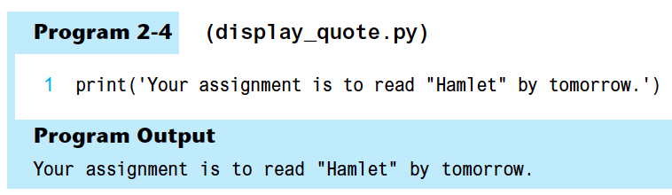
Strings and String Literals (cont’d)
Similarly if you want a string literal to contain a double-quote, you can enclose the string literal in single-quote marks

Slide 22
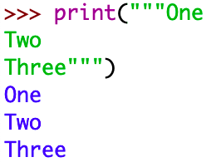

Strings and String Literals (cont’d)
String literal can be enclosed in triple quotes (''' or """)
Enclosed string can contain both single and double quotes and can have multiple lines
Here is an example:

Slide 23
Comments
Comments: notes of explanation within a program
Ignored by Python interpreter
Intended for a person reading the program’s code
Begin with a # character
End-line comment: appears at the end of a line of code
Typically explains the purpose of that line

Slide 24
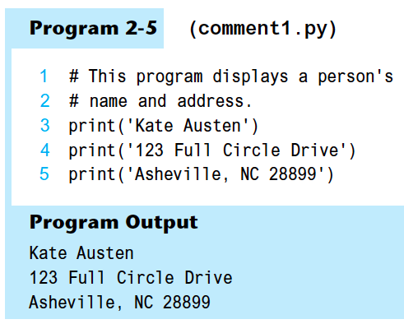
Comments (cont’d)

Slide 25
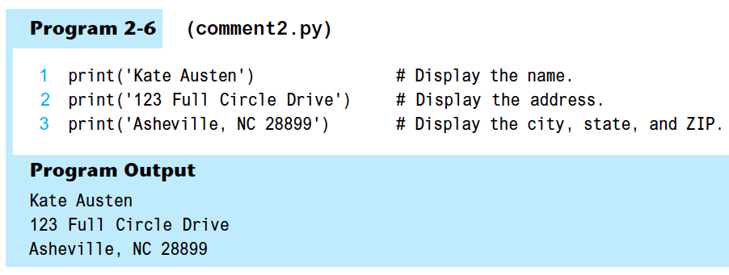
Comments (cont’d)

Slide 26

Variables
Variable: name that represents a value stored in the computer memory
Used to access and manipulate data stored in memory
A variable references the value it represents
Assignment statement: used to create a variable and make it reference data
General format is variable = expression
Example: age = 25
Assignment operator: the equal sign (=)

Slide 27


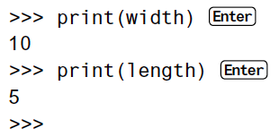
Variables (cont’d.)
In assignment statement, variable receiving value must be on left side
A variable can be passed as an argument to a function
Variable name should not be enclosed in quote marks
You can only use a variable if a value is assigned to it

Slide 28
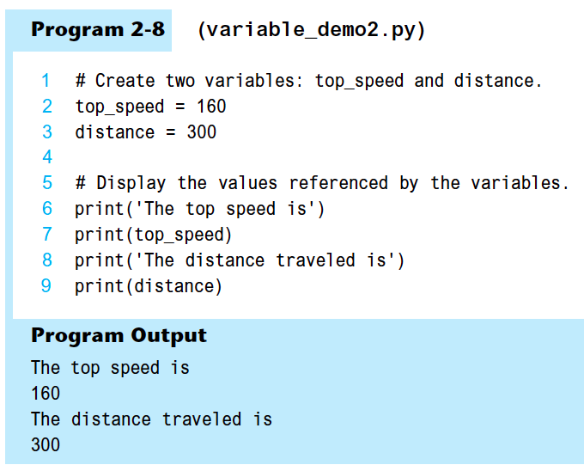

Example

Slide 29
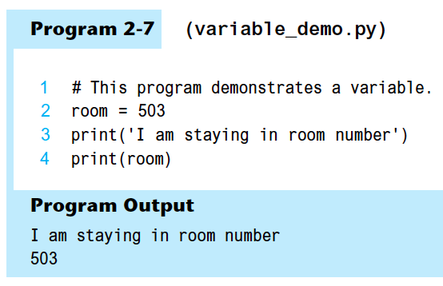
Example

Slide 30
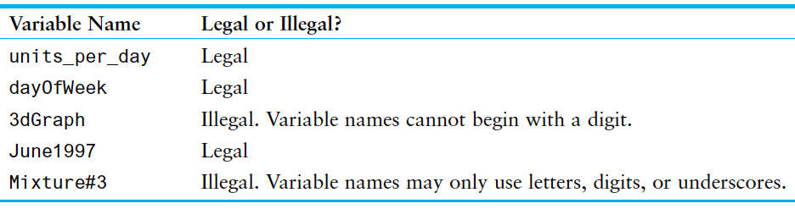
Variable Naming Rules
Rules for naming variables in Python:
Variable name cannot be a Python key word
Variable name cannot contain spaces
First character must be a letter or an underscore
After first character may use letters, digits, or underscores
Variable names are case sensitive
Variable name should reflect its use

Slide 31
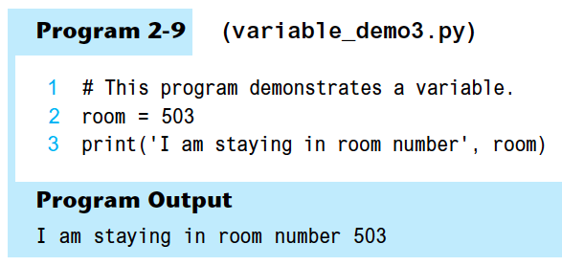
Displaying Multiple Items with the print Function
Python allows one to display multiple items with a single call to print
Items are separated by commas when passed as arguments
Arguments displayed in the order they are passed to the function
Items are automatically separated by a space when displayed on screen

Slide 32
Variable Reassignment
Variables can reference different values while program is running
Garbage collection: removal of values that are no longer referenced by variables
Carried out by Python interpreter
A variable can refer to item of any type
Variable that has been assigned to one type can be reassigned to another type

Slide 33
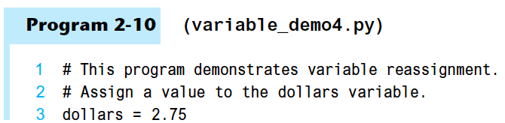

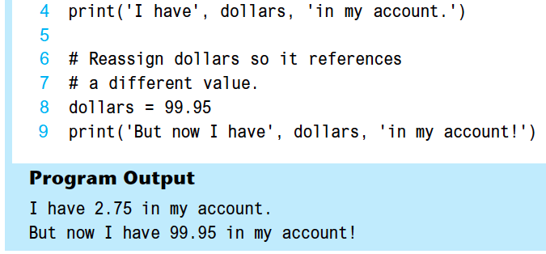
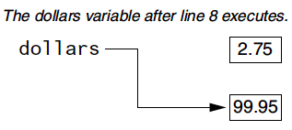
Example

Slide 34


Numeric Data Types, Literals, and the str Data Type
Data types: categorize value in memory
e.g., int for integer, float for real number, str used for storing strings in memory
Numeric literal: number written in a program
No decimal point considered int, otherwise, considered float
Some operations behave differently depending on data type

Slide 35
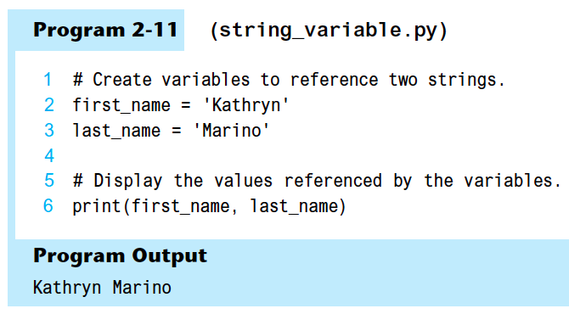
Storing Strings with the str Data Type

Slide 36
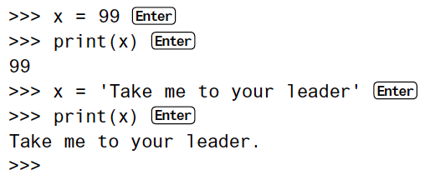
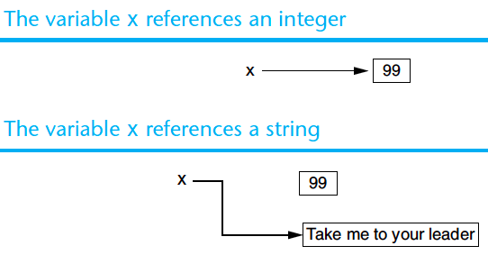
Reassigning a Variable to a Different Type
A variable in Python can refer to items of any type

Slide 37
Reading Input from the Keyboard
Most programs need to read input from the user
Built-in input function reads input from keyboard
Returns the data as a string
Format: variable = input(prompt)
prompt is typically a string instructing user to enter a value
Does not automatically display a space after the prompt

Slide 38
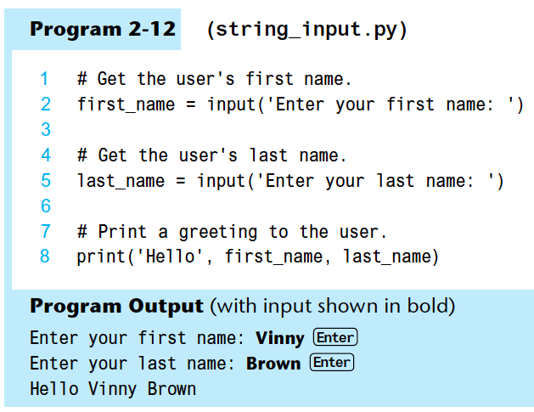
Example

Slide 39
Reading Numbers with the input Function
input function always returns a string
Built-in functions convert between data types
int(item) converts item to an int
float(item) converts item to a float
Nested function call: general format: function1(function2(argument))
value returned by function2 is passed to function1
Type conversion only works if item is valid numeric value, otherwise, throws exception

Slide 40
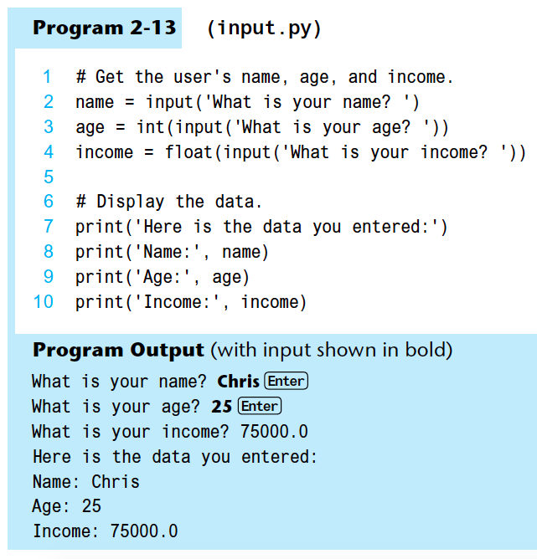
Enter

Slide 41
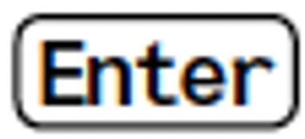
eval()function
The eval() function evaluates the specified expression, if the expression is a legal Python statement, it will be executed.
>>> eval('1 + 2')
3
>>> eval(1 + 2)
Traceback (most recent call last):
File "<stdin>", line 1, in <module>
TypeError: eval() arg 1 must be a string, bytes or code object
>>>

Slide 42
input2.py
1 # Get the user's name, age, and income.
2 name = input('What is your name? ‘)
3 age = eval(input('What is your age? ‘))
4 income = eval(input('What is your income? ‘))
5 6 # Display the data.
7 print('Here is the data you entered:’)
8 print('Name:', name)
9 print('Age:', age)
10 print('Income:', income)
What is your name? Peter
What is your age? 35
What is your income? 10000.50
Here is the data you entered:
Name: Peter
Age: 35
Income: 10000.5
Enter
Enter
Enter

Slide 43
Performing Calculations
Math expression: performs calculation and gives a value
Math operator: tool for performing calculation
Operands: values surrounding operator
Variables can be used as operands
Resulting value typically assigned to variable

Slide 44
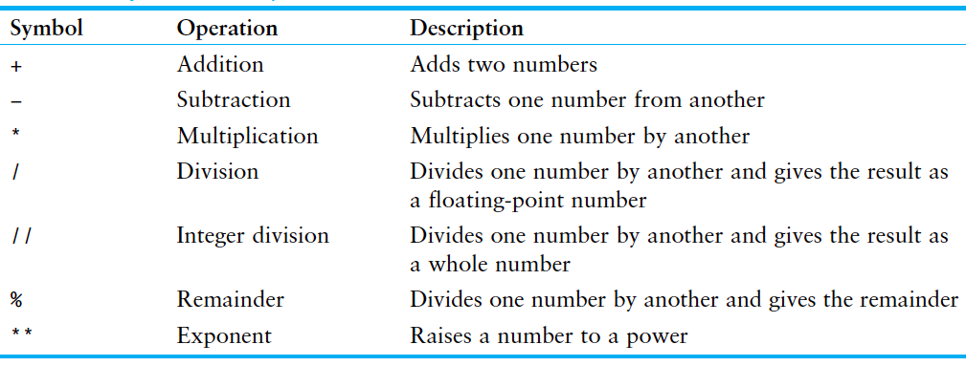
Performing Calculations (cont’d)

Slide 45



Performing Calculations (cont’d)
Two types of division:
/ operator performs floating point division
// operator performs integer division
Positive results truncated, negative rounded away from zero

Slide 46
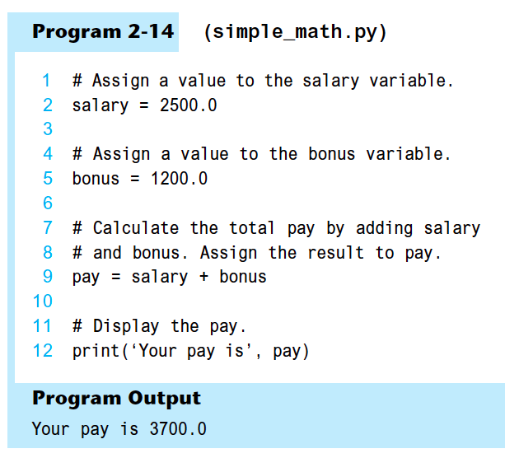

Slide 47
Operator Precedence and Grouping with Parentheses
Python operator precedence:
Operations enclosed in parentheses
Forces operations to be performed before others
Exponentiation (**)
Multiplication (*), division (/ and //), and remainder (%)
Addition (+) and subtraction (-)
Higher precedence performed first
Same precedence operators execute from left to right

Slide 48
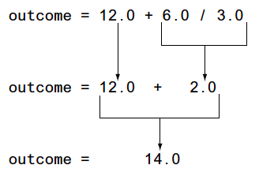
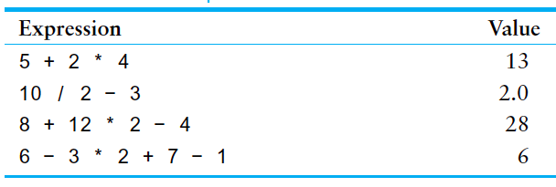
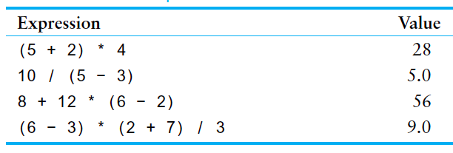
Example

Slide 49
The Exponent Operator and the Remainder Operator
Exponent operator (**): Raises a number to a power
x ** y = x^{y}
Remainder operator (%): Performs division and returns the remainder
a.k.a. modulus operator
e.g., 4%2=0, 5%2=1
Typically used to convert times and distances, and to detect odd or even numbers

Slide 50
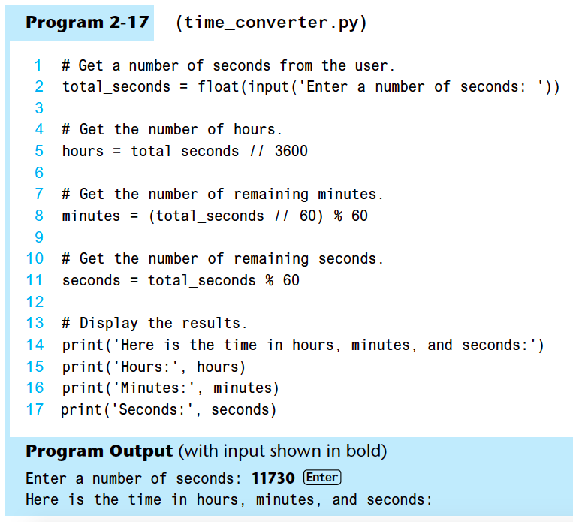
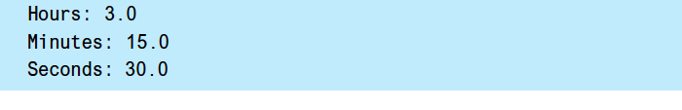

Slide 51
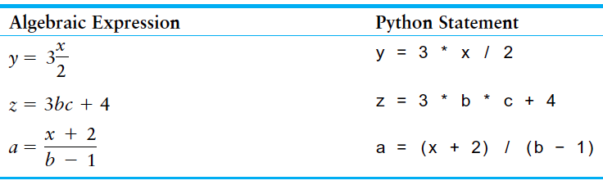
Converting Math Formulas to Programming Statements
Operator required for any mathematical operation
When converting mathematical expression to programming statement:
May need to add multiplication operators
May need to insert parentheses

Slide 52
Mixed-Type Expressions and Data Type Conversion
Data type resulting from math operation depends on data types of operands
Two int values: result is an int
Two float values: result is a float
int and float: int temporarily converted to float, result of the operation is a float
Mixed-type expression
Type conversion of float to int causes truncation of fractional part

Slide 53
Breaking Long Statements into Multiple Lines
Long statements cannot be viewed on screen without scrolling and cannot be printed without cutting off
Multiline continuation character (\): Allows to break a statement into multiple lines
result = var1 * 2 + var2 * 3 + \
var3 * 4 + var4 * 5

Slide 54
Breaking Long Statements into Multiple Lines
Any part of a statement that is enclosed in parentheses can be broken without the line continuation character.
print("Monday's sales are", monday,
"and Tuesday's sales are", tuesday,
"and Wednesday's sales are", Wednesday)
total = (value1 + value2 +
value3 + value4 +
value5 + value6)

Slide 55




More About Data Output
print function displays line of output
Newline character at end of printed data
Special argument end='delimiter' causes print to place delimiter at end of data instead of newline character
print function uses space as item separator
Special argument sep='delimiter' causes print to use delimiter as item separator

Slide 56
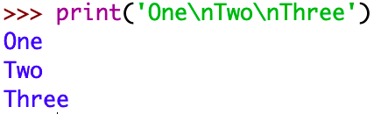
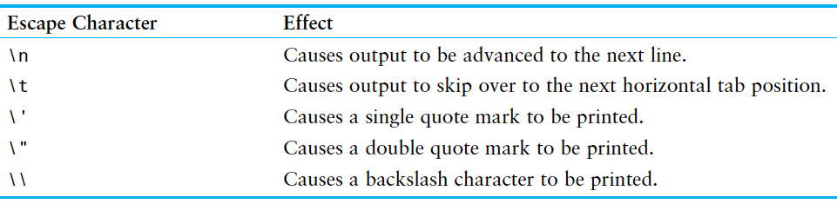
More About Data Output (cont’d.)
Special characters appearing in string literal
Preceded by backslash (\)
Examples: newline (\n), horizontal tab (\t)
Treated as commands embedded in string

Slide 57
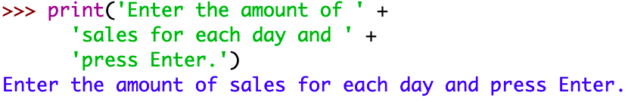
More About Data Output (cont’d.)
When + operator used on two strings in performs string concatenation
Useful for breaking up a long string literal

Slide 58
Formatting Numbers
Can format display of numbers on screen using built-in format function
Two arguments:
Numeric value to be formatted
Format specifier
Returns string containing formatted number
Format specifier typically includes precision and data type
Can be used to indicate comma separators and the minimum field width used to display the value

Slide 59
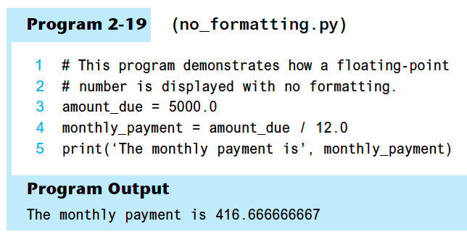
Example

Slide 60



Example
Notes:
print('The number is {0:.2f}'.format(1.234567))
print('The number are {:.2f} and {:.3f}'.format(1.234567, 2.34567))

Slide 61



Inserting Comma Separators
If you want the number to be formatted with comma separators, you can insert a comma into the format specifier, as shown here:

Slide 62
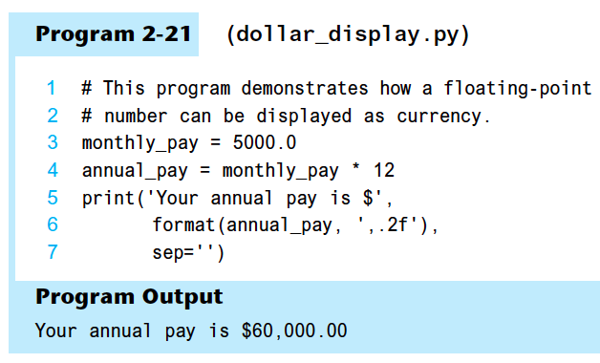

Slide 63
Specifying a Minimum Field Width
The format specifier can also include a minimum field width, which is the minimum number of spaces that should be used to display the value. The following example prints a number in a field that is 12 spaces wide:

Slide 64
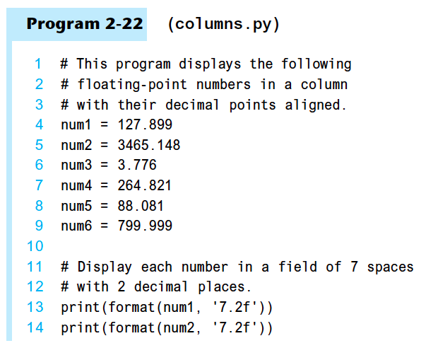
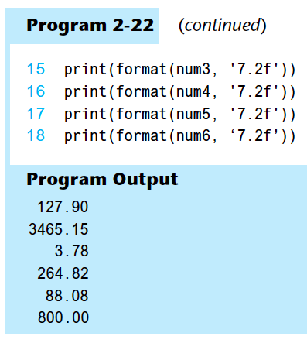

Slide 65


Formatting a Floating-Point Number as a Percentage
The % symbol can be used in the format string of format function to format number as percentage

Slide 66



Formatting Integers
To format an integer using format function:
Use d as the type designator
Do not specify precision
Can still use format function to set field width or comma separator

Slide 67
Magic Numbers
A magic number is an unexplained numeric value that appears in a program’s code. Example: amount = balance * 0.069
What is the value 0.069? An interest rate? A fee percentage? Only the person who wrote the code knows for sure.

Slide 68
The Problem with Magic Numbers
It can be difficult to determine the purpose of the number.
If the magic number is used in multiple places in the program, it can take a lot of effort to change the number in each location, should the need arise.
You take the risk of making a mistake each time you type the magic number in the program’s code.
For example, suppose you intend to type 0.069, but you accidentally type .0069. This mistake will cause mathematical errors that can be difficult to find.

Slide 69
Named Constants
You should use named constants instead of magic numbers.
A named constant is a name that represents a value that does not change during the program's execution.
Example: INTEREST_RATE = 0.069
This creates a named constant named INTEREST_RATE, assigned the value 0.069. It can be used instead of the magic number: amount = balance * INTEREST_RATE

Slide 70
Advantages of Using Named Constants
Named constants make code self-explanatory (self-documenting)
Named constants make code easier to maintain (change the value assigned to the constant, and the new value takes effect everywhere the constant is used)
Named constants help prevent typographical errors that are common when using magic numbers

Slide 71
Python String Formatting
Python supports multiple ways to format text strings. For example, %-formatting, str.format(), and f-Strings.
Notes:
- Reference
https://docs.python.org/3/reference/lexical_analysis.html#f-strings
https://realpython.com/python-f-strings/
https://realpython.com/python-string-formatting/
http://zetcode.com/python/fstring/

Slide 72
%-formatting
Strings in Python have a unique built-in operation that can be accessed with the % operator.
Program s-1
name = "Eric"
print("Hello, %s." % name)
Program Output
Hello, Eric.

Slide 73
%-formatting (cont’d)
Program s-2
name = "Eric"
age = 74
print("Hello, %s. You are %s." % (name, age))
Program Output
Hello, Eric. You are 74.

Slide 74
%-formatting (cont’d)
Program s-3
first_name = "Eric"
last_name = "Idle"
age = 74
profession = "comedian"
affiliation = "Monty Python"
print("Hello, %s %s. You are %s. You are a %s.
You were a member of %s." %
(first_name, last_name, age, profession, affiliation))
Program Output
Hello, Eric Idle. You are 74. You are a comedian. You were a member of Monty Python.

Slide 75
str.format()
str.format() was introduced in Python 2.6. With str.format(), the replacement fields are marked by curly braces
Program s-4
name = "Eric"
age = 74
print("Hello, {}. You are {}.".format(name, age))
Program Output
Hello, Eric. You are 74.

Slide 76
str.format() (cont’d)
You can reference variables in any order by referencing their index.
Program s-5
name = "Eric"
age = 74
print("Hello, {1}. You are {0}.".format(age, name))
Program Output
Hello, Eric. You are 74.

Slide 77
str.format() (cont’d)
Program s-6
first_name = "Eric"
last_name = "Idle"
age = 74
profession = "comedian"
affiliation = "Monty Python"
print(("Hello, {first_name} {last_name}. You are {age}. " +
"You are a {profession}. You were a member of {affiliation}.") \
.format(first_name=first_name, last_name=last_name, age=age, \
profession=profession, affiliation=affiliation))
Program Output
Hello, Eric Idle. You are 74. You are a comedian. You were a member of Monty Python.

Slide 78
Python 3's f-Strings
Python 3.6 added a new string formatting approach called formatted string literals or “f-strings”.
Also called “formatted string literals,” f-strings are string literals that have an f at the beginning and curly braces containing expressions that will be replaced with their values.

Slide 79
f-Strings
Program s-7
name = "Eric"
age = 74
print(f"Hello, {name}. You are {age}.")
Program Output
Hello, Eric. You are 74.
Notes:
It would also be valid to use a capital letter F:
F"Hello, {name}. You are {age}.”

Slide 80
f-Strings (cont’d)
Program s-8
first_name = "Eric"
last_name = "Idle"
age = 74
profession = "comedian"
affiliation = "Monty Python"
print(f"Hello, {first_name} {last_name}. You are {age}. " +
f"You are a {profession}. " +
f"You were a member of {affiliation}.")
Program Output
Hello, Eric Idle. You are 74. You are a comedian. You were a member of Monty Python.

Slide 81
f-Strings (cont’d)
Program s-9
name = "eric"
sentence = f'{name.title()} is funny.'
print(sentence)
Program Output
Eric is funny.

Slide 82
f-Strings (cont’d)
Program s-10
x = 3.14159265
print(f'PI = {x:.2f}')
Program Output
PI = 3.14

Slide 83
f-Strings (cont’d)
Program s-11
x = 12345.6789
print(f'x = {x:,.2f}')
Program Output
x = 12,345.68

Slide 84
f-Strings (cont’d)
Program s-12
s1 = 'ab'
s2 = 'abc'
s3 = 'abcd'
s4 = 'abcde'
print(f'{s1:10}')
print(f'{s2:<10}')
print(f'{s3:^10}')
print(f'{s4:>10}')
Program Output
ab
abc
abcd
abcde

Slide 85
f-Strings (cont’d)
Program s-13
a = 5
b = 10
print(f'Five plus ten is {a + b} and not {2 * (a + b)}.')
Program Output
Five plus ten is 15 and not 30.

Slide 86
Summary
This chapter covered:
The program development cycle, tools for program design, and the design process
Ways in which programs can receive input, particularly from the keyboard
Ways in which programs can present and format output
Use of comments in programs
Uses of variables and named constants
Tools for performing calculations in programs

