Slide 1
CN101
Lecture 4-5
Decision Structures and Boolean Logic

Slide 2
Topics
The if Statement
The if-else Statement
Comparing Strings
Nested Decision Structures and the if-elif-else Statement
Logical Operators
Boolean Variables

Slide 3
The if Statement
Control structure: logical design that controls order in which set of statements execute
Sequence structure: set of statements that execute in the order they appear
Decision structure: specific action(s) performed only if a condition exists
Also known as selection structure

Slide 4
The if Statement (cont’d.)
In flowchart, diamond represents true/false condition that must be tested
Actions can be conditionally executed
Performed only when a condition is true
Single alternative decision structure: provides only one alternative path of execution
If condition is not true, exit the structure

Slide 5
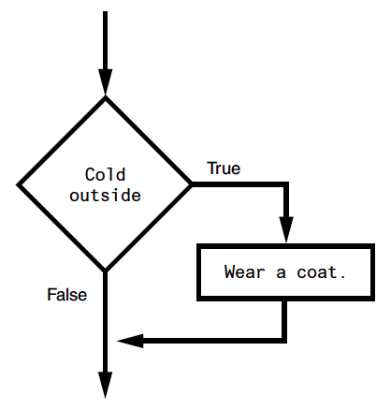
The if Statement (cont’d.)

Slide 6
The if Statement (cont’d.)
Python syntax:
if condition:
Statement
Statement
First line known as the if clause
Includes the keyword if followed by condition
The condition can be true or false
When the if statement executes, the condition is tested, and if it is true the block statements are executed. otherwise, block statements are skipped

Slide 7
Boolean Expressions and Relational Operators
Boolean expression: expression tested by if statement to determine if it is true or false
Example: a > b
True if a is greater than b; False otherwise
Relational operator: determines whether a specific relationship exists between two values
Example: greater than (>)

Slide 8
Boolean Expressions and Relational Operators (cont’d.)
>= and <= operators test more than one relationship
It is enough for one of the relationships to exist for the expression to be true
== operator determines whether the two operands are equal to one another
Do not confuse with assignment operator (=)
!= operator determines whether the two operands are not equal

Slide 9
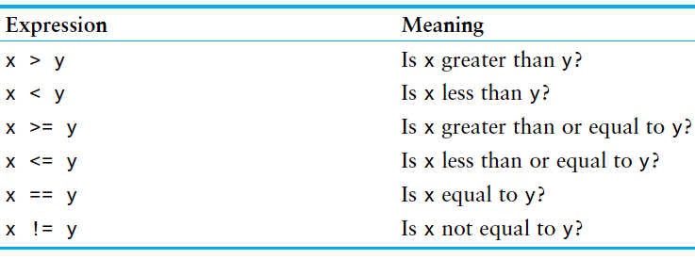
Boolean Expressions and Relational Operators (cont’d.)

Slide 10
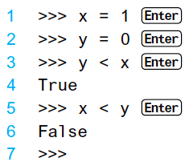
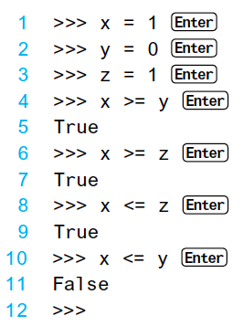
Example

Slide 11
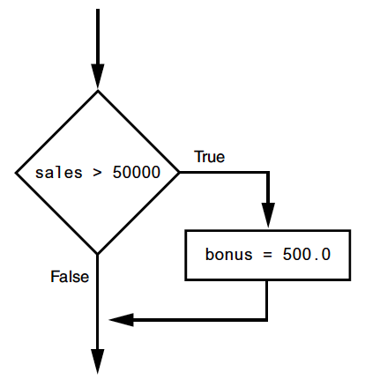

Putting It All Together

Slide 12
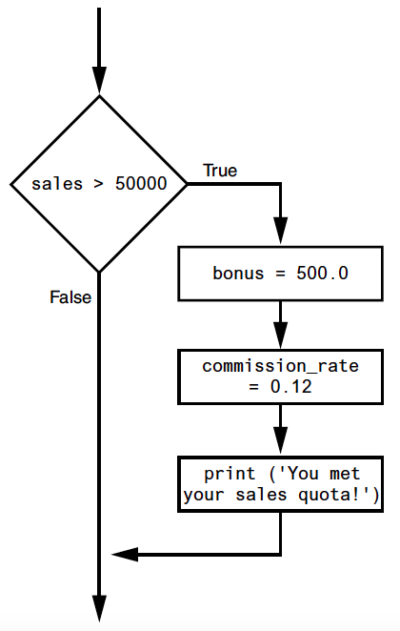
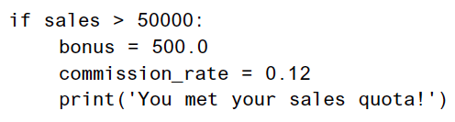
Putting It All Together

Slide 13
Putting It All Together
if total >= 10000:
total = total * 0.9
print('Your total is', total)

Slide 14
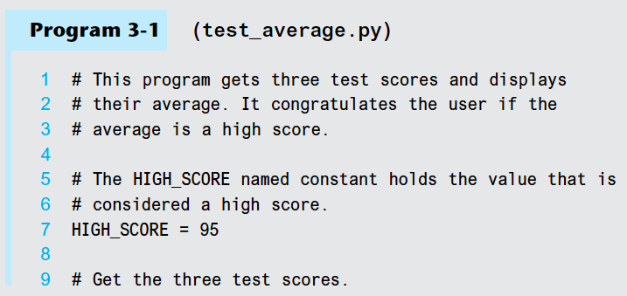
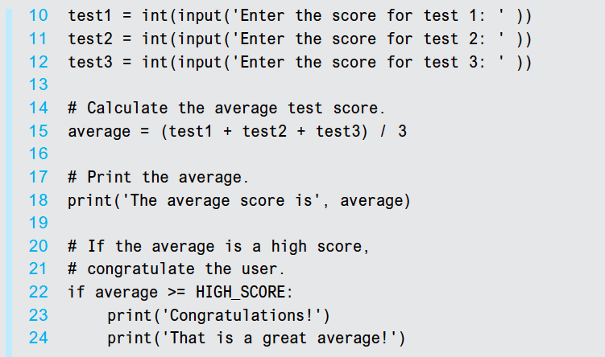

Slide 15
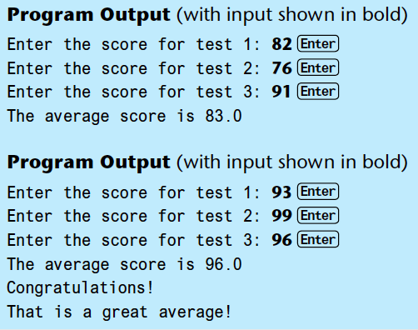

Slide 16
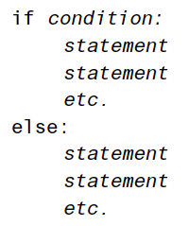
The if-else Statement
Dual alternative decision structure: two possible paths of execution
One is taken if the condition is true, and the other if the condition is false
Syntax: if condition:
statements
else:
other statements
if clause and else clause must be aligned
Statements must be consistently indented

Slide 17
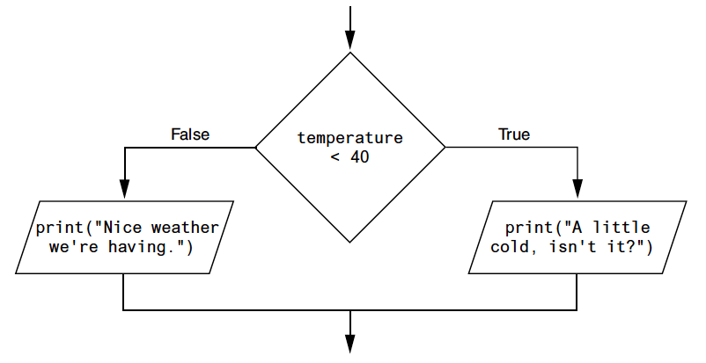
The if-else Statement (cont’d.)

Slide 18
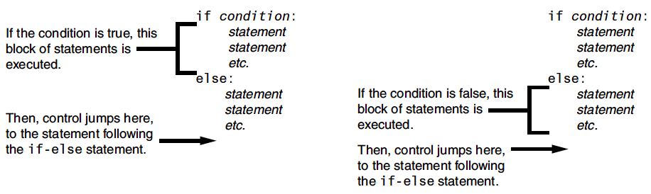
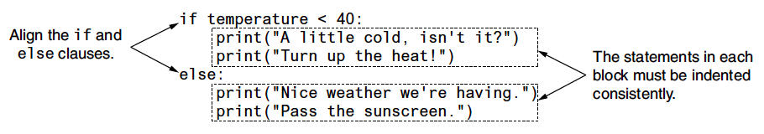
The if-else Statement (cont’d.)

Slide 19
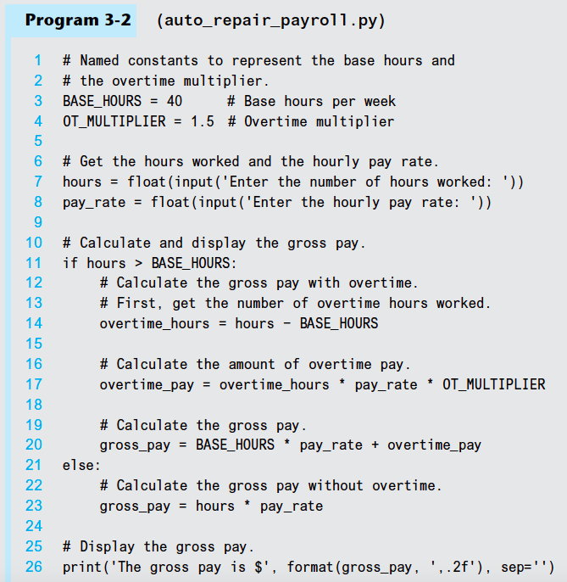

Slide 20
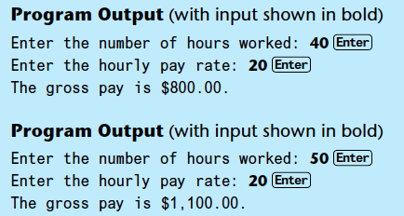

Slide 21
Exercise
Write an if statement that assigns 20 to the variable y, and assigns 40 to the variable z if the variable x is greater than 100.

Slide 22
Exercise
Write a program that reads in a positive integer n from the user and then prints whether n is even or odd.
Hint: An even number is a multiple of 2. Any multiple of 2 leaves a remainder of zero when divided by 2.
An example run of the program is shown below.
Enter a positive integer: 101
101 is odd

Slide 24
Comparing Strings
Strings can be compared using the == and != operators
String comparisons are case sensitive
Strings can be compared using >, <, >=, and <=
Compared character by character based on the ASCII values for each character
If shorter word is substring of longer word, longer word is greater than shorter word

Slide 25
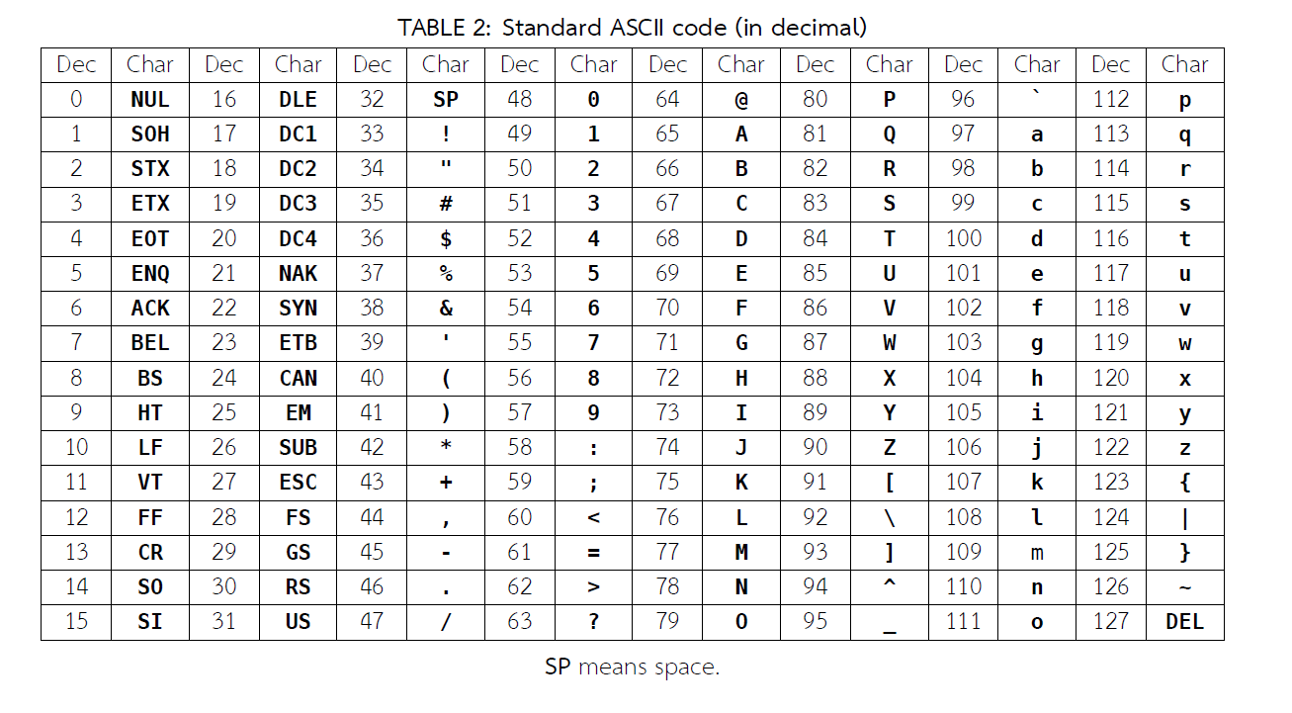
ASCII Chart

Slide 26
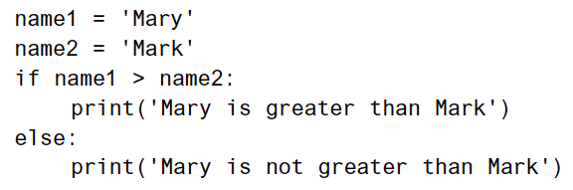
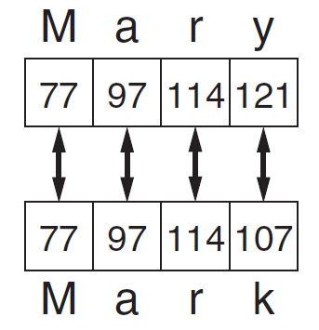
Comparing Strings (cont’d.)

Slide 27
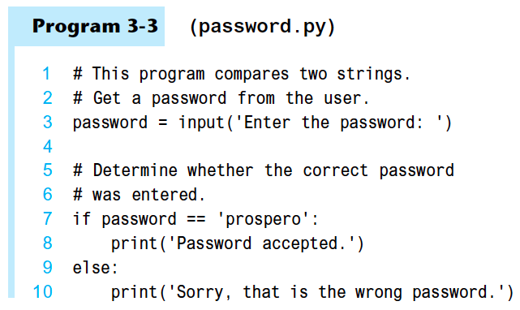
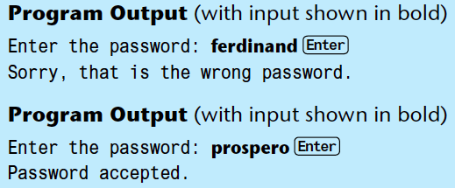

Slide 28
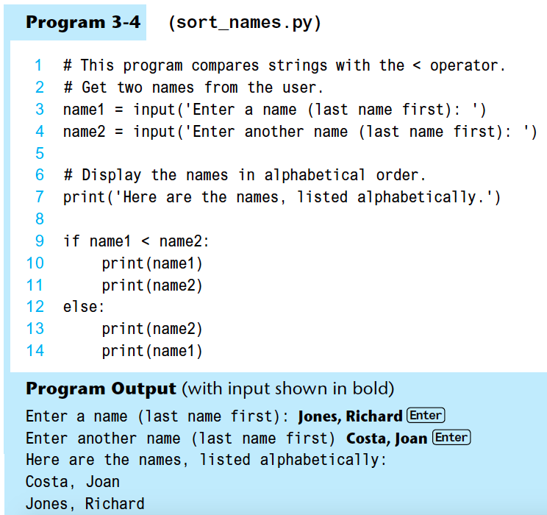

Slide 29
Nested Decision Structures and the if-elif-else Statement
A decision structure can be nested inside another decision structure
Commonly needed in programs
Example:
Determine if someone qualifies for a loan, they must meet two conditions:
Must earn at least $30,000/year
Must have been employed for at least two years
Check first condition, and if it is true, check second condition

Slide 30
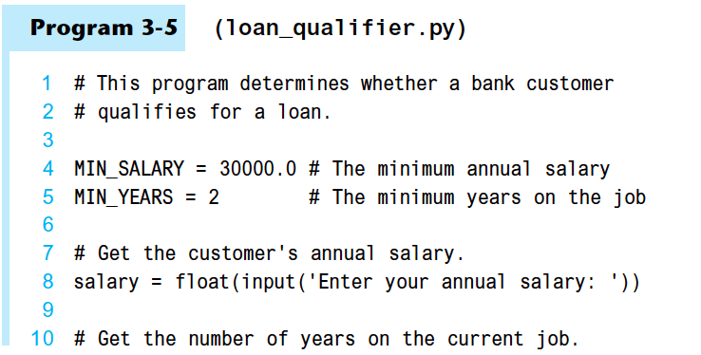
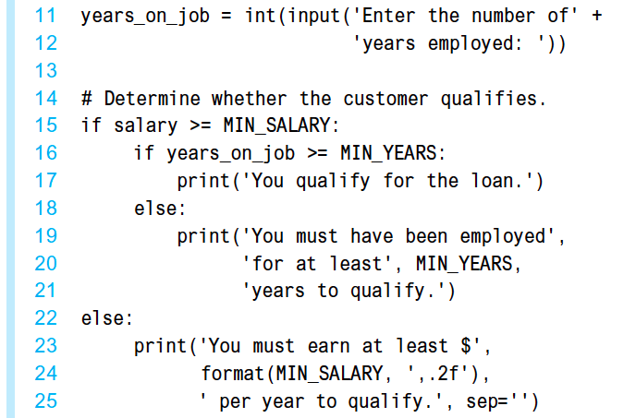

Slide 31
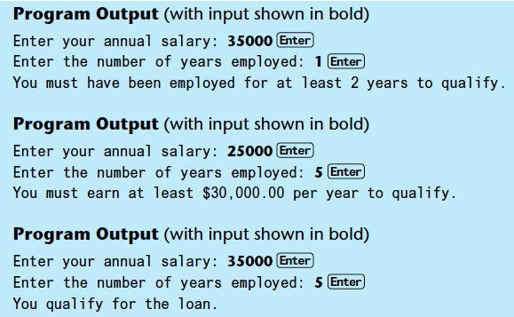

Slide 32
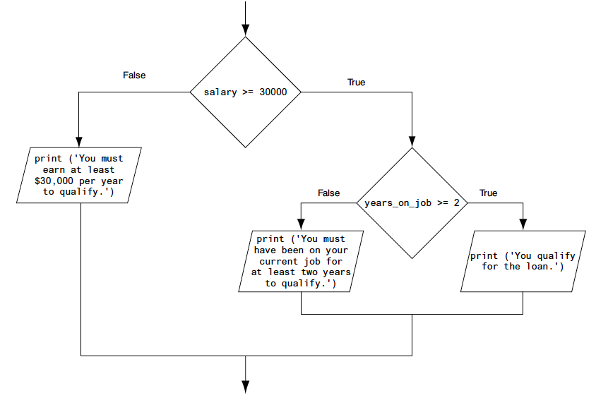

Slide 33
Nested Decision Structures and the if-elif-else Statement (cont’d.)
Important to use proper indentation in a nested decision structure
Important for Python interpreter
Makes code more readable for programmer
Rules for writing nested if statements:
else clause should align with matching if clause
Statements in each block must be consistently indented

Slide 34
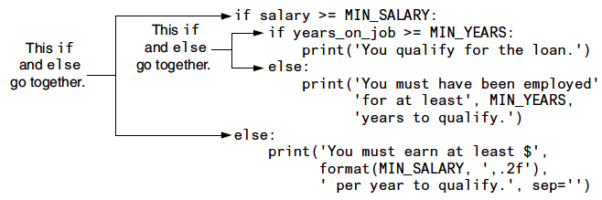

Slide 35
The if-elif-else Statement
if-elif-else statement: special version of a decision structure
Makes logic of nested decision structures simpler to write
Can include multiple elif statements
Syntax:
if condition_1:
statement(s)
elif condition_2:
statement(s)
elif condition_3:
statement(s)
else
statement(s)
Insert as many elif clauses
as necessary.

Slide 36
The if-elif-else Statement (cont’d.)
Alignment used with if-elif-else statement:
if, elif, and else clauses are all aligned
Conditionally executed blocks are consistently indented
if-elif-else statement is never required, but logic easier to follow
Can be accomplished by nested if-else
Code can become complex, and indentation can cause problematic long lines

Slide 37
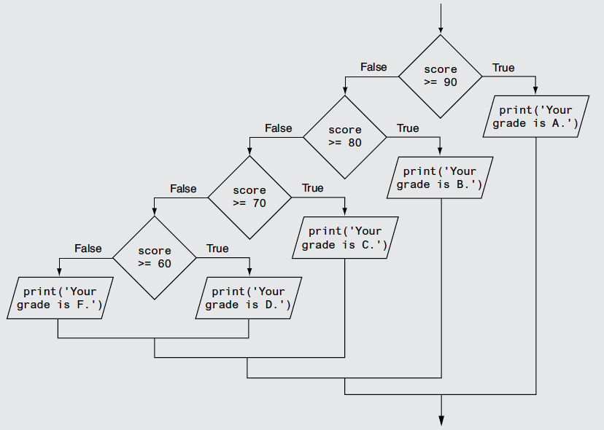

Slide 38
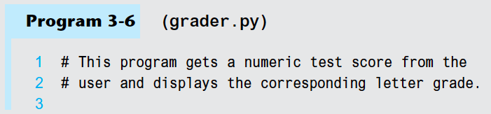
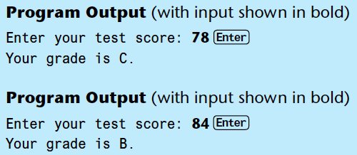
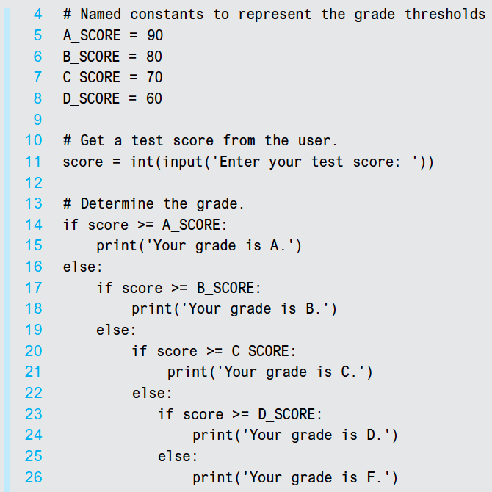
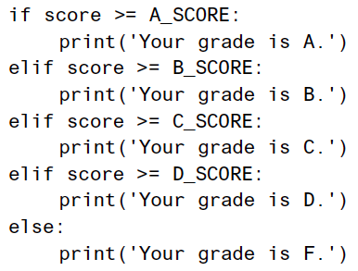

Slide 39
Logical Operators
Logical operators: operators that can be used to create complex Boolean expressions
and operator and or operator: binary operators, connect two Boolean expressions into a compound Boolean expression
not operator: unary operator, reverses the truth of its Boolean operand

Slide 40
The and Operator
Takes two Boolean expressions as operands
Creates compound Boolean expression that is true only when both sub expressions are true
Can be used to simplify nested decision structures
Truth table for the and operator
Value of the Expression | Expression
False | False and False
False | False and True
False | True and False
True | True and True

Slide 41
The or Operator
Takes two Boolean expressions as operands
Creates compound Boolean expression that is true when either of the sub expressions is true
Can be used to simplify nested decision structures
Truth table for the or operator
Value of the Expression | Expression
False | False or False
True | False or True
True | True or False
True | True or True

Slide 42
Short-Circuit Evaluation
Short circuit evaluation: deciding the value of a compound Boolean expression after evaluating only one sub expression
Performed by the or and and operators
For or operator: If left operand is true, compound expression is true. Otherwise, evaluate right operand
For and operator: If left operand is false, compound expression is false. Otherwise, evaluate right operand

Slide 43
The not Operator
Takes one Boolean expressions as operand and reverses its logical value
Sometimes it may be necessary to place parentheses around an expression to clarify to what you are applying the not operator
Truth table for the not operator
Value of the Expression | Expression
False | not True
True | not False

Slide 44
Checking Numeric Ranges with Logical Operators
To determine whether a numeric value is within a specific range of values, use and
Example: x >= 10 and x <= 20
Can also be written as: 10 <= x <= 20
if x >= 10 and x <= 20
print('The value is in the acceptable range.')

Slide 45
Checking Numeric Ranges with Logical Operators (cont’d)
To determine whether a numeric value is outside of a specific range of values, use or
Example: x < 10 or x > 20
if x < 10 or x > 20
print('The value is outside the acceptable range.')

Slide 46
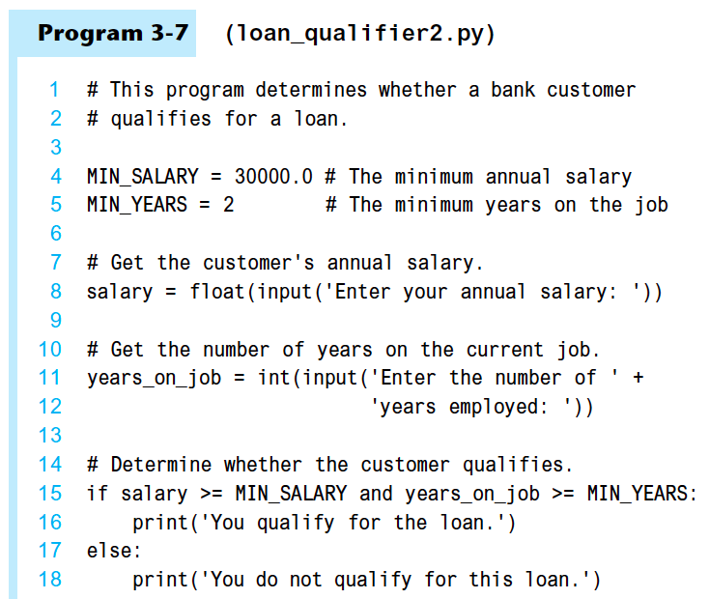

Slide 47
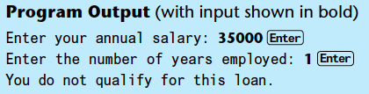
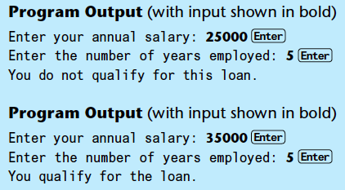

Slide 48
Boolean Variables
Boolean variable: references one of two values, True or False
Represented by bool data type
Commonly used as flags
Flag: variable that signals when some condition exists in a program
Flag set to False → condition does not exist
Flag set to True → condition exists

Slide 49
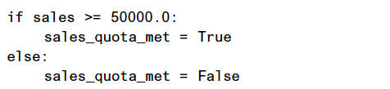
Boolean Variables (cont’d)
For example, the following code determines whether the quota of $50,000 of a salesperson has been met:

Slide 50


Boolean Variables (cont’d)
The bool variable sales_quota_met can be used as a flag to indicate whether the sales quota has been met. We can test the flag in the following way:
or

Slide 51
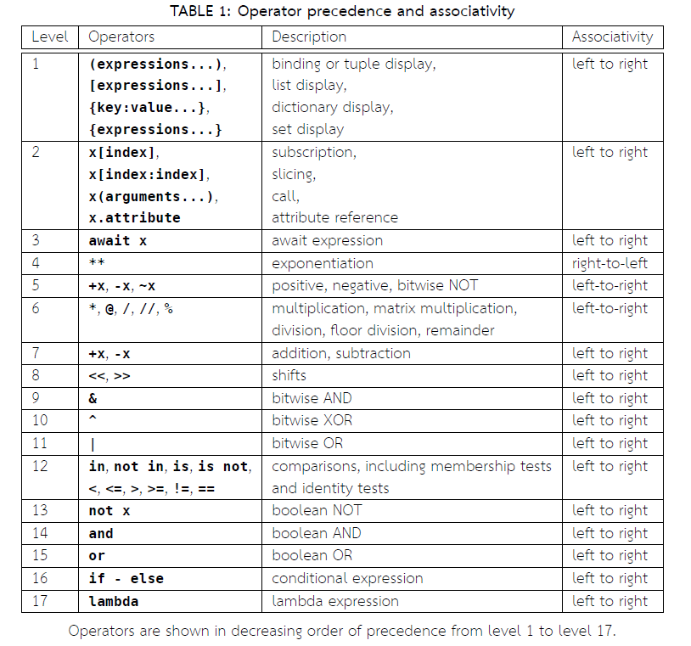

Slide 52
Summary
This chapter covered:
Decision structures, including:
Single alternative decision structures
Dual alternative decision structures
Nested decision structures
Relational operators and logical operators as used in creating Boolean expressions
String comparison as used in creating Boolean expressions
Boolean variables

Slide 53
Exercise
Write a program that asks the user to enter 3 integers. The program should display the maximum number.
An example run of the program is shown below.
Enter integer #1: 10
Enter integer #2: 35
Enter integer #3: 9
The maximum number is 35

Slide 55
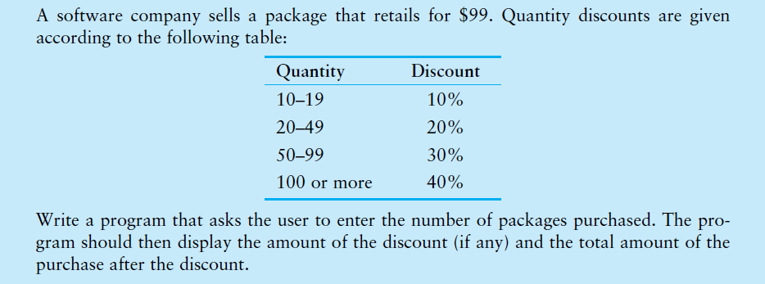
Exercise

