Slide 1
CN101
Lecture 6-7
Repetition Structures

Slide 2
Topics
Introduction to Repetition Structures
The while Loop: a Condition-Controlled Loop
The for Loop: a Count-Controlled Loop
Calculating a Running Total
Sentinels
Input Validation Loops
Nested Loops

Slide 3
Introduction to Repetition Structures
Often have to write code that performs the same task multiple times
Disadvantages to duplicating code
Makes program large
Time consuming
May need to be corrected in many places
Repetition structure: makes computer repeat included code as necessary
Includes condition-controlled loops and count-controlled loops

Slide 4
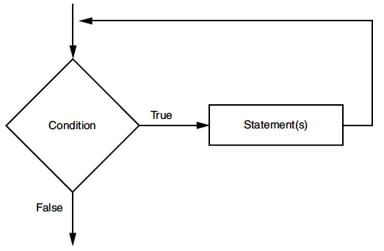
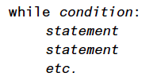
The while Loop: a Condition-Controlled Loop
while loop: while condition is true, do something
Two parts:
Condition tested for true or false value
Statements repeated as long as condition is true
In flow chart, line goes back to previous part
General format:

Slide 5
The while Loop: a Condition-Controlled Loop (cont’d.)
In order for a loop to stop executing, something has to happen inside the loop to make the condition false
Iteration: one execution of the body of a loop
while loop is known as a pretest loop
Tests condition before performing an iteration
Will never execute if condition is false to start with
Requires performing some steps prior to the loop

Slide 6
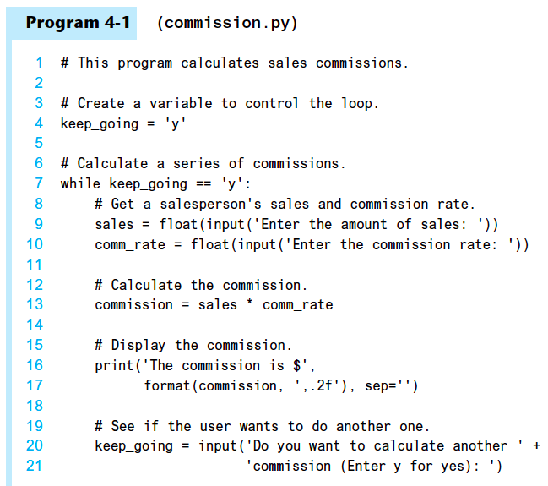

Slide 7
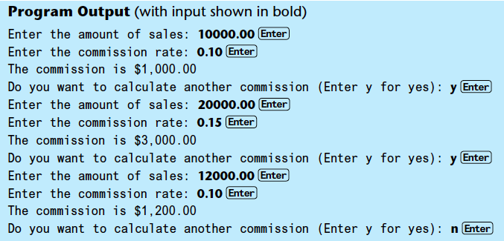

Slide 8
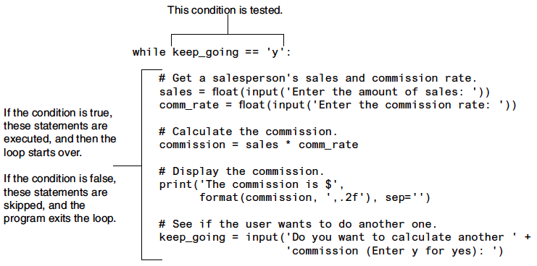

Slide 9
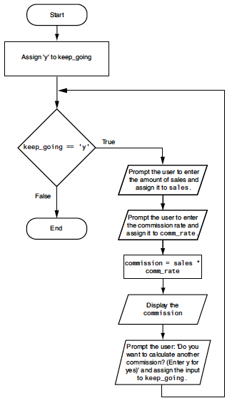

Slide 10
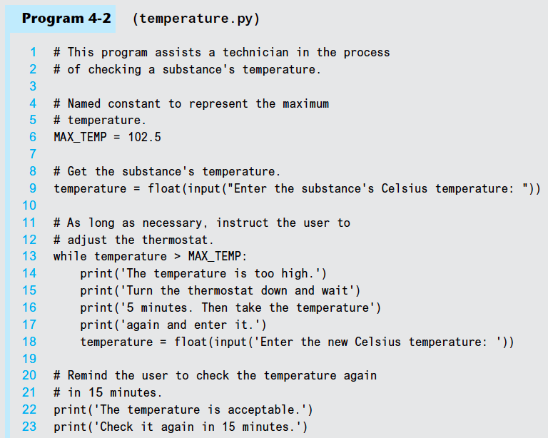

Slide 11
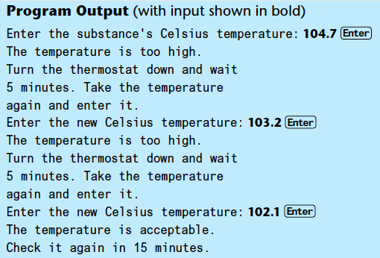

Slide 12
Infinite Loops
Loops must contain within themselves a way to terminate
Something inside a while loop must eventually make the condition false
Infinite loop: loop that does not have a way of stopping
Repeats until program is interrupted
Occurs when programmer forgets to include stopping code in the loop

Slide 13
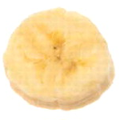
The for Loop: a Count-Controlled Loop
Count-Controlled loop: iterates a specific number of times
Use a for statement to write count-controlled loop
Designed to work with sequence of data items
Iterates once for each item in the sequence
General format:
for variable in [val1, val2, etc]:
statements
Target variable: the variable which is the target of the assignment at the beginning of each iteration

Slide 14
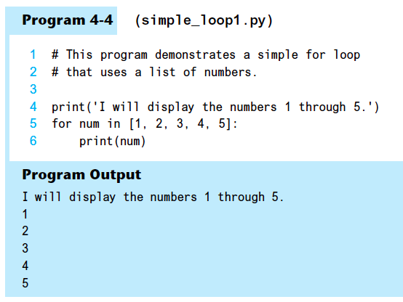

Slide 15
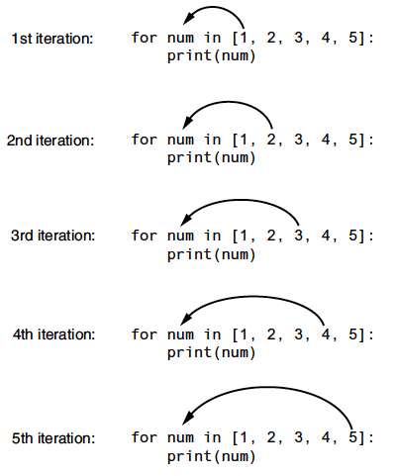

Slide 16
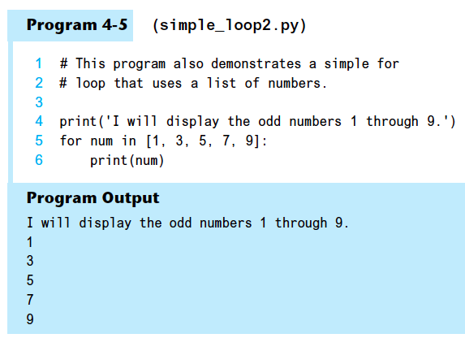

Slide 17
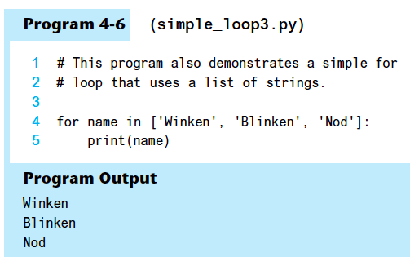

Slide 18
Using the range Function with the for Loop
The range function simplifies the process of writing a for loop
range returns an iterable object
Iterable: contains a sequence of values that can be iterated over
range characteristics:
One argument: used as ending limit
Two arguments: starting value and ending limit
Three arguments: third argument is step value

Slide 19
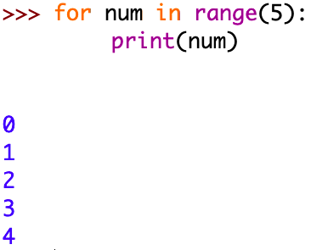
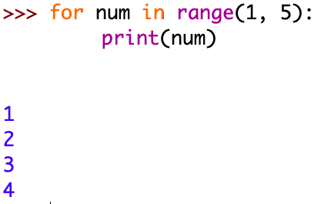
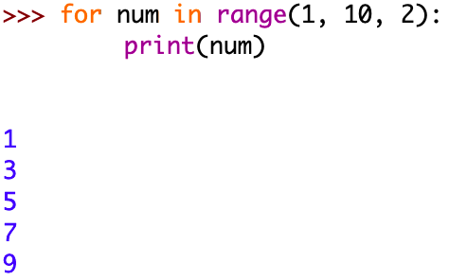

Slide 20
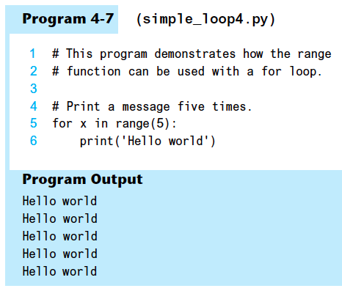

Slide 21
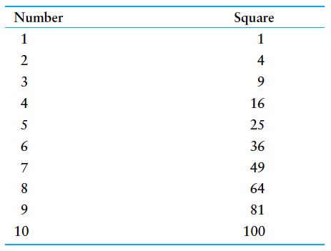
Using the Target Variable Inside the Loop
Purpose of target variable is to reference each item in a sequence as the loop iterates
Target variable can be used in calculations or tasks in the body of the loop
Example: calculate square of each number in a range

Slide 22
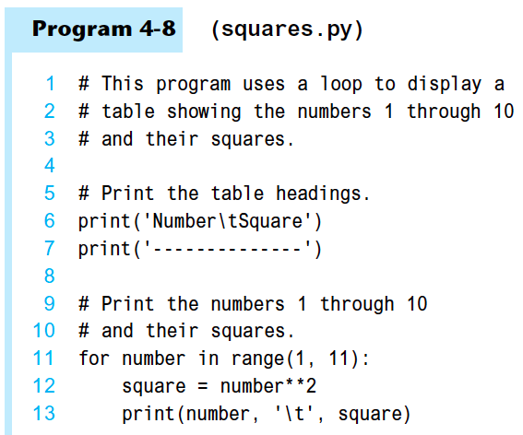
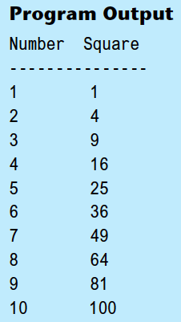

Slide 23
Letting the User Control the Loop Iterations
Sometimes the programmer does not know exactly how many times the loop will execute
Can receive range inputs from the user, place them in variables, and call the range function in the for clause using these variables
Be sure to consider the end cases: range does not include the ending limit

Slide 24
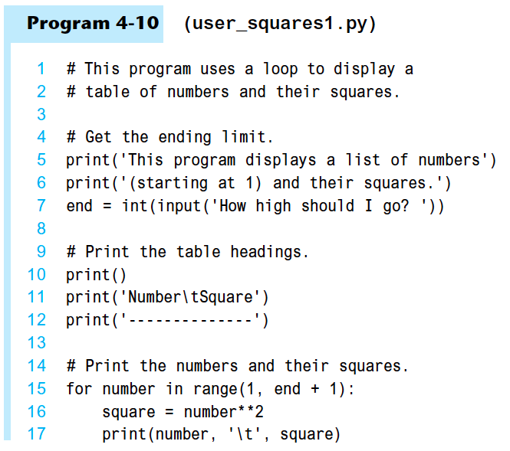

Slide 25
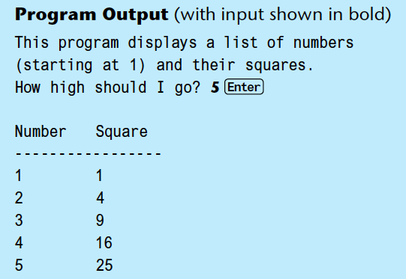

Slide 26
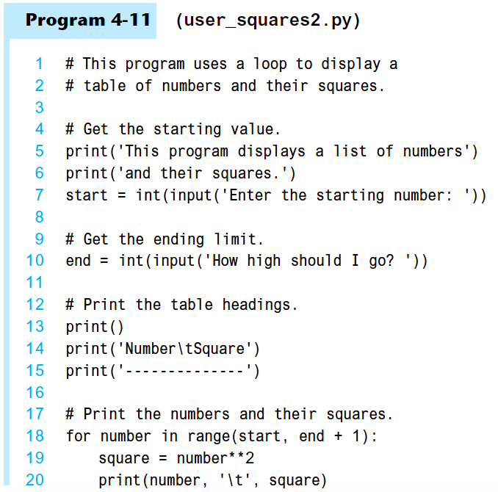

Slide 27
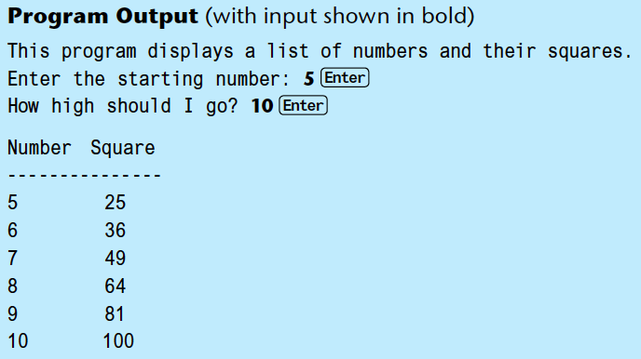

Slide 28
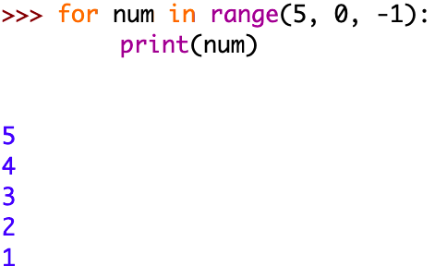
Generating an Iterable Sequence that Ranges from Highest to Lowest
The range function can be used to generate a sequence with numbers in descending order
Make sure starting number is larger than end limit, and step value is negative
Example: range (5, 0, -1)

Slide 29
Calculating a Running Total
Programs often need to calculate a total of a series of numbers
Typically include two elements:
A loop that reads each number in series
An accumulator variable
Known as program that keeps a running total: accumulates total and reads in series
At end of loop, accumulator will reference the total

Slide 30
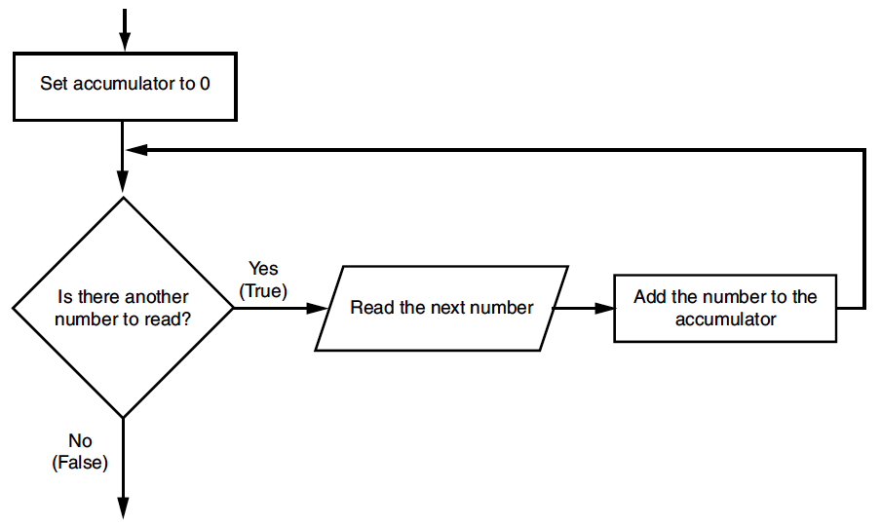
Calculating a Running Total (cont’d.)

Slide 31
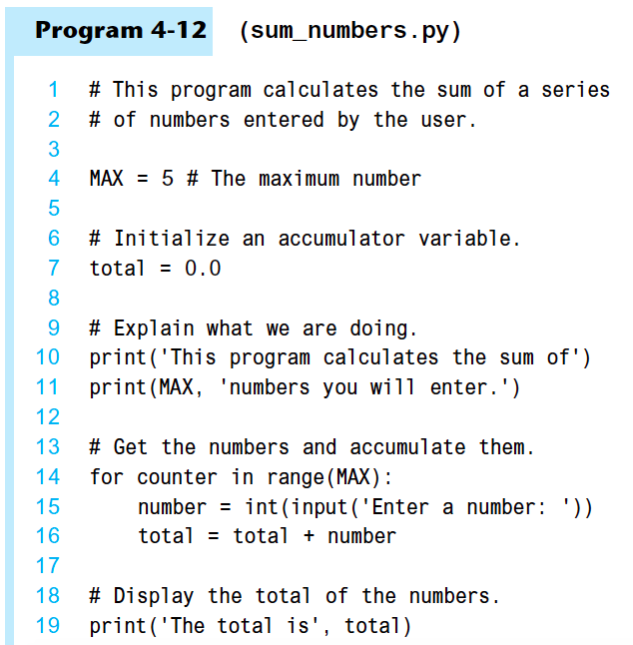

Slide 32
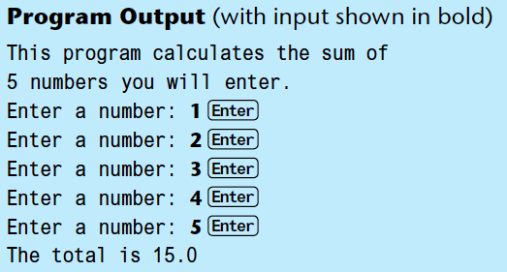

Slide 33
The Augmented Assignment Operators
In many assignment statements, the variable on the left side of the = operator also appears on the right side of the = operator
Augmented assignment operators: special set of operators designed for this type of job
Shorthand operators

Slide 34
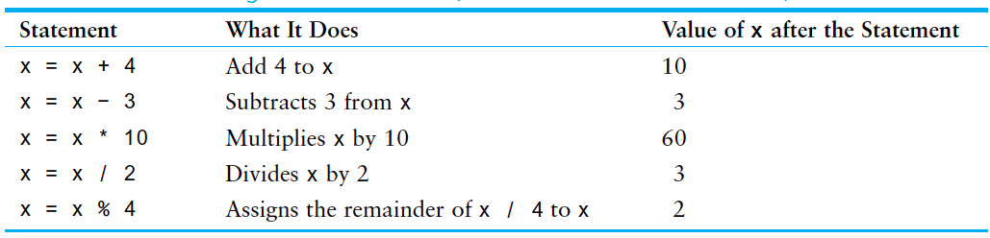
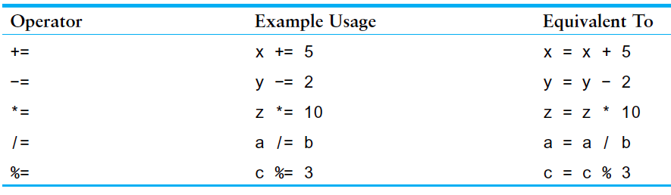
The Augmented Assignment Operators (cont’d.)

Slide 35
Sentinels
Sentinel: special value that marks the end of a sequence of items
When program reaches a sentinel, it knows that the end of the sequence of items was reached, and the loop terminates
Must be distinctive enough so as not to be mistaken for a regular value in the sequence
Example: when reading an input file, empty line can be used as a sentinel

Slide 36
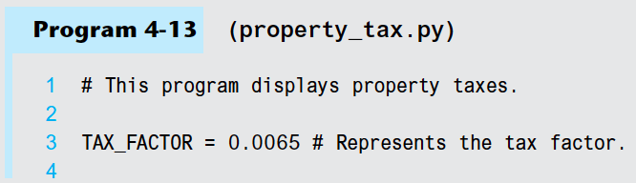
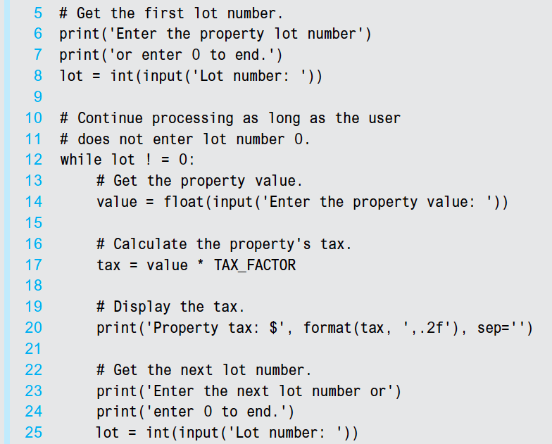

Slide 37
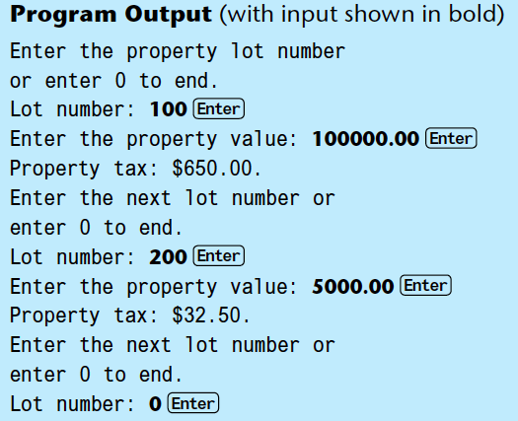

Slide 38
Input Validation Loops
Computer cannot tell the difference between good data and bad data
If user provides bad input, program will produce bad output
GIGO: garbage in, garbage out
It is important to design program such that bad input is never accepted

Slide 39
Input Validation Loops (cont’d.)
Input validation: inspecting input before it is processed by the program
If input is invalid, prompt user to enter correct data
Commonly accomplished using a while loop which repeats as long as the input is bad
If input is bad, display error message and receive another set of data
If input is good, continue to process the input

Slide 40
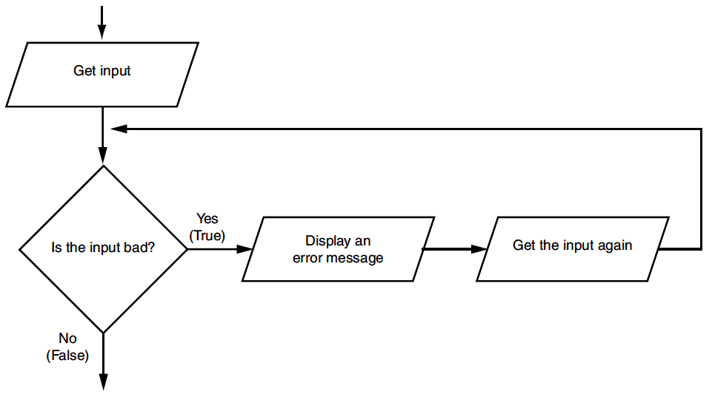
Input Validation Loops (cont’d.)

Slide 41
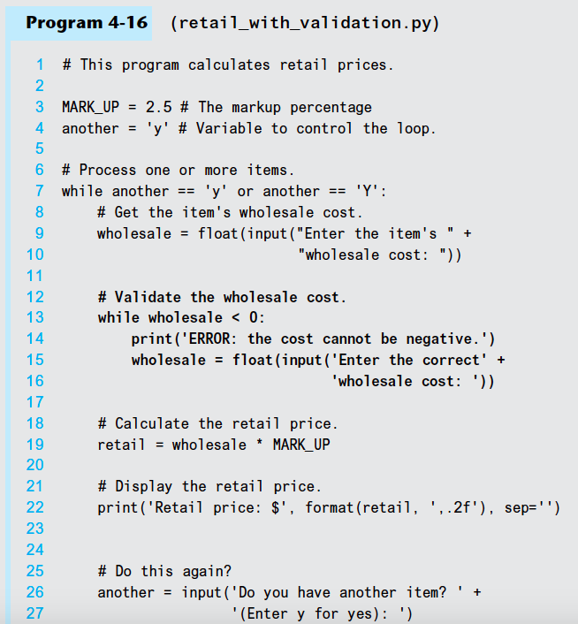

Slide 42
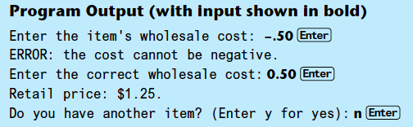

Slide 43
Nested Loops
Nested loop: loop that is contained inside another loop
Example: analog clock works like a nested loop
Hours hand moves once for every twelve movements of the minutes hand: for each iteration of the “hours,” do twelve iterations of “minutes”
Seconds hand moves 60 times for each movement of the minutes hand: for each iteration of “minutes,” do 60 iterations of “seconds”

Slide 44
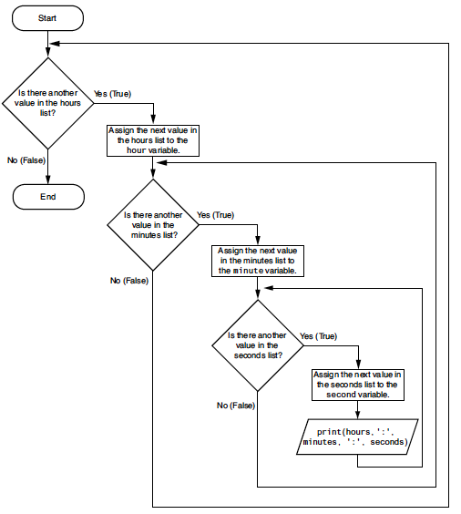

Slide 45
Nested Loops (cont’d.)
Key points about nested loops:
Inner loop goes through all of its iterations for each iteration of outer loop
Inner loops complete their iterations faster than outer loops
Total number of iterations in nested loop: number_iterations_inner x
number_iterations_outer

Slide 46
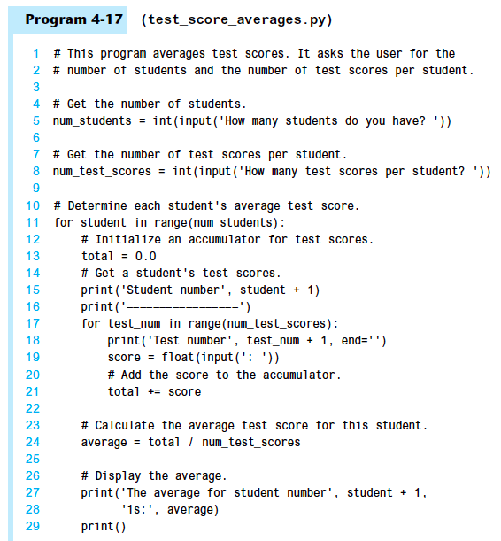

Slide 47
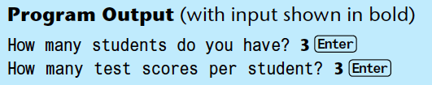
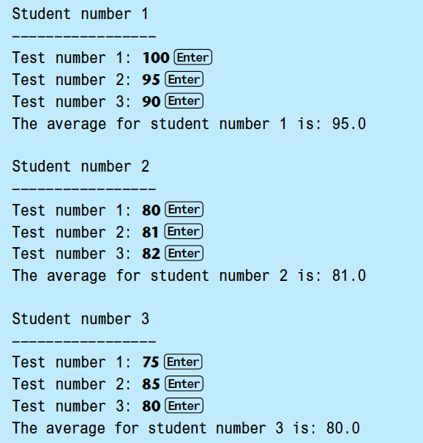

Slide 48
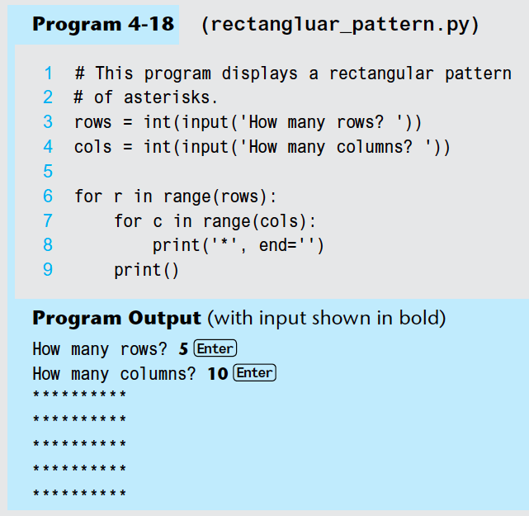

Slide 49
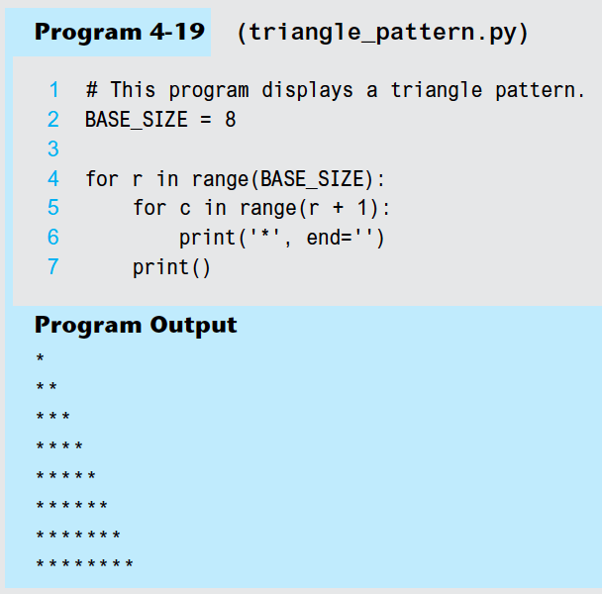

Slide 50
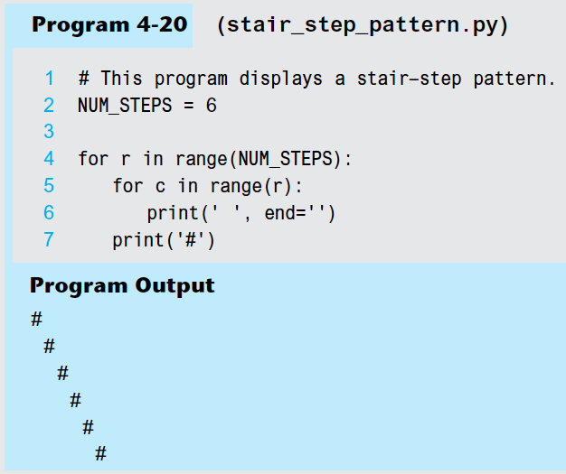

Slide 51
Summary
This chapter covered:
Repetition structures, including:
Condition-controlled loops
Count-controlled loops
Nested loops
Infinite loops and how they can be avoided
range function as used in for loops
Calculating a running total and augmented assignment operators
Use of sentinels to terminate loops

