Slide 1
CN101
Lecture 8-10
Functions

Slide 2
Topics
Introduction to Functions
Defining and Calling a Void Function
Designing a Program to Use Functions
Local Variables
Passing Arguments to Functions
Global Variables and Global Constants
Introduction to Value-Returning Functions: Generating Random Numbers
Writing Your Own Value-Returning Functions
The math Module

Slide 3
Introduction to Functions
Function: a group of statements within a program that perform a specific task
Usually one task of a large program
Functions can be executed in order to perform overall program task
Known as divide and conquer approach
Modularized program: a program where each task within the program is in its own function

Slide 4
Using functions to divide and conquer a large task
This program is one long
sequence of statements.
In this program, the task has been divided into smaller tasks.
Each smaller task is performed by a separate function
def function1():
statement
statement
statement
statement
statement
statement
statement
statement
statement
statement
statement
statement
function
def function2():
statement
statement
statement
function
def function3():
statement
statement
statement
function

Slide 5
Benefits of Modularizing a Program with Functions
The benefits of using functions include:
Simpler code
Code reuse
write the code once and call it multiple times
Better testing and debugging
Can test and debug each function individually
Faster development
Easier facilitation of teamwork
Different team members can write different functions

Slide 6
Defining a Function
Consist of 2 parts
a function header and a function body (block)
def function_name(optional_list_of_parameters):
statement
statement
…
Function header: first line of function
Includes keyword def and function_name, followed by optional_list_of_parameters within parentheses, and a colon
Function body (Block):
indented set of statements that belong together as a group

Slide 7
Function Names
Function naming rules:
Cannot use key words as a function name
Cannot contain spaces
First character must be a letter or underscore
All other characters must be a letter, number or underscore
Uppercase and lowercase characters are distinct, i.e. case sensitive

Slide 8
Defining a Function (cont’d.)
Function name should be descriptive of the task carried out by the function
Often includes a verb
Function definition: specifies what function does
def function_name():
statement
statement
…
def message():
print('I am Arthur.')
print('King of the Britons.')
function definition
function definition

Slide 9
Void Functions and Value-Returning Functions
A void function:
Executes the statements it contains
then terminates.
Technically returns None
A value-returning function:
Executes the statements it contains
then returns a value back to the statement that called it.
Examples of value-returning functions: input, int, float
Always contains at least one or more return statements
A return statement
a statement with return keyword with an optional expression
if return is without any expression, default to return None

Slide 10
Example: void functions
# examples of void functions
def print_name():
print("You name is: unknown")
def print_len():
print("Length of your name: 7")
def do_something():
a, b = 20, 30
print(f"{a} + {b} = {a + b}")
def do_nothing():
# pass statement – does nothing when executed
pass

Slide 11
Example: void functions (2)
# examples of void functions
def func_xxx():
print("This is a function.")
def func_yyy():
print("This is a function.")
# Both func_xxx and func_yyy are essentially the same functions
# since they both
# - are void functions
# - take no parameters
# - have the same body that give the same result

Slide 12
Example: value-returning functions
# examples of value-returning functions
def get_name():
name = "unknown"
return name
def get_len():
return 7
def add_something():
a, b = 20, 30
return a + b
def do_nothing():
# default to return None
return

Slide 13
Example: value-returning functions (2)
# examples of value-returning functions
def get_xxx():
a, b = 10, 20
return a + b
def get_yyy():
x, y = 10, 20
return x + y
# Both get_xxx and get_yyy are essentially the same functions
# since they both
# - are void functions
# - take no parameters
# - have the same body that give the same result

Slide 14
Calling a Function
Call a function to execute it
When a function is called:
Interpreter jumps to the function and executes statements in the block
Interpreter jumps back to the part of the program where the function is called
Known as function return

Slide 15
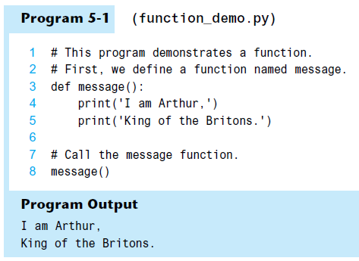

Slide 16
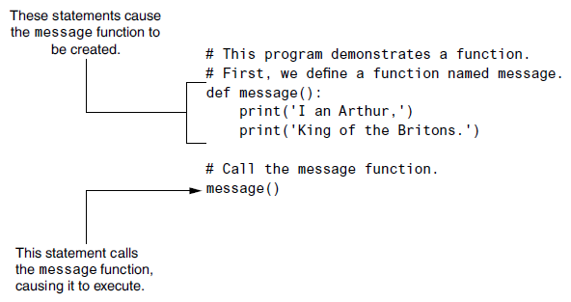
Function Definition and Function Call

Slide 17
Defining and Calling a Function (cont’d.)
function main:
Is only a convention to indicate
the mainline logic of a program
Has no special meaning in Python
Is normally used to call other functions when they are needed

Slide 18
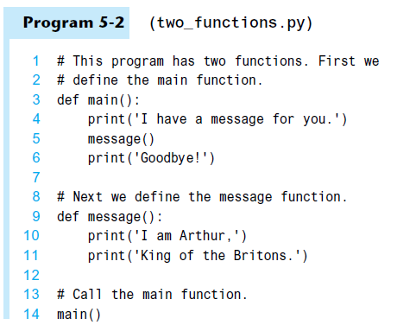
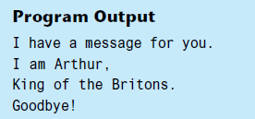

Slide 19
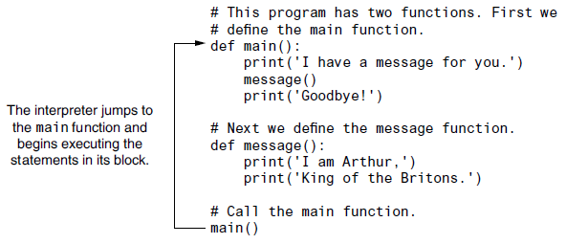
Calling the main function

Slide 20
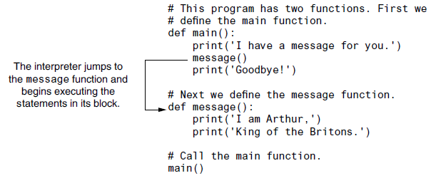
Calling the message function

Slide 21
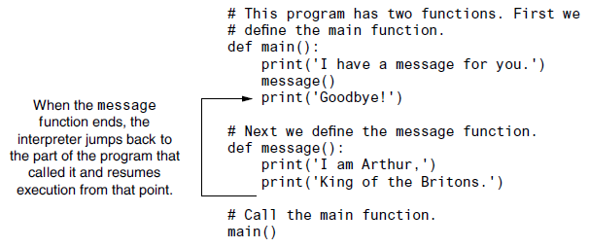
The message function returns

Slide 22
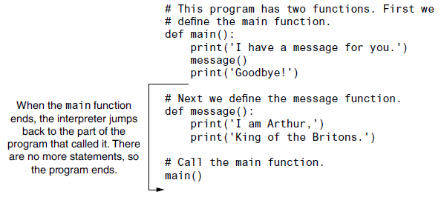
The main function returns

Slide 23
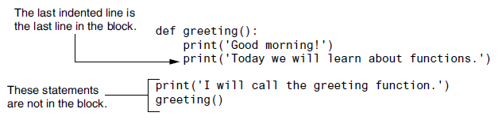
Indentation in Python
Each block must be indented
Lines in block must begin with the same number of spaces
Use tabs or spaces (prefer spaces) to indent lines in a block, but not both as this can confuse the Python interpreter
IDLE automatically indents the lines in a block
Blank lines that appear in a block are ignored

Slide 24

Designing a Program to Use Functions
In a flowchart, function call is shown as rectangle with vertical bars at each side
Function name written in the symbol
Typically draw separate flow chart for each function in the program
End terminal symbol usually reads Return

Slide 25
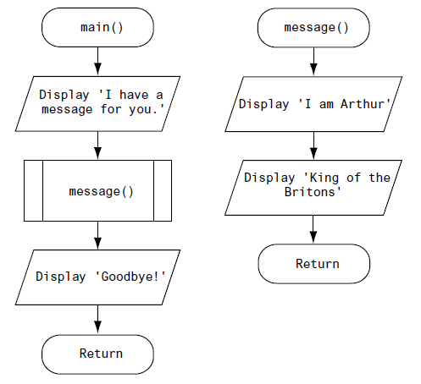

Slide 26
Designing a Program to Use Functions (cont’d.)
Top-down design: technique for breaking algorithm into functions
Hierarchy chart: depicts relationship between functions
AKA structure chart
Box for each function in the program, Lines connecting boxes illustrate the functions called by each function
Does not show steps taken inside a function
Use input function to have program wait for user to press enter

Slide 27
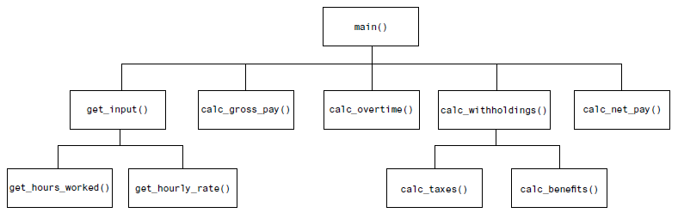
A hierarchy chart

Slide 28
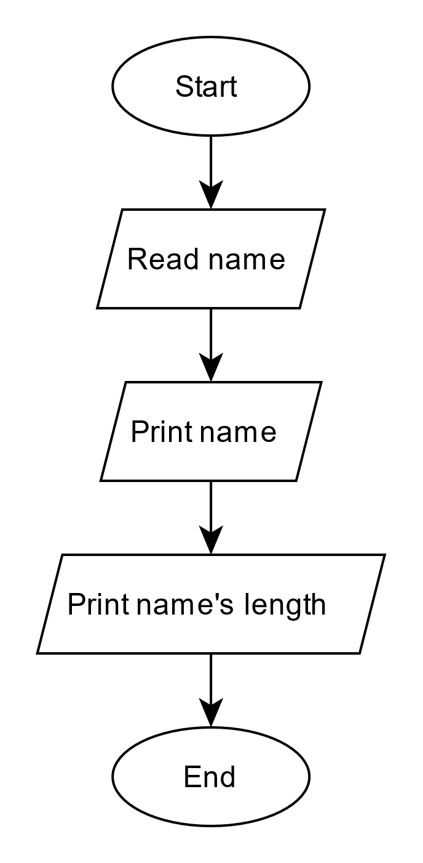
Example: Rewrite with Functions (1)
# simple program
name = input("Enter a name: ")
print("This will print your name.")
print("You name:", name)
print("This will print length of your name.")
print("Length of your name:", len(name))

Slide 29
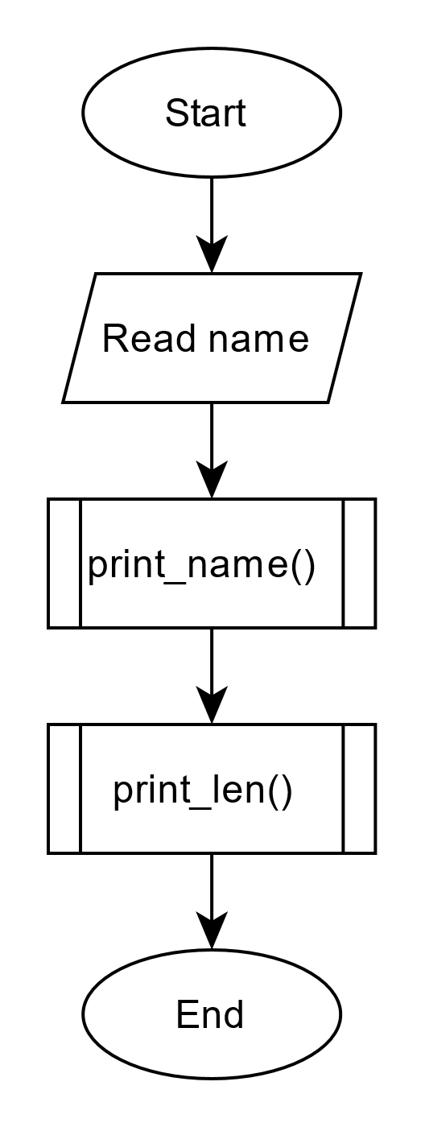
Example: Rewrite with Functions (2)
# simple program rewritten using functions
name = input("Enter a name: ")
def print_name():
print("This will print your name.")
print("You name:", name)
def print_len():
print("This will print length of your name.")
print("Length of your name:", len(name))
def main():
print_name()
print_len()
main()

Slide 30
Exercise 1: Rewrite with Functions
Rewrite the following program to use functions.
print("This program will find an average of 2 numbers.")
print("The program will then print the resulting average value.");
x = int(input("Enter x: "))
y = int(input("Enter y: "))
average = (x + y)/2
print(f"The average is => {average}")

Slide 31
Exercise 1: (cont’d.)
An example of a rewrite (not necessary a good one).
def print_intro():
print("This program will find an average of 2 numbers.")
print("The program will then print the resulting average value.");
def find_average():
x = int(input("Enter x: "))
y = int(input("Enter y: "))
return (x + y)/2
def main():
print_intro()
average = find_average()
print(f"The average is => {average}")
main()

Slide 32
Local Variables
Local variable: variable that is assigned a value inside a function
Belongs to the function in which it was created
only statements inside that function can access it
error will occur if another function tries to access the variable
Scope: the part of a program in which a name may be accessed
For local variable:
within the function that the variable is created

Slide 33
Local Variables (cont’d.)
Local variable can only be accessed by
statements inside its function, after the variable is created
Different functions may have local variables with the same name
Each function does not see the other function’s local variables

Slide 34
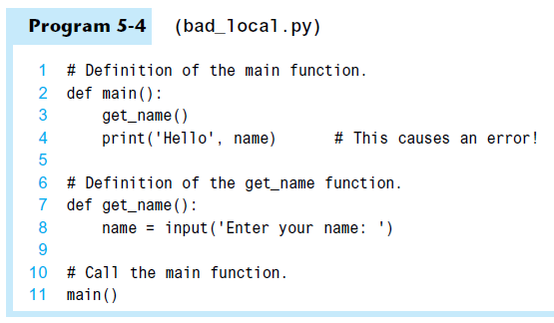

Slide 35
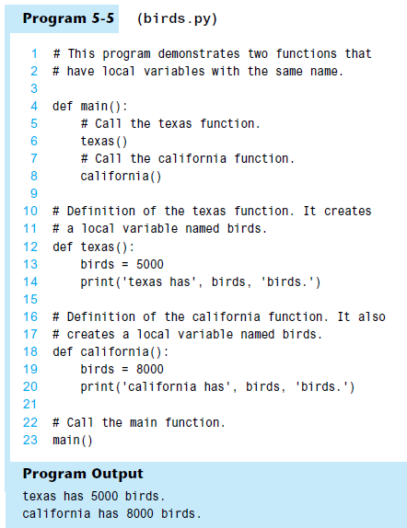
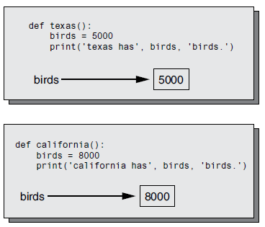
Each function has its own birds variable

Slide 36
Example: Local variables (1)
# each function has its own local variable "x"
def aaa():
# a local variable "x" in function aaa()
x = 10
print(f"In function aaa: x = {x}")
def bbb():
# another local variable "x" in function bbb()
x = 20
print(f"In function bbb: x = {x}")
def main():
aaa()
bbb()
main()

Slide 37
Example: Local variables (2)
# variable can only be accessed after it is created
def aaa():
x = 10
# can use variable x after it is created
print(f"In function aaa: x = {x}")
def bbb():
# this will cause an error because variable x is not created yet
# take note of the error message
print(f"In function bbb: x = {x}")
x = 20
def main():
aaa()
bbb() # this function call will cause an error
main()

Slide 38
Example: Local variables (3)
# a function can create any number of local variables
def aaa():
x = 10 # create a local variable x
print(f"In function aaa: x = {x}")
y = 4.5 # create another local variable y
print(f"In function aaa: y = {y}")
z = [1,2,3] # create another local variable z
print(f"In function aaa: z = {z}")
def main():
aaa()
main()

Slide 39
Passing Arguments to Functions
Argument: piece of data that is sent into a function
Function can use argument in calculations
When calling the function, the argument is placed in parentheses following the function name
def show_double(number):
result = number * 2
print(result)
x = 4
show_double(x)
number is a parameter (in function definition)
variable x is an argument (in function call)

Slide 40
Passing Arguments to Functions (cont’d.)
Parameter variable: variable that is assigned the value of an argument when the function is called
The parameter and the argument reference the same value
General format:
def function_name(list_of_parameters):
Scope of a parameter: within the function in which the parameter is used

Slide 41
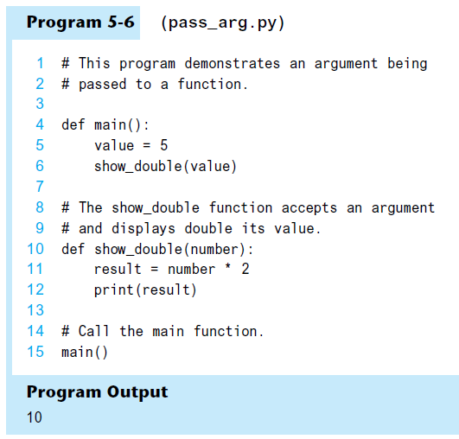
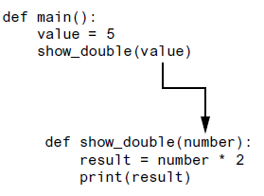
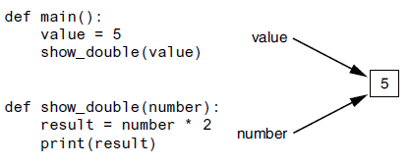
The value variable is passed as an argument
The value variable and the number parameter reference the same value

Slide 42
Example: Single parameter (1)
# void functions with a single parameter
def aaa(x):
# x is a parameter
print(f"In function aaa: x = {x}")
def main():
aaa(1) # argument is 1
m = 2
aaa(m) # argument is m
n = m*m
aaa(n) # argument is n
aaa(1+m+n) # argument is 1+m+n
main()

Slide 43
Example: Single parameter (2)
# void functions with a single parameter
def aaa(x):
# x is a parameter
print(f"In function bbb: x = {x}")
def main():
aaa([1,2,3]) # argument is [1,2,3]
m = [4,5,6,7]
aaa(m) # argument is m
n = (7,8,9,10,11)
aaa(n) # argument is n
main()

Slide 44
Example: Single parameter (3)
# void functions with a single parameter
def bbb(x):
# x is a parameter
y = len(x)
print(f"Length is => {y}")
def main():
bbb("Message") # argument is "Message"
m = [1,2,3]
bbb(m) # argument is m
n = (4,5,6,7)
bbb(n) # argument is n
main()

Slide 45
Example: Single parameter (4)
# void functions with a single parameter
def bbb(x):
# x is a parameter
y = len(x) # x must have value that can be used with function len
print(f"Length is => {y}")
def main():
bbb(1) # argument is 1, this function call will cause an error
m = True
bbb(m) # argument is m, this function call will cause an error
n = 3.14159
bbb(n) # argument is n, this function call will cause an error
main()

Slide 46
Example: Single parameter (5)
# void functions with a single parameter
def ccc(x):
# x is a parameter
sorted(x)
print(f"Min = {x[0]}, Max = {x[-1]}, Length is => {len(x)}")
def main():
bbb([1, 3, 5, 7, 3, 5, 1)
bbb([2020, -5, -10, 8, 12])
m = (3.5, 1.5, -2.7, -9, 11, 20.2)
bbb(m)
main()

Slide 47
Exercise 2: Single parameter
Write a function print_digit() which
takes a single string parameter
prints all characters that are decimal digits, i.e. 0 - 9
def print_digit(a_string):
… # complete the body of this function
print_digit('24 hours in 1 day, 7 days in a 1 week.')
message = 'I met a man with 7 wives. Each wife had 7 sacks.'
print_digit(message)
# output
>2 4 1 7 1
>7 7

Slide 48
Exercise 3: Single parameter
Write a function print_even() which
takes a list of integer numbers as a parameter
prints all numbers that are even
def print_even(a_list):
… # complete the body of this function
print_even([1, 2, 3, 4, 5])
list_1 = [1, 3, 5, 7, 9, 11, 13, 15, 17, 20, 21, 20]
list_2 = list(range(20, 0, -3))
print_even(list_1)
print_even(list_2)
# output
>2 4
>20 20
>20 14 8 2

Slide 49
Passing Multiple Arguments
Python allows writing a function that accepts multiple arguments
Parameter list replaces single parameter
Parameter list items are separated by comma
Positional arguments are passed by position to corresponding parameters
First parameter receives value of first argument
Second parameter receives value of second argument
etc.

Slide 50
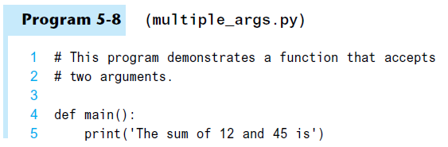
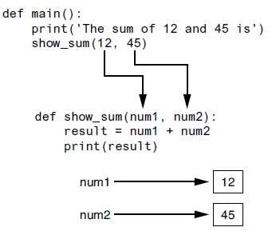
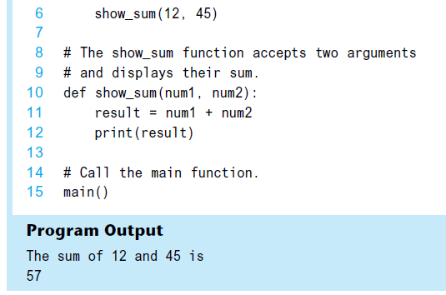

Slide 51
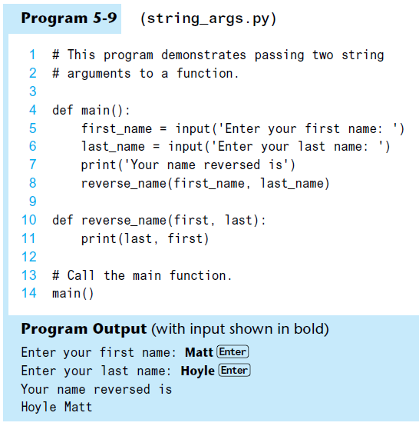

Slide 52
Example: Multiple parameters (1)
# void functions with multiple parameters
def ppp(x, y):
# x and y are parameters
print(f"{x} + {y} => {x + y}")
def main():
ppp(1, 2) # arguments are 1 and 2
m = 3
n = 4
ppp(m, n) # arguments are m and n
ppp(m*m, n*n) # arguments are m*m and n*n
main()

Slide 53
Example: Multiple parameters (2)
# void functions with multiple parameters
def ppp(x, y):
# x and y are parameters
print(f"{x} + {y} => {x + y}")
def main():
ppp(1, True) # arguments are 1 and True
m = 3.14159
ppp(m, 5) # arguments are m and 5
m = 1
ppp((m+1)*2, 2*m) # arguments are (m+1)*2, 2*m
main()

Slide 54
Example: Multiple parameters (3)
# void functions with multiple parameters
def ppp(x, y):
# x and y are parameters
print(f"{x} + {y} => {x + y}")
def main():
ppp([1, 2], [3, 4, 5]) # arguments are [1, 2] and [3, 4, 5]
m = [6, 7]
n = [8, 9, 10]
ppp(m, n) # arguments are m and n
ppp(n, m) # arguments are n and m (note the order of n and m)
main()

Slide 55
Example: Multiple parameters (4)
# void functions with multiple parameters
def ppp(x, y):
# x and y are parameters
print(f"{x} + {y} => {x + y}")
def main():
m = [1, 2]
n = [3, 4, 5]
ppp(m, n) # arguments are m and n
ppp(len(m), len(n)) # arguments are len(m) and len(n)
ppp(min(m), max(n)) # arguments are min(m) and max(n)
main()

Slide 56
Example: Multiple parameters (5)
# void functions with multiple parameters
def ppp(x, y):
# x and y are parameters
print(f"{x} + {y} => {x + y}")
def main():
ppp((11,21), (13,14,15)) # arguments are (11,12) and (13,14,15)
m = (16, 17)
n = (18, 19, 20)
ppp(m, n) # arguments are m and n
ppp(n, m) # arguments are n and m (note the order of n and m)
main()

Slide 57
Example: Multiple parameters (6)
# void functions with multiple parameters
def ppp(x, y):
# x and y are parameters
print(f"{x} + {y} => {x + y}")
def main():
n = [2, 3, 4]
ppp(len(n), n) # this functional call will create an error
ppp(n, min(n)) # this functional call will create an error
ppp(max(n), n) # this functional call will create an error
main()

Slide 58
Example: Multiple parameters (7)
# void functions with multiple parameters
def qqq(x, y, z):
# x, y, z are parameters
print(f"({x} + {y}) > {z} => {(x + y) > z}")
def main():
qqq(1, 2, 4) # arguments are 1, 2 and 4
qqq(2, 4, 1) # arguments are 2, 4 and 1
qqq(4, 1, 2) # arguments are 4, 1 and 2
main()

Slide 59
Example: Multiple parameters (8)
# void functions with multiple parameters
def qqq(x, y, z):
# x, y, z are parameters
print(f"({x} + {y}) > {z} => {(x + y) > z}")
def main():
a = 2
b = 10
c = 5
qqq(a, b, c) # arguments are a, b and c
qqq(c, a, b) # arguments are b, c and a
qqq(b*b, -(4*a*c), 0) # arguments are b*b, -(4*a*c) and 0
main()

Slide 60
Example: Multiple parameters (9)
# void functions with multiple parameters
def qqq(x, y, z):
# x, y, z are parameters
print(f"({x} + {y}) > {z} => {(x + y) > z}")
def main():
a = [1, 2, 3]
b = [4, 5, 6, 7]
c = [8, 9, 10, 11, 12]
qqq(len(a), len(b), len(c)) # arguments are len(a), len(b) and len(c)
qqq(min(a), min(b), min(c)) # arguments are min(a), min(b) and min(c)
qqq(max(a), max(b), max(c)) # arguments are max(a), max(b) and max(c)
main()

Slide 61
Exercise 4: Multiple parameters
Write a function print_sqare() which
takes 2 integers, x and y as parameters
prints the sum of the squares of the 2 integers
def print_square(x, y):
… # complete the body of this function
print_square(3, 4)
a, b = 7, 9
print_square(a, b)
# output
>9 + 16 = 25
>49 + 81 = 130

Slide 62
Exercise 5: Multiple parameters
Write a function print_less() which
takes an integer, x and a list on integers, a_list as parameters
prints all numbers in the list a_list that are less than x
def print_less(x, a_list):
… # complete the body of this function
print_less(50, [50, 51, 99, 79, 47, 83, 90, 39, 90, 25])
a, list_1 = 55, list(range(30, 100, 15))
print_less(a, list_1)
# output
>47 39 25
>30 45

Slide 63
Making Changes to Parameters
Changes made to a parameter value within the function do not affect the argument
Known as pass by value
Provides a way for unidirectional communication between one function and another function
Calling function can communicate with called function

Slide 64
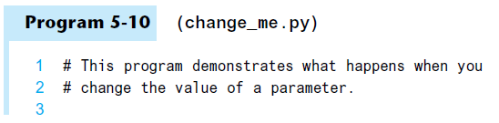
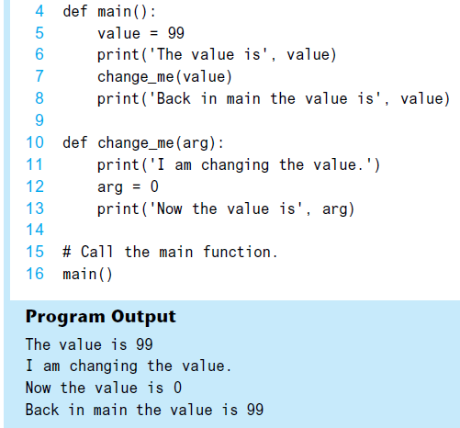

Slide 65
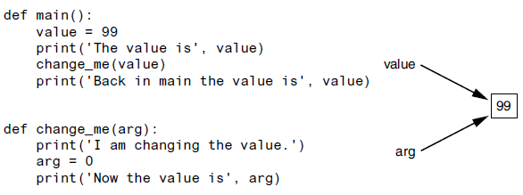
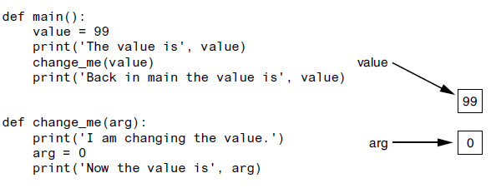
The value variable passed to the change_me function cannot be changed by it

Slide 66
Default Arguments
Function argument can be given default value
In function definition, parameters can be assigned default.
Default arguments must be given after all positional parameters
All default arguments must come after any positional argument

Slide 67
Example: Default arguments
# function with 3 parameters
# 2 parameters are assigned default values
def ask_ok(prompt, retries=4, reminder='Please try again!'):
while True:
ok = input(prompt)
if ok.lower() in ('y', 'ye', 'yes'):
return True
if ok.lower() in ('n', 'no', 'nop', 'nope'):
return False
retries = retries - 1
if retries <= 0:
print('invalid user response')
break
print(reminder)
ask_ok('Enter yes or no: ') # call the function

Slide 68
Keyword Arguments
Keyword argument: argument that specifies which parameter the value should be passed to
Position when calling function is irrelevant
General Format:
def function_name(parameter=value)
Possible to mix keyword and positional arguments when calling a function
Positional arguments must appear before keyword arguments

Slide 69
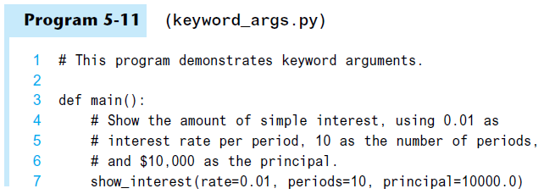
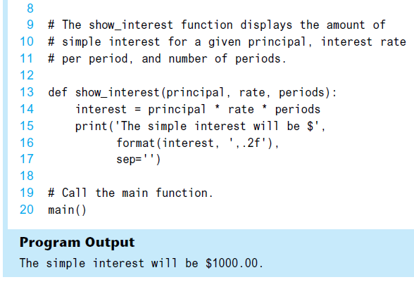

Slide 70
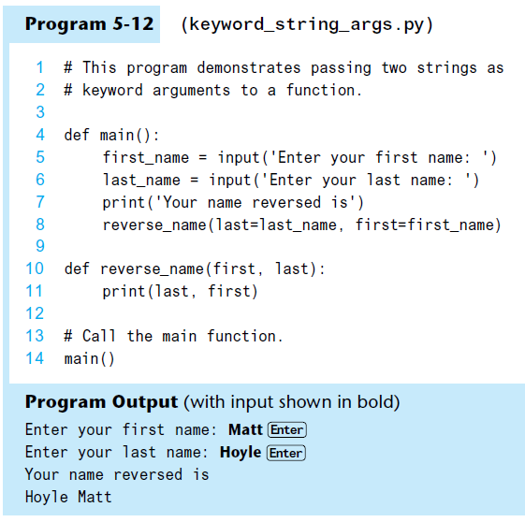

Slide 71
Example: Keyword Arguments (1)
# void functions with 6 parameters
def eee(a, b, c, d, e, f):
# a, b, c, d, e, f are parameters
print(f"a = {a}, b = {b}, c = {c}, d = {d}, e = {e}, f = {f}")
def main():
eee(1, 2, 3, 4, 5, 6)
eee(1, 2, 3, 4, e=5, f=6) # keyword arguments e, f
eee(1, 2, c=3, d=4, e=5, f=6) # keyword arguments c, d, e, f
eee(1, 2, d=4, e=5, f=6, c=3) # keyword arguments c, d, e, f
eee(1, 2, e=5, f=6, c=3, d=4) # keyword arguments c, d, e, f
eee(1, 2, d=4, f=6, e=5, c=3) # keyword arguments c, d, e, f
eee(1, e=5, f=6, c=3, b=2, d=4) # keyword arguments b, c, d, e, f
main()

Slide 72
Example: Keyword Arguments (2)
def eee(a, b, c, d=4, e=5, f=6):
# a, b, c, d, e, f are parameters
# d, e, f have default values
print(f"a = {a}, b = {b}, c = {c}, d = {d}, e = {e}, f = {f}")
def main():
eee(1, 2, 3) # used default value for d, e, f
eee(1, 2, 3, 4) # used default value for e, f
eee(1, 2, 3, 4, 5) # used default value for f
eee(1, 2, 3, 4, 5, 6)
eee(1, 2, d=4, e=5, f=6, c=3) # keyword arguments c, d, e, f
eee(1, 2, e=5, f=6, c=3, d=4) # keyword arguments c, d, e, f
eee(1, 2, d=4, f=6, e=5, c=3) # keyword arguments c, d, e, f
eee(1, e=5, f=6, c=3, b=2, d=4) # keyword arguments b, c, d, e, f
main()

Slide 73
Global Variables and Global Constants
Global variable: created by assignment statement written outside all functions
Can be accessed by any statement in the program file, including from within a function
If a function needs to assign a value to the global variable
the global variable must be redeclared within the function
general format: global variable_name

Slide 74
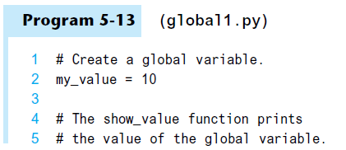
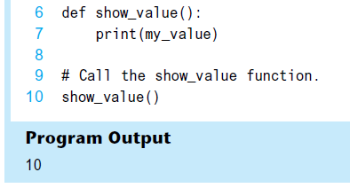

Slide 75
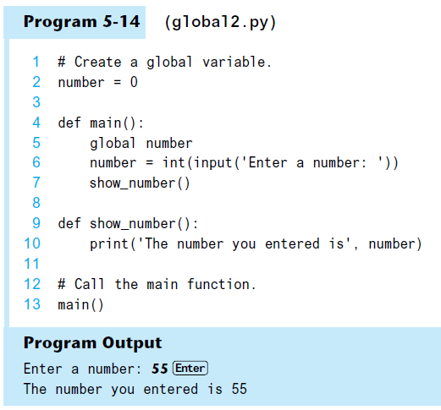

Slide 76
Global Variables and Global Constants (cont’d.)
Reasons to avoid using global variables:
Global variables making debugging difficult
Many locations in the code could be causing a wrong variable value
Functions that use global variables are usually dependent on those variables
Makes function hard to transfer to another program
Global variables make a program hard to understand

Slide 77
Global Constants
Global constant: global name that references a value that cannot be changed
Permissible to use global constants in a program
To simulate global constant in Python, create global variable and do not re-declare it within functions
By convention, use all uppercases for constant names

Slide 78
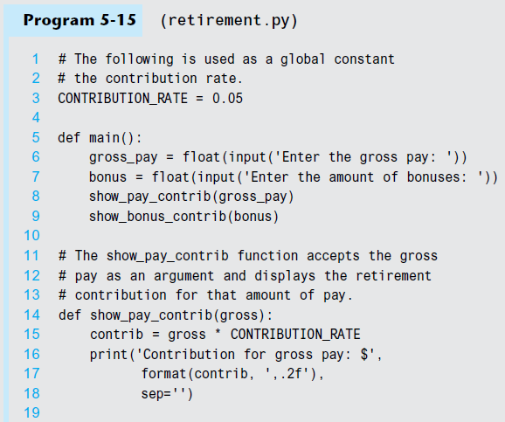

Slide 79
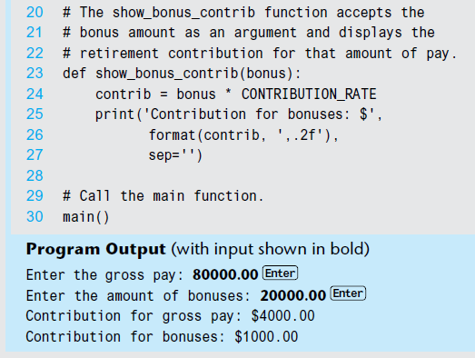

Slide 80
Introduction to Value-Returning Functions: Generating Random Numbers
void function: group of statements within a program for performing a specific task
Call function when you need to perform the task
Value-returning function: similar to void function, returns a value
Value returned to part of program that called the function when function finishes executing

Slide 81
Standard Library Functions and the import Statement
Standard library: library of pre-written functions that comes with Python
Library functions perform tasks that programmers commonly need
Example: print, input, range
Viewed by programmers as a “black box”
Some library functions built into Python interpreter
To use, just call the function
Library
Function
Input
Output

Slide 82
Standard Library Functions and the import Statement (cont’d.)
Modules: files that stores functions of the standard library
Help organize library functions not built into the interpreter
Copied to computer when you install Python
To call a function stored in a module, need to write an import statement
Written at the top of the program
Format: import module_name

Slide 83
Generating Random Numbers
Random number are useful in a lot of programming tasks
module random: includes library functions for working with random numbers
Dot notation: notation for calling a function belonging to a module
Format: module_name.function_name()

Slide 84
Generating Random Numbers (cont’d.)
function randint: generates a random number in the range provided by the arguments
Returns the random number to part of program that called the function
Returned integer can be used anywhere that an integer would be used
You can experiment with the function in interactive mode

Slide 85
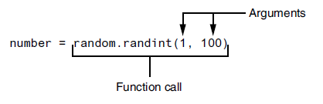
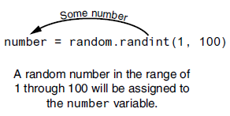
A statement that calls the random function

Slide 86
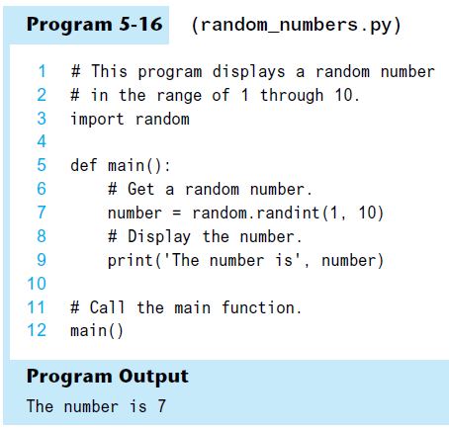

Slide 87
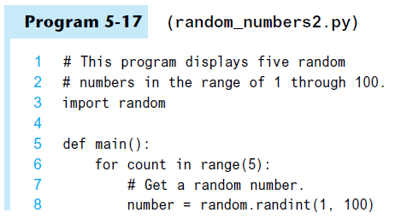
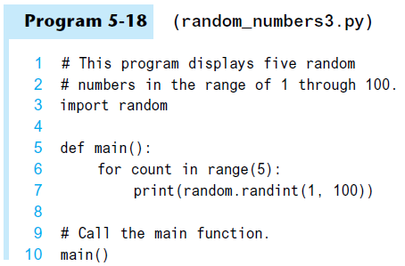
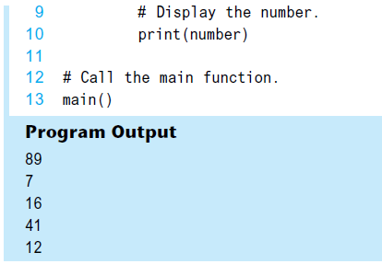
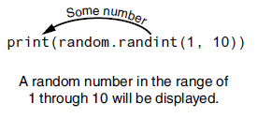

Slide 88
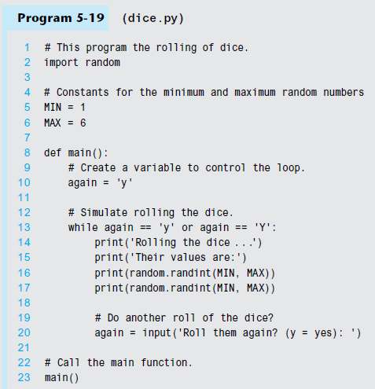
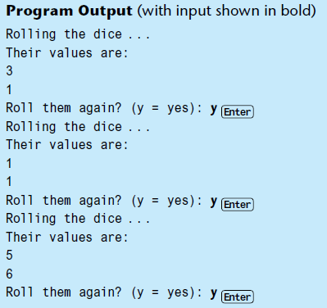

Slide 89
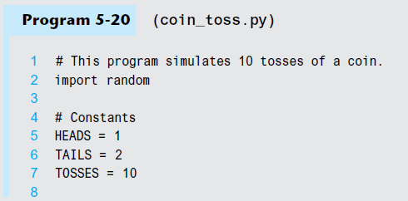
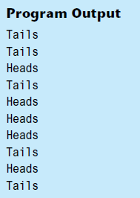
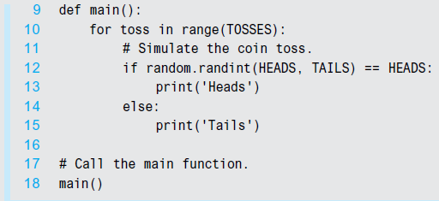

Slide 90
Generating Random Numbers (cont’d.)
function randrange : similar to range function, but returns randomly selected integer from the resulting sequence
Same arguments as for the range function
function random : returns a random float in the range of 0.0 and 1.0
Does not receive arguments
function uniform : returns a random float but allows user to specify range

Slide 91
Random Number Seeds
Random number created by functions in random module are actually pseudo-random numbers
Seed value: initializes the formula that generates random numbers
Need to use different seeds in order to get different series of random numbers
By default uses system time for seed
Can use random.seed() function to specify desired seed value

Slide 92
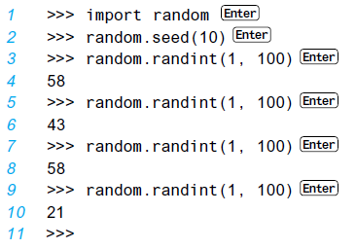
If we start a new interactive session and repeat these statements, we get the same sequence of pseudorandom numbers, as shown here:

Slide 93
Writing Your Own Value-Returning Functions
To write a value-returning function, you write a simple function and add one or more return statements
Format: return expression
The value for expression will be returned to the part of the program that called the function
The expression in the return statement can be a complex expression, such as a sum of two variables or the result of another value- returning function
def function_name():
statement
statement
…
return expression

Slide 94
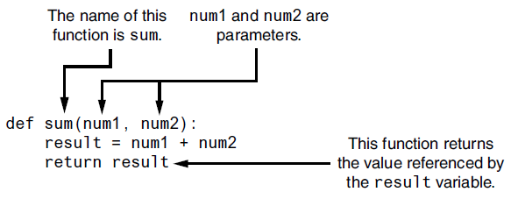
Writing Your Own Value-Returning Functions (cont’d.)

Slide 95
How to Use Value-Returning Functions
Value-returning function can be useful in specific situations
Example: have function prompt user for input and return the user’s input
Simplify mathematical expressions
Complex calculations that need to be repeated throughout the program
Use the returned value
Assign it to a variable or use as an argument in another function

Slide 96
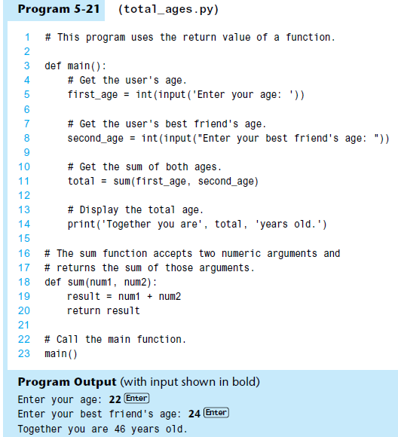


Because the return statement can return the value of an expression, you can eliminate the result variable and rewrite the function as:

Slide 97


Slide 98


Slide 99
Returning Strings
You can write functions that return strings
For example:
def get_name():
# Get the user’s name.
name = input('Enter your name: ')
# Return the name.
return name

Slide 100
Returning Boolean Values
Boolean function: returns either True or False
Use to test a condition such as for decision and repetition structures
Common calculations, such as whether a number is even, can be easily repeated by calling a function
Use to simplify complex input validation code

Slide 101
Example: Returning Boolean Values
def is_even(number):
# Determine whether number is even.
# If it is, set status to true.
# Otherwise, set status to false.
if (number % 2) == 0:
status = True
else:
status = False
# Return the value of the status variable.
return status
x = 10
y = 25
print(f"{x} is even: {is_even(x)}")
print(f"{y} is even: {is_even(y)}")

Slide 102

Example: Sum of First n Integers
Write a function sum_n to find summation of the first n integers from 1
$$S\left(n\right)= \sum_{i=1}^{n}{i}=1+2+3+…+n$$
def sum_n(n):
s = 0
for i in range(1, n+1):
s = s + i
return s
x = sum_n(5)
y = sum_n(10)
print(f"x = {x}")
print(f"y = {y}")

Slide 103
Example: Factorial
Write a function factorial to find factorial of n
$$F\left(n\right)=n!=n \left(n−1\right)\left(n−2\right)…(2)(1)$$
import math
def factorial(n):
fact = 1
for i in range(1, n+1):
fact = fact * i
return fact
x = factorial(5) # using user-defined function
y = math.factorial(5) # using function factorial in math module
print(f"x = {x}, y = {y}")

Slide 104
Example: Sum of Numbers in a List
Write a function sum_list to find summation of all numbers in a list
def sum_list(a_list):
s = 0
for i in a_list:
s = s + i
return s
list_1 = [1,3,5,7,9]
list_2 = list( range(1,10,2) )
# using user-defined function
x = sum_list(list_1)
y = sum_list(list_2)
# using built-in function sum
a = sum(list_1)
b = sum(list_2)
print(f"x = {x}, y = {y}")
print(f"a = {a}, b = {b}")

Slide 105
Returning Multiple Values
In Python, a function can return multiple values
Specified after the return statement separated by commas
Format: return expression1, expression2, etc.
When you call such a function in an assignment statement, you need a separate variable on the left side of the = operator to receive each returned value
def get_name():
# Get the user’s first and last names.
first = input("Enter your first name: ")
last = input("Enter your last name: ")
return first, last # Return both names.
first_name, last_name = get_name()
print(f"First name: {first_name}\nLast name: {last_name}")

Slide 106
The math Module
module math: part of standard library that contains functions that are useful for performing mathematical calculations
Typically accept one or more values as arguments, perform mathematical operation, and return the result
Use of module requires an import math statement

Slide 107


Slide 108
The math Module (cont’d.)
The math module defines variables pi and e, which are assigned the mathematical values for pi and e
Can be used in equations that require these values, to get more accurate results
Variables must also be called using the dot notation
Example:
circle_area = math.pi * radius**2

Slide 109



Slide 110


Example: Area of a Triangle
Heron’s formula states that
the area (A) of a triangle whose sides have lengths a, b and c is:
Where s is the semi-perimeter (half perimeter) of the triangle:
$$A=\sqrt{s(s−a)(s−b)(s−c)}$$
a
c
$$s=\frac{a+b+c}{2}$$
b

Slide 111
Example: Area of a Triangle (cont’d.)
import math
def area_of_triangle(a, b, c):
s = 0.5 * (a + b + c)
area = math.sqrt(s*(s-a)*(s-b)*(s-c))
return area
def main():
a, b, c = input("Enter lengths of 3 sides: ").split()
a = float(a); b = float(b); c = float(c)
area = area_of_triangle(a, b, c)
print(f"Area = {area}")
main()

Slide 112

Example: Law of Cosines
The law of cosines states
where a, b, c are the lengths of 3 sides of a triangle
$$c^{2}= a^{2}+b^{2}−2ab\cos{x}$$
C
b
x
a
y
z
A
B
c

Slide 113
Example: Law of Cosines (cont’d.)
import math
def length_of_triangle(a, b, x):
# x is angle in radians, between two sides a and b
radian = math.radians(x)
c = math.sqrt(a*a + b*b - a*b*math.cos(radian))
return c
def main():
a, b = input("Enter lengths of 2 sides: ").split()
x = input("Enter angle between the 2 sides (degree): ")
a = float(a); b = float(b); x = float(x)
c = length_of_triangle(a, b, x)
print(f"Length of remaining side = {c}")
main()

Slide 114
Exercise 6: Area of a Circular Sector
Write a function area_of_circular_sector() which
takes 2 numbers as parameters
r - radius of the circle
d - angle of the circular sector, in degrees
return the area of the circular sector
import math
def area_of_circular_sector(r, d):
… # complete the body of this function
area_1 = area_of_circular_sector(10, 90)
area_2 = area_of_circular_sector(10, 180)
print(f"Area 1 = {area_1:.2f}, Area 2 = {area_2:.3f}")
d
r
# output
>Area 1 = 78.54, Area 2 = 157.080
circular sector

Slide 115


Exercise 7: $y=x^{n}(=e^{n\ln{x}})$
Write a function power() (not using math.pow())
takes 2 numbers as parameters
x - base
n - exponent
return value of $x^{n}$
import math
def power(x, n):
… # complete the body of this function
a1 = power(4, 0.5); a2 = power(5.0625, 0.25)
b1 = math.pow(4, 0.5); b2 = math.pow(5.0625, 0.25)
print(f"a1 = {a1}, a2 = {a2}, b1 = {b1}, b2 = {b2}")
# output
>a1 = 2.0, a2 = 1.5, b1 = 2.0, b2 = 1.5

Slide 116
Summary
This chapter covered:
The advantages of using functions
The syntax for defining and calling a function
Methods for designing a program to use functions
Use of local variables and their scope
Syntax and limitations of passing arguments to functions
Global variables, global constants, and their advantages and disadvantages

Slide 117
Summary (cont’d.)
Value-returning functions, including:
Writing value-returning functions
Using value-returning functions
Functions returning multiple values
Using library functions and the import statement
Modules, including the random and math modules

