Slide 1
CN101
Lecture 11-12
Lists and Tuples

Slide 2
Topics
Sequences
Introduction to Lists
List Slicing
Finding Items in Lists with the in Operator
List Methods and Useful Built-in Functions
Copying Lists
Two-Dimensional Lists
Tuples

Slide 3
Sequences
Sequence: an object that contains multiple items of data
The items are stored in sequence one after another
Python provides different types of sequences, including lists and tuples
The difference between these is that a list is mutable and a tuple is immutable

Slide 4


Introduction to Lists
List: an object that contains multiple data items
Element: An item in a list
Format: list = [item1, item2, etc.]
Can hold items of different types
print function can be used to display an entire list
list() function can convert certain types of objects to lists

Slide 5


Introduction to Lists (cont’d.)
Here is a statement that creates a list of integers:
even_numbers = [2, 4, 6, 8, 10]
The following is another example:
names = ['Molly', 'Steven', 'Will', 'Alicia', 'Adriana']
A list can hold items of different types, as shown in the following example:
info = ['Alicia', 27, 1550.87]

Slide 6


The Repetition Operator and Iterating over a List
Repetition operator: makes multiple copies of a list and joins them together
The * symbol is a repetition operator when applied to a sequence and an integer
Sequence is left operand, number is right
General format: list * n
You can iterate over a list using a for loop
Format: for x in list:

Slide 7
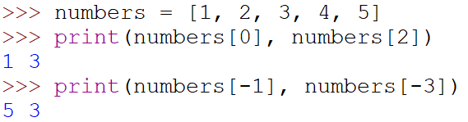
Indexing
Index: a number specifying the position of an element in a list
Enables access to individual element in list
Index of first element in the list is 0, second element is 1, and n’th element is n-1
Negative indexes identify positions relative to the end of the list
The index -1 identifies the last element, -2 identifies the next to last element, etc.

Slide 8

The len function
An IndexError exception is raised if an invalid index is used
len function: returns the length of a sequence such as a list
Example: size = len(my_list)
Returns the number of elements in the list, so the index of last element is len(list)-1
Can be used to prevent an IndexError exception when iterating over a list with a loop

Slide 9
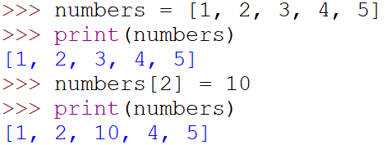
Lists Are Mutable
Mutable sequence: the items in the sequence can be changed
Lists are mutable, and so their elements can be changed
An expression such as
list[1] = new_value can be used to assign a new value to a list element
Must use a valid index to prevent raising of an IndexError exception

Slide 10
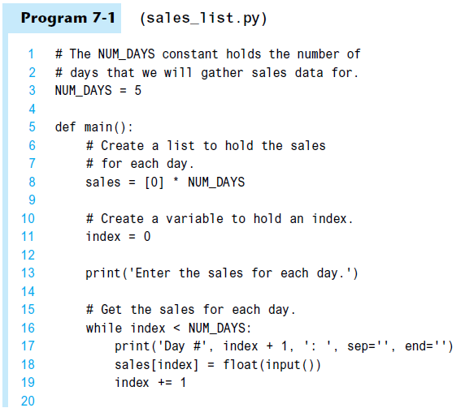
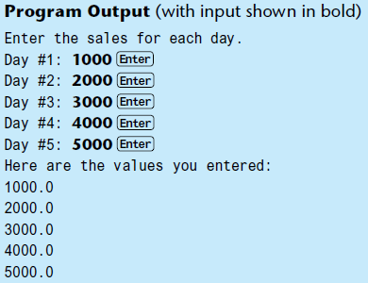
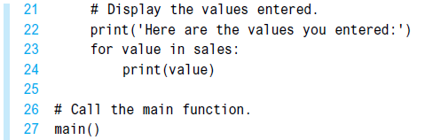

Slide 11
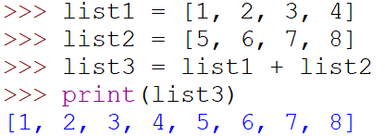

Concatenating Lists
Concatenate: join two things together
The + operator can be used to concatenate two lists
Cannot concatenate a list with another data type, such as a number
The += augmented assignment operator can also be used to concatenate lists

Slide 12
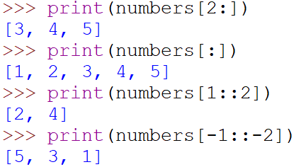
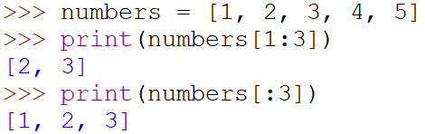
List Slicing
Slice: a span of items that are taken from a sequence
List slicing format: list[start : end]
Span is a list containing copies of elements from start up to, but not including, end
If start not specified, 0 is used for start index
If end not specified, len(list) is used for end index
Slicing expressions can include a step value and negative indexes relative to end of list

Slide 13
Finding Items in Lists with the in Operator
You can use the in operator to determine whether an item is contained in a list
General format: item in list
Returns True if the item is in the list, or False if it is not in the list
Similarly you can use the not in operator to determine whether an item is not in a list

Slide 14
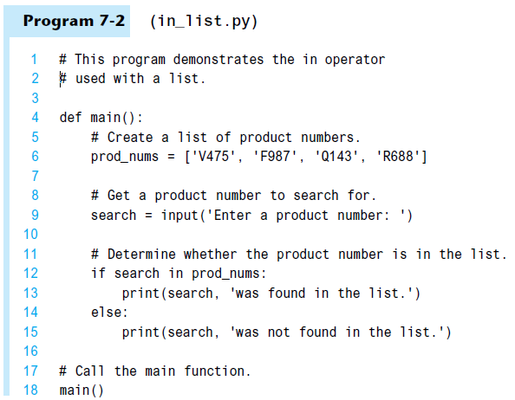
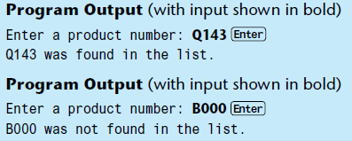

Slide 15
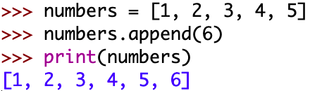
List Methods
append(item): used to add items to a list – item is appended to the end of the existing list

Slide 16
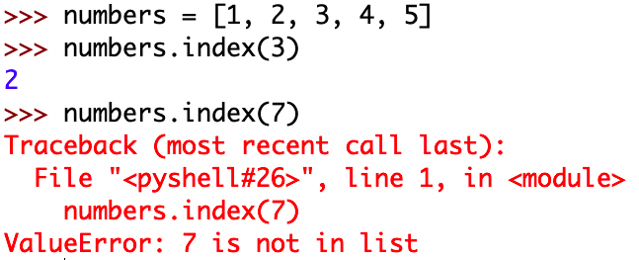
List Methods (cont’d.)
index(item): used to determine where an item is located in a list
Returns the index of the first element in the list containing item
Raises ValueError exception if item not in the list

Slide 17
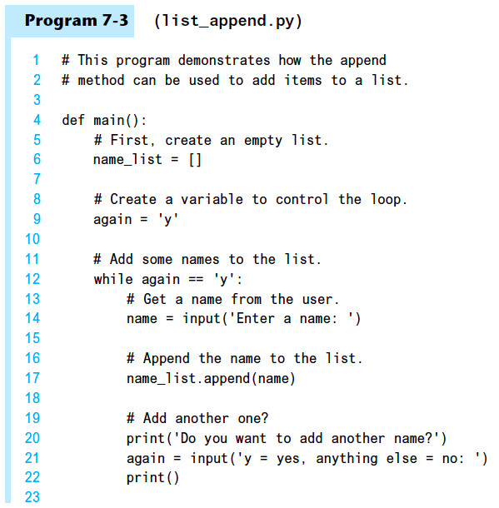

Slide 18
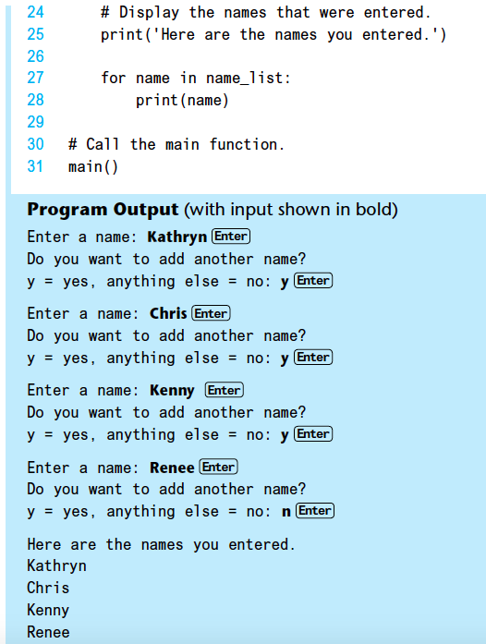

Slide 19
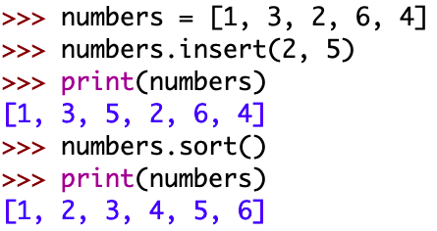
List Methods (cont’d.)
insert(index, item): used to insert item at position index in the list
sort(): used to sort the elements of the list in ascending order

Slide 20
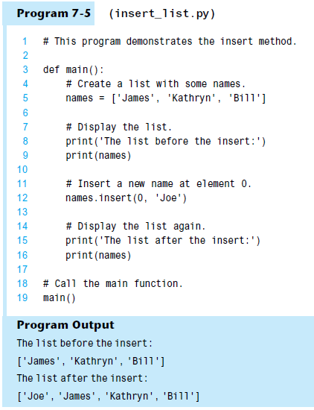

Slide 21
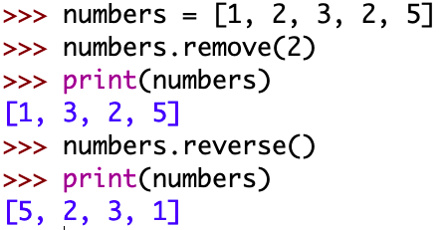
List Methods (cont’d.)
remove(item): removes the first occurrence of item in the list
Raises ValueError exception if item not in the list
reverse(): reverses the order of the elements in the list

Slide 22
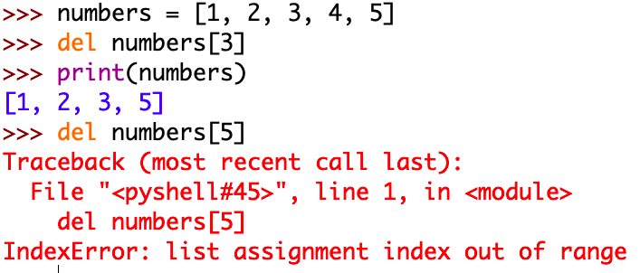
Useful Built-in Functions
del statement: removes an element from a specific index in a list
General format: del list[i]

Slide 23
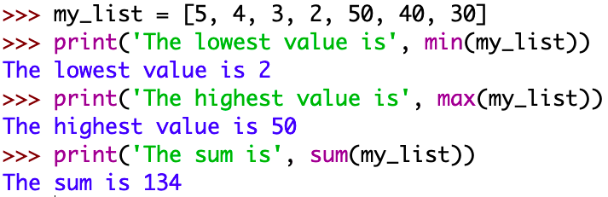
Useful Built-in Functions (cont’d.)
min and max functions: built-in functions that returns the item that has the lowest or highest value in a sequence
The sequence is passed as an argument
Sum functions: built-in functions that returns the sum of all values in a sequence

Slide 24
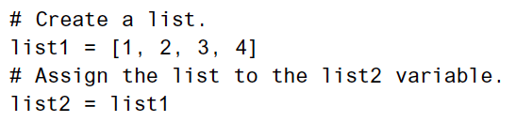
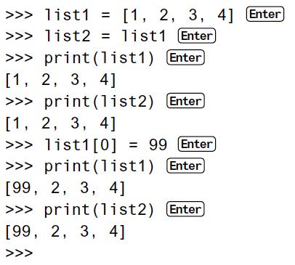
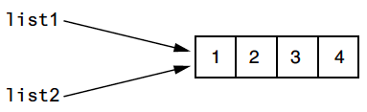
List Referencing
After this code executes, both variables list1 and list2 will reference the same list in memory.

Slide 25
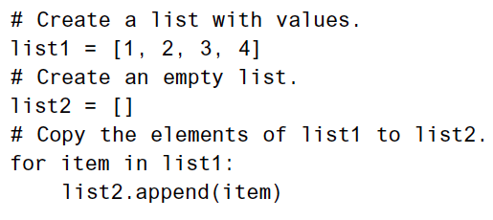
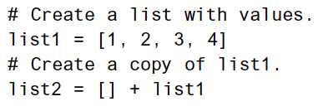
Copying Lists
To make a copy of a list you must copy each element of the list
Two methods to do this:
Creating a new empty list and using a for loop to add a copy of each element from the original list to the new list
Creating a new empty list and concatenating the old list to the new empty list
As a result, list1 and list2 will reference two separate but identical lists.

Slide 26
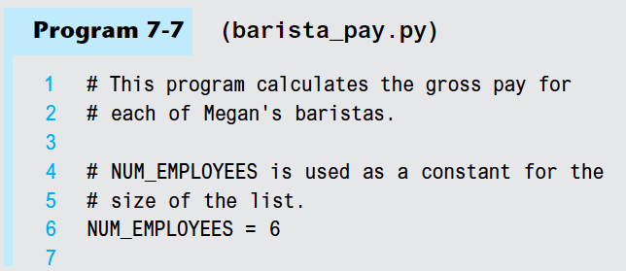
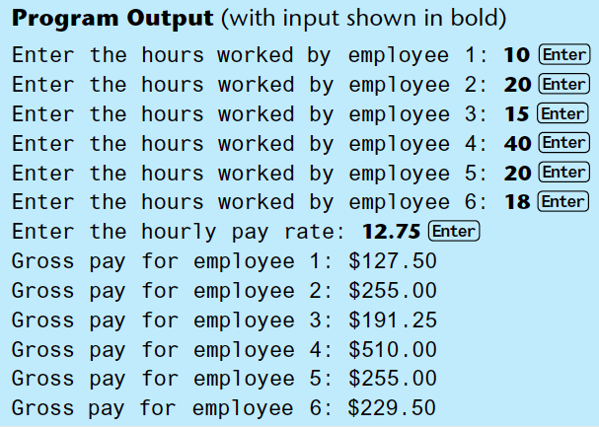
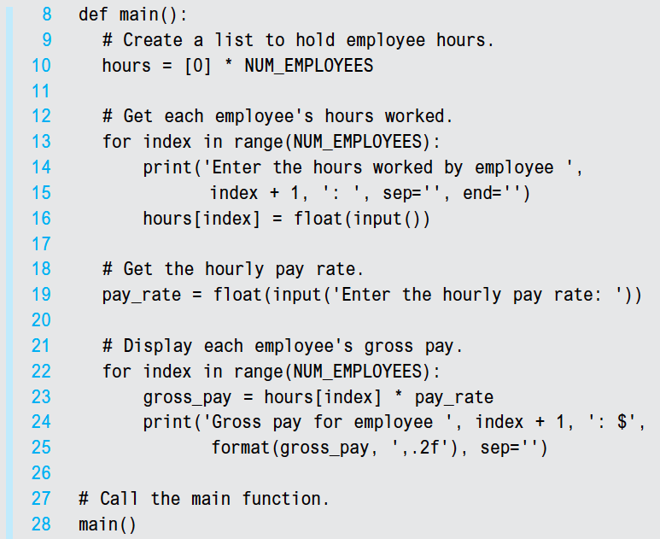

Slide 27
Two-Dimensional Lists
Two-dimensional list: a list that contains other lists as its elements
Also known as nested list
Common to think of two-dimensional lists as having rows and columns
Useful for working with multiple sets of data
To process data in a two-dimensional list need to use two indexes
Typically use nested loops to process

Slide 28
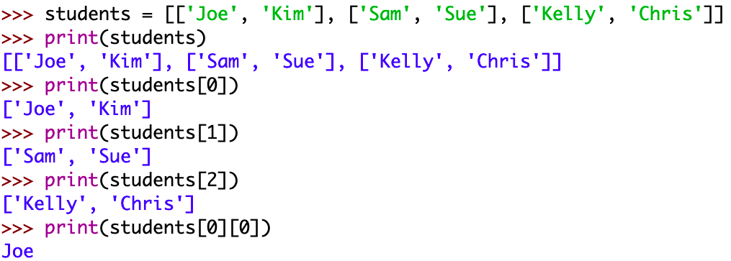
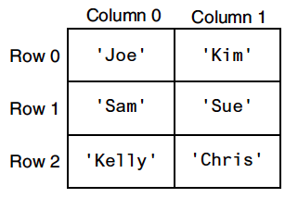
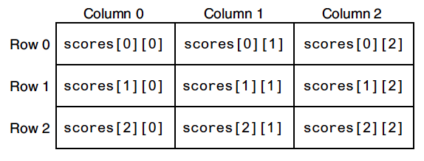
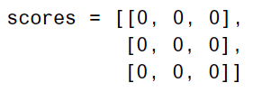
Two-Dimensional Lists (cont’d.)

Slide 29
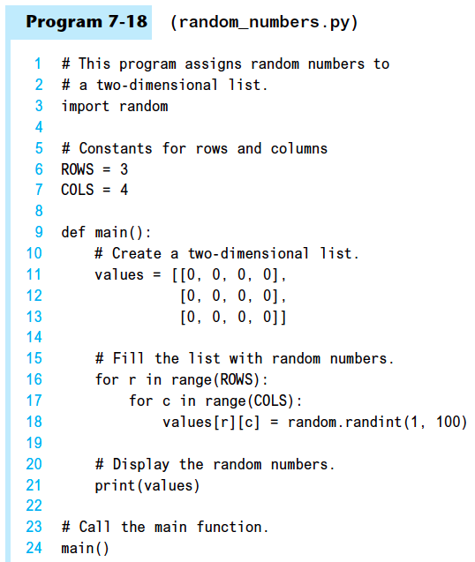


Slide 30
Tuples
Tuple: an immutable sequence
Very similar to a list
Once it is created it cannot be changed
Format: tuple_name = (item1, item2)
Tuples support operations as lists
Subscript indexing for retrieving elements
Methods such as index
Built in functions such as len, min, max, sum
Slicing expressions
The in, +, and * operators

Slide 31
Tuples (cont’d.)
Tuples do not support the methods:
append
remove
insert
reverse
sort
Tuples do not support del statement

Slide 32

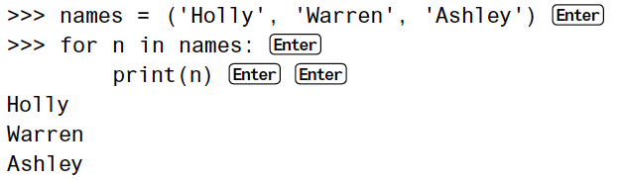
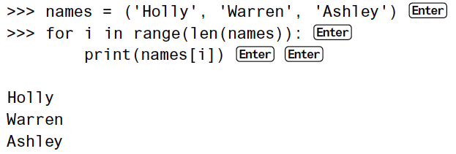

Slide 33
Tuples (cont’d.)
Advantages for using tuples over lists:
Processing tuples is faster than processing lists
Tuples are safe
Some operations in Python require use of tuples
list() function: converts tuple to list
tuple() function: converts list to tuple

Slide 34
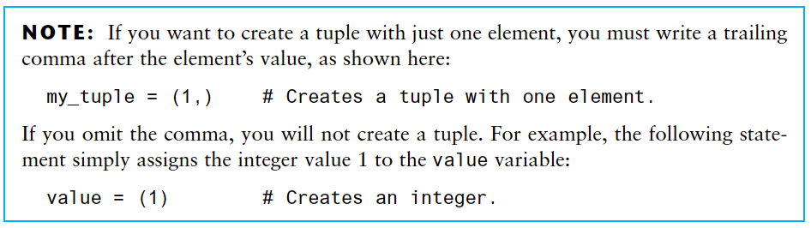

Slide 35
Summary
This chapter covered:
Lists, including:
Repetition and concatenation operators
Indexing
Techniques for processing lists
Slicing and copying lists
List methods and built-in functions for lists
Two-dimensional lists
Tuples, including:
Immutability
Difference from and advantages over lists

