Slide 1
CN101
Lecture 13-14
More About Strings

Slide 2
Topics
Basic String Operations
String Slicing
Testing, Searching, and Manipulating Strings

Slide 3
Basic String Operations
Many types of programs perform operations on strings
In Python, many tools for examining and manipulating strings
Strings are sequences, so many of the tools that work with sequences work with strings
Display the character by using print()function
Assigning a string into a variable can be done by quotes.
>> print (“Hello”)
Hello
>> a = “Hello”
>> print (a)
Hello

Slide 4
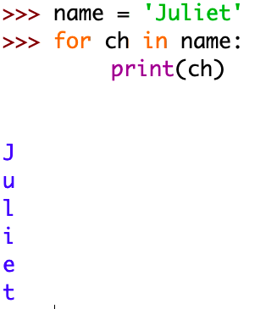
Accessing the Individual Characters in a String
To access an individual character in a string:
Use a for loop
Format: for character in string:
Useful when need to iterate over the whole string, such as to count the occurrences of a specific character

Slide 5
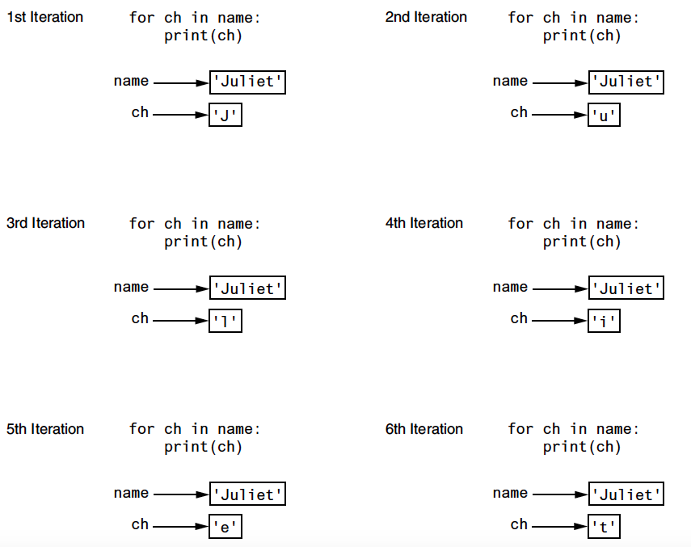

Slide 6
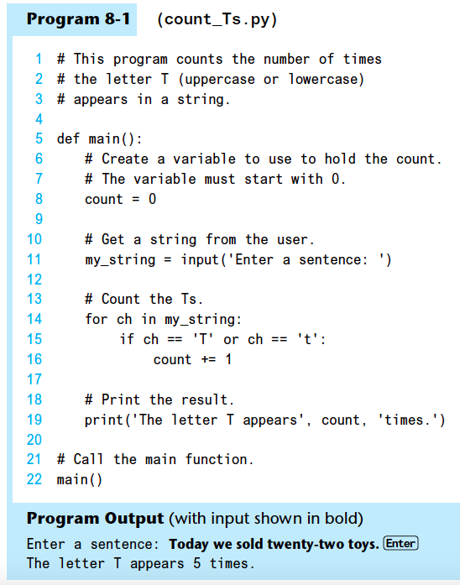

Slide 7
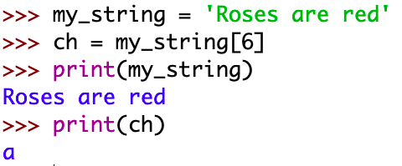

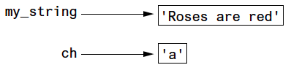
Accessing the Individual Characters in a String
To access an individual character in a string:
Use indexing
Each character has an index specifying its position in the string, starting at 0
Format: character = my_string[i]

Slide 8
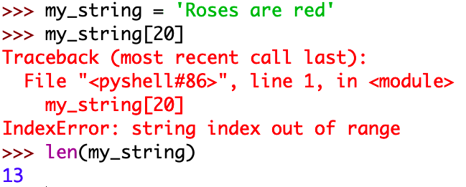
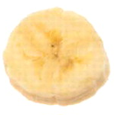
Accessing the Individual Characters in a String (cont’d.)
IndexError exception will occur if:
You try to use an index that is out of range for the string
Likely to happen when loop iterates beyond the end of the string
len(string) function can be used to obtain the length of a string
Useful to prevent loops from iterating beyond the end of a string

Slide 9
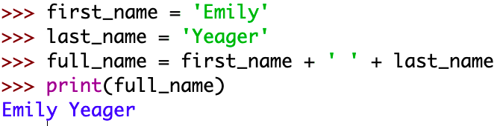
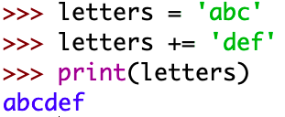
String Concatenation
Concatenation: appending one string to the end of another string
Use the + operator to produce a string that is a combination of its operands
The augmented assignment operator += can also be used to concatenate strings
The operand on the left side of the += operator must be an existing variable; otherwise, an exception is raised

Slide 10
Strings Are Immutable
Strings are immutable
Once they are created, they cannot be changed
Concatenation doesn’t actually change the existing string, but rather creates a new string and assigns the new string to the previously used variable
Cannot use an expression of the form
string[index] = new_character
Statement of this type will raise an exception

Slide 11
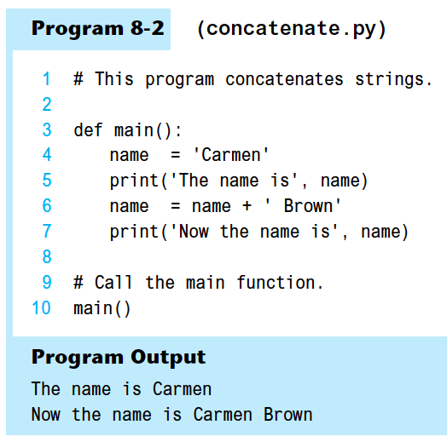
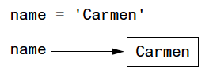
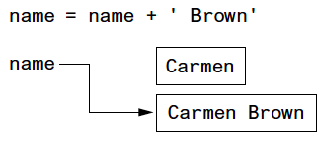
Strings Are Immutable (cont’d.)

Slide 12
String Slicing
Slice: span of items taken from a sequence, known as substring
Slicing format: string[start : end]
Expression will return a string containing a copy of the characters from start up to, but not including, end
If start not specified, 0 is used for start index
If end not specified, len(string) is used for end index
Slicing expressions can include a step value and negative indexes relative to end of string

Slide 13
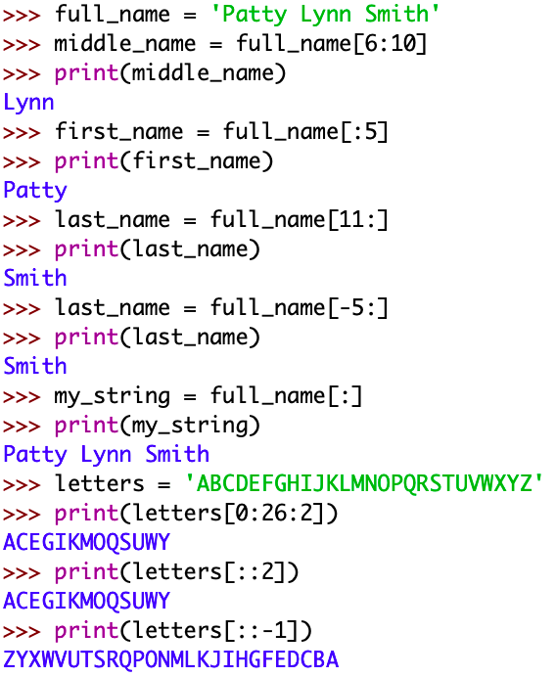

Slide 14
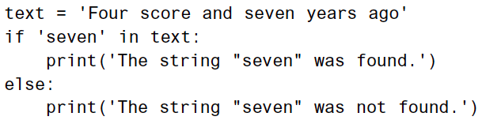
Testing, Searching, and Manipulating Strings
You can use the in operator to determine whether one string is contained in another string
General format: string1 in string2
string1 and string2 can be string literals or variables referencing strings
Similarly you can use the not in operator to determine whether one string is not contained in another string

Slide 15
String Methods
Strings in Python have many types of methods, divided into different types of operations
General format: mystring.method(arguments)
Some methods test a string for specific characteristics
Generally Boolean methods, that return True if a condition exists, and False otherwise

Slide 16
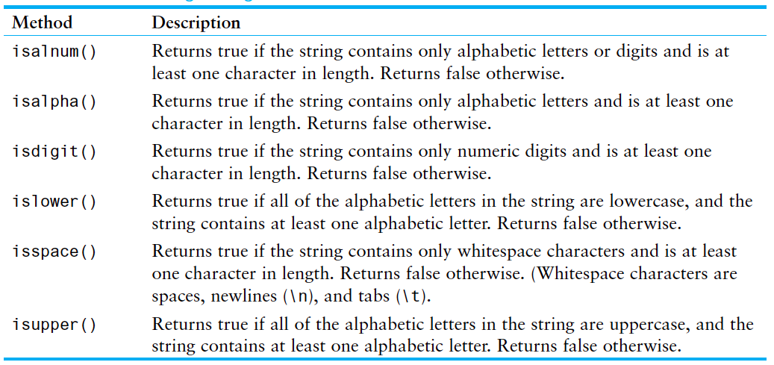
String Methods (cont’d.)

Slide 17
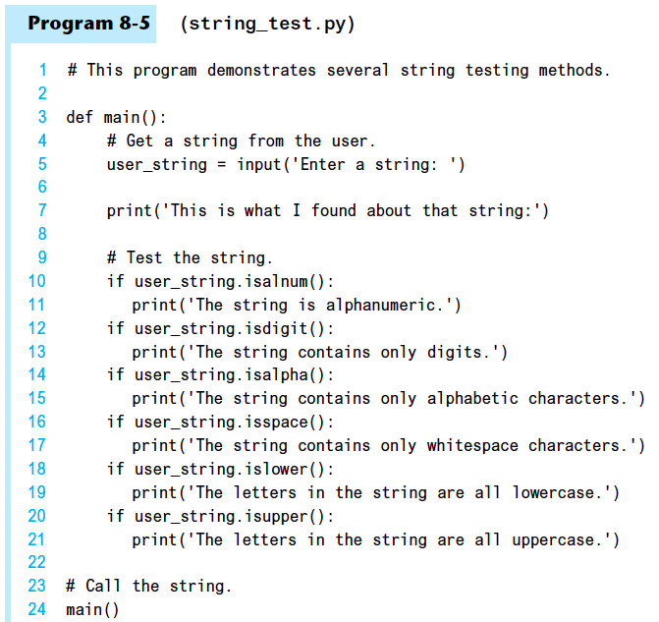

Slide 18
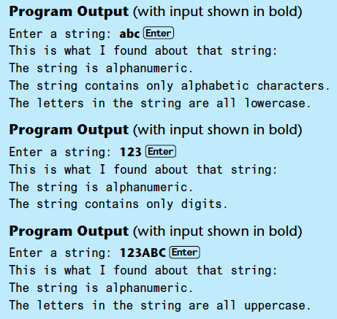

Slide 19
String Methods (cont’d.)
Some methods return a copy of the string, to which modifications have been made
Simulate strings as mutable objects
String comparisons are case-sensitive
Uppercase characters are distinguished from lowercase characters
lower and upper methods can be used for making case-insensitive string comparisons

Slide 20
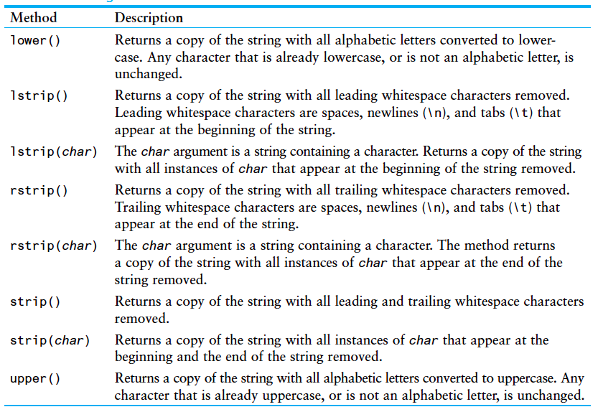

Slide 21
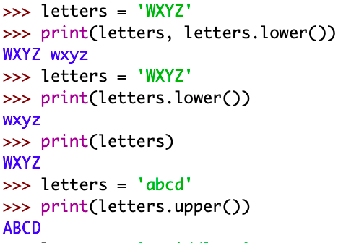
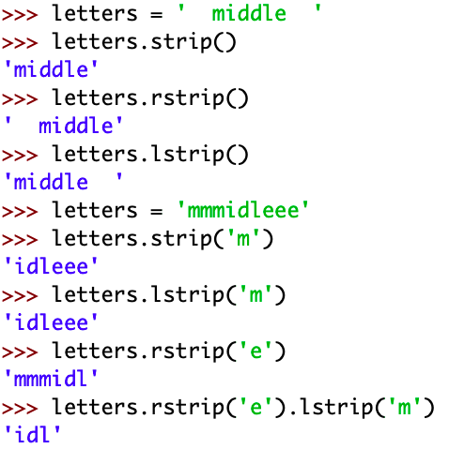

Slide 22
String Methods (cont’d.)
Programs commonly need to search for substrings
Several methods to accomplish this:
endswith(substring): checks if the string ends with substring
Returns True or False
startswith(substring): checks if the string starts with substring
Returns True or False

Slide 23
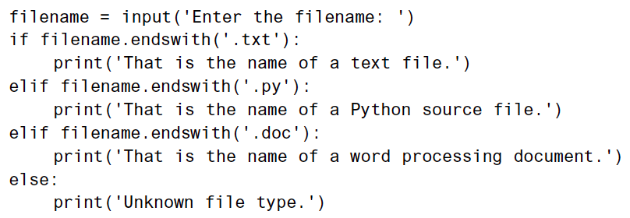

Slide 24
String Methods (cont’d.)
Several methods to accomplish this (cont’d):
find(substring): searches for substring within the string
Returns lowest index of the substring, or if the substring is not contained in the string, returns -1
replace(substring, new_string):
Returns a copy of the string where every occurrence of substring is replaced with new_string

Slide 25
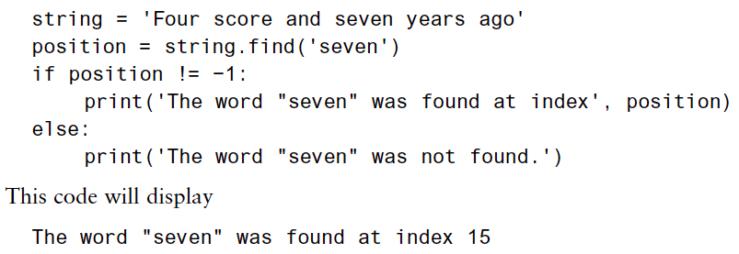
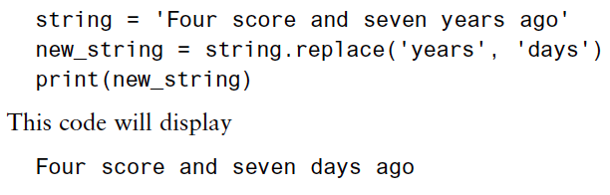

Slide 26
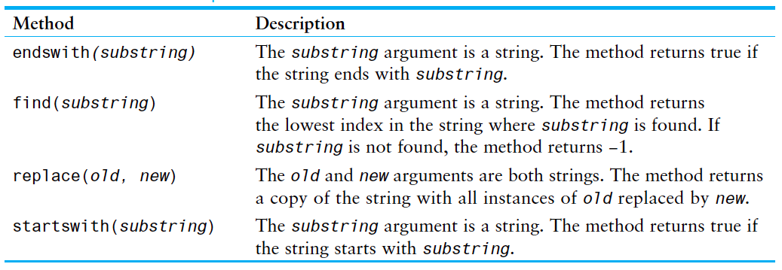
String Methods (cont’d.)

Slide 27
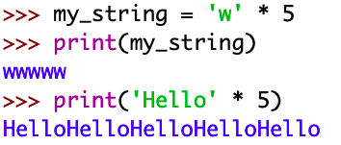
The Repetition Operator
Repetition operator: makes multiple copies of a string and joins them together
The * symbol is a repetition operator when applied to a string and an integer
String is left operand; number is right
General format: string_to_copy * n
Variable references a new string which contains multiple copies of the original string

Slide 28
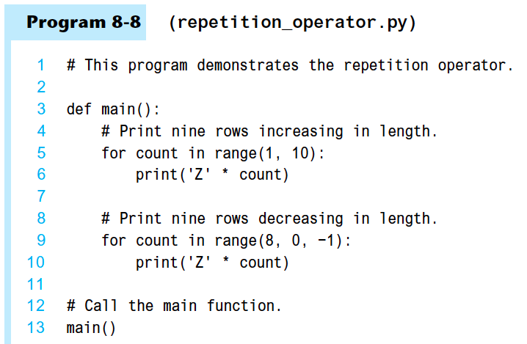
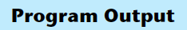
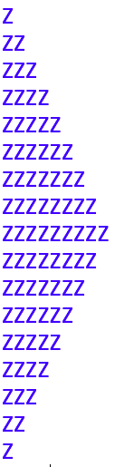

Slide 29
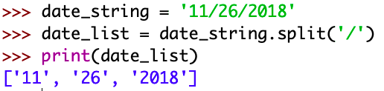
Splitting a String
split method: returns a list containing the words in the string
By default, uses space as separator
Can specify a different separator by passing it as an argument to the split method

Slide 30
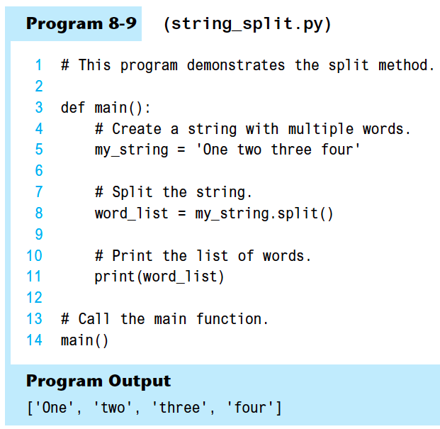

Slide 31
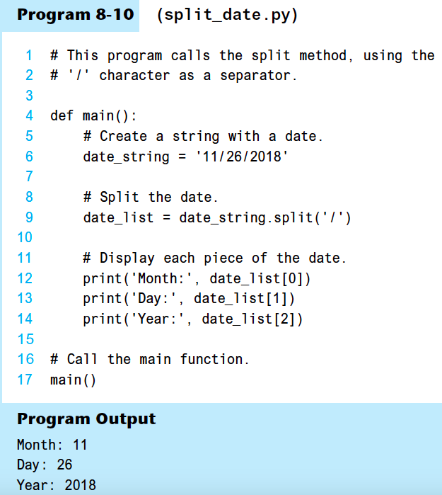

Slide 32
String Join
Join: method takes an iterable (objects capable of returning its members one at a time) as its parameter.
The Join method returns a string created by joining the elements of an iterable by string separator.
>>> numList = ['1', '2', '3', '4']
>>> separator = ', '
>>> print(separator.join(numList))
1, 2, 3, 4
test = {'1', '2', '3'}
s = ', '
print(s.join(test))
1, 2, 3
text = {'A', 'B', 'C’}
a = '- '
print(a.join(text))
A-B-C

Slide 33
Summary
This chapter covered:
String operations, including:
Methods for iterating over strings
Repetition and concatenation operators
Strings as immutable objects
Slicing strings and testing strings
String methods
Splitting a string

