Slide 1


NumPy Module

Slide 2

The Basics
NumPy’s main object is the homogeneous multidimensional array. It is a table of elements (usually numbers), all of the same type, indexed by a tuple of non-negative integers. In NumPy dimensions are called axes.
For example, the coordinates of a point in 3D space [1, 2, 1] has one axis. That axis has 3 elements in it, so we say it has a length of 3. In the example pictured, the array has 2 axes. The first axis has a length of 2, the second axis has a length of 3.
NumPy’s array class is called ndarray. It is also known by the alias array. The important attributes of an ndarray object are:
ndarray.ndim - the number of axes (dimensions) of the array.
ndarray.shape - the dimensions of the array. This is a tuple of integers indicating the size of the array in each dimension. For a matrix with n rows and m columns, shape will be (n,m). The length of the shape tuple is therefore the number of axes, ndim.
ndarray.size - the total number of elements of the array. This is equal to the product of the elements of shape.
(more on next slide)

Slide 3
The Basics
ndarray.dtype - an object describing the type of the elements in the array. One can create or specify dtype’s using standard Python types. Additionally NumPy provides types of its own. numpy.int32, numpy.int16, and numpy.float64 are some examples.
ndarray.itemsize - the size in bytes of each element of the array. For example, an array of elements of type float64 has itemsize 8 (=64/8), while one of type complex32 has itemsize 4 (=32/8). It is equivalent to ndarray.dtype.itemsize.
ndarray.data - the buffer containing the actual elements of the array. Normally, we won’t need to use this attribute because we will access the elements in an array using indexing facilities.

Slide 4
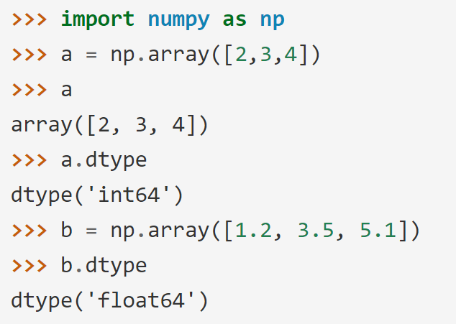
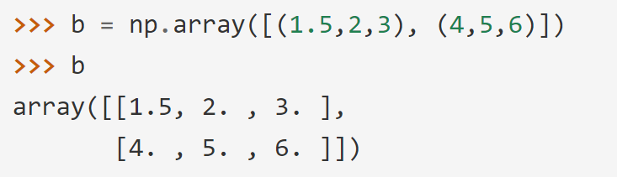
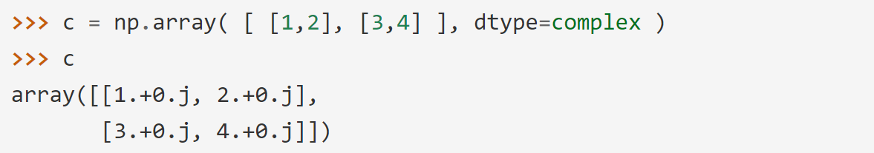
The Basics
Array Creation – array function
There are several ways to create arrays.
For example, you can create an array from a regular Python list or tuple using the array function. The type of the resulting array is deduced from the type of the elements in the sequences.
The type of the array can also be explicitly specified at creation time:

Slide 5
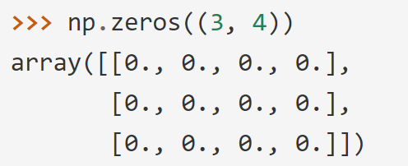
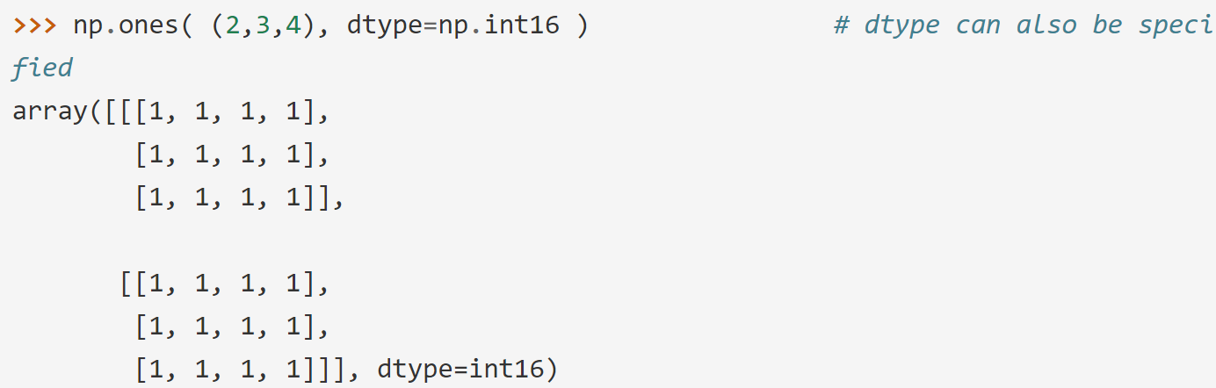
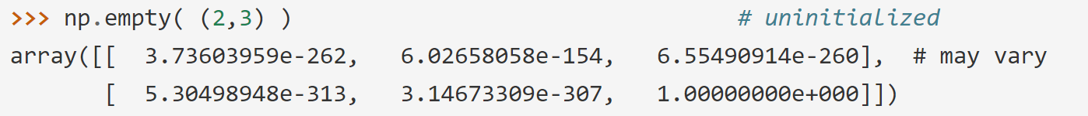
The Basics
Array Creation – zeros, ones, empty function
The function zeros creates an array full of zeros.
The function ones creates an array full of ones.
The function empty creates an array whose initial content is random and depends on the state of the memory. By default, the dtype of the created array is float64.

Slide 6
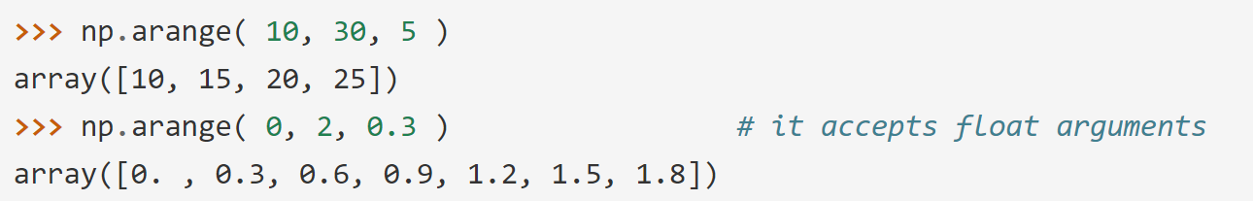
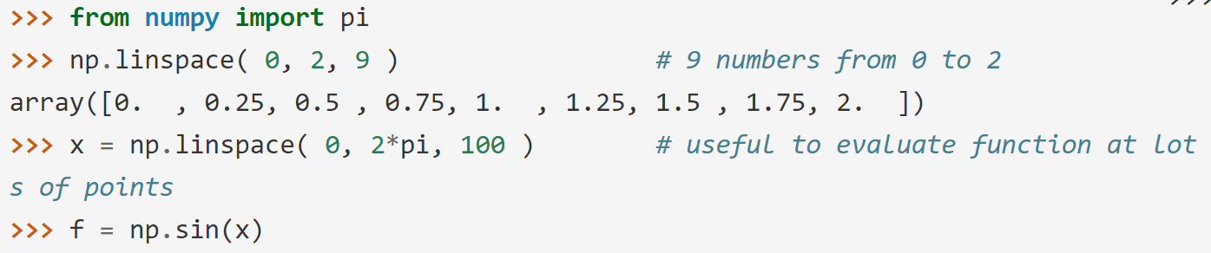
The Basics
Array Creation – arange, linspace function
To create sequences of numbers, NumPy provides the arange function which is analogous to the Python built-in range, but returns an array.
When arange is used with floating point arguments, it is generally not possible to predict the number of elements obtained, due to the finite floating point precision.
For this reason, it is usually better to use the function linspace that receives as an argument the number of elements that we want, instead of the step:

Slide 7
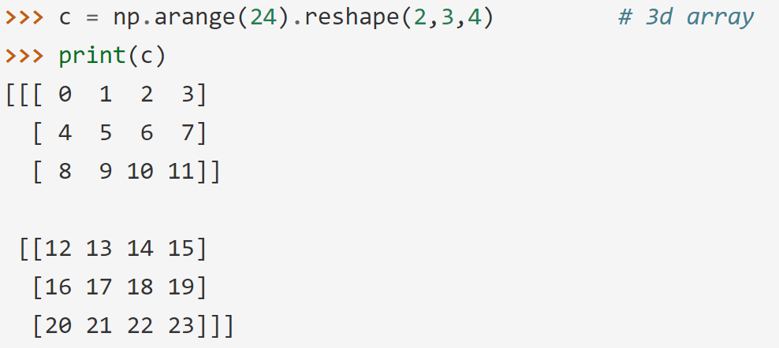
The Basics
Printing Array
When you print an array, NumPy displays it in a similar way to nested lists, but with the following layout:
the last axis is printed from left to right,
the second-to-last is printed from top to bottom,
the rest are also printed from top to bottom, with each slice separated from the next by an empty line.
One-dimensional arrays are then printed as rows, bidimensionals as matrices and tridimensionals as lists of matrices.

Slide 8
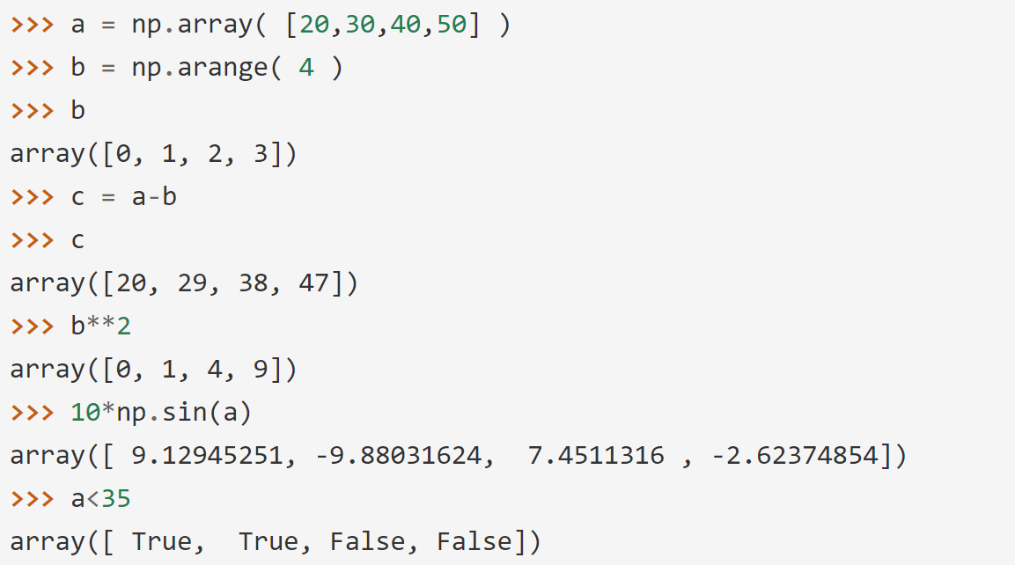
The Basics
Basic Operations – basic elementwise operators
Arithmetic operators on arrays apply elementwise. A new array is created and filled with the result.

Slide 9
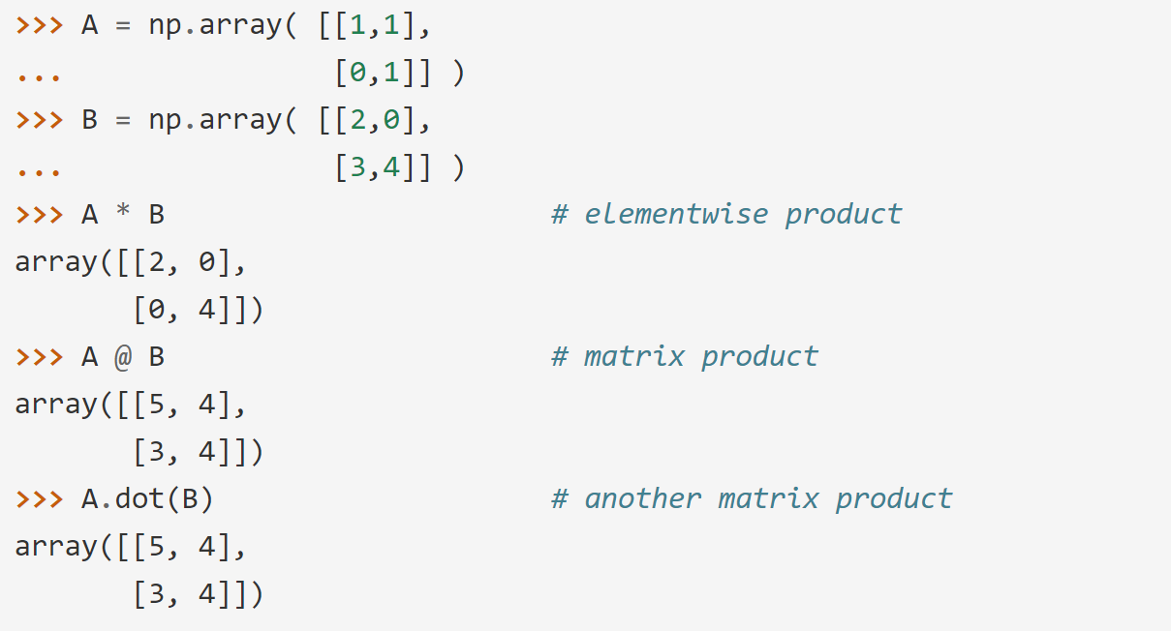
The Basics
Basic Operations – elementwise product
Unlike in many matrix languages, the product operator * operates elementwise in NumPy arrays. The matrix product can be performed using the @ operator (in python >=3.5) or the dot function or method:

Slide 10
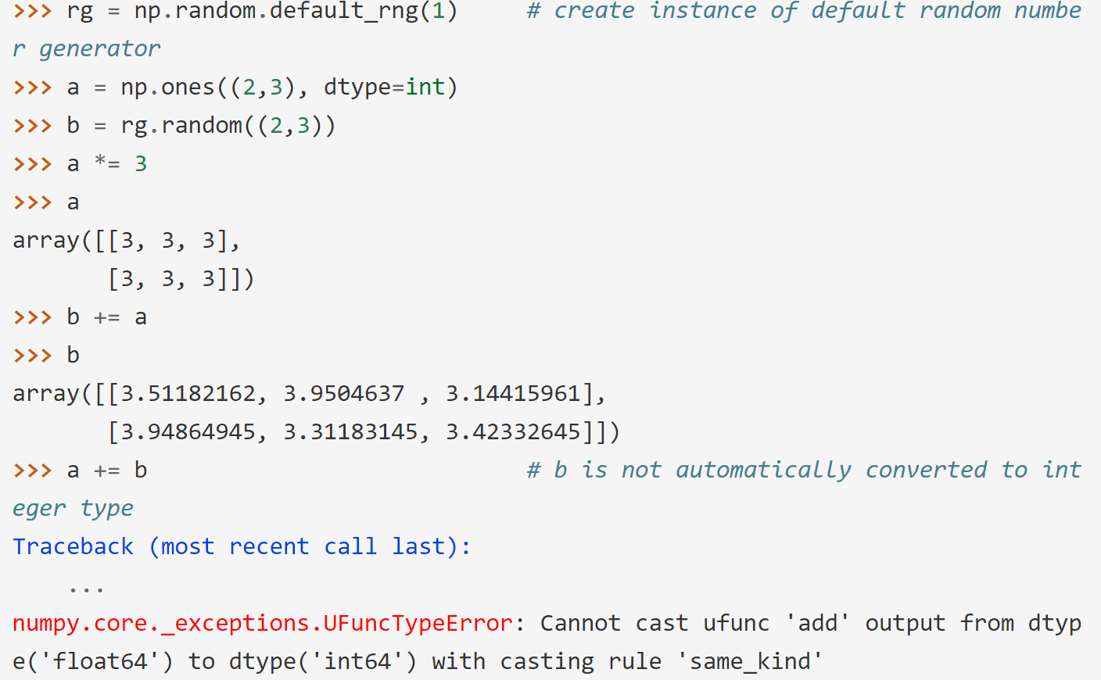
The Basics
Basic Operations – in-place operations
Some operations, such as += and *=, act in place to modify an existing array rather than create a new one.

Slide 11
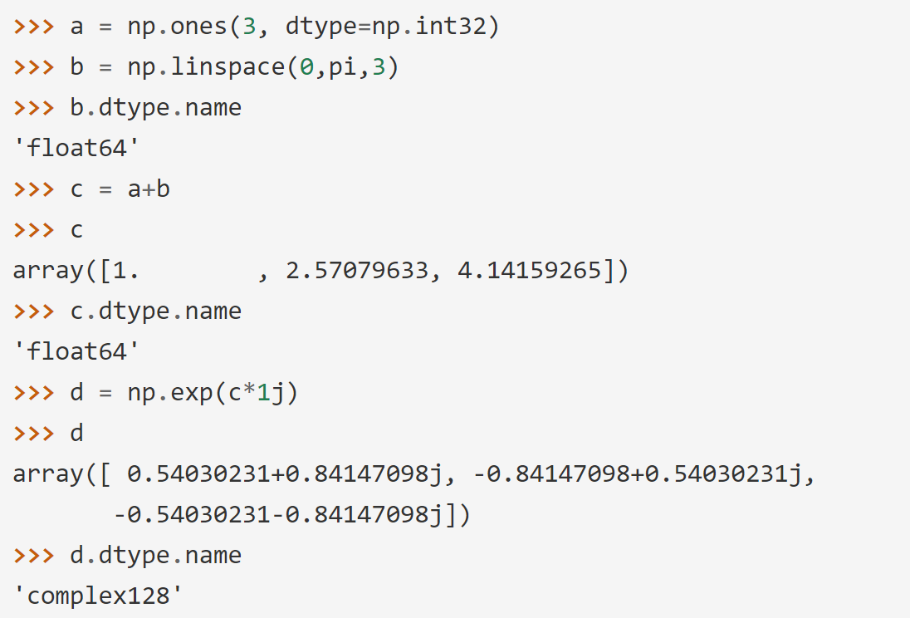
The Basics
Basic Operations – upcasting
When operating with arrays of different types, the type of the resulting array corresponds to the more general or precise one (a behavior known as upcasting).

Slide 12
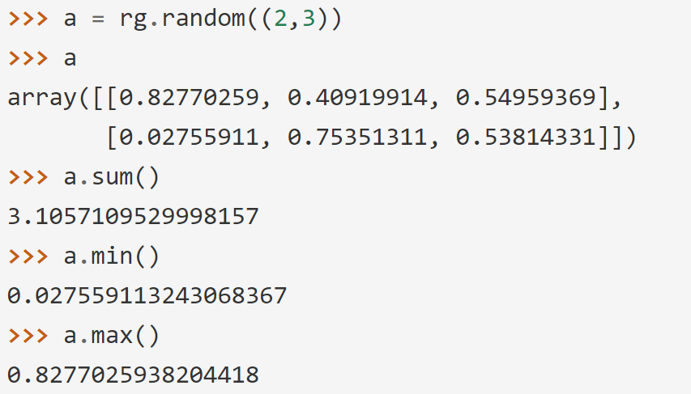
The Basics
Basic Operations – methods of ndarray class
Many unary operations, such as computing the sum of all the elements in the array, are implemented as methods of the ndarray class.

Slide 13
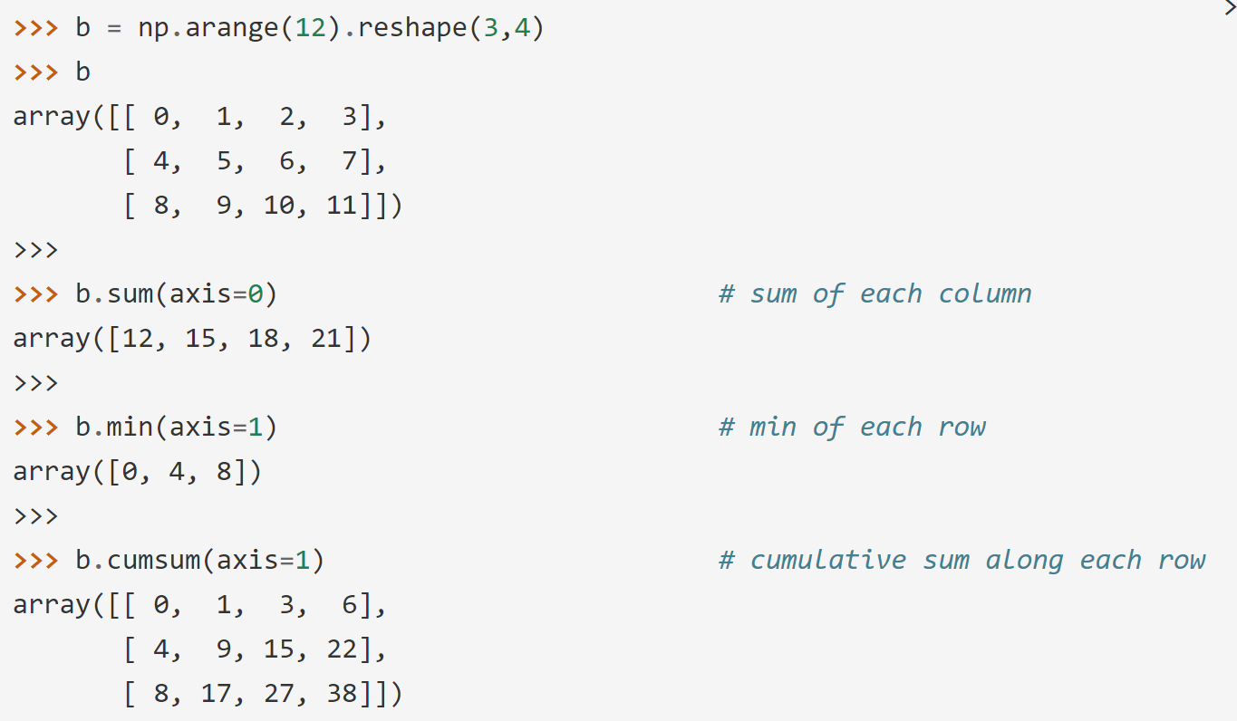
The Basics
Basic Operations – methods of ndarray class (cont.)
By default, these operations apply to the array as though it were a list of numbers, regardless of its shape. However, by specifying the axis parameter you can apply an operation along the specified axis of an array:

Slide 14
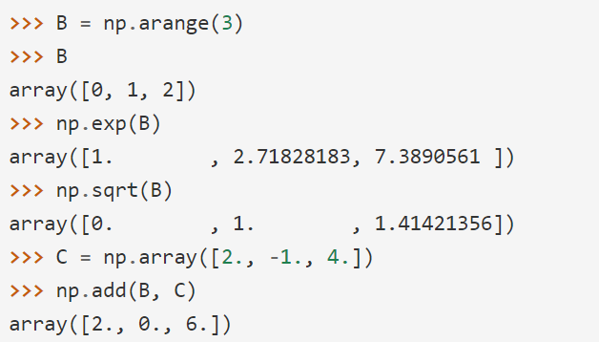
The Basics
Universal Functions
NumPy provides familiar mathematical functions such as sin, cos, and exp. In NumPy, these are called “universal functions”(ufunc). Within NumPy, these functions operate elementwise on an array, producing an array as output.

Slide 15
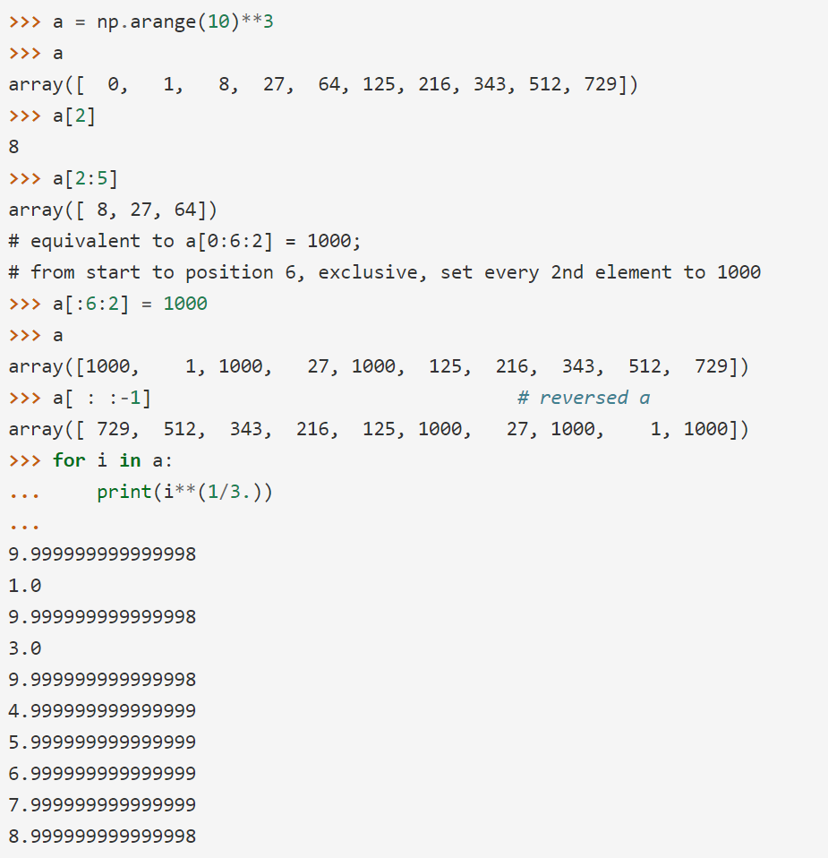
The Basics
Indexing, Slicing and Iterating
One-dimensional arrays can be indexed, sliced and iterated over, much like list and other Python sequences.

Slide 16
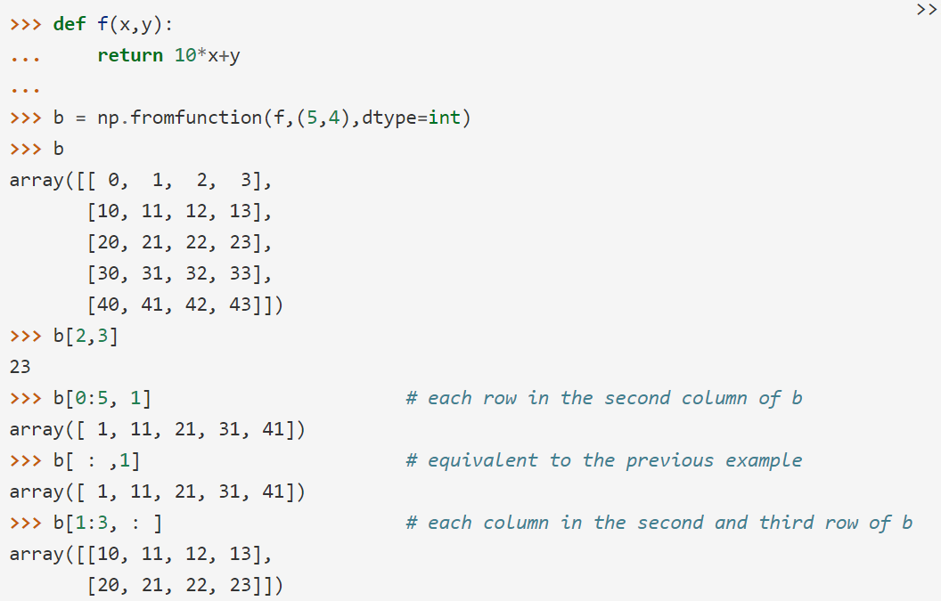
The Basics
Indexing, Slicing and Iterating
Multidimensional arrays can have one index per axis. These indices are given in a tuple separated by commas:

Slide 17
The Basics
Indexing, Slicing and Iterating
When fewer indices are provided than the number of axes, the missing indices are considered complete slices:

Slide 18
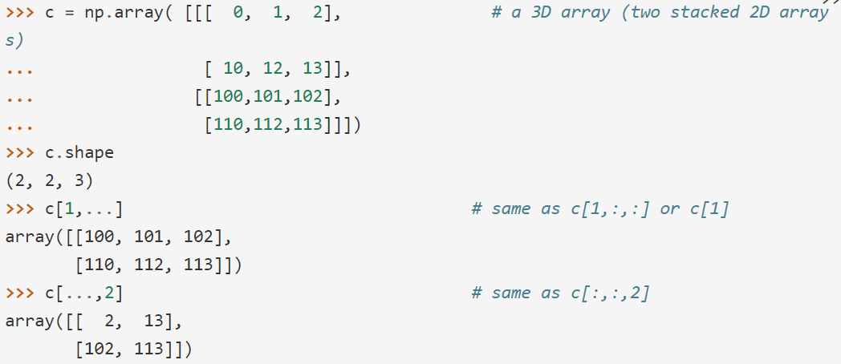
The Basics
Indexing, Slicing and Iterating
The expression within brackets in b[i] is treated as an i followed by as many instances of : as needed to represent the remaining axes. NumPy also allows you to write this using dots as b[i, ...].
The dots (...) represent as many colons as needed to produce a complete indexing tuple. For example, if x is an array with 5 axes, then
x[1, 2, ...] is equivalent to x[1, 2, :, :, :],
x[..., 3] to x[:, :, :, :, 3] and
x[4, ..., 5, :] to x[4, :, :, 5, :].

Slide 19
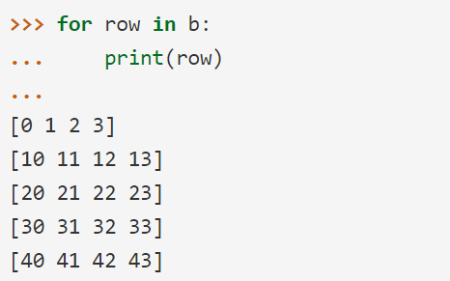
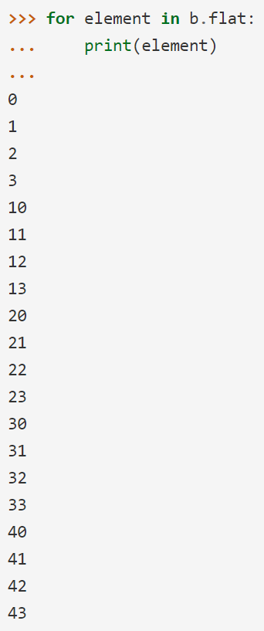
The Basics
Indexing, Slicing and Iterating
Iterating over multidimensional arrays is done with respect to the first axis:
However, if one wants to perform an operation on each element in the array, one can use the flat attribute which is an iterator over all the elements of the array:

Slide 20
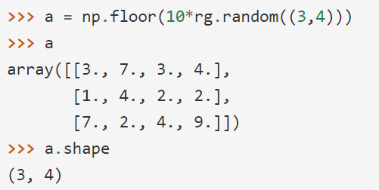
Shape Manipulation
Changing the shape of an array
An array has a shape given by the number of elements along each axis:

Slide 21
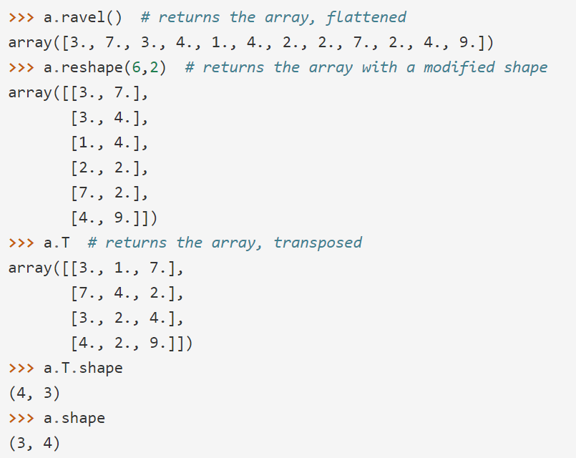
Shape Manipulation
Changing the shape of an array
The shape of an array can be changed with various commands. Note that the following three commands all return a modified array, but do not change the original array:

Slide 22
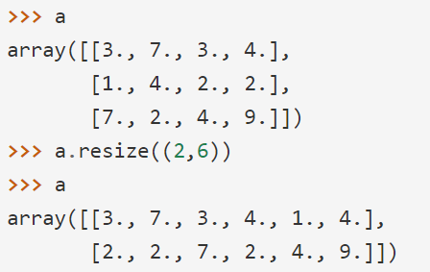
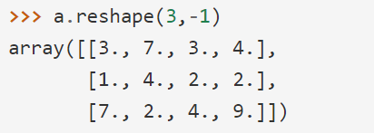
Shape Manipulation
Changing the shape of an array
The reshape function returns its argument with a modified shape, whereas the ndarray.resize method modifies the array itself:
If a dimension is given as -1 in a reshaping operation, the other dimensions are automatically calculated:

Slide 23
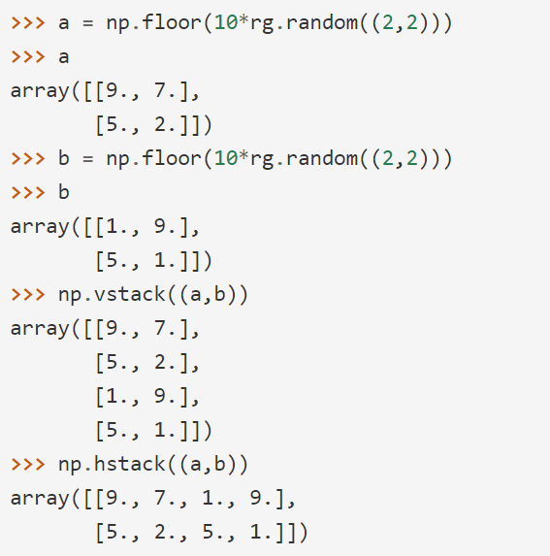
Shape Manipulation
Stacking together different arrays
Several arrays can be stacked together along different axes:

Slide 24
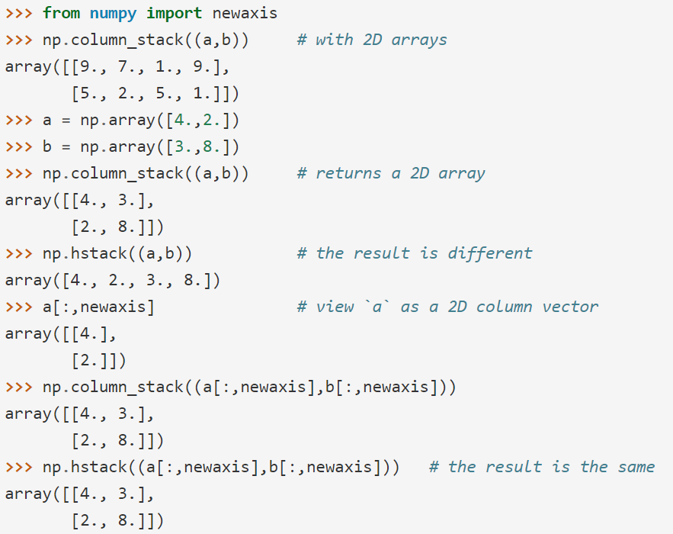
Shape Manipulation
Stacking together different arrays
The function column_stack stacks 1D arrays as columns into a 2D array. It is equivalent to hstack only for 2D arrays:

Slide 25
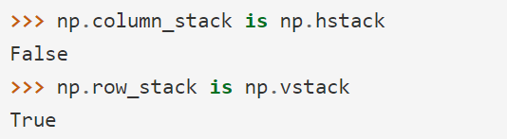
Shape Manipulation
Stacking together different arrays
On the other hand, the function row_stack is equivalent to vstack for any input arrays. In fact, row_stack is an alias for vstack:
In general, for arrays with more than two dimensions, hstack stacks along their second axes, vstack stacks along their first axes, and concatenate allows for an optional arguments giving the number of the axis along which the concatenation should happen.

Slide 26

Shape Manipulation
Stacking together different arrays
In complex cases, r_ and c_ are useful for creating arrays by stacking numbers along one axis. They allow the use of range literals (“:”)
When used with arrays as arguments, r_ and c_ are similar to vstack and hstack in their default behavior, but allow for an optional argument giving the number of the axis along which to concatenate.

Slide 27
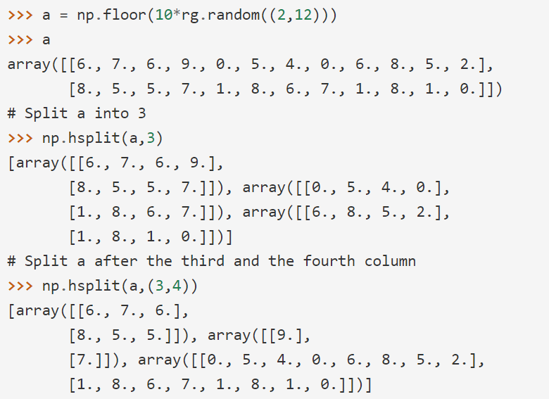
Shape Manipulation
Splitting one array into several smaller ones
Using hsplit, you can split an array along its horizontal axis, either by specifying the number of equally shaped arrays to return, or by specifying the columns after which the division should occur:
vsplit splits along the vertical axis, and array_split allows one to specify along which axis to split.

Slide 28
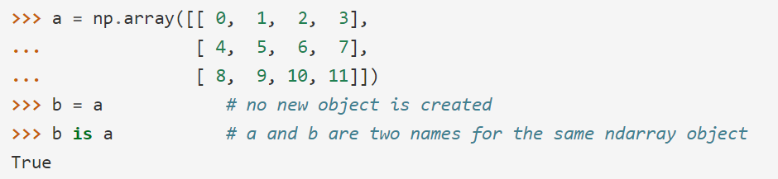
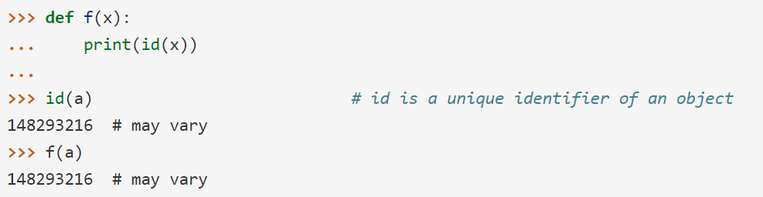
Copies and Views
No Copy at All
When operating and manipulating arrays, their data is sometimes copied into a new array and sometimes not. This is often a source of confusion for beginners. There are three cases, so let’s look at No Copy at All case first.
Simple assignments make no copy of objects or their data.
Python passes mutable objects as references, so function calls make no copy.

Slide 29
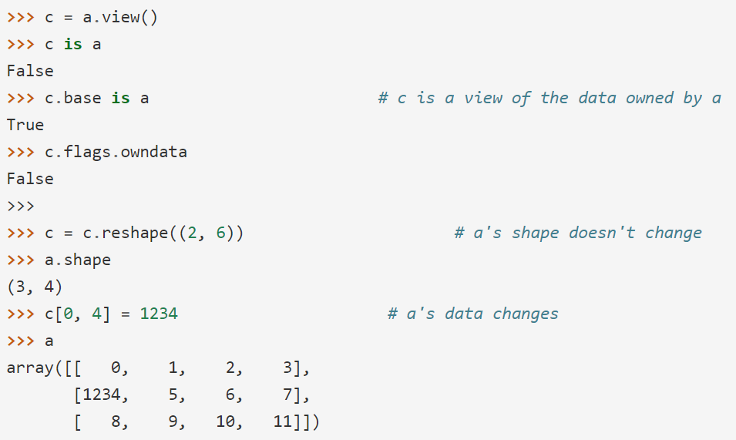
Copies and Views
View or Shallow Copy
Different array objects can share the same data. The view method creates a new array object that looks at the same data.

Slide 30
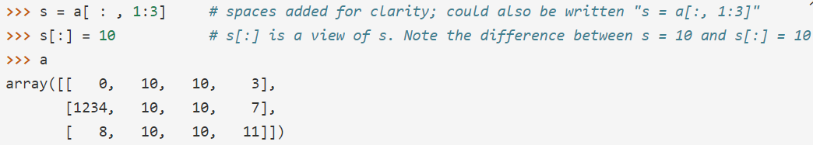
Copies and Views
View or Shallow Copy (cont.)
Slicing an array returns a view of it:

Slide 31
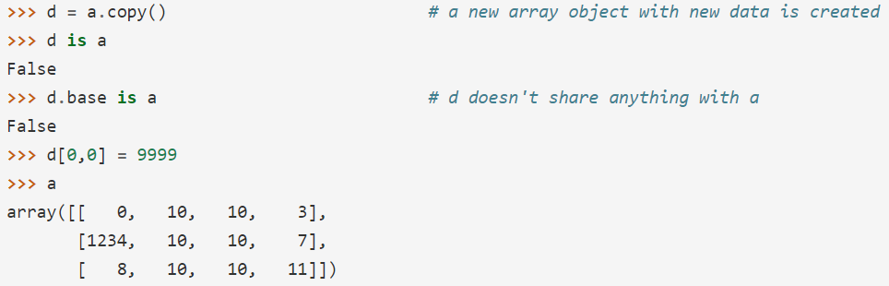
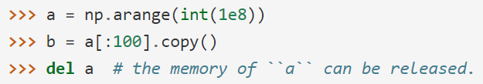
Copies and Views
Deep Copy
The copy method makes a complete copy of the array and its data.
Sometimes copy should be called after slicing if the original array is not required anymore. For example, suppose a is a huge intermediate result and the final result b only contains a small fraction of a, a deep copy should be made when constructing b with slicing:
If b = a[:100] is used instead, a is referenced by b and will persist in memory even if del a is executed.

Slide 32
Functions and Methods Overview
Here is a list of some useful NumPy functions and methods names ordered in categories.
Array Creation
arange, array, copy, empty, empty_like, eye, fromfile, fromfunction, identity, linspace, logspace,
mgrid, ogrid, ones, ones_like, r_, zeros, zeros_like
Conversions
ndarray.astype, atleast_1d, atleast_2d, atleast_3d, mat
Manipulations
array_split, column_stack, concatenate, diagonal, dsplit, dstack, hsplit, hstack, ndarray.item,
newaxis, ravel, repeat, reshape, resize, squeeze, swapaxes, take, transpose, vsplit, vstack
Questions
all, any, nonzero, where
(more on next slide)

Slide 33
Functions and Methods Overview
Ordering
argmax, argmin, argsort, max, min, ptp, searchsorted, sort
Operations
choose, compress, cumprod, cumsum, inner, ndarray.fill, imag, prod, put, putmask, real, sum
Basic Statistics
cov, mean, std, var
Basic Linear Algebra
cross, dot, outer, linalg.svd, vdot

