Slide 1

Tutorial
An R package for exploring human prehistory with the ROCEEH Out of Africa Database

Slide 2
Before we begin…
Install R: https://cran.rstudio.com/
Install Rstudio: https://posit.co/download/rstudio-desktop/
Rtools: https://cran.r-project.org/bin/windows/Rtools/ for Windows

Slide 3
Before we begin…
# Github installation
install.packages("devtools")
devtools::install_github("sommergeo/roadDB")
# Load the library
library(roadDB)
# Your first query
my_query <- road_get_localities(cultural_periods=“Middle Paleolithic”)

Slide 4
Before we begin…
# Install packages (needs to be done only once)
install.packages("tidyverse")
install.packages("sf")
install.packages("tmap")
install.packages("rcarbon")
# Load libraries (every time you run this tutorial)
library(tidyverse)
library(sf)
library(tmap)
library(rcarbon)

Slide 5
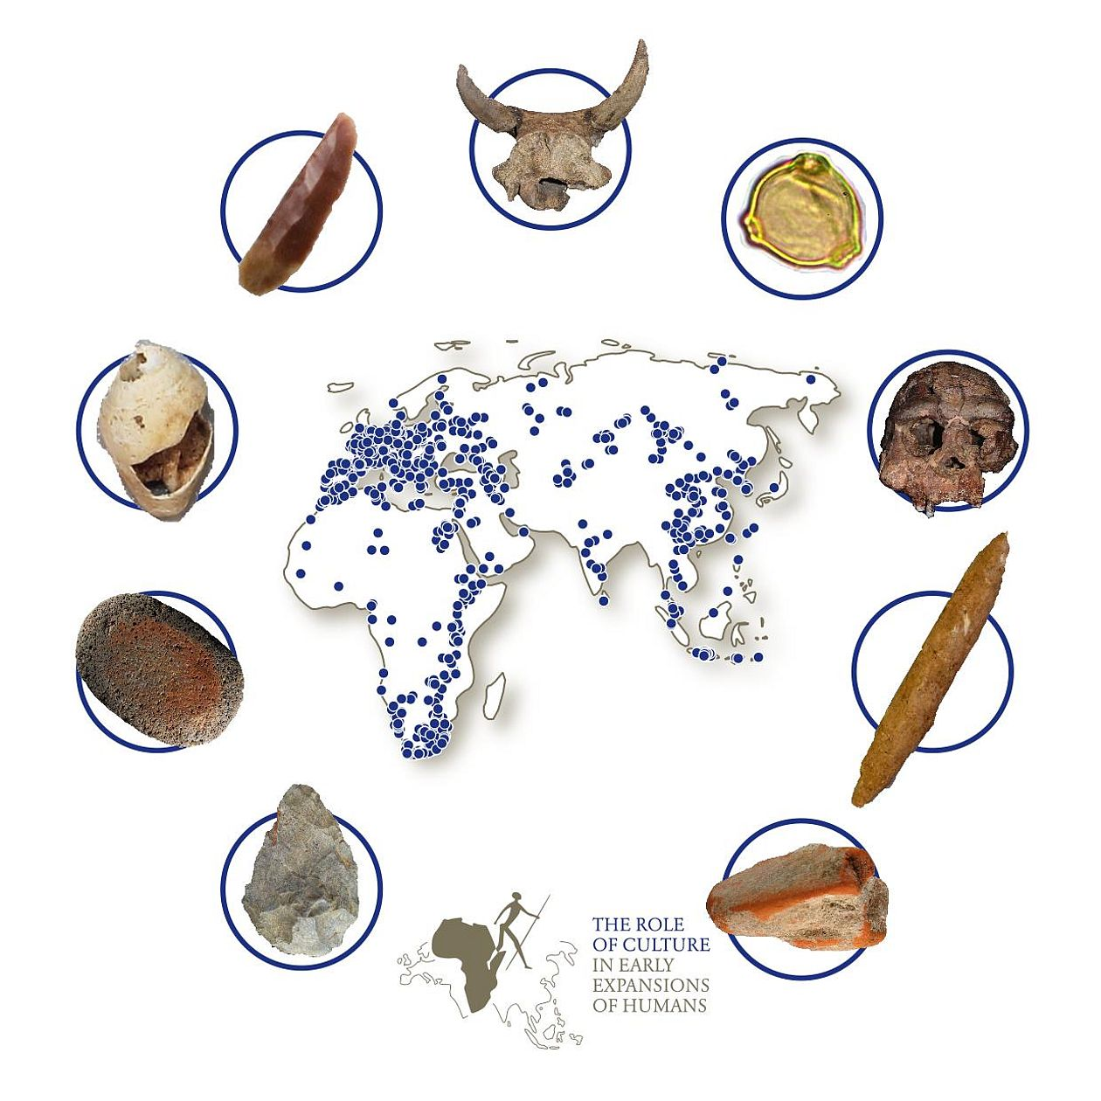
The ROCEEH Out of Africa Database

Slide 6
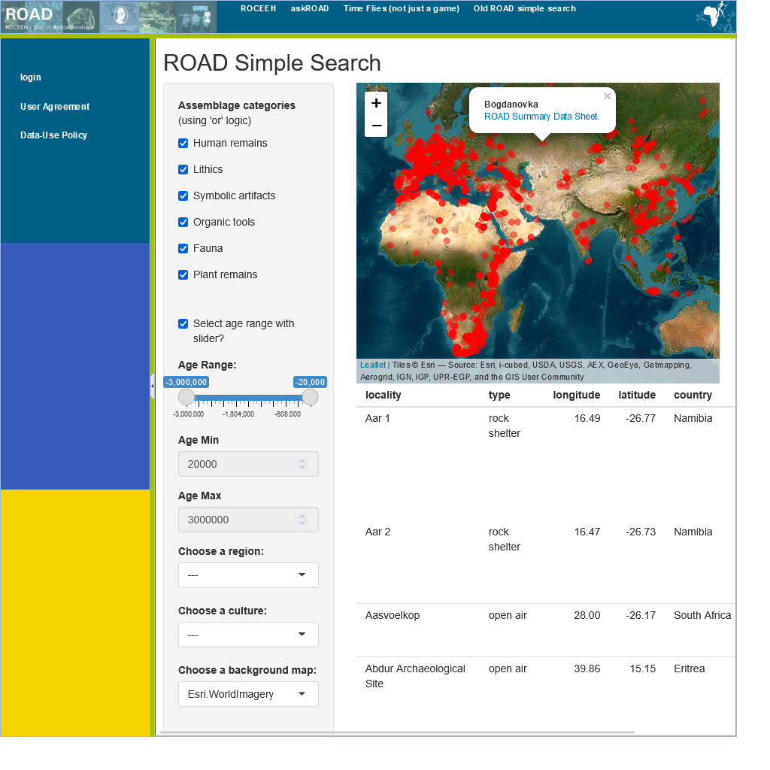
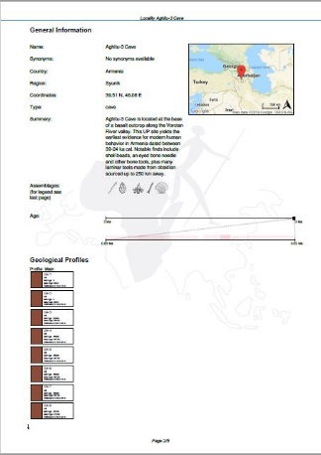
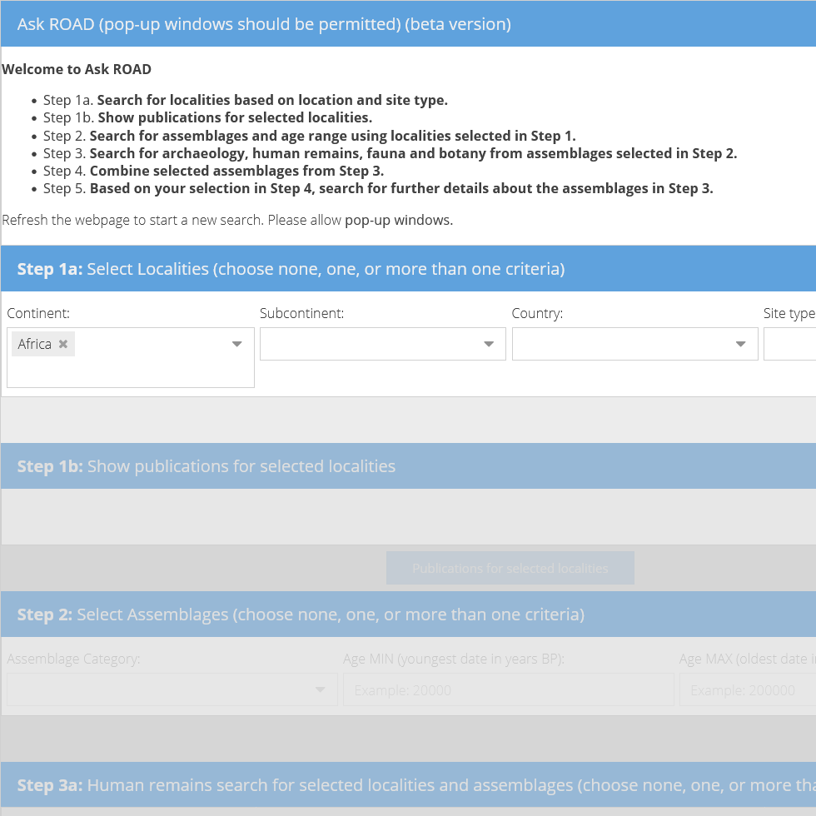
ROAD – Access without login
ROAD Simple Search: Get an overview over sites, timeframes and broad find categories
Summary Data Sheets: All information about a site in a handy, structured PDF format
Ask ROAD: Guides you through 5 steps to the data query you need. Many download options.
Queried on
6 Feb. 2023

Slide 7
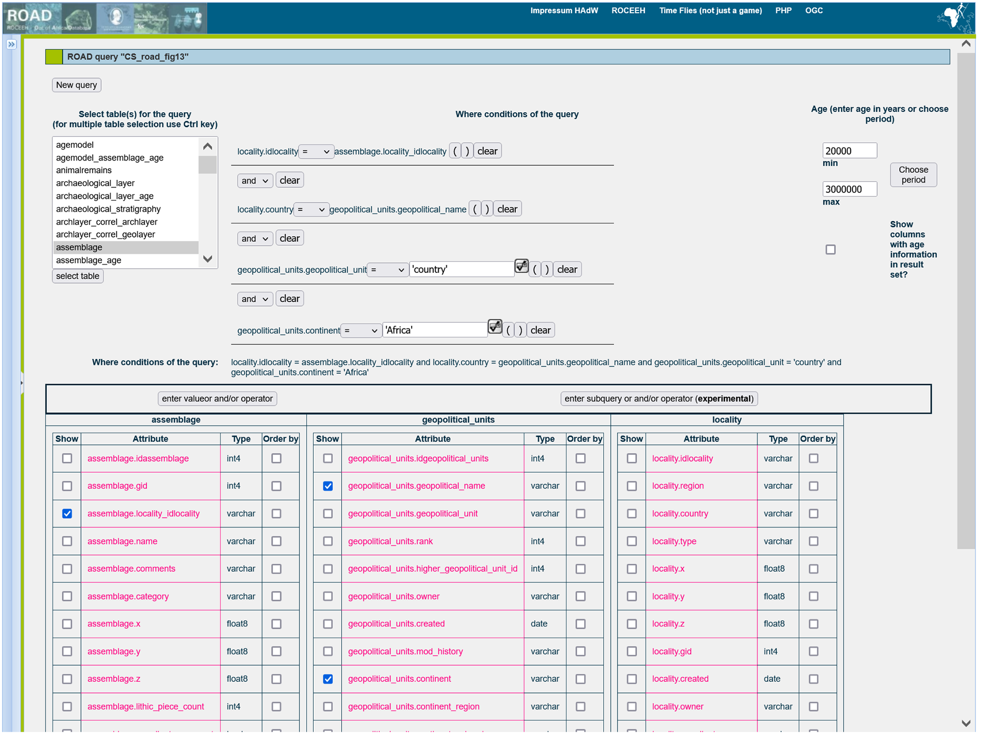
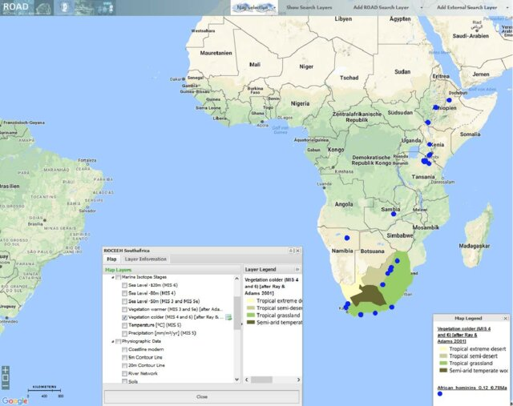
Road – Access with login
ROAD Query Tool: Write SQL queries to make customized and complex requests.
ROAD WebGIS: Visualize query results on background maps.
Queried on
6 Feb. 2023

Slide 8
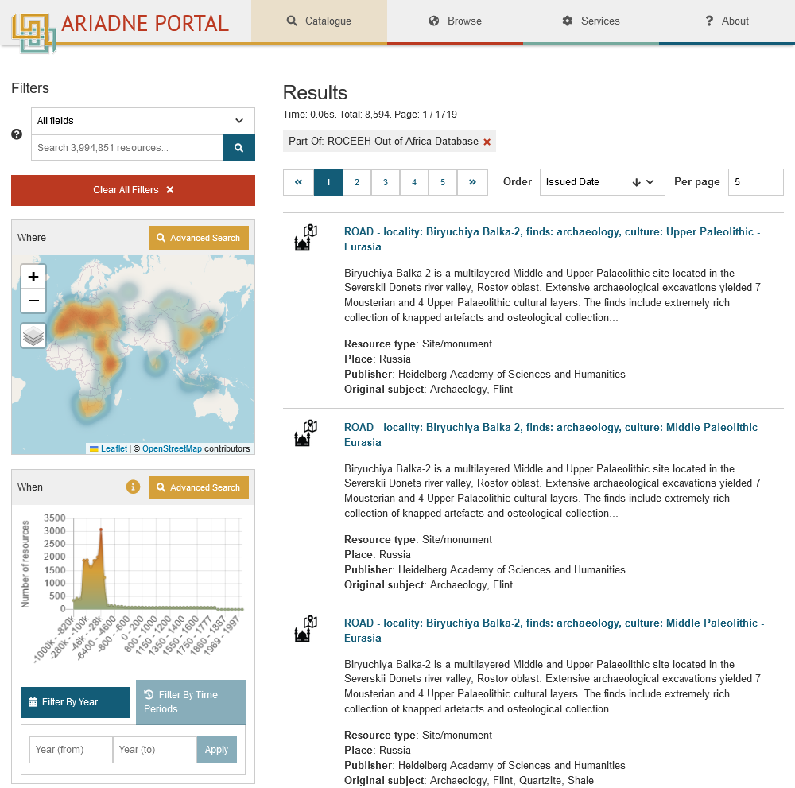
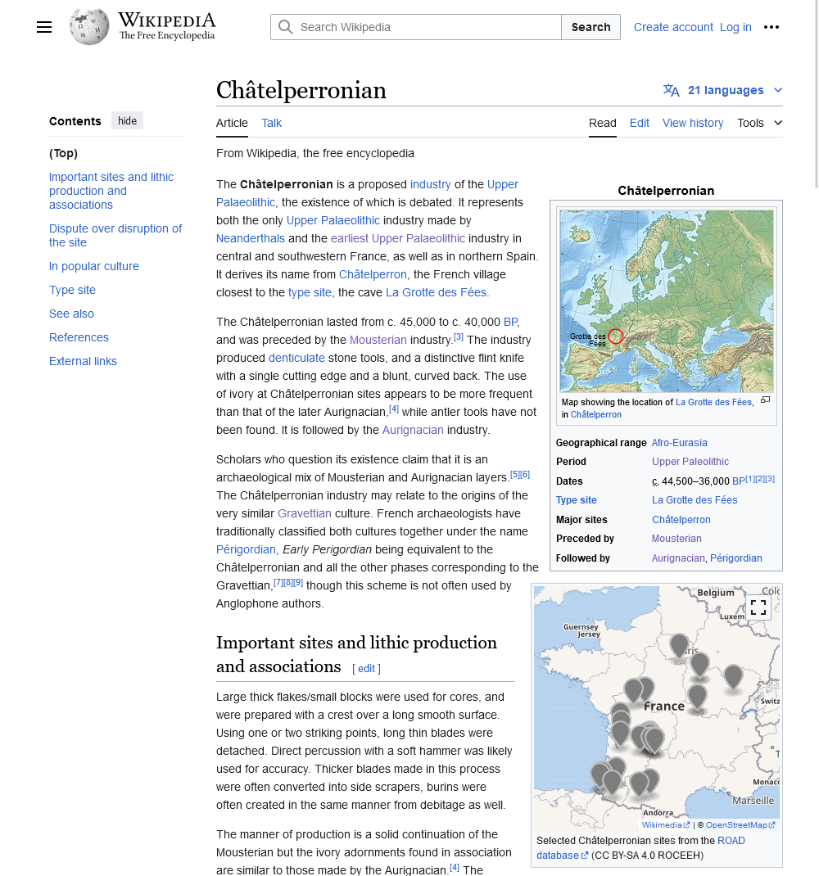
ROAD – Access from external platforms
ROAD Query Tool: Write SQL queries to make customized and complex requests.
Queried on
6 Feb. 2023
https://portal.ariadne-infrastructure.eu/
Interactive maps in Wikipedia

Slide 9
ROAD – Access through R
https://sommergeo.com/roadDB/tutorial.html

Slide 10
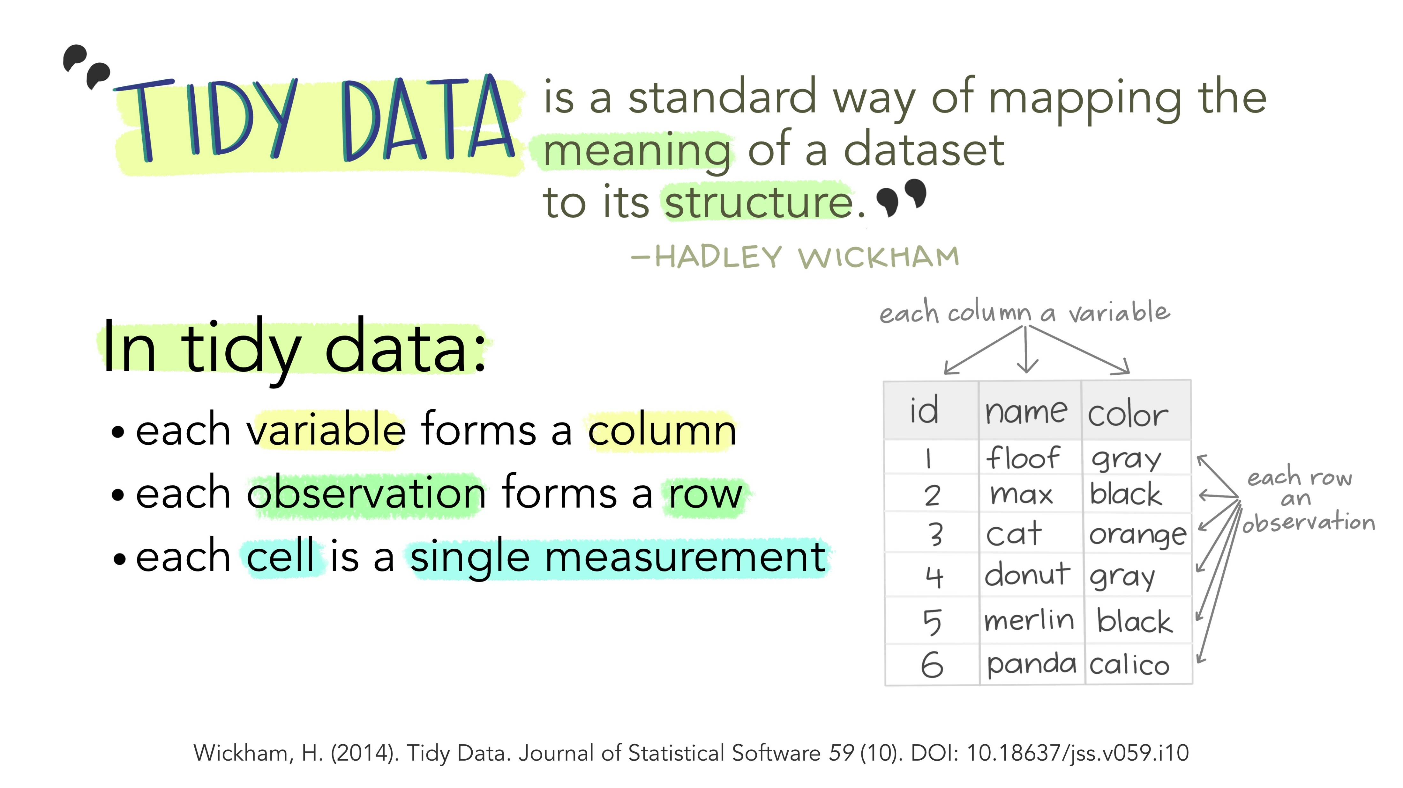
Source: Alison Horst, CC BY 4.0

Slide 11








Three levels of Detail
road_get_localities()
Locality
road_get_assemblages()
road_get_human_remains()
road_get_paleofauna()
road_get_paleobotany()
road_get_lithic_typology()
road_get_lithic_raw_material()
road_get_organic_tools()
road_get_symbolic_artifacts()
road_get_feature()
road_get_miscellaneous_finds()
Assemblage
Date
road_get_dates()

Slide 12



LOD-related inheritance
Inheritance of arguments and outputs across Levels Of Detail
Locality
road_get_localities()
Assemblage road_get_assemblages()
Date road_get_dates()
1 locality ≙ 1 row
1 locality ≙ n rows
1 assemblage ≙ 1 row
1 locality ≙ n rows
1 assemblage ≙ m rows
1 date ≙ 1 row
Loc.
Locality A
Locality B
Locality C
Locality D
…
Loc. | Ass.
Locality A | 1
Locality A | 2
Locality B | 1
Locality B | 2
… | …
Loc. | Ass. | Date
Locality A | 1 | 20-25 ka
Locality A | 1 | 19-39 ka
Locality A | 2 | 25-35 ka
Locality B | 1 | 60-75 ka
… | … | …

Slide 13
Arguments
# Single argument
road_get_localities(cultural_periods='MSA')
# Multiple arguments
road_get_localities(cultural_periods='MSA', countries='South Africa')
# Lists of arguments
road_get_localities(cultural_periods=c('MSA','LSA'),
countries=c('South Africa','Namibia'))

Slide 14
Functions & Arguements

Slide 15
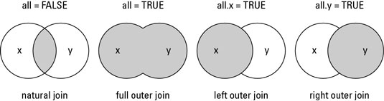
Table joins

