Slide 1
Aims
Users query ROAD comfortably through R functions
R scripting conventions ease access
Users do not need to know ROAD’s data structure
Users do not need to know SQL
Functions translate user’s arguments into queries
Output delivered in R’s dataframes
Users can further process the dataframes with their preferred frameworks, packages, functions

Slide 2
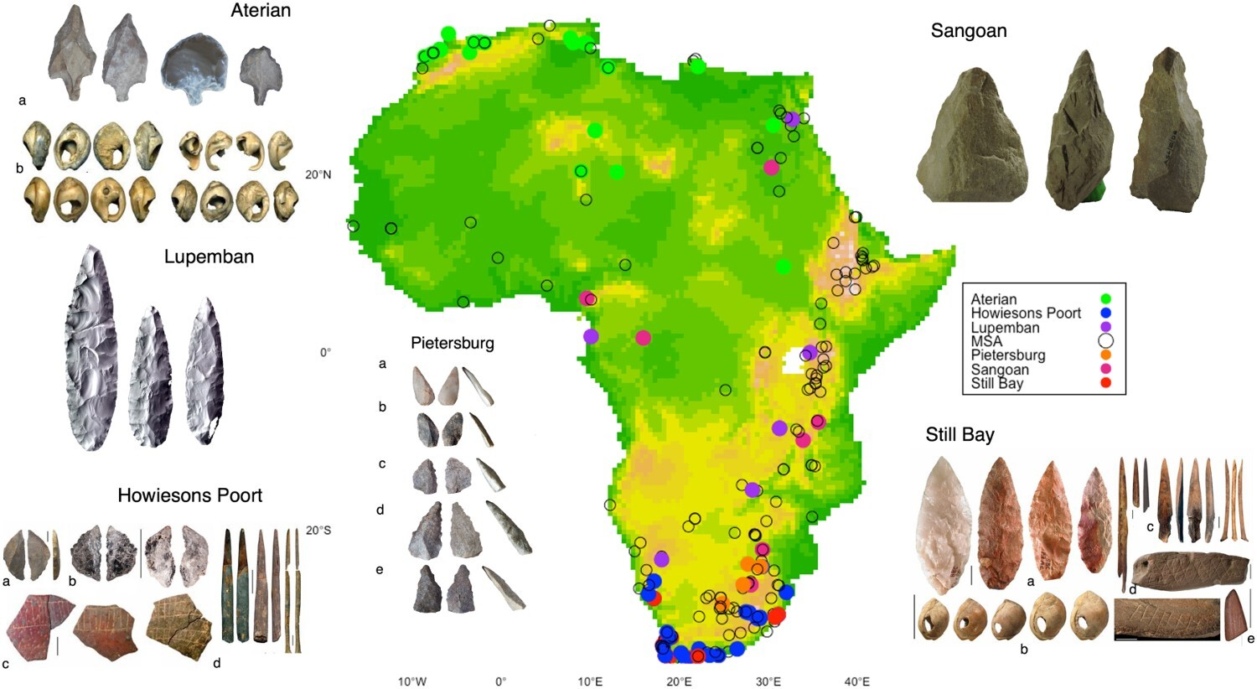
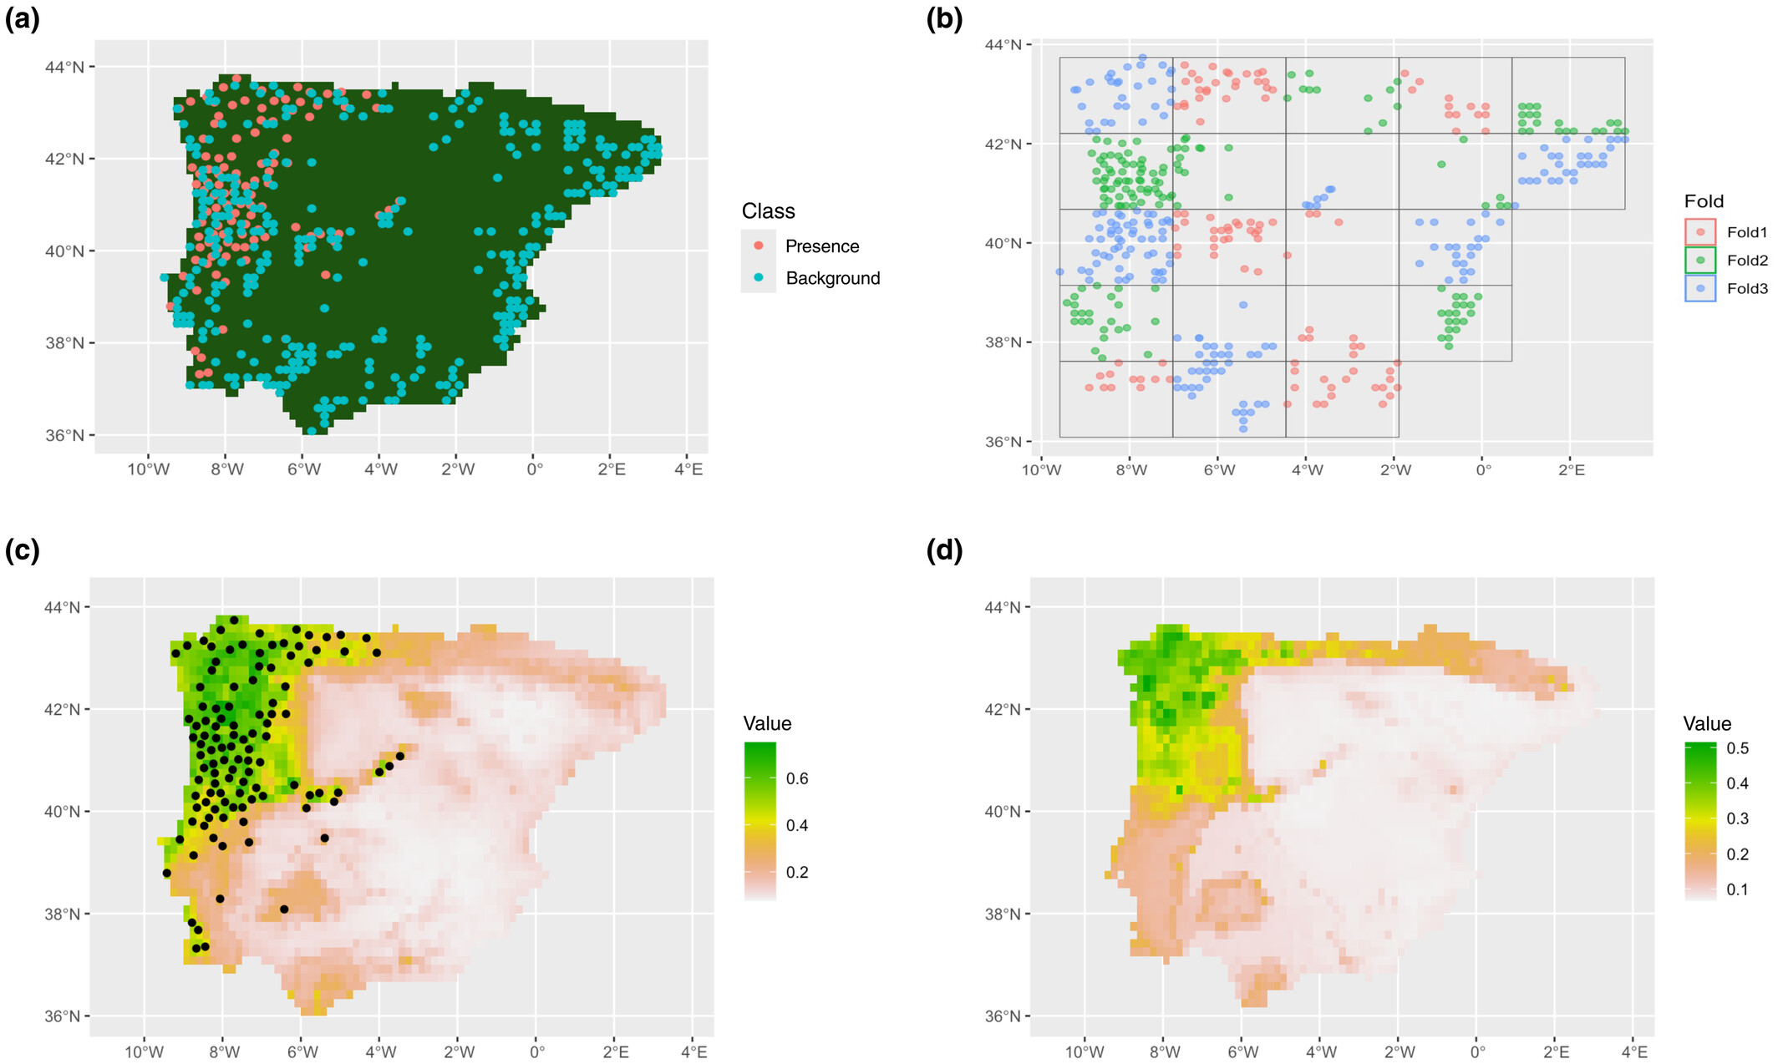
Use case: spatial analysis
Requires:
x, y (point geodata)
Products:
Visualization of maps
further processing of kernel density estimates, network analysis, etc.
Integration with auxiliary data like climate models, environment, etc. for statistical analysis, ecological niche modelling, etc.
Important packages:
sf, sp, pastclim, tidysdm
Timbrell, L. (2024). Ecology and demography of early Homo sapiens: A synthesis of archaeological and climatic data from eastern Africa. Azania: Archaeological Research in Africa, 59(1), 76–110. https://www.tandfonline.com/doi/abs/10.1080/0067270X.2024.2307790
Leonardi, M., Colucci, M., Pozzi, A. V., Scerri, E. M. L., & Manica, A. (2024). tidysdm: Leveraging the flexibility of tidymodels for species distribution modelling in R. Methods in Ecology and Evolution, 15, 1789–1795. https://doi.org/10.1111/2041-210X.14406

Slide 3
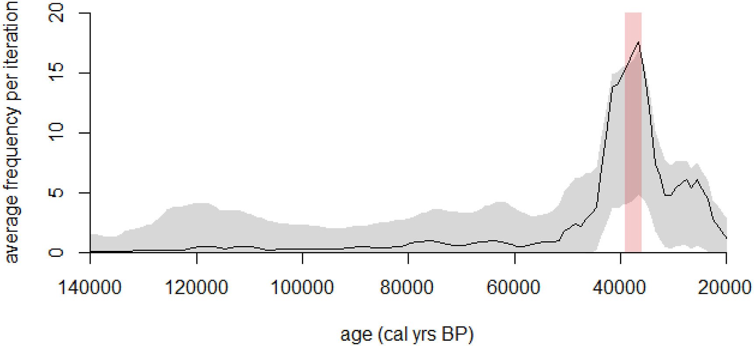
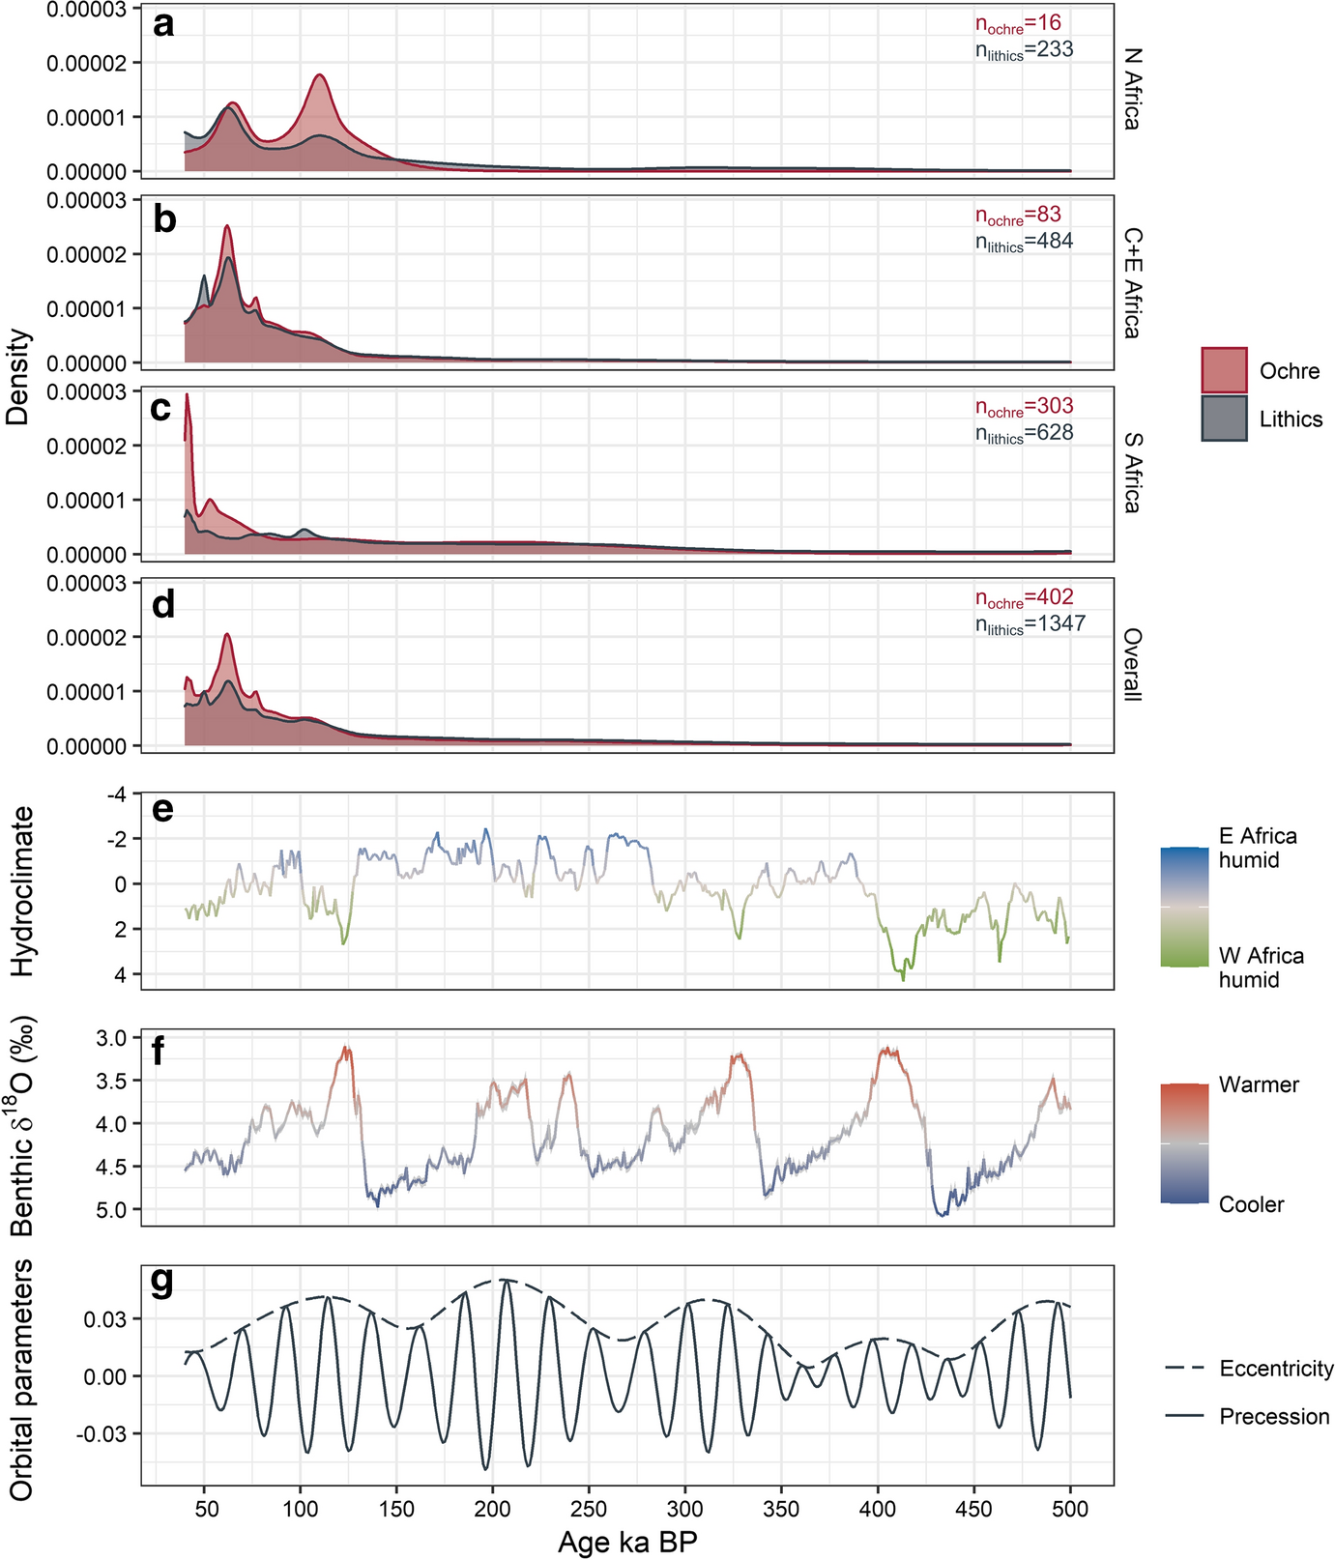
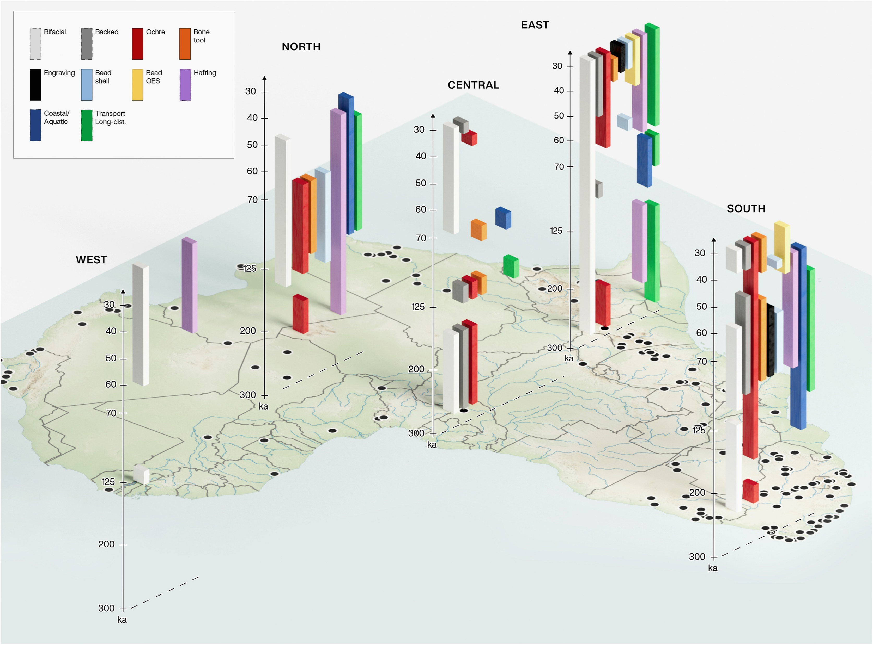
Use case: temporal analysis
Requires:
age, age_stdev_min, age_stdev_max
dating_method, y, to perform dedicated age modelling (e.g. radiocarbon calibration)
geolayer for bayesian modelling
Important packages: rcarbon, archSeries
Kelly, R. L., Mackie, M. E., & Kandel, A. W. (2023). Rapid increase in production of symbolic artifacts after 45,000 years ago is not a consequence of taphonomic bias. Journal of Archaeological Science, 160, 105885. https://doi.org/10.1016/j.jas.2023.105885
Scerri, E. M. L., & Will, M. (2023). The revolution that still isn’t: The origins of behavioral complexity in Homo sapiens. Journal of Human Evolution, 179, 103358. https://doi.org/10.1016/j.jhevol.2023.103358
Dapschauskas, R., Göden, M. B., Sommer, C., & Kandel, A. W. (2022). The Emergence of Habitual Ochre Use in Africa and its Significance for The Development of Ritual Behavior During The Middle Stone Age. Journal of World Prehistory, 35(3), 233–319. https://doi.org/10.1007/s10963-022-09170-2

Slide 4








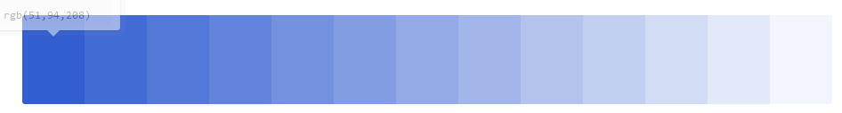
Locality
Assemblage
Date

Slide 5



LOD-related inheritance
Inheritance of arguments and outputs across Levels Of Detail
Locality
road_get_localities()
Assemblage road_get_assemblages()
Date road_get_dates()
1 locality ≙ 1 row
1 locality ≙ n rows
1 assemblage ≙ 1 row
1 locality ≙ n rows
1 assemblage ≙ m rows
1 date ≙ x row
Loc.
Locality A
Locality B
Locality C
Locality D
…
Loc. | Ass.
Locality A | 1
Locality A | 2
Locality B | 1
Locality B | 2
… | …
Loc. | Ass. | Date
Locality A | 1 | 20-25 ka
Locality A | 1 | 19-39 ka
Locality A | 2 | 25-35 ka
Locality B | 1 | 60-75 ka
… | … | …

Slide 6
LOD-related outputs
Inheritance of outputs with increasing Level of Detail
Locality
road_get_localities()
Assemblage road_get_assemblages()
Date road_get_dates()
Columns:
locality, country, continent, subcontinent, locality_type, x, y;
Columns:
All from locality plus
assemblage_name, assemblage_id, technology, typology, raw_material, function, miscelaneous_finds, organic_tools, symbolic_artifacts, feature, animal_remains, paleofauna, plant_remains, human_remains, synthesized_age_min, synthesized_age_max, geolayer, archaeoleayer;
Columns:
Some from assemblage plus
age, age_stdev_plus, age_stdev_minus, dating_method, material, lab_number, lab, y, geolayer, archaeolayer;
Color key:
Character string
Numeric
Boolean
List

Slide 7
LOD-related arguments
Inheritance of arguments across all Levels Of Detail
Locality
road_get_localities()
Assemblage road_get_assemblages()
Date road_get_dates()
Arguments:
locality, country, continent, subcontinent, locality_type, assemblage_name, assemblage_id, culture, cultural_period, technology, typology, raw_material, function, miscalaneous_finds, organic_tools, symbolic_artifacts, feature, animal_remains, plant_remains, geolayer, age_min, age_max;
Color key:
Character string
Numeric
Boolean
List

Slide 8
Functions extending LOD Assemblage
Locality
road_get_localities()
Assemblage road_get_assemblages()
Date road_get_dates()
Human remains road_get_human_remains()
Archaeology
road_get_lithic_typology()
road_get_lithic_raw_material()
road_get_organic_tools()
road_get_symbolic_artifacts()
road_get_feature()
road_get_miscalaneous_finds()
Paleofauna road_get_paleofauna()
Paleobotany road_get_paleobotany()
Columns:
Some from assemblage plus
…
Columns:
Some from assemblage plus
…
Columns:
Some from assemblage plus
…
Columns:
Some from assemblage plus
…

Slide 9
Examples

Slide 10
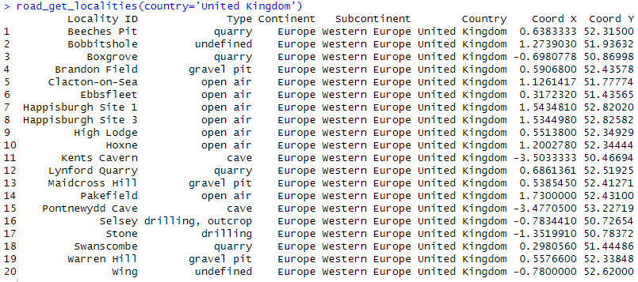
road_get_localities()

