Slide 1
SLIDE 1
Business Problem
More than half of surveyed airline passengers are not satisfied.
Management does not currently know exactly which factors drive satisfaction or which customer segments are most at risk of leaving. This analysis uses public airline survey data to find out where to focus improvement efforts.
56.6%
Why this matters
Dissatisfied passengers are more likely to switch airlines. Fixing the right service gaps can directly protect revenue and loyalty.
of passengers are NEUTRAL or DISSATISFIED
(129,880 passengers surveyed)
Airline Passenger Satisfaction Analysis | Somya Gupta
1

Slide 2
SLIDE 2
Data & Methodology
Dataset
Airline Passenger Satisfaction (Kaggle) — 129,880 passenger survey responses, 24 columns
Cleaning
Combined 2 files, removed duplicates, filled 393 missing delay values with median, fixed text/number formats
New fields added
Total delay, delay buckets, age groups, average service rating, satisfied flag
Tools used
Python (Pandas, NumPy, Matplotlib) in Google Colab, plus Google Sheets for the raw data tabs
Analysis approach
Grouped satisfaction rate by class, travel type, age, delay, and correlated it with 14 service ratings
Airline Passenger Satisfaction Analysis | Somya Gupta
2

Slide 3
SLIDE 3
Key Findings
1
Travel class is the biggest satisfaction gap
Business class: 69% satisfied vs Economy: 19% satisfied
2
Online boarding matters most
Strongest link to satisfaction of all 14 service factors
3
Leisure travelers are far less satisfied
Only 10% satisfied vs 58% for business travelers
4
Delays matter less than expected
Satisfaction only drops ~10-12 points even with long delays
Airline Passenger Satisfaction Analysis | Somya Gupta
3

Slide 4
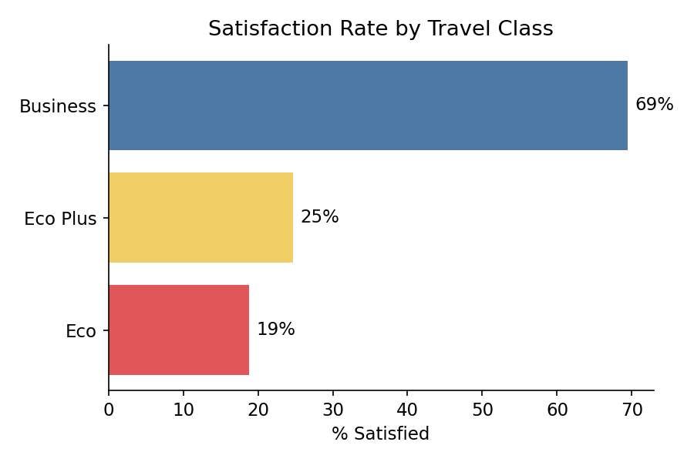
SLIDE 4
Deep-Dive: The Class Satisfaction Gap
What the data shows
Business class passengers are satisfied 3.7x more often than Economy passengers (69% vs 19%). Economy Plus barely does better than Economy (25%), even though it costs more.
Economy is also the largest group — about 58,000 of the 129,880 passengers — so this gap affects the most people.
Evidence used: satisfaction % grouped by Class, from the processed dataset (Q4 worksheet)
Airline Passenger Satisfaction Analysis | Somya Gupta
4

Slide 5
SLIDE 5
Recommendations
Priority 1
Priority 2
Priority 3
Redesign online boarding / check-in
Improve Economy class experience
Research leisure/personal traveler needs
Biggest single lever for satisfaction — fix this first
Largest passenger group, lowest satisfaction — don't just focus on Business class
Even Business class doesn't satisfy them — needs its own study
Airline Passenger Satisfaction Analysis | Somya Gupta
5

Slide 6
SLIDE 6
Expected Business Impact
If these recommendations are acted on:
•
Fewer Economy passengers switching to competitor airlines (Economy is the largest segment)
•
Higher satisfaction among loyalty program members, who are currently only 48% satisfied
•
A clearer, tested understanding of what leisure travelers actually need
How to measure success
Track overall satisfaction %, Economy-class satisfaction %, and online boarding rating month over month after changes are made.
Airline Passenger Satisfaction Analysis | Somya Gupta
6

Slide 7
SLIDE 7
Limitations & Next Steps
What management should be cautious about
•
This is a one-time survey, not tracked over time — we can't yet say if satisfaction is improving
•
No pricing, route, or date data — we can see patterns but not always the exact root cause
•
These are correlations, not proof — we cannot say fixing one service alone guarantees a fixed result
Next steps to analyze
•
Run a dedicated survey of leisure/personal travelers to find the real reason for low satisfaction
•
Add route and date data in future surveys to check seasonal or route-specific patterns
Airline Passenger Satisfaction Analysis | Somya Gupta
7

