Slide 1


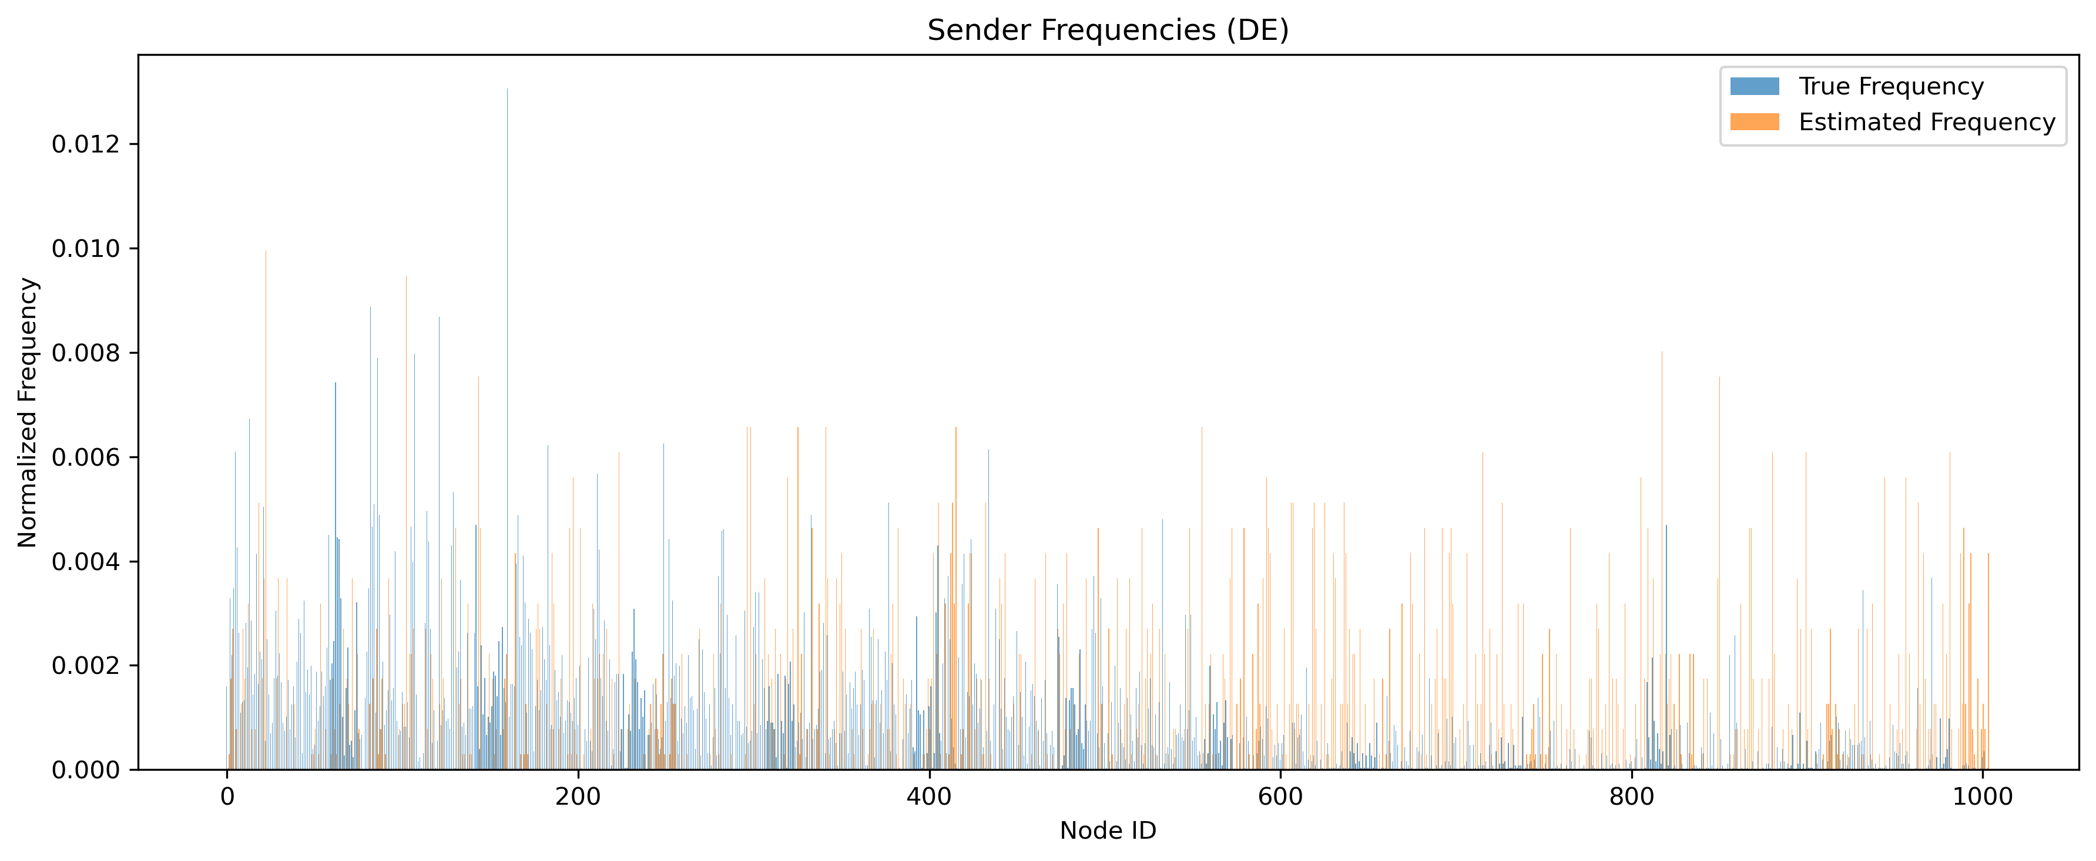
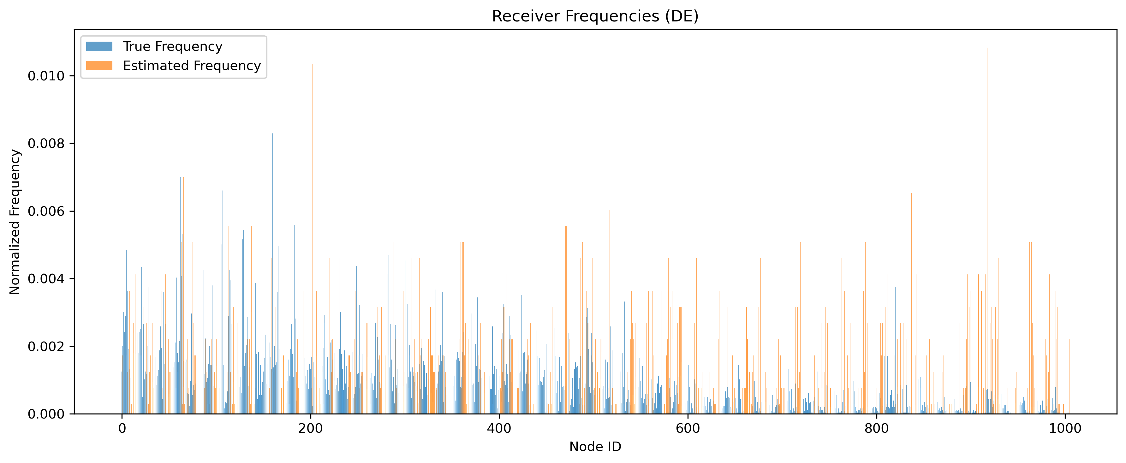
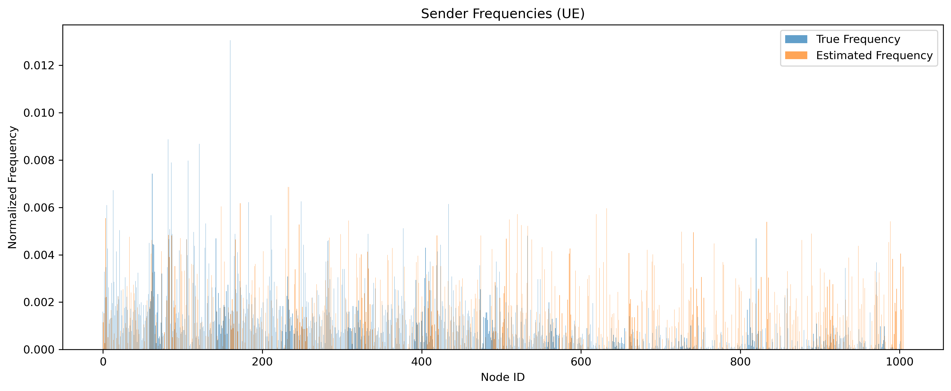
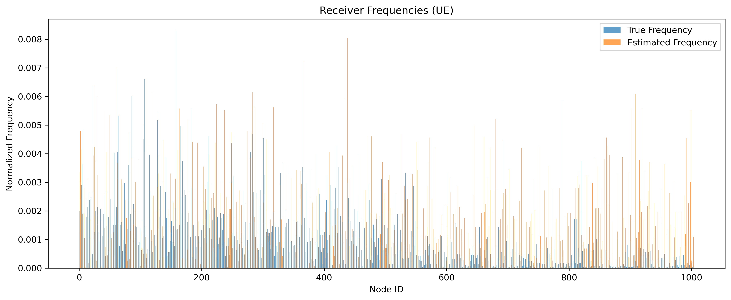
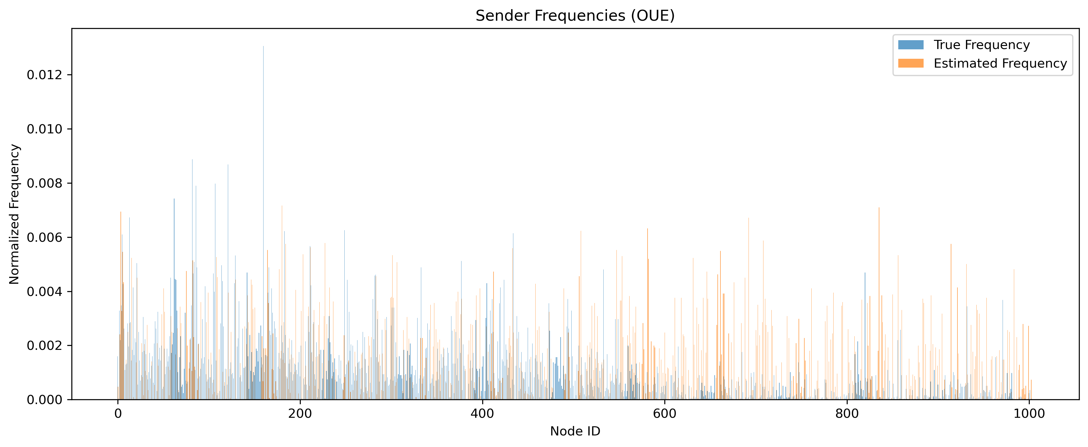
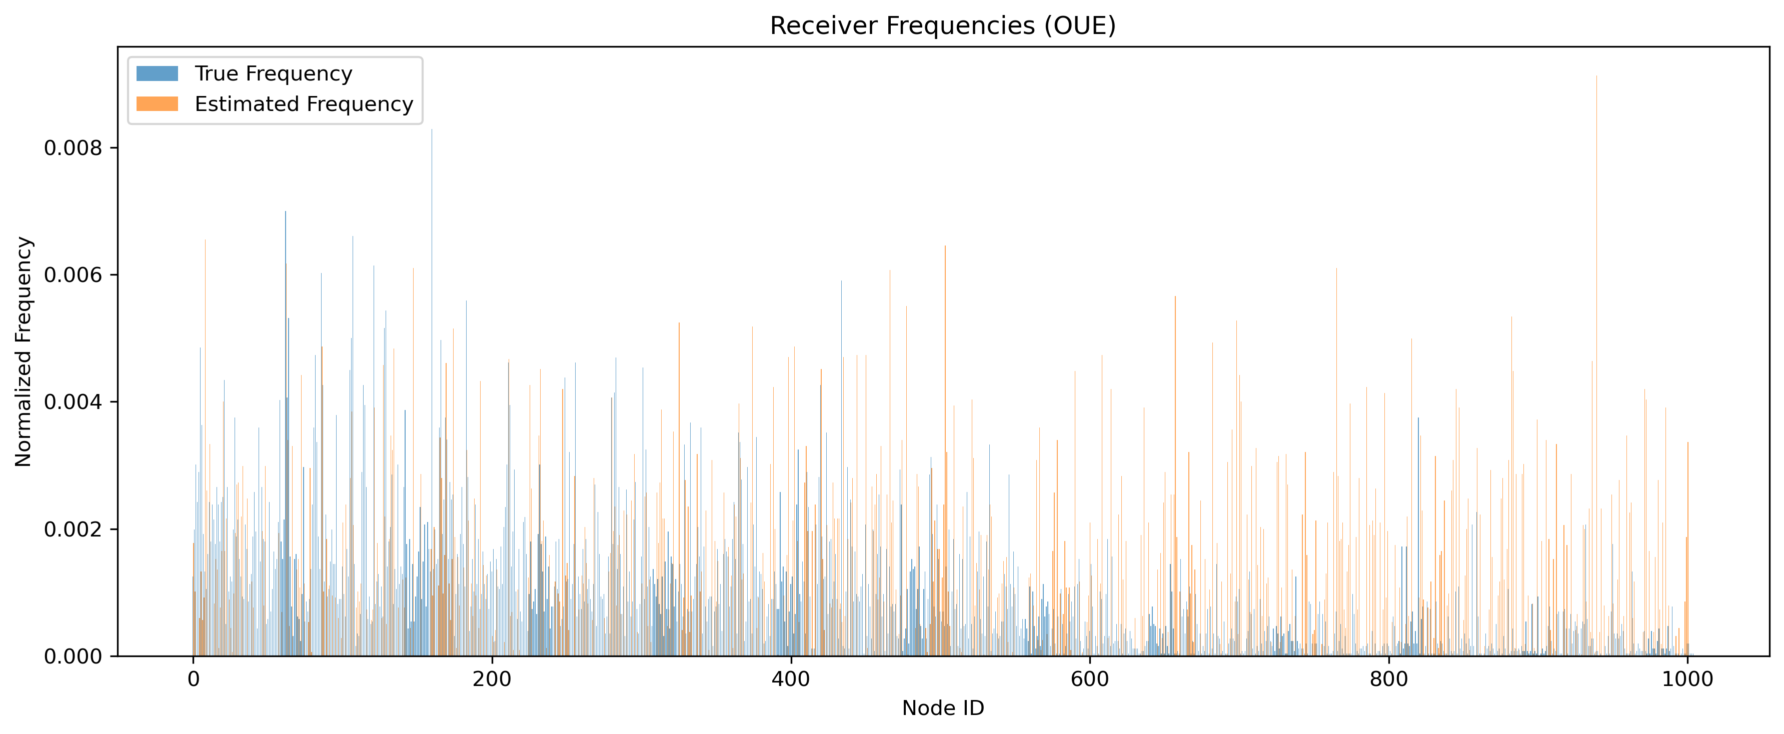
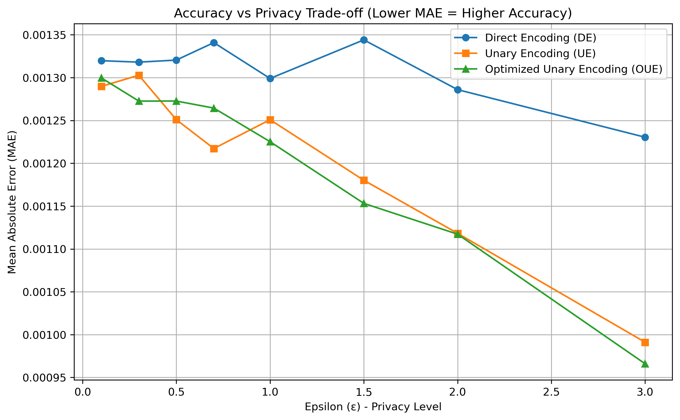
The Statistical Estimation Using Local Differential Privacy
Sommojoty Dasgupta Research Advisor: Dr. Emre Yilmaz University of Houston–Downtown, Dept. of Computer Science and Engineering Technology, Houston, TX 77002
Abstract This research explores the effectiveness of Local Differential Privacy (LDP) mechanisms—including Direct Encoding (DE), Unary Encoding (UE), and Optimized Unary Encoding (OUE)—for protecting individual node identity in real-world graph datasets. Focusing on the email-Eu-core dataset, we evaluate perturbation mechanisms applied to sender and receiver node IDs, observing Mean Absolute Error (MAE) in statistical estimation under varying domain sizes.
Background Graph datasets like email-Eu-core reflect real-world communication networks, where individual nodes represent users and edges represent interactions. Traditional privacy-preserving approaches struggle to retain utility. LDP offers a promising direction by allowing perturbation at the local level without relying on a trusted aggregator.
Conclusion Perturbation method and domain size heavily affect utility. Direct Encoding is useful for tightly bounded domains. UE provides balance. OUE, though theoretically optimal, may introduce greater estimation error under certain structural distributions.
Results
DE showed higher accuracy for small domain sizes (≤100), while UE performed better in medium ranges (100–800). Surprisingly, OUE did not consistently outperform UE, indicating tradeoffs between optimization parameters and estimation stability.
Future Objectives Expand to multi-attribute perturbation (e.g., sender-department pairings), implement adaptive ε tuning strategies, and apply LDP techniques to commercial graph datasets like Amazon co-purchase network.
Problem Statement How effective are different LDP perturbation mechanisms at preserving privacy while minimizing error in statistical estimation of edge distributions in large-scale graph datasets?
References Wang, T., Blocki, J., Li, N., & Jha, S. (2017). Locally differentially private protocols for frequency estimation. USENIX Security Symposium, 729–745. https://www.usenix.org/system/files/conference/usenixsecurity17/sec17-wang-tianhao.pdf
Yang, M., Guo, T., Zhu, T., Tjuawinata, I., Zhao, J., & Lam, K. (2023). Local differential privacy and its applications: A comprehensive survey. Computer Standards & Interfaces, 89, 103827. https://doi.org/10.1016/j.csi.2023.103827
SNAP: Network datasets: email-Eu-core network. (n.d.). https://snap.stanford.edu/data/email-Eu-core.html
Hypothesis H₀: UE mechanisms yield lower MAE than DE under ε = 1.0 in large sized domains. H₁: OUE outperforms UE in sparse domains and converges faster under higher privacy budgets.
Methods We parsed the email-Eu-core graph into sender and receiver vectors, applied DE, UE, and OUE mechanisms with ε = 1.0, and used randomized response to simulate local noise. Post-perturbation, we used frequency estimation algorithms to reconstruct sender and receiver distributions and calculated MAE.

