Slide 1
Om-MobileShop
Sabale Somnath Instructed By -SrinivasPattnaik

Slide 2
Introduction
At Om-Mobileshop, we help you decide "What to Buy" & "Where to Buy". Here are 6 easy ways to have an awesome 91mobiles shopping experience:
1. Om-MobileShopscore: Every mobile phone has a score, based on our editors' extensive research. Select your price-range & feature requirements. And then buy the phone with the highest score. Simple.
2. Latest Prices & Deals: Latest prices, deals, and facilities from all leading online stores are listed for every product. Just pick a Best Buy offer for the mobile you're looking for, to get the best combination of price & service.
3. Find & Compare: Intuitive Finder & mobile comparison tool help you discover mobile phones & compare mobile specifications.

Slide 3
4. Recommendations: Intelligent recommendations based on the products you browse help you find your ideal product.
5. Offline Store Finder: Find mobile dealers & service centers near your location.
Project Overview :
The shopping projectneeds to create the shoping system to organize the products record and the other information about the customers. How customers can buy products from website can be recognized from their emailId and password.

Slide 4
Scope : Online shopping is rising day by day in India. Because India is the country where computer user's are increasing day by day so as the online shopping trends are also increasing. this project covers the online selling of electronic devices. The project shows the product category and then product details from the product details, catrgory detais from the category detais and supplier details from supplier details.

Slide 5
Software And Hardware Requirements
Software Requirement :
User interface : (Eclipse , Tomcat , JSP , Java Script, HTML, CSS, MySQL )
Database : MYSQL
Server side software
Web-Server software
Windows : 7 or Newer
Hardware Requirement :
Processor: Minimum 1 GHz; Recommended 2GHz or more
Ethernet connection (LAN) OR a wireless adapter (Wi-Fi)
Hard Drive: Minimum 32 GB; Recommended 64 GB or more
Memory (RAM): Minimum 256Mb; Recommended 4 GB or above
Monitor: Standard color monitor
Keyboard: Standard Keyboard
Mouse: Standard Mouse

Slide 6
Module description
Login
Manage Category
Add New Categoty
Insert Category
Delete Category
Update Category
Manage Supplier
Add New Supplier
Insert Supplier
Delete Supplier
Update Supplier

Slide 7
4. Manage Product 1. Add New Product 2. Insert Product 3. Delete Product 4. Update Product

Slide 8
Key Features
User login with Email Id and password
Email Id and Password will be provided after user registration is confirmed
The administrator can add category, delete category , update category
The administrator can add product, delete product , update product
The administrator can add supplier name and description, delete supplier name and description and update name ,id and description

Slide 9
Database Creation
Dtabase are the storehouses of data used in the software systems. The data is stored in tables inside the database.
Several tables are created for the Manipulation of the data for the system. Two essential settings for a database are PRIMARY KEY and FOREIGN KEY.
Tables :
category
create table category (categoryId int Auto-Increment, categoryName varchar(50), categoryDesc varchar(225),constraint pk_category_id primary key(categoryId));
categoryId categoryName categoryDesc
1 Motorola All Models of Motorola Mobiles
2 Samsung All Models of Samsung Mobiles
select * from category

Slide 10
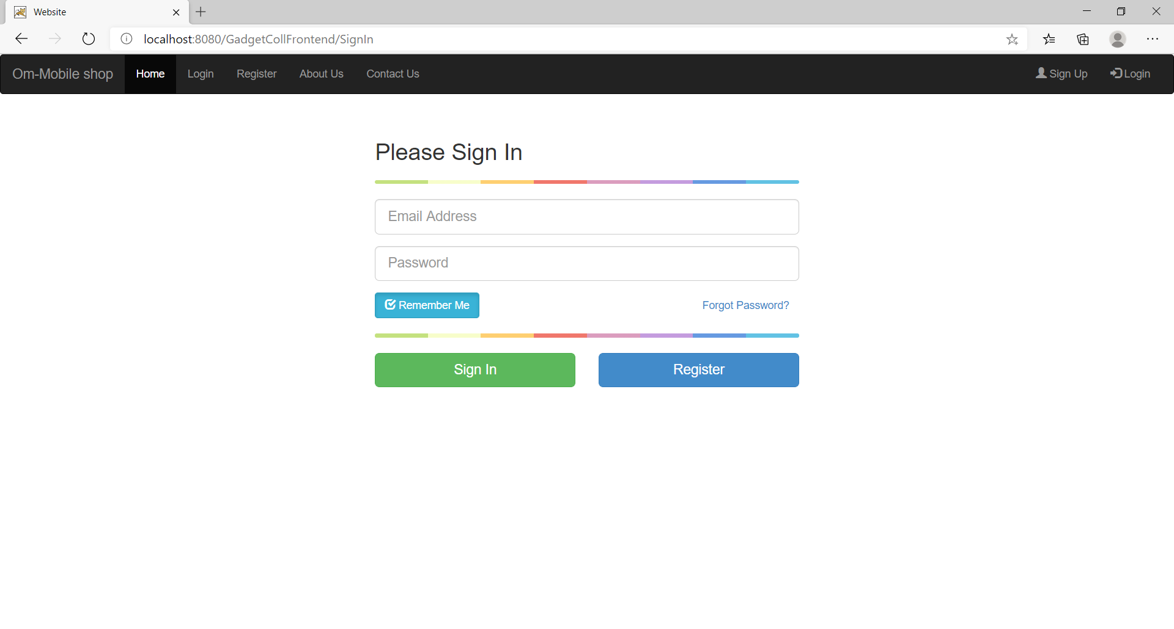

Slide 11
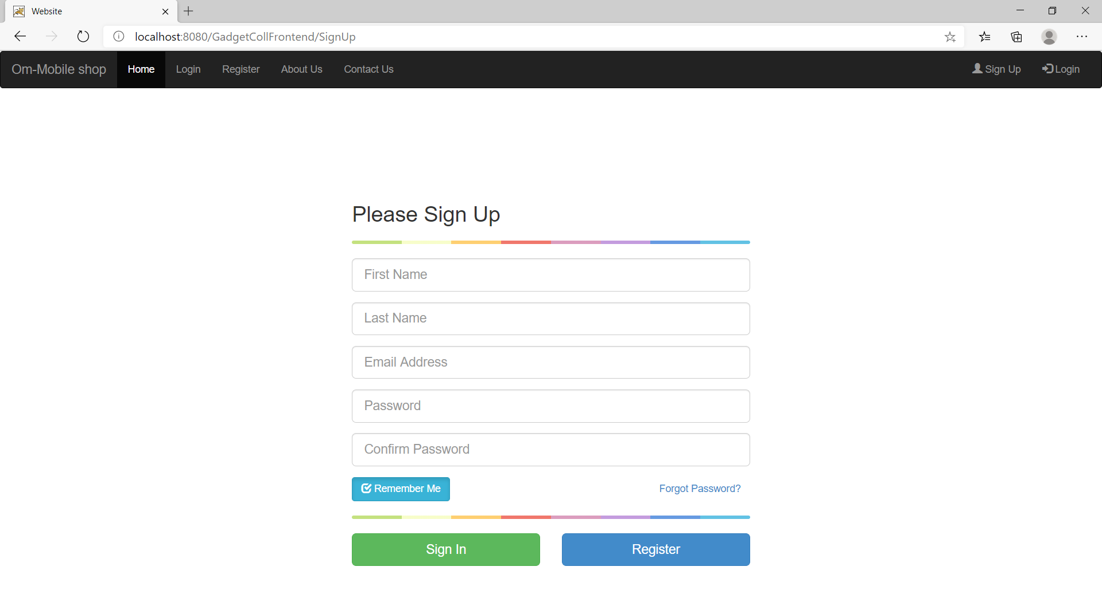

Slide 12
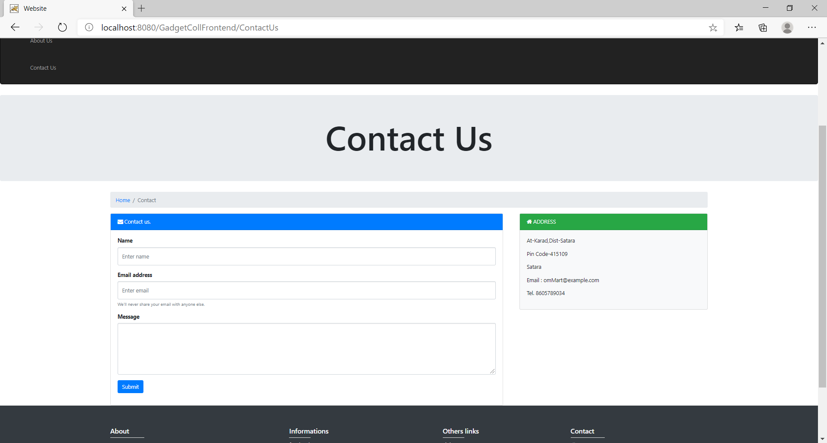

Slide 13
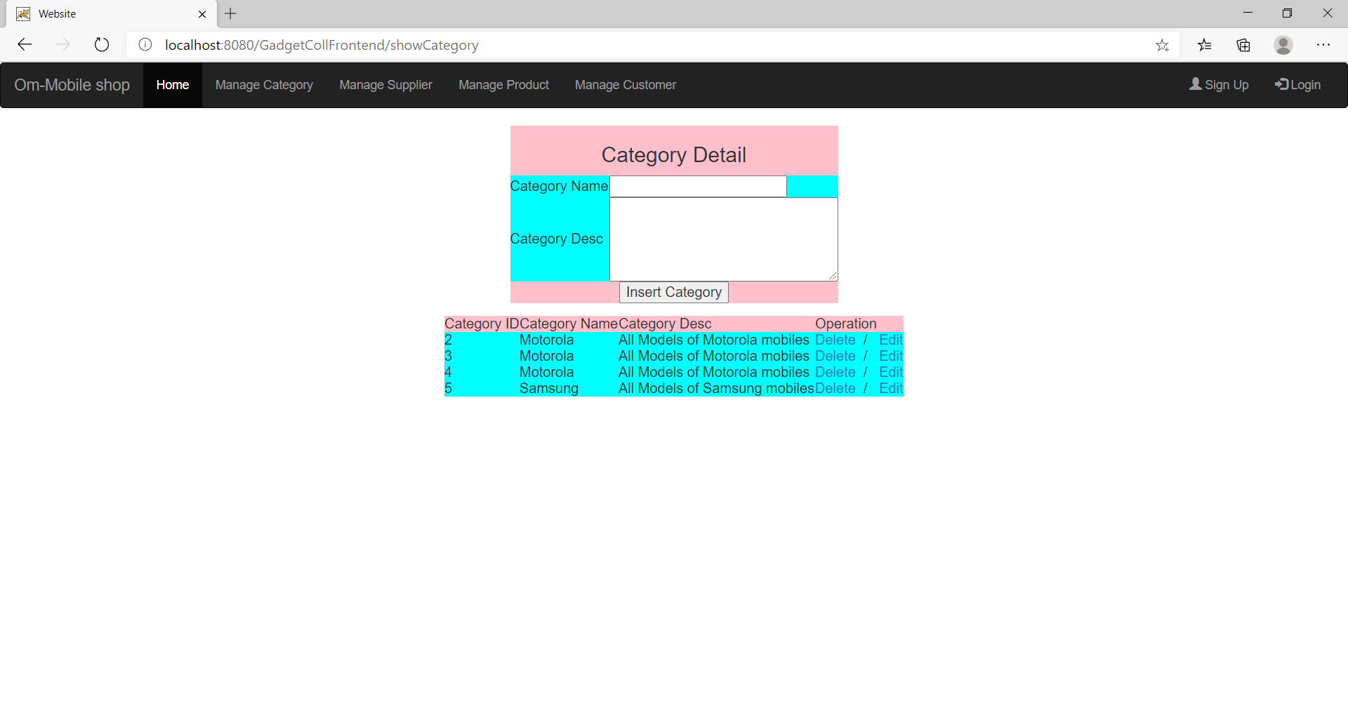

Slide 14
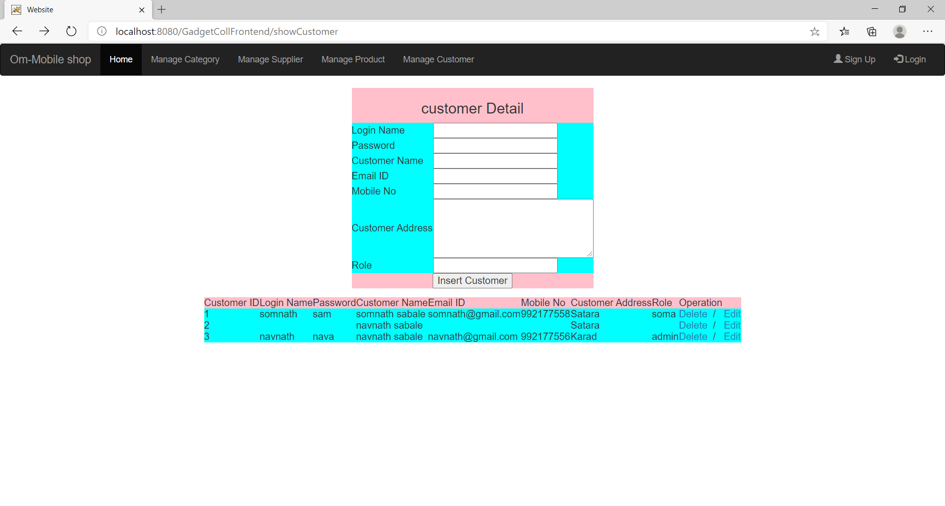

Slide 15
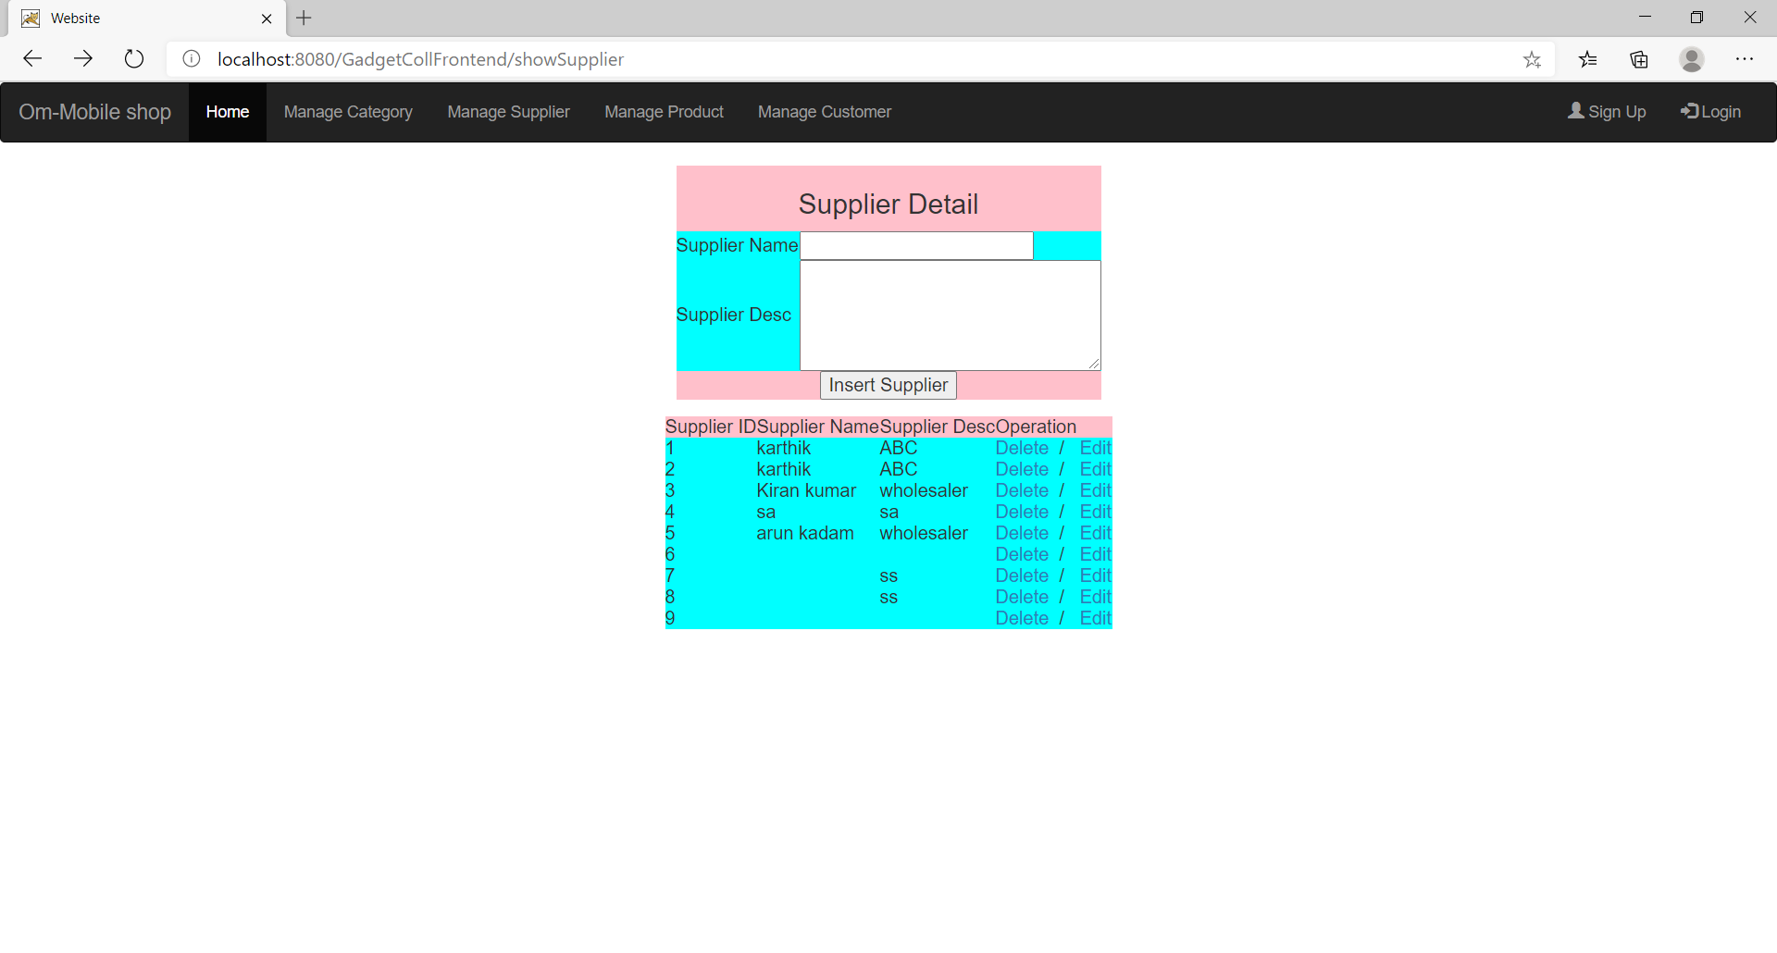

Slide 16
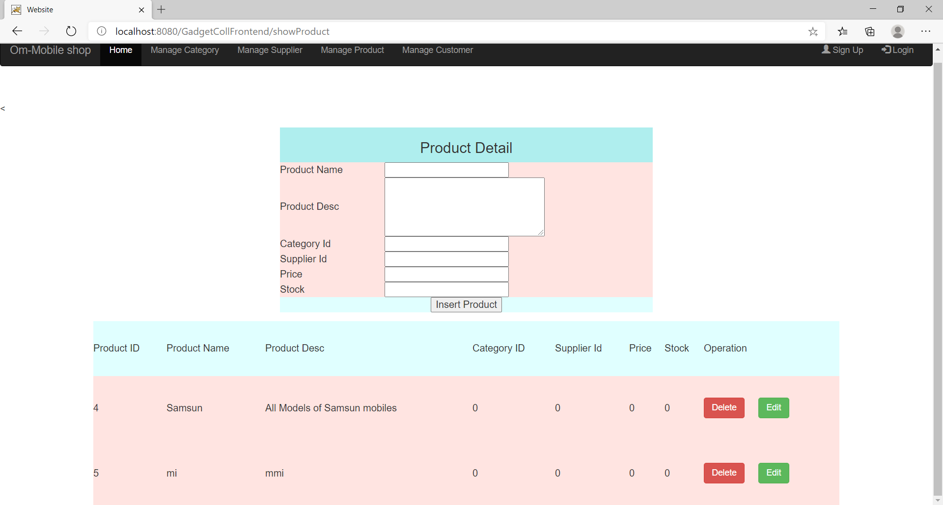

Slide 17
Conclusion
E-commerce has grown significantly during the past 12 years. E-commerce has not onlychange the way consumers view their purchasing power but also help skyroketed the economy.
E-commerce is a helpful technology that gives the consumer access to business and companies all over the world.
Once consumers and businesses realize some of the dangers of e-commerce, there could less incidents of identity theft and credit card fraud.

