Slide 1

Customer Shopping Behaviour Analysis
Uncovering insights from 3,900 transactions to guide strategic business decisions

Slide 2

Project Overview
Dataset Scope
Strategic Goals
3,900 purchases across various product categories with 18 key features including demographics, purchase details, and shopping behaviour.
Uncover spending patterns, customer segments, product preferences, and subscription behaviour to inform business strategy.

Slide 3
Data Preparation in Python
01
02
03
Data Loading
Initial Exploration
Data Cleaning
Imported dataset using pandas for analysis
Used df.info() and describe() to understand data structure
Handled 37 missing values in Review Rating using median by category
04
05
Feature Engineering
Database Integration
Created age_group and purchase_frequency_days columns
Loaded cleaned data into PostgreSQL

Slide 4

SQL Analysis: Revenue Insights
3,900
18
Total Transactions
Data Columns
Key features from demographics to behaviour
Complete purchase dataset analyzed
37
Missing Values
Handled in Review Rating column

Slide 5

Gender-Based Revenue Analysis
Key Finding
Revenue distribution analysis by gender revealed spending patterns across product categories.
Strategic Insight
Understanding gender-based preferences helps tailor marketing campaigns and product positioning.

Slide 6

Discount & High-Spending Analysis
High-Spending Discount Users
Discount-Dependent Products
Identified customers who frequently use discounts for premium purchases, revealing discount dependency patterns.
Product categories showing strong correlation with discount usage, indicating price sensitivity.
Revenue Impact
Analysis balanced sales boosts against margin control considerations.

Slide 7

Product Performance Insights
Top Products by Rating
Identified highest-rated products across all categories, highlighting quality preferences.
Top 3 Products per Category
Category-level analysis revealed best-selling items and competitive positioning opportunities.

Slide 8
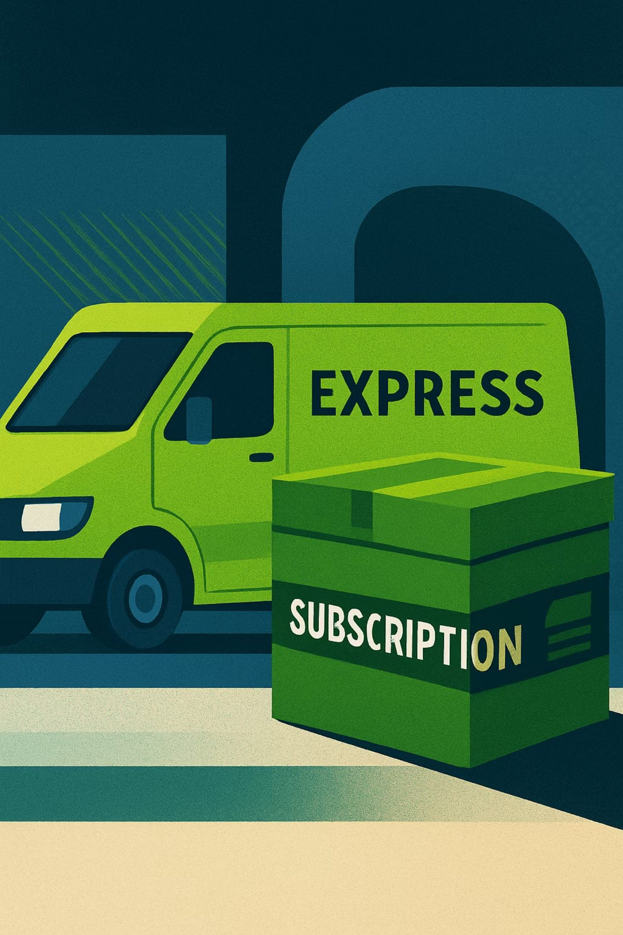
Shipping & Subscription Analysis
Shipping Type Comparison
Express shipping users showed higher purchase frequency and revenue contribution.
Subscribers vs Non-Subscribers
Subscription status analysis revealed engagement levels and revenue differences between customer groups.
Repeat Buyers & Subscriptions
Repeat purchase patterns correlated with subscription status, identifying loyalty opportunities.

Slide 9



Customer Segmentation
25%
35%
40%
High-Value Segment
Mid-Value Segment
Entry-Level Segment
Top revenue contributors
Regular purchasers
New and occasional buyers
Age group analysis revealed 25-35 and 35-45 demographics as highest revenue contributors.

Slide 10


Strategic Recommendations
Boost Subscriptions
Promote exclusive benefits for subscribers to increase retention.
Customer Loyalty Programs
Reward repeat buyers to move them into the 'Loyal' segment.
Review Discount Policy
Balance sales boosts with margin control across product categories.
Targeted Marketing
Focus efforts on high-revenue age groups and express-shipping users.

