Slide 1
Task Mangement System
Task management is the process of managing a task through its life cycle. It involves planning, testing, tracking and reporting. Task management can help either individuals achieve goals, or groups of individuals collaborate and share knowledge for the accomplishment of collectivegoals.Tasks are also differentiated by complexity, from low to high.
Effective task management requires managing all aspects of a task, including its status, priority, time, human and financial resources assignments, recurrency, notifications and so on. These can be lumped together broadly into the basic activities of task management.

Slide 2
Objective
An effective and efficient Task Management Includes Principal Of “Getting Things Done”.
Highly configured work flow .
Can be deployed in-house or through cloud .
Design your own process and put control over them.

Slide 3
Task life cycle
The status of tasks can be described by the following states:
Ready
Assigned
Terminated
Expired
Forwarded
Finished
Failed

Slide 4
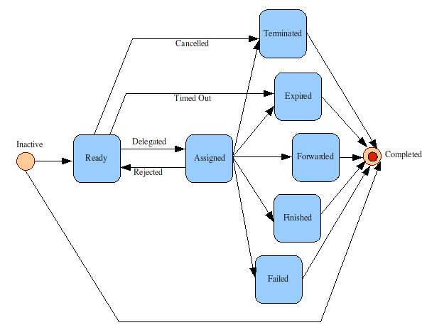
Life cycle Image

Slide 5
Entity
1.Task_Group
2.Piority
3.Components
4.Status
5.Resolution
6.User_Type
7.Type
8.Task
9.Comment
10.Employee
11.Address
12.Department

Slide 6
Attributes
        Task_Group
id
task_id
dept_id
emp_id

Slide 7
Task
task_id
name
emp_id
dept_id
piority_id
subtask
owener_task_id
status_id
user_type_id
actual_start_date
actual_end_date
expected_start_date
expected_end_date

Slide 8
Employee
id
name
address_id
date_of_joining
dept_id
dob

Slide 9
Address
id
location
phone_no
email
country
state
city
pin

Slide 10
Priority
id
type

Slide 11
Status
id
type

Slide 12
Department
id
name

Slide 13
User_Type
id
user_type

Slide 14
Resolution
id
resolution_type

Slide 15
Comment
id
task_id
emp_id
description
attachment

Slide 16
Component
id
task_group_id
dept_id

Slide 17
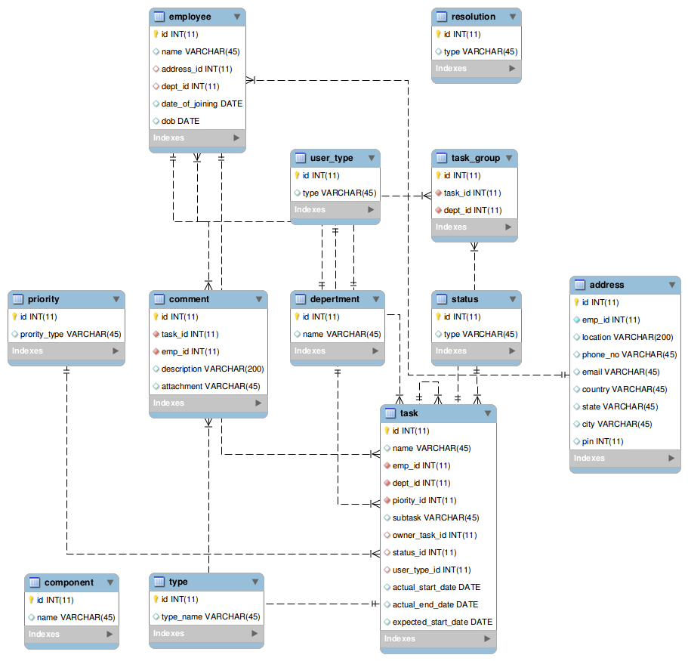

Slide 18
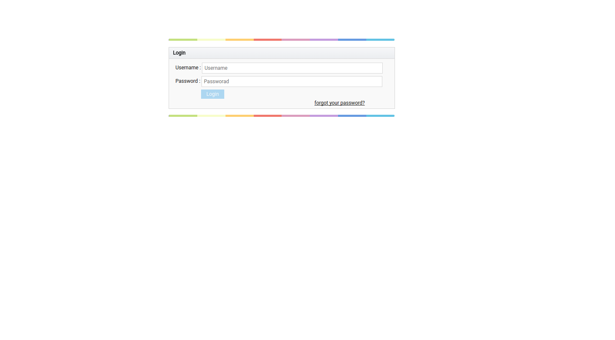
Buissness Logic
After giving username and password and click on login button,controls goes to dashboard.

Slide 19
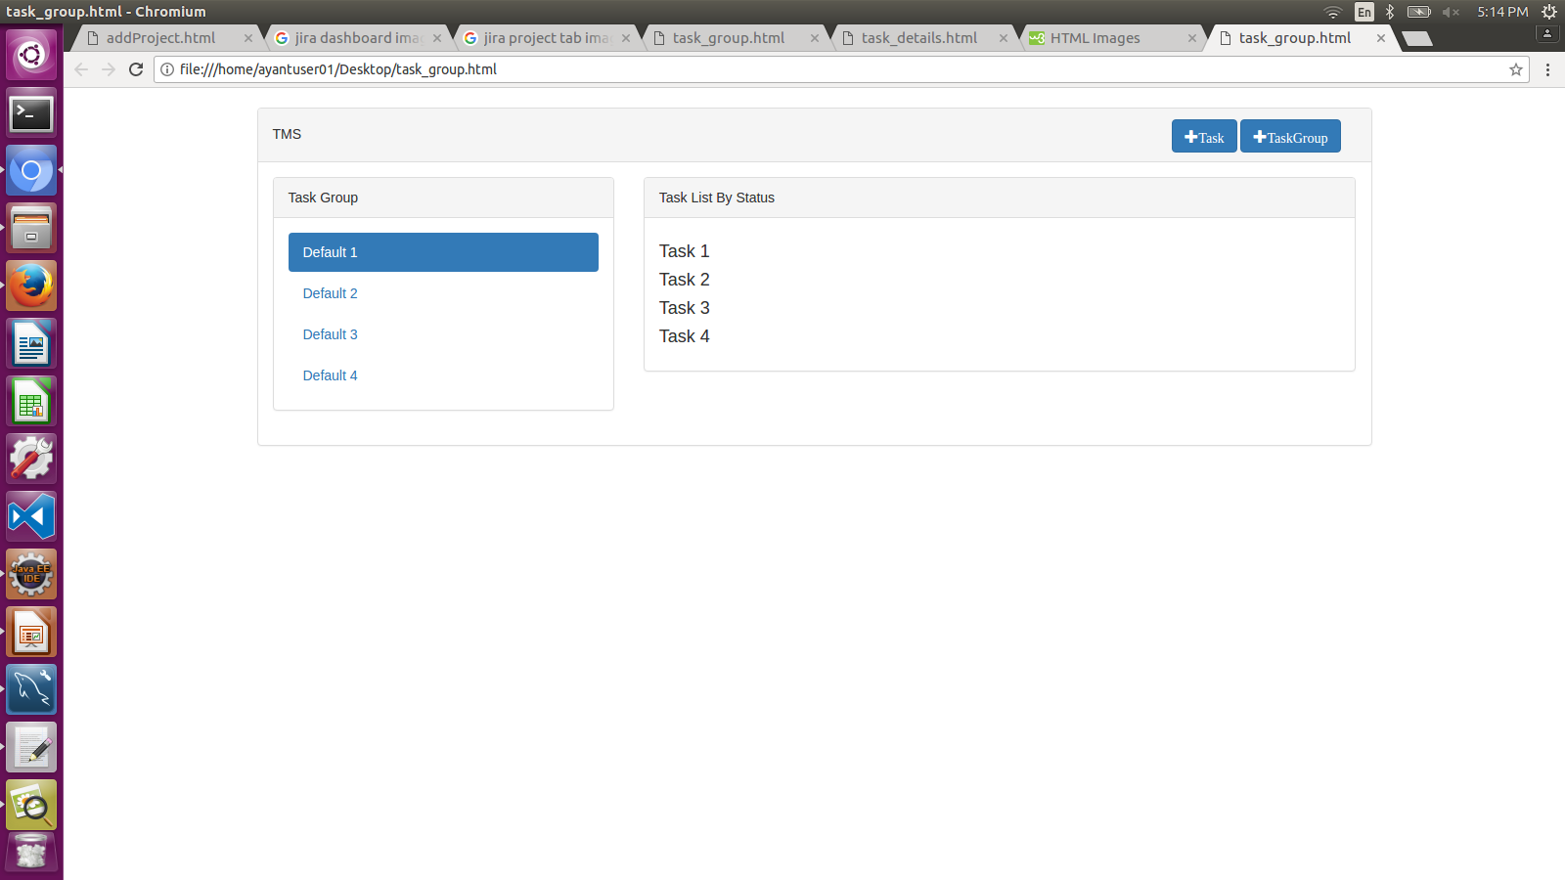
After click on any individual task list option goes to the task summery page.
Click on Task button control goes to addTask screen and on clicking TaskGroup
Button control goes to taskGroup screen

Slide 20
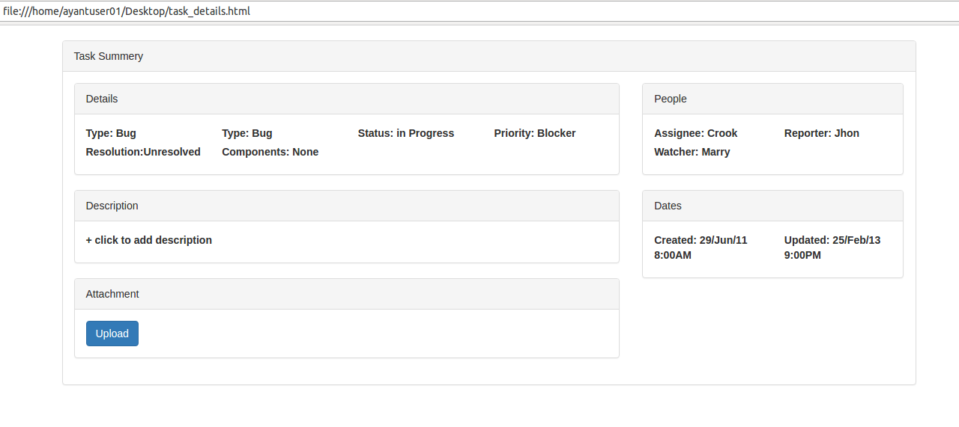
After click on each task ,control goes to task summery page wher details of task will be viewed.

Slide 21
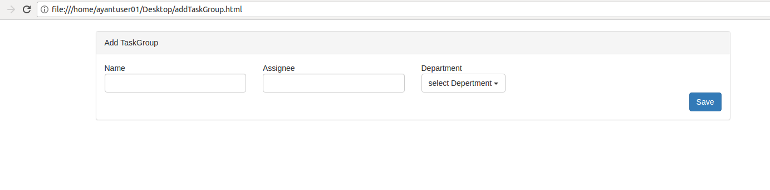

Slide 22
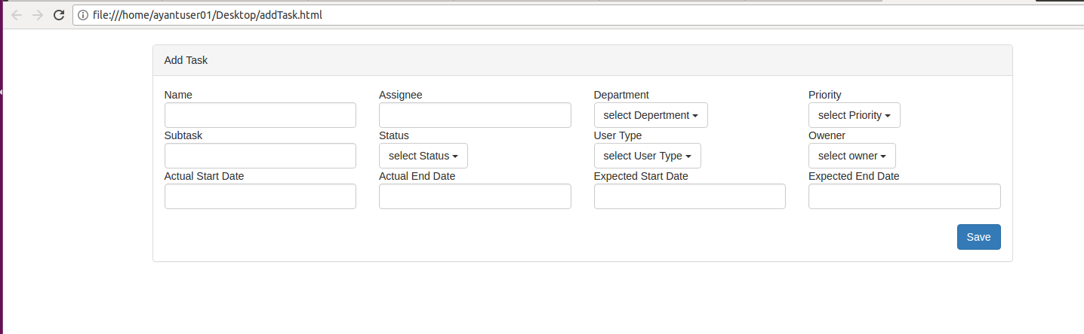

Slide 23
Thank you

