Slide 1
BA--Prerequisite
1-Bussiness Scenario
2-Process Knowledge
3-Domain Understanding

Slide 2
Case Study
HealthCare Industry
Banking
Air Traffic

Slide 3
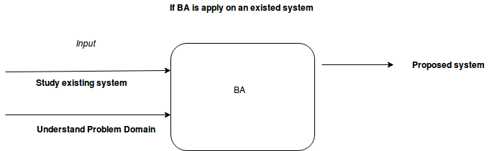
What is Bussiness Analysis

Slide 4
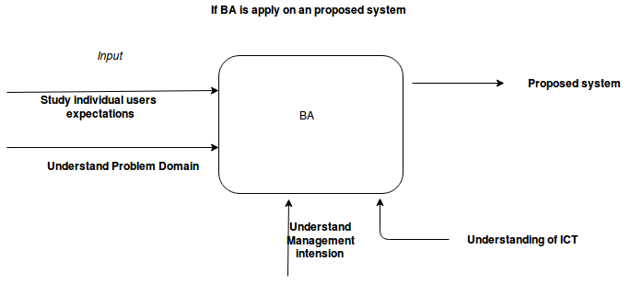
What is Bussiness Analysis

Slide 5
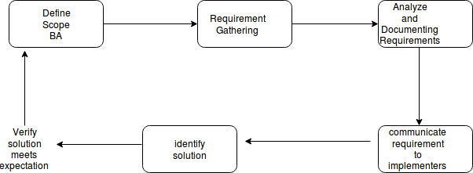
Specific Phase Wise Role

Slide 6
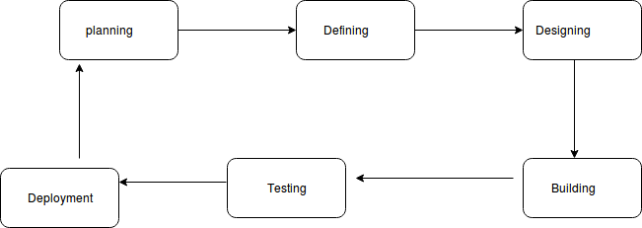
SDLC

Slide 7
Planing
In this phase , we shuld have clear concept of what is the subject matter for consideration and how shuld we move forward towards it.

Slide 8
Defining
In this phase we need to use different tools for gathering functional requirements and then put them in a tangible documented form;This job is done by interviewing a number users.

Slide 9
Designing
Inthis phase BA work closely with the technical people as how the system programming is done ,how UI screens are generated as per user requirements or not.what about the database designing etc.

Slide 10
Building
This part is connected with coders who code the project.

Slide 11
Testing
In this phase the prepared solution is tested by a group of user on the proposed expectation;Here the number of techniques are prototyping,user acceptance test(UAT) etc done.

