Slide 1
Techniques
1.Questionnaire
2.User story
3.Use case

Slide 2
Case study#1-Registration System
A University Registration System
Professors indicate which courses they will teach on
A course catalog can be printed
Allow students to select on
line four courses for upcoming
semester.
No course may have more than
students or less than
students.
When the registration is completed, the system sends
information to the billing system.
Professors can obtain course rosters on
line.
Students can add or drop classes on
line.

Slide 3
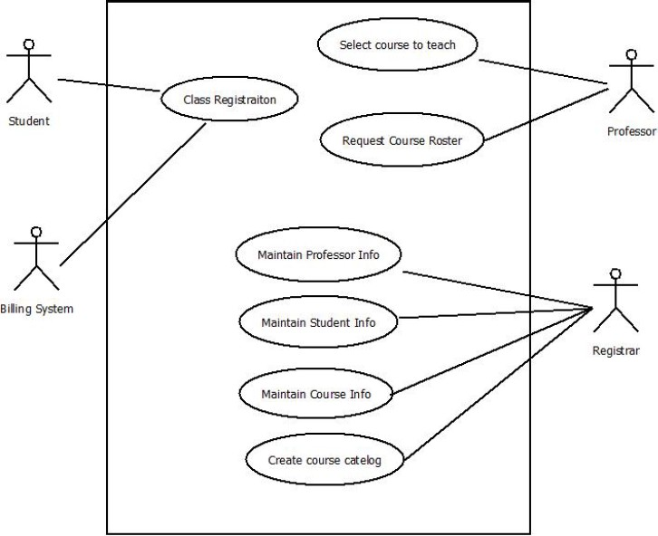
Use Case 1

Slide 4
Begin with a Use Case!
A user placing an order with a sales company might follow these steps :
Browse catalog and select items.
Call sales representative.
Supply shipping information.
Supply payment information.
Receive conformation number from salesperson.
Then translate Use Case sequence into Diagram

Slide 5
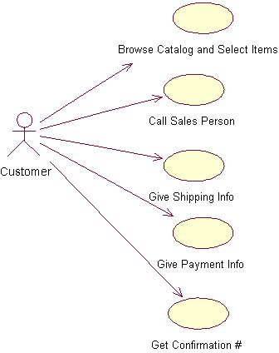

Slide 6
Vending Machine
After client interview the following system scenarios were identified:
A customer buys a product
The supplier restocks the machine
The supplier collects money from the machine
On the basis of these scenarios, the following three actors can be identified:
Customer; Supplier; Collector (in this case Collector=Supplier)

Slide 7
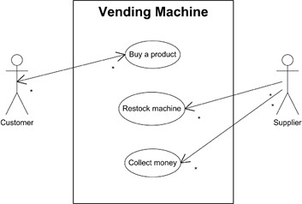

Slide 8
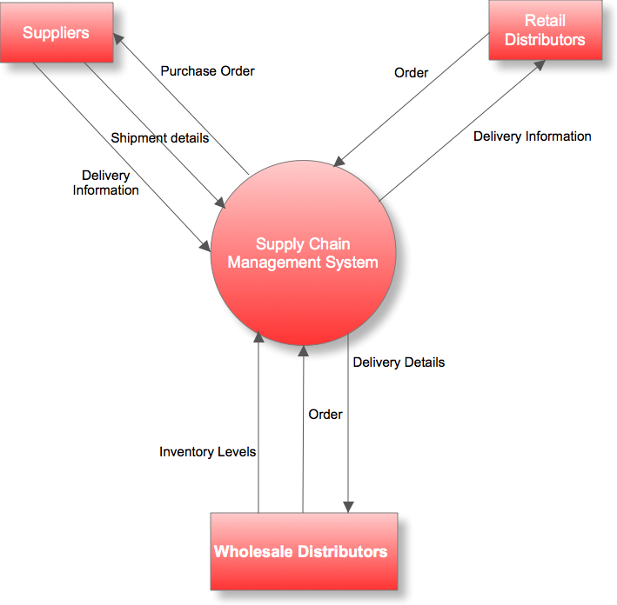

Slide 9
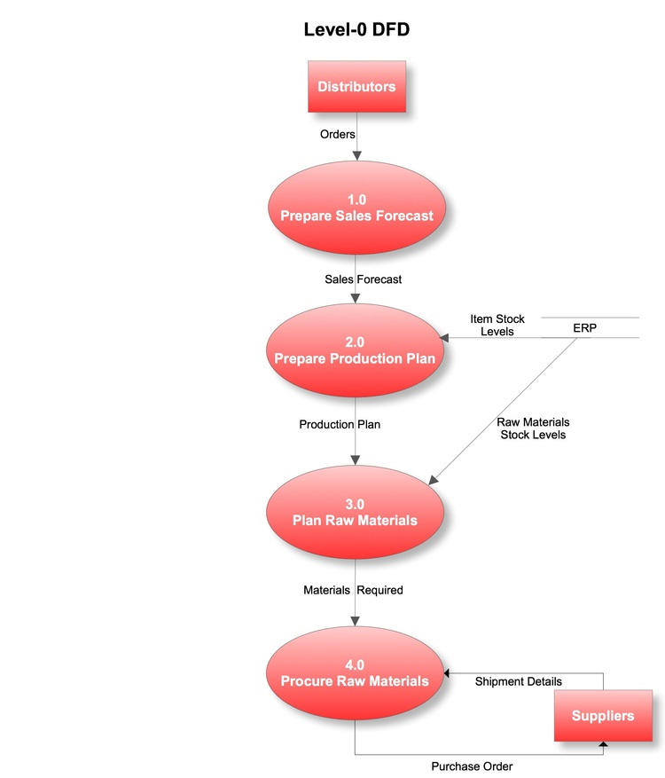

Slide 10
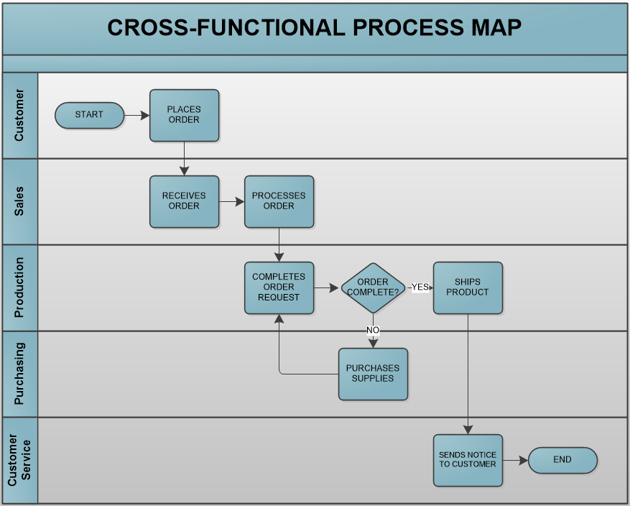

Slide 11
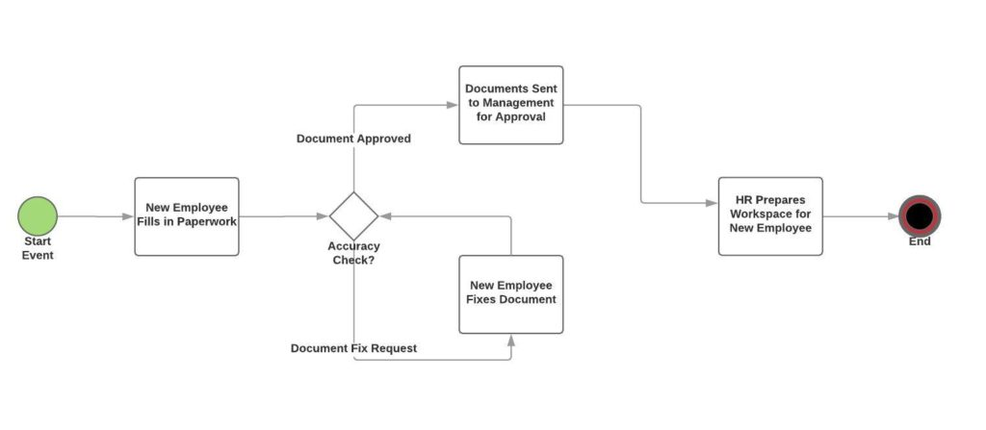
Document approve

Slide 12
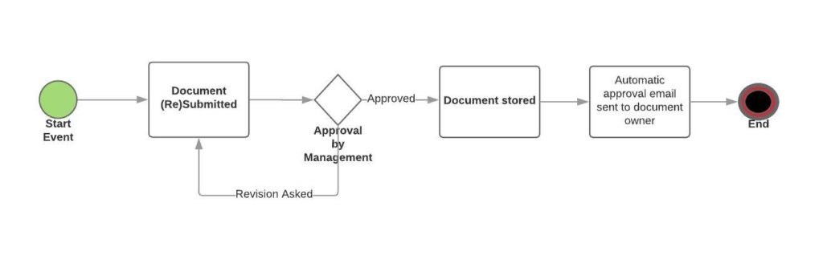
Employee Onboarding Process

