Slide 1

CASE STUDY
Of Marketing strategies on Jeans

Slide 2
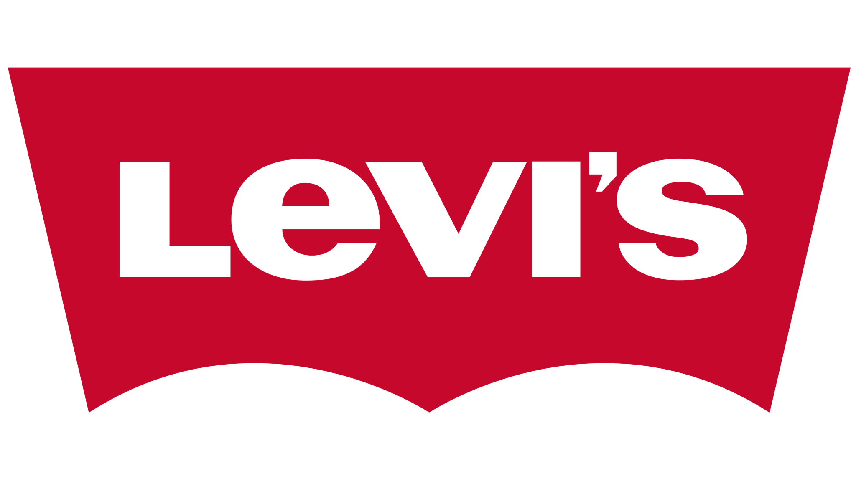

Levi’s Jeans
Founded in 1853,
One of the largest Jeans company in the world,
Sells their products in more than 160 countries around the world and one of the most recognised company amoung the other available companies.
Mainly designs Market Jeans, casual wear and other wearing accessories.

Slide 3
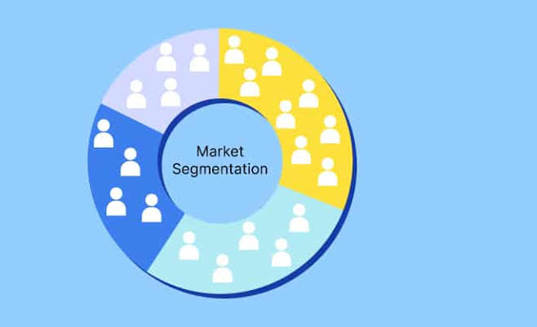
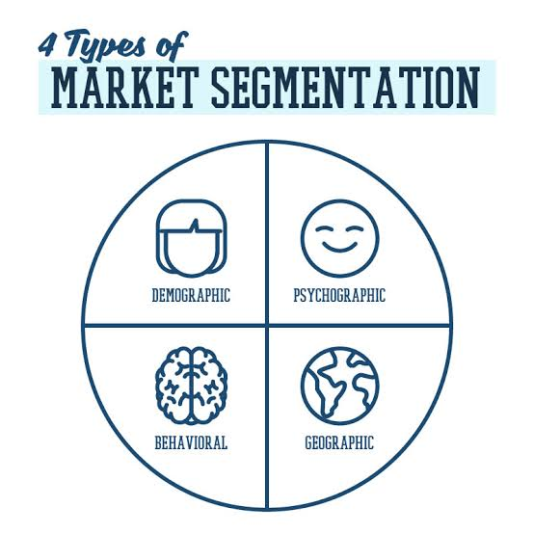
Of Levi’s India

Slide 4

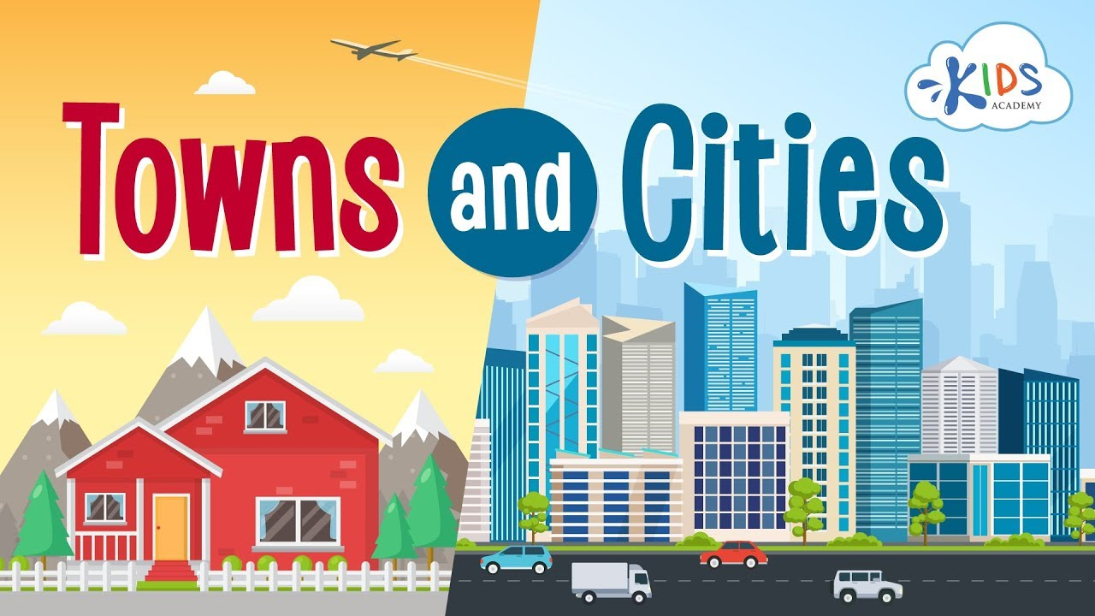
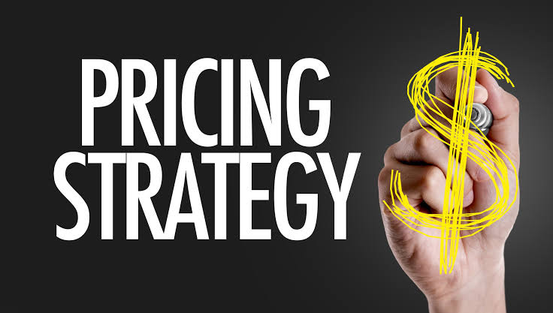
PREMIUM AND BUDGET RANGE
Urban and rural
Pricing strategy
Launched last year and priced between Rs 599-Rs999(USD 15- USD 25) in small towns and
upto Rs 1399(USD 35) in larger towns,
Convenient features, and product’s affordability based on the target audience.
From Rs 1299 (for Levi’s cost-sensitive customers) to Rs 7000 (customers with luxury).
the Premium and Super-Premium segment by launching more products in this segment. On the other hand, it is seeking to strengthen its Value Brand – Signature.

Slide 5
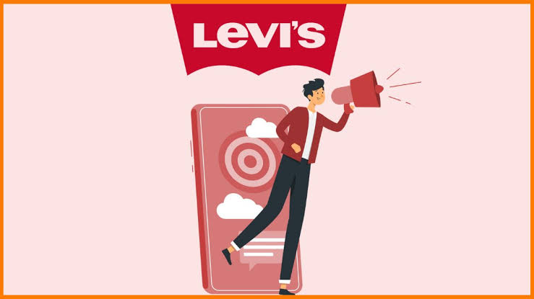
Promotional strategies

Slide 6

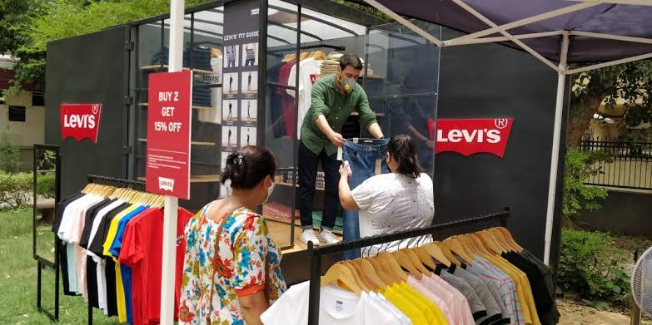
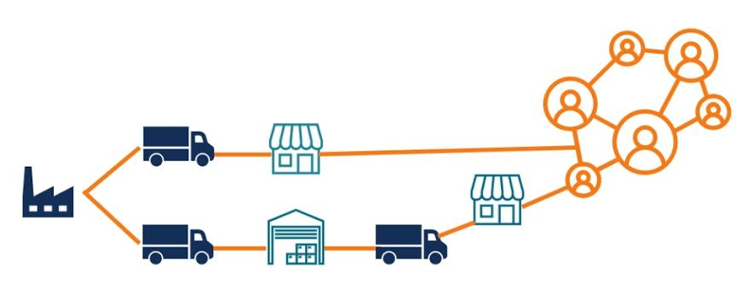
BRAND AMBASSADOR
Smooth Distribution
Loyal customers
Levi’s distribution strategy is remarkable. It manages the entire supply chain smoothly as well as the delivery through distribution channels, franchise models and advanced qualified staff.
Extraordinary and advanced marketing strategies that show how people would be shopping in the future.
Extremely comfortable and of great quality. Through this, the company owns immense popularity in the market and has a huge customer base with loyalty.
It’s denim jeans are innovative, enough spacious for keeping the necessary stuff and come with double layers for durability.
In 2021 Levi's appointed Deepika Padukone as its global brand ambassador.

