Slide 1
complexity OF THE FACTORS OF POLYNOMIALS
Somnath Bhattacharjee
(University of Toronto)
Based on joint works with
Mrinal Kumar (TIFR), Shantanu Rai (TIFR), Varun Ramanathan (TIFR), Ramprasad Saptharishi (TIFR) and Shubhangi Saraf (UofT)

Slide 2
Agenda
How do the factors of polynomial behave?

Slide 3
Agenda
How do the factors of polynomial behave?
Can we create a representation of factors from a representation of the original polynomial?

Slide 4
Agenda
How do the factors of polynomial behave?
Can we create a representation of factors from a representation of the original polynomial?
What is even a representation of polynomials?

Slide 5
Agenda
How do the factors of polynomial behave?
Can we create a representation of factors from a representation of the original polynomial?
What is even a representation of polynomials?
Are factors "easy" if the original polynomial is easy?

Slide 6
The model of computing Polynomials

Slide 7
Monomial representation:

Slide 8
Monomial representation:
We write all the monomials of the polynomials

Slide 9
Monomial representation:
We write all the monomials of the polynomials
Factors can have large number of monomials

Slide 10
Monomial representation:
We write all the monomials of the polynomials
Factors can have large number of monomials
Example:

Slide 11

Monomial representation:
We write all the monomials of the polynomials
Factors can have large number of monomials
Example:
Not so efficient
Exponentially large polynomials can be represented "easily"

Slide 12

Monomial representation:
We write all the monomials of the polynomials
Factors can have large number of monomials
Example:
Not so efficient
Exponentially large polynomials can be represented "easily"
Example $\left(1+x_{1}\right)\left(1+x_{2}\right)…(1+x_{n})$

Slide 13
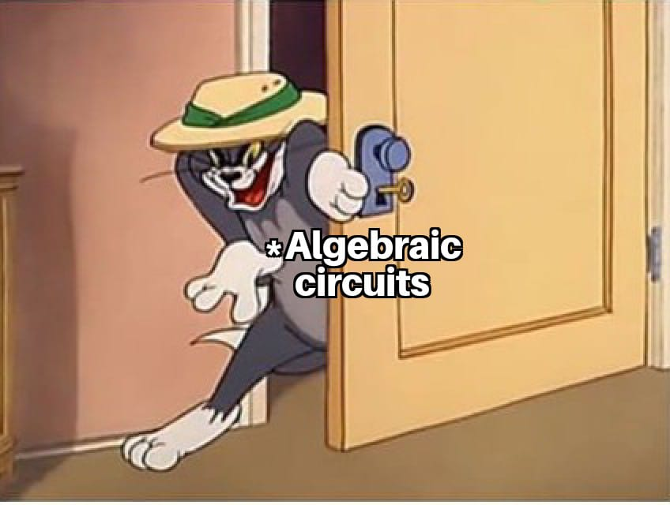
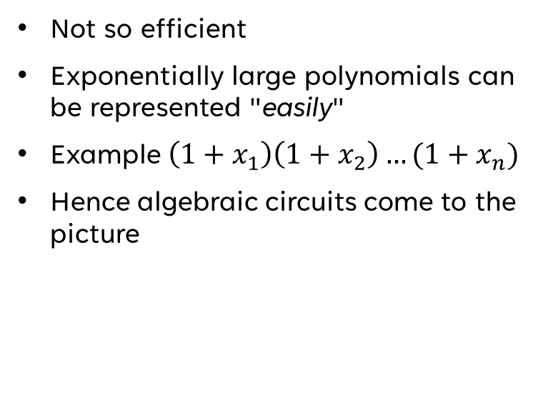
Monomial representation:
We write all the monomials of the polynomials
Factors can have large number of monomials
Example:
Not so efficient
Exponentially large polynomials can be represented "easily"
Example $\left(1+x_{1}\right)\left(1+x_{2}\right)…(1+x_{n})$
Hence algebraic circuits come to the picture

Slide 14
Algebraic Circuits

Slide 15
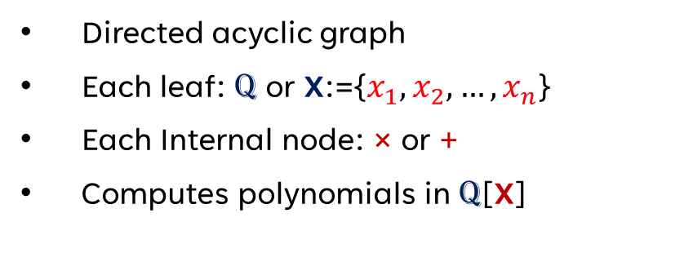
Algebraic Circuits
Directed acyclic graph
Each leaf: Q or X:={$x_{1},x_{2},…,x_{n}$}
Each Internal node: × or +
Computes polynomials in Q[X]

Slide 16
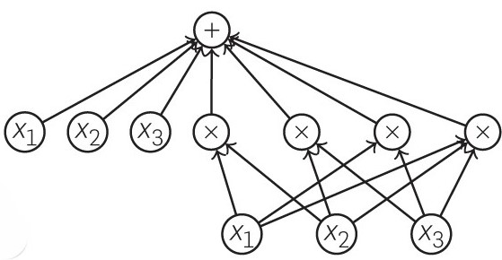
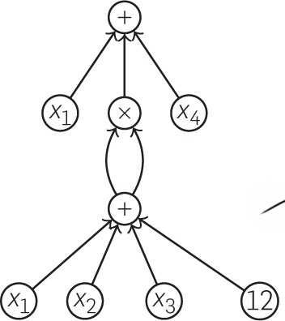
Algebraic Circuits
Directed acyclic graph
Each leaf: Q or X:={$x_{1},x_{2},…,x_{n}$}
Each Internal node: × or +
Computes polynomials in Q[X]

Slide 17
Measures:
Algebraic Circuits
Directed acyclic graph
Each leaf: Q or X:={$x_{1},x_{2},…,x_{n}$}
Each Internal node: × or +
Computes polynomials in Q[X]

Slide 18
Measures:
Algebraic Circuits
Directed acyclic graph
Each leaf: Q or X:={$x_{1},x_{2},…,x_{n}$}
Each Internal node: × or +
Computes polynomials in Q[X]
Size: # of edges
Depth: Longest path from root to leaf

Slide 19
Measures:
Algebraic Circuits
Directed acyclic graph
Each leaf: Q or X:={$x_{1},x_{2},…,x_{n}$}
Each Internal node: × or +
Computes polynomials in Q[X]
We are rational person
Size: # of edges
Depth: Longest path from root to leaf

Slide 20
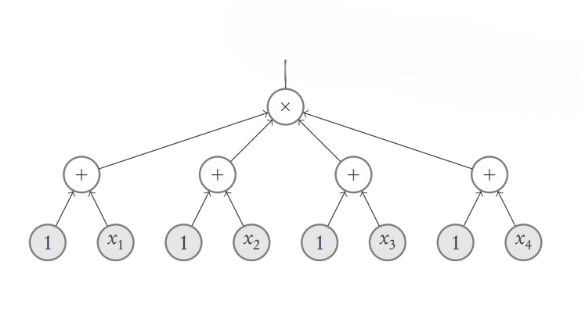
Algebraic Formulas
Underlying graph is a tree

Slide 21
Algebraic Complexity

Slide 22
Algebraic Complexity
What are the easy polynomials?
What are the complexity classes?

Slide 23
Algebraic Complexity
What are the easy polynomials?
What are the complexity classes?
VP: Polynomials computed by poly(n) size circuits

Slide 24
Algebraic Complexity
What are the easy polynomials?
What are the complexity classes?
VP: Polynomials computed by poly(n) size circuits
VNP: Exponential sum of VP Polynomials

Slide 25
Algebraic Complexity
What are the easy polynomials?
What are the complexity classes?
VP: Polynomials computed by poly(n) size circuits
VNP: Exponential sum of VP Polynomials
VF: Polynomials computed by Formulas

Slide 26
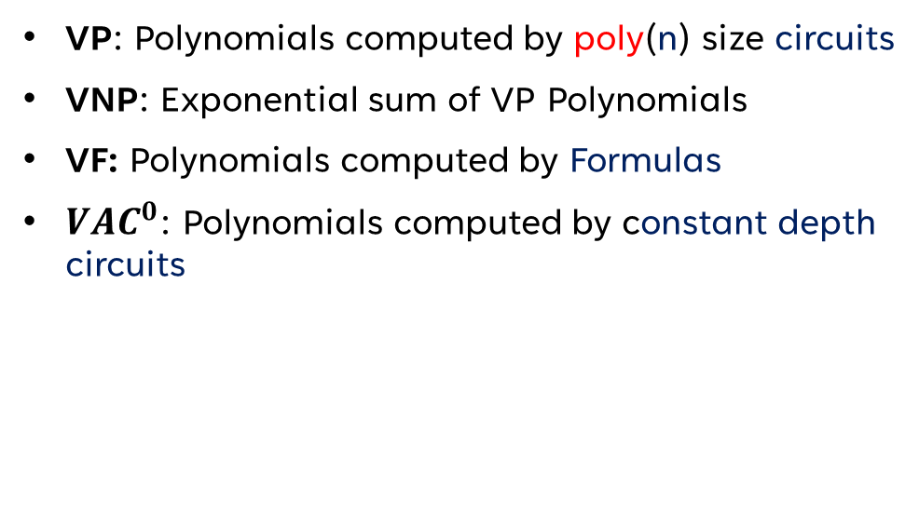
Algebraic Complexity
What are the easy polynomials?
What are the complexity classes?
VP: Polynomials computed by poly(n) size circuits
VNP: Exponential sum of VP Polynomials
VF: Polynomials computed by Formulas
${VAC}^{0}$: Polynomials computed by constant depth circuits

Slide 27
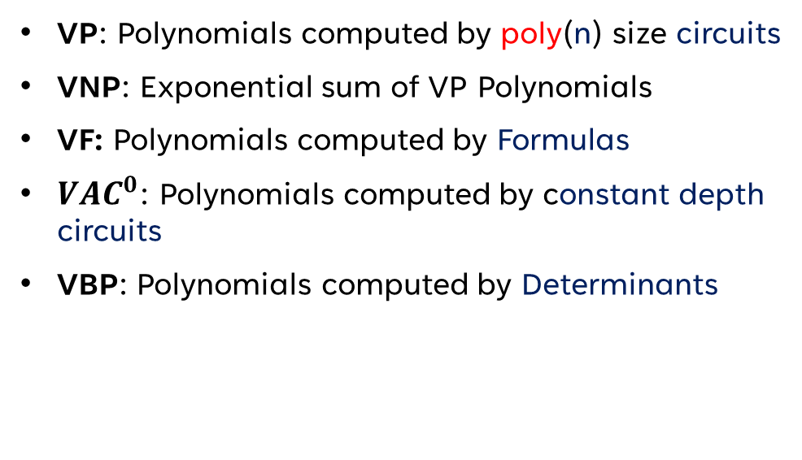
Algebraic Complexity
What are the easy polynomials?
What are the complexity classes?
VP: Polynomials computed by poly(n) size circuits
VNP: Exponential sum of VP Polynomials
VF: Polynomials computed by Formulas
${VAC}^{0}$: Polynomials computed by constant depth circuits
VBP: Polynomials computed by Determinants

Slide 28
Questions in Algebraic Complexity
?
?
?
?

Slide 29
Questions in Algebraic Complexity
Hardness questions
?
?
?

Slide 30
Hardness Questions
What is the relation between all the defined classes?

Slide 31

Hardness Questions
What is the relation between all the defined classes?
$$VAC^{0}$$
VF
VBP
VP
VNP

Slide 32




Hardness Questions
What is the relation between all the defined classes?
$$VAC^{0}$$
VF
VBP
VP
VNP
$$⊆$$
$$⊆$$
$$⊆$$
$$⊆$$

Slide 33
Hardness Questions
What is the relation between all the defined classes?
$$VAC^{0}$$
VF
VBP
VP
VNP
$$⊆$$
$$⊆$$
$$⊆$$
$$⊆$$
Analogous to P vs NP

Slide 34
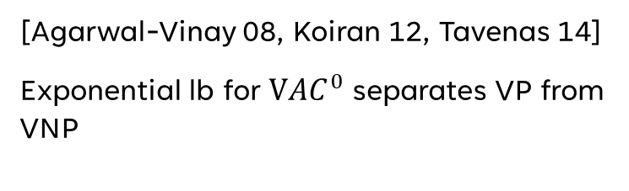
Hardness Questions
What is the relation between all the defined classes?
$$VAC^{0}$$
VF
VBP
VP
VNP
$$⊆$$
$$⊆$$
$$⊆$$
$$⊆$$
[Agarwal-Vinay 08, Koiran 12, Tavenas 14]
Exponential lb for $VAC^{0}$ separates VP from VNP
Analogous to P vs NP

Slide 35
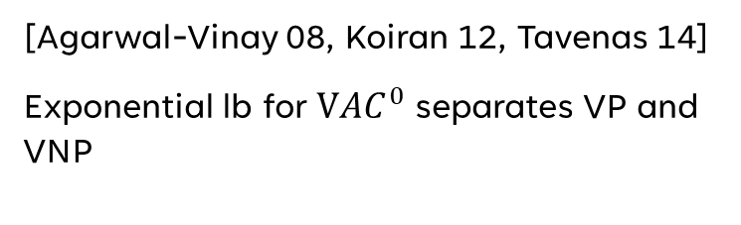

Hardness Questions
What is the relation between all the defined classes?
$$VAC^{0}$$
VF
VBP
VP
VNP
$$⊆$$
$$⊆$$
$$⊆$$
$$⊆$$
[Agarwal-Vinay 08, Koiran 12, Tavenas 14]
Exponential lb for $VAC^{0}$ separates VP and VNP
Analogous to P vs NP
Break through by
[Limaye-Srinivasan-Tavenas 21]
Super polynomial lower bound for $VAC^{0}$

Slide 36

Hardness Questions
What is the relation between all the defined classes?
$$VAC^{0}$$
VF
VBP
VP
VNP
$$⊊$$
$$⊆$$
$$⊆$$
$$⊆$$
[Agarwal-Vinay 08, Koiran 12, Tavenas 14]
Exponential lb for $VAC^{0}$ separates VP and VNP
Analogous to P vs NP
Break through by
[Limaye-Srinivasan-Tavenas 21]
Super polynomial lower bound for $VAC^{0}$

Slide 37
Questions in Algebraic Complexity
Hardness questions
?
?
?

Slide 38
Questions in Algebraic Complexity
Hardness questions
Complexity of Factors
?
?

Slide 39
Complexity of Factors
For a circuit class C
What is the relation between Fact(C) and C ?

Slide 40
Complexity of Factors
For a circuit class C
What is the relation between Fact(C) and C ?
$$VAC^{0}$$
VF
VBP
VP
VNP

Slide 41
Complexity of Factors
For a circuit class C
What is the relation between Fact(C) and C ?
$$VAC^{0}$$
VF
VBP
VP
VNP
=
Fact​
(VP)
[Kaltofen 80]

Slide 42
Complexity of Factors
For a circuit class C
What is the relation between Fact(C) and C ?
$$VAC^{0}$$
VF
VBP
VP
VNP
=
=
=
Fact​
(VBP)
Fact​
(VP)
Fact​
(VNP)
[Sinhababu- Thierauf 20]
[Chou-Kumar-Solomon 19]

Slide 43

Complexity of Factors
For a circuit class C
What is the relation between Fact(C) and C ?
$$VAC^{0}$$
VF
VBP
VP
VNP
=
=
=
Fact​
(VBP)
Fact​
(VP)
Fact​
(VNP)
[Sinhababu- Thierauf 20]
[Chou-Kumar-Solomon 19]

Slide 44
Complexity of Factors
For a circuit class C
What is the relation between Fact(C) and C ?
$$VAC^{0}$$
VF
VBP
VP
VNP
All these works uses Newton iteration/ Hensel lifting.
Those are not supported in VAC or VF model
=
=
=
Fact​
(VBP)
Fact​
(VP)
Fact​
(VNP)
[Sinhababu- Thierauf 20]
[Chou-Kumar-Solomon 19]

Slide 45
Questions in Algebraic Complexity
Hardness questions
Complexity of Factors
?
?

Slide 46
Questions in Algebraic Complexity
Hardness questions
Complexity of Factors
Algorithmic Questions
?

Slide 47
Algorithmic questions
Polynomial Identity Testing:

Slide 48
Algorithmic questions
Polynomial Identity Testing: Given a circuit C , Check C=0?

Slide 49
Algorithmic questions
Polynomial Identity Testing: Given a circuit C , Check C=0?
Randomized algorithm: Evaluate on a random point

Slide 50
Algorithmic questions
Polynomial Identity Testing: Given a circuit C , Check C=0?
Randomized algorithm: Evaluate on a random point
Polynomial time algorithm known for sparse polynomials and other restrictive cases.

Slide 51

Algorithmic questions
Polynomial Identity Testing: Given a circuit C , Check C=0?
Randomized algorithm: Evaluate on a random point
Polynomial time algorithm known for sparse polynomials and other restrictive cases.
[LST]+[CKS] gives subexponential time PIT for $VAC^{0}$

Slide 52

Algorithmic questions
Polynomial Identity Testing: Given a circuit C , Check C=0?
Randomized algorithm: Evaluate on a random point
Polynomial time algorithm known for sparse polynomials and other restrictive cases.
[LST]+[CKS] gives subexponential time PIT for $VAC^{0}$
Factorization:

Slide 53

Algorithmic questions
Polynomial Identity Testing: Given a circuit C , Check C=0?
Randomized algorithm: Evaluate on a random point
Polynomial time algorithm known for sparse polynomials and other restrictive cases.
[LST]+[CKS] gives subexponential time PIT for $VAC^{0}$
Factorization: Given a circuit C ,Find the irreducible factors of C.

Slide 54

Algorithmic questions
Polynomial Identity Testing: Given a circuit C , Check C=0?
Randomized algorithm: Evaluate on a random point
Polynomial time algorithm known for sparse polynomials and other restrictive cases.
[LST]+[CKS] gives subexponential time PIT for $VAC^{0}$
Factorization: Given a circuit C ,Find the irreducible factors of C.
[Kal80] guaranties a polynomial size circuit and gives a randomized algorithm

Slide 55

Algorithmic questions
Polynomial Identity Testing: Given a circuit C , Check C=0?
Randomized algorithm: Evaluate on a random point
Polynomial time algorithm known for sparse polynomials and other restrictive cases.
[LST]+[CKS] gives subexponential time PIT for $VAC^{0}$
Factorization: Given a circuit C ,Find the irreducible factors of C.
[Kal80] guaranties a polynomial size circuit and gives a randomized algorithm
[Bhargava-Saraf-Volkovitch 21] gives quasi-poly PIT for Sparse individual degree polynomials

Slide 56
Questions in Algebraic Complexity
Hardness questions
Complexity of Factors
Algorithmic Questions
?

Slide 57
Questions in Algebraic Complexity
Hardness questions
Complexity of Factors
Algorithmic Questions
connection

Slide 58
Hardness, PIT and Factorization
Does efficient PIT give efficient Factorization algorithm?
Can we achieve efficient PIT from hardness results?

Slide 59
Hardness, PIT and Factorization
Does efficient PIT give efficient Factorization algorithm?
[Kopparty-Saraf-Shpilka 13]: PIT for VP implies Factorization for VP
Can we achieve efficient PIT from hardness results?

Slide 60
Hardness, PIT and Factorization
Does efficient PIT give efficient Factorization algorithm?
[Kopparty-Saraf-Shpilka 13]: PIT for VP implies Factorization for VP
Can we achieve efficient PIT from hardness results?
We know better PIT for many restrictive cases, what about factorization?

Slide 61
Hardness, PIT and Factorization
Does efficient PIT give efficient Factorization algorithm?
[Kopparty-Saraf-Shpilka 13]: PIT for VP implies Factorization for VP
Can we achieve efficient PIT from hardness results?
[Kabanets-Impagliazzo 04]: lowerbounds for VP derandomizes PIT for VP
We know better PIT for many restrictive cases, what about factorization?

Slide 62
Hardness, PIT and Factorization
Does efficient PIT give efficient Factorization algorithm?
[Kopparty-Saraf-Shpilka 13]: PIT for VP implies Factorization for VP
Can we achieve efficient PIT from hardness results?
[Kabanets-Impagliazzo 04]: lowerbounds for VP derandomizes PIT for VP
[CKS]+[LST] uses hardness to design subexp PIT for $VAC^{0}$
[CKS]+[LST] uses hardness to design subexp PIT for V𝐴𝐶^0
We know better PIT for many restrictive cases, what about factorization?

Slide 63
Hardness, PIT and Factorization
Does efficient PIT give efficient Factorization algorithm?
[Kopparty-Saraf-Shpilka 13]: PIT for VP implies Factorization for VP
Can we achieve efficient PIT from hardness results?
[Kabanets-Impagliazzo 04]: lowerbounds for VP derandomized PIT for VP
[B-Kumar-Ramanathan-Saptharishi-Saraf 25]: Subexp factorization for $VAC^{0}$
[B-Kumar-Ramanathan-Saptharishi-Saraf 25]: Subexp factorization for V𝐴𝐶^0
[CKS]+[LST] uses hardness to design subexp PIT for $VAC^{0}$
[CKS]+[LST] uses hardness to design subexp PIT for V𝐴𝐶^0
We know better PIT for many restrictive cases, what about factorization?

Slide 64

Hardness, PIT and Factorization
Does efficient PIT give efficient Factorization algorithm?
[Kopparty-Saraf-Shpilka 13]: PIT for VP implies Factorization for VP
Can we achieve efficient PIT from hardness results?
[Kabanets-Impagliazzo 04]: lowerbounds for VP derandomized PIT for VP
[B-Kumar-Ramanathan-Saptharishi-Saraf 25]: Subexp factorization for $VAC^{0}$
[B-Kumar-Ramanathan-Saptharishi-Saraf 25]: Subexp factorization for V𝐴𝐶^0
[CKS]+[LST] uses hardness to design subexp PIT for $VAC^{0}$
[CKS]+[LST] uses hardness to design subexp PIT for V𝐴𝐶^0
We know better PIT for many restrictive cases, what about factorization?
Is there a unified way to argue for all classes?

Slide 65

Our Result:
All rich-enough classes are closed under factorization
(Includes VF and $VAC^{0}$)

Slide 66
Our Result:
As a consequence:
Efficient (black-box) PIT for a class C will give efficient factorization of C
Lowerbounds for a class C will derandomized PIT for C
All rich-enough classes are closed under factorization
(Includes VF and $VAC^{0}$)

Slide 67
Our Result:
As a consequence:
Efficient (black-box) PIT for a class C will give efficient factorization of C
Lowerbounds for a class C will derandomized PIT for C
All rich-enough classes are closed under factorization
(Includes VF and $VAC^{0}$)
Main Theorem:
If a n variate d degree polynomial P(X) in Q[X] has a circuit of size s and depth Δ, then its factors can be computed by a circuit of size poly(n,s,d) and depth Δ+O(1) in Q

Slide 68
Our Result
VF and $VAC^{0}$ closed under factorization
VF and V𝐴𝐶^0 closed under factorization
Single unified proof of all closure results
Efficient PIT implies efficient factorization
Parallel algorithms for GCD computation over arbitrary (large enough) fields
Subexponential factorization and irreducibility testing for Sparse and $VAC^{0}$ polynomials
Subexponential factorization and irreducibility testing for Sparse and V𝐴𝐶^0 polynomials
Factors of Sparse polynomials has depth 6 circuit ($ΣΠΣ∧ΣΠ$)
Factors of Sparse polynomials has depth 6 circuit (ΣΠΣ∧ΣΠ)
Poly size approximations for low degree factors for exponential degree polynomials
(Extends the result of [Andrews and Wigderson 24])
(Alternative proof of [Bürgisser 04])

Slide 69
Remaining plan
Power series root
Newton iteration and it's limitation
Furstenberg's trick
Applications

Slide 70
Factors of polynomials

Slide 71
Factors of polynomials
Roots

Slide 72
Factors of polynomials
Roots
Let P(y) be a univariate degree d polynomial

Slide 73

Factors of polynomials
Roots
Let P(y) be a univariate degree d polynomial
P(y) has all it’s d many roots in $\overline{ℚ}$

Slide 74

Factors of polynomials
Roots
Let P(y) be a univariate degree d polynomial
P(y) has all it’s d many roots in $\overline{ℚ}$
We can find the irreducible factors in poly(d) time [Lenstra-Lenstra-Lovasz 84]

Slide 75
Factors of polynomials
Roots
Let P(X,y) be a n+1 variate polynomial in Q[X,y]

Slide 76
Factors of polynomials
Roots
Let P(X,y) be a n+1 variate polynomial in Q[X,y]
Degree: d = poly(n), circuit size: s = poly(n)

Slide 77
Factors of polynomials
Roots
Let P(X,y) be a n+1 variate polynomial in Q[X,y]
Degree: d = poly(n), circuit size: s = poly(n)
Satisfy “nice” conditions:

Slide 78
Factors of polynomials
Roots
Let P(X,y) be a n+1 variate polynomial in Q[X,y]
Degree: d = poly(n), circuit size: s = poly(n)
Satisfy “nice” conditions:
Monic in y

Slide 79
Factors of polynomials
Roots
Let P(X,y) be a n+1 variate polynomial in Q[X,y]
Degree: d = poly(n), circuit size: s = poly(n)
Satisfy “nice” conditions:
Monic in y
P(0,y) is square-free

Slide 80

Factors of polynomials
Roots
Let P(X,y) be a n+1 variate polynomial in Q[X,y]
Degree: d = poly(n), circuit size: s = poly(n)
Satisfy “nice” conditions:
Monic in y
P(0,y) is square-free
Theorem (Newton, Puiseux, Rhapson,…)
Where $φ_{i}$ are in $\overline{ℚ}[[X]]$

Slide 81
Factors of polynomials
Roots

Slide 82
Factors of polynomials
Roots

Slide 83

Factors of polynomials
Roots
Clearly $u= φ(\overline{0})$ , the constant term

Slide 84
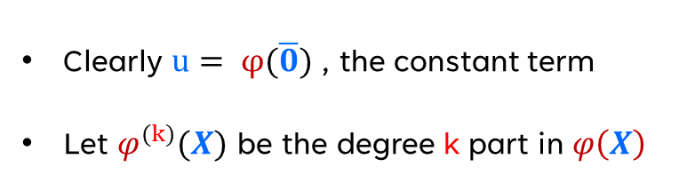
Factors of polynomials
Roots
Clearly $u= φ(\overline{0})$ , the constant term
Let $φ^{(k)}(X)$ be the degree k part in $φ\left(X\right)$

Slide 85
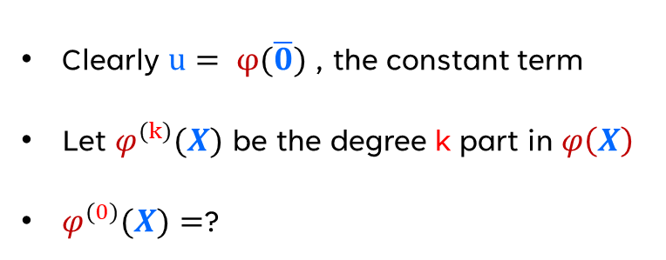
Factors of polynomials
Roots
Clearly $u= φ(\overline{0})$ , the constant term
Let $φ^{(k)}(X)$ be the degree k part in $φ\left(X\right)$
$φ^{(0)}(X)=$?

Slide 86
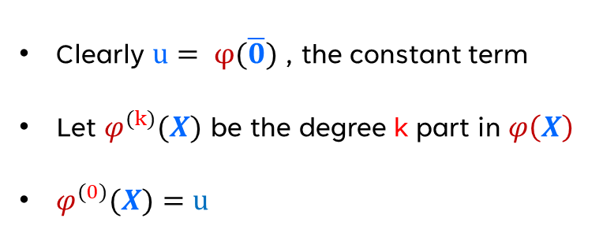
Factors of polynomials
Roots
Clearly $u= φ(\overline{0})$ , the constant term
Let $φ^{(k)}(X)$ be the degree k part in $φ\left(X\right)$
$φ^{(0)}(X)=u$

Slide 87
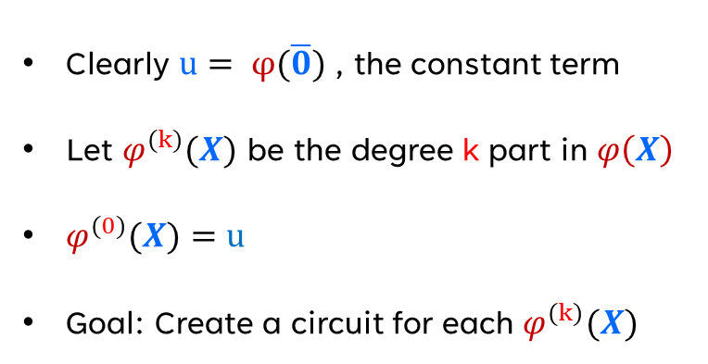
Factors of polynomials
Roots
Clearly $u= φ(\overline{0})$ , the constant term
Let $φ^{(k)}(X)$ be the degree k part in $φ\left(X\right)$
$φ^{(0)}(X)=u$
Goal: Create a circuit for each $φ^{(k)}(X)$

Slide 88
Newton iteration

Slide 89
Newton iteration
$φ^{(k)}$ can be computed
𝜑^((k)) can be computed
Recursively from $φ^{(k−1)}$
Recursively from 𝜑^((k−1))

Slide 90
Newton iteration
$φ^{(k)}$ can be computed
𝜑^((k)) can be computed
Recursively from $φ^{(k−1)}$
Recursively from 𝜑^((k−1))
Newton iteration
$φ^{\left(k\right)}=φ^{\left(k−1\right)}−\frac{P(X,{ φ}^{(k−1)})}{∂_{y}P(0, { φ}^{(0)})}$ mod ${<X>}^{k}$
𝜑^((𝑘) )=𝜑^((𝑘−1) )−(P(𝑿,〖 𝜑〗^((k−1))))/(𝜕_y P(𝟎, 〖 𝜑〗^((0)))) mod 〖<𝑿>〗^𝑘

Slide 91
Newton iteration
$φ^{(k)}$ can be computed
𝜑^((k)) can be computed
Recursively from $φ^{(k−1)}$
Recursively from 𝜑^((k−1))
Newton iteration
$φ^{\left(k\right)}=φ^{\left(k−1\right)}−\frac{P(X,{ φ}^{(k−1)})}{∂_{y}P(0, { φ}^{(0)})}$ mod ${<X>}^{k}$
𝜑^((𝑘) )=𝜑^((𝑘−1) )−(P(𝑿,〖 𝜑〗^((k−1))))/(𝜕_y P(𝟎, 〖 𝜑〗^((0)))) mod 〖<𝑿>〗^𝑘
u is a root of P(0,y)
Lift using $φ^{\left(0\right)}=u$
Lift using 𝜑^((0) )=u

Slide 92

P
$$φ^{\left(0\right)}$$
P

Slide 93

P
$$φ^{\left(1\right)}$$
$$φ^{\left(0\right)}$$
P

Slide 94
P
$$φ^{\left(1\right)}$$
$$φ^{\left(0\right)}$$
P

Slide 95


$$φ^{\left(2\right)}$$
$$φ^{\left(0\right)}$$
P
$$φ^{\left(1\right)}$$
$$φ^{\left(0\right)}$$
P

Slide 96
.
.
.
$$φ^{\left(2\right)}$$
$$φ^{\left(0\right)}$$
P
$$φ^{\left(1\right)}$$
$$φ^{\left(0\right)}$$
P

Slide 97


$$φ^{\left(k\right)}$$
$$φ^{\left(0\right)}$$
P
.
.
.
$$φ^{\left(2\right)}$$
$$φ^{\left(0\right)}$$
P
$$φ^{\left(1\right)}$$
$$φ^{\left(0\right)}$$
P

Slide 98
$$φ^{\left(k\right)}$$
$$φ^{\left(0\right)}$$
P
.
.
.
Depth: O (k)
$$φ^{\left(2\right)}$$
$$φ^{\left(0\right)}$$
P
$$φ^{\left(1\right)}$$
$$φ^{\left(0\right)}$$
P

Slide 99
$$φ^{\left(k\right)}$$
$$φ^{\left(0\right)}$$
P
.
.
.
Depth: O (k)
Can be improved to: O (log k)
$$φ^{\left(2\right)}$$
$$φ^{\left(0\right)}$$
P
$$φ^{\left(1\right)}$$
$$φ^{\left(0\right)}$$
P

Slide 100
$$φ^{\left(k\right)}$$
$$φ^{\left(0\right)}$$
P
.
.
.
Depth: O (k)
Can be improved to: O (log k)
Goal: Constant depth
$$φ^{\left(2\right)}$$
$$φ^{\left(0\right)}$$
P
$$φ^{\left(1\right)}$$
$$φ^{\left(0\right)}$$
P

Slide 101
Furstenberg's Trick
[Furstenberg 1967]

Slide 102
Furstenberg's Trick (bivariate version)
[Furstenberg 1967]

Slide 103
Furstenberg's Trick (bivariate version)
[Furstenberg 1967]
If P(t,y) is a nice polynomial (monic, square-free)

Slide 104
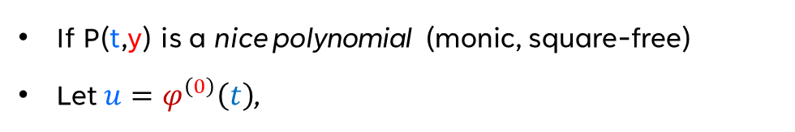
Furstenberg's Trick (bivariate version)
[Furstenberg 1967]
If P(t,y) is a nice polynomial (monic, square-free)
Let $u=φ^{\left(0\right)}\left(t\right)$,

Slide 105
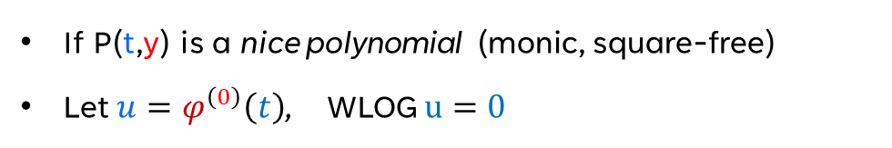
Furstenberg's Trick (bivariate version)
[Furstenberg 1967]
If P(t,y) is a nice polynomial (monic, square-free)
Let $u=φ^{\left(0\right)}\left(t\right)$, WLOG $u=0$

Slide 106
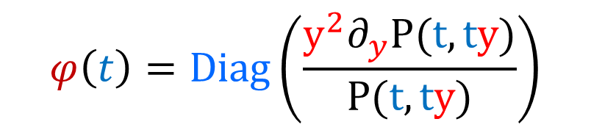
Furstenberg's Trick (bivariate version)
[Furstenberg 1967]
If P(t,y) is a nice polynomial (monic, square-free)
Let $u=φ^{\left(0\right)}\left(t\right)$, WLOG $u=0$
$$φ\left(t\right)=Diag\left(\frac{y^{2}∂_{y}P(t,ty)}{P(t,ty)}\right)$$

Slide 107
Furstenberg's Trick (bivariate version)
[Furstenberg 1967]
If P(t,y) is a nice polynomial (monic, square-free)
Let $u=φ^{\left(0\right)}\left(t\right)$, WLOG $u=0$
$$φ\left(t\right)=Diag\left(\frac{y^{2}∂_{y}P(t,ty)}{P(t,ty)}\right)$$
Where $Diag(Power series(t,y))=$ Keep those monomials where t-degree = y-degree

Slide 108
Furstenberg's Trick (bivariate version)
[Furstenberg 1967]
If P(t,y) is a nice polynomial (monic, square-free)
Let $u=φ^{\left(0\right)}\left(t\right)$, WLOG $u=0$
$$φ\left(t\right)=Diag\left(\frac{y^{2}∂_{y}P(t,ty)}{P(t,ty)}\right)$$
Proof: Left as an exercise
Where $Diag(Power series(t,y))=$ Keep those monomials where t-degree = y-degree

Slide 109
Lifting to multivariate

Slide 110
Lifting to multivariate
If P(X,y) is a nice polynomial (monic, square-free)

Slide 111
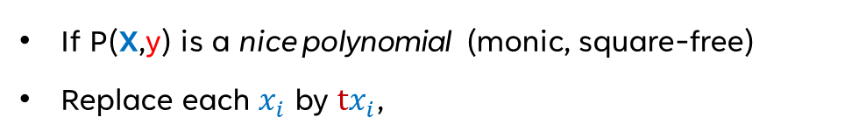
Lifting to multivariate
If P(X,y) is a nice polynomial (monic, square-free)
Replace each $x_{i}$ by ${tx}_{i}$,

Slide 112
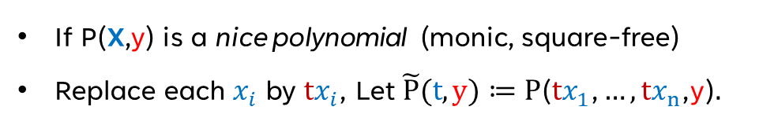
Lifting to multivariate
If P(X,y) is a nice polynomial (monic, square-free)
Replace each $x_{i}$ by ${tx}_{i}$, Let $\tilde{P}(t,y)≔P\text{(}{tx}_{1}\text{,}…,{tx}_{n}\text{,}\text{y}\text{)}.$

Slide 113
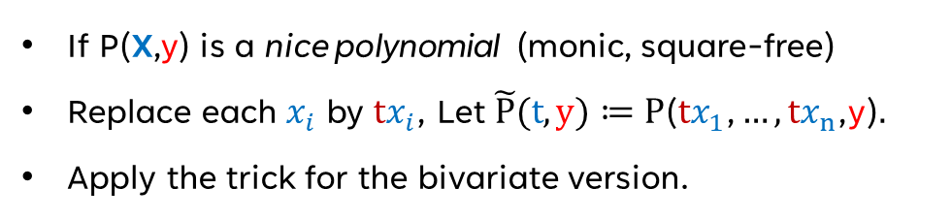
Lifting to multivariate
If P(X,y) is a nice polynomial (monic, square-free)
Replace each $x_{i}$ by ${tx}_{i}$, Let $\tilde{P}(t,y)≔P\text{(}{tx}_{1}\text{,}…,{tx}_{n}\text{,}\text{y}\text{)}.$
Apply the trick for the bivariate version.

Slide 114
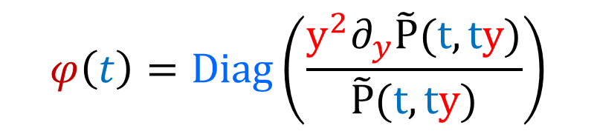
Lifting to multivariate
If P(X,y) is a nice polynomial (monic, square-free)
Replace each $x_{i}$ by ${tx}_{i}$, Let $\tilde{P}(t,y)≔P\text{(}{tx}_{1}\text{,}…,{tx}_{n}\text{,}\text{y}\text{)}.$
Apply the trick for the bivariate version.
$$φ\left(t\right)=Diag\left(\frac{y^{2}∂_{y}\tilde{P}(t,ty)}{\tilde{P}(t,ty)}\right)$$

Slide 115
Lifting to multivariate
If P(X,y) is a nice polynomial (monic, square-free)
Replace each $x_{i}$ by ${tx}_{i}$, Let $\tilde{P}(t,y)≔P\text{(}{tx}_{1}\text{,}…,{tx}_{n}\text{,}\text{y}\text{)}.$
Apply the trick for the bivariate version.
In constant depth we can do the followings (Known)
Partial derivative computation
Division
Diagonal entry computation
$$φ\left(t\right)=Diag\left(\frac{y^{2}∂_{y}\tilde{P}(t,ty)}{\tilde{P}(t,ty)}\right)$$

Slide 116
Factors of polynomials
Roots
P

Slide 117

Factors of polynomials
Roots
$$φ^{\left(k\right)}$$
Depth: constant
Size: Poly(n,d,k)
P

Slide 118
Factors of polynomials
Roots

Slide 119
Factors of polynomials
Roots
Let Q(X,y) is irreducible factor of P(X,y) of degree r

Slide 120
Factors of polynomials
Roots
Let Q(X,y) is irreducible factor of P(X,y) of degree r
Roots of Q is some r length subset of roots of P

Slide 121
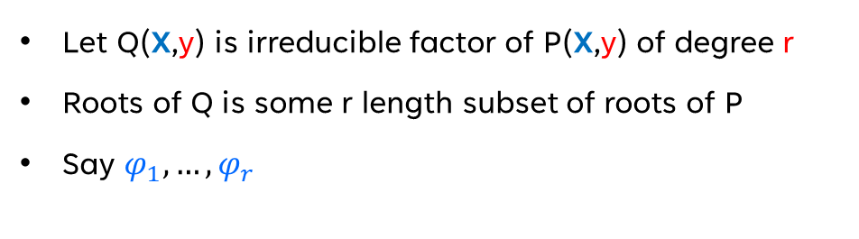
Factors of polynomials
Roots
Let Q(X,y) is irreducible factor of P(X,y) of degree r
Roots of Q is some r length subset of roots of P
Say $φ_{1},…,φ_{r}$

Slide 122
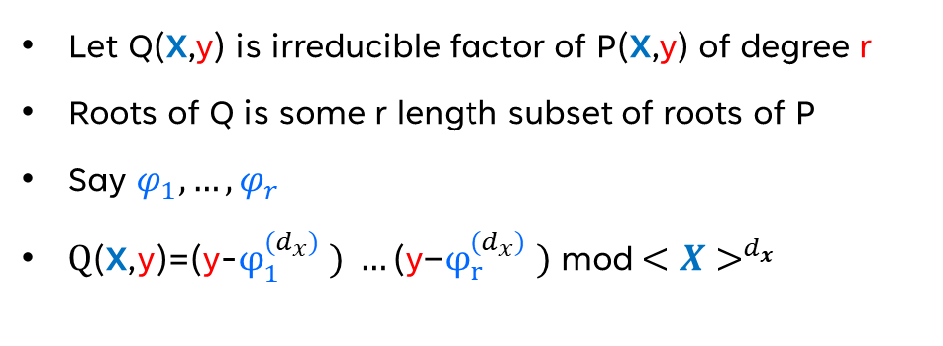
Factors of polynomials
Roots
Let Q(X,y) is irreducible factor of P(X,y) of degree r
Roots of Q is some r length subset of roots of P
Say $φ_{1},…,φ_{r}$
$\text{Q}\text{(}\text{X}\text{,}\text{y}\text{)}\text{=(}\text{y}\text{−}φ_{1}^{(d_{x})} ) …\text{(}\text{y}\text{−}φ_{r}^{(d_{x})} )$ mod$<X>^{d_{x} }$

Slide 123
Factors of polynomials
Roots
Q
Let Q(X,y) is irreducible factor of P(X,y) of degree r
Roots of Q is some r length subset of roots of P
Say $φ_{1},…,φ_{r}$
$\text{Q}\text{(}\text{X}\text{,}\text{y}\text{)}\text{=(}\text{y}\text{−}φ_{1}^{(d_{x})} ) …\text{(}\text{y}\text{−}φ_{r}^{(d_{x})} )$ mod$<X>^{d_{x} }$
P
P
…
P

Slide 124
Factors of polynomials
Roots
Q
Let Q(X,y) is irreducible factor of P(X,y) of degree r
Roots of Q is some r length subset of roots of P
Say $φ_{1},…,φ_{r}$
$\text{Q}\text{(}\text{X}\text{,}\text{y}\text{)}\text{=(}\text{y}\text{−}φ_{1}^{(d_{x})} ) …\text{(}\text{y}\text{−}φ_{r}^{(d_{x})} )$ mod$<X>^{d_{x} }$
Depth: constant
Size: Poly(n,d,s)
P
P
…
P
d - many

Slide 125
Factors of polynomials
Roots
Q
Let Q(X,y) is irreducible factor of P(X,y) of degree r
Roots of Q is some r length subset of roots of P
Say $φ_{1},…,φ_{r}$
$\text{Q}\text{(}\text{X}\text{,}\text{y}\text{)}\text{=(}\text{y}\text{−}φ_{1}^{(d_{x})} ) …\text{(}\text{y}\text{−}φ_{r}^{(d_{x})} )$ mod$<X>^{d_{x} }$
Depth: constant
Size: Poly(n,d,s)
P
P
…
P
Main Theorem:
If a n variate d degree polynomial P(X) in Q[X] has a circuit of size s and depth Δ, then its factors can be computed by a circuit of size poly(n,s,d) and depth Δ+O(1) in Q
d - many

Slide 126
Hardness implies Derandomization
Generalization of Kabanets-Impagliazzo

Slide 127
Derandomization: variable reduction

Slide 128
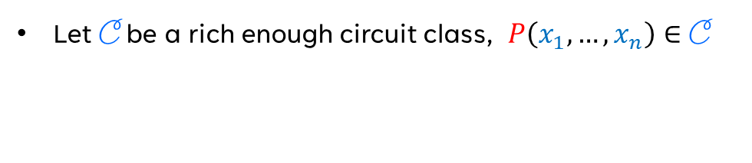
Derandomization: variable reduction
Let C be a rich enough circuit class, $P\left(x_{1},…,x_{n}\right)∈$ C

Slide 129
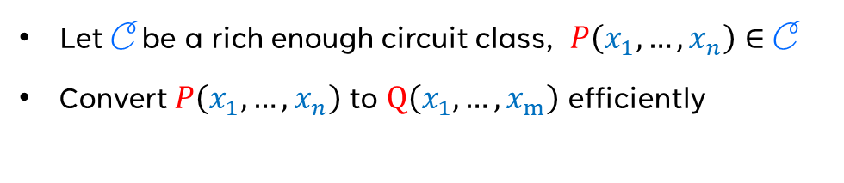
Derandomization: variable reduction
Let C be a rich enough circuit class, $P\left(x_{1},…,x_{n}\right)∈$ C
Convert $P\left(x_{1},…,x_{n}\right)$ to $Q\left(x_{1},…,x_{m}\right)$ efficiently

Slide 130
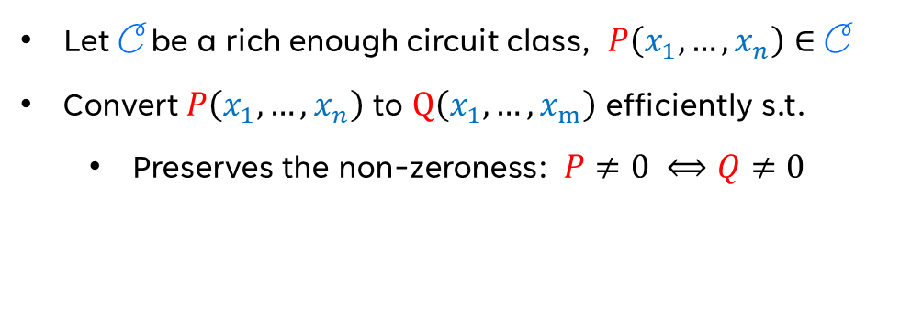
Derandomization: variable reduction
Let C be a rich enough circuit class, $P\left(x_{1},…,x_{n}\right)∈$ C
Convert $P\left(x_{1},…,x_{n}\right)$ to $Q\left(x_{1},…,x_{m}\right)$ efficiently s.t.
Preserves the non-zeroness: $P≠0 ⟺Q≠0$

Slide 131
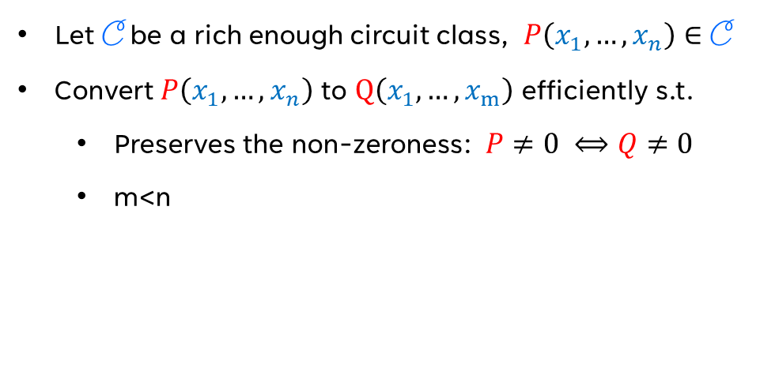
Derandomization: variable reduction
Let C be a rich enough circuit class, $P\left(x_{1},…,x_{n}\right)∈$ C
Convert $P\left(x_{1},…,x_{n}\right)$ to $Q\left(x_{1},…,x_{m}\right)$ efficiently s.t.
Preserves the non-zeroness: $P≠0 ⟺Q≠0$
m<n

Slide 132
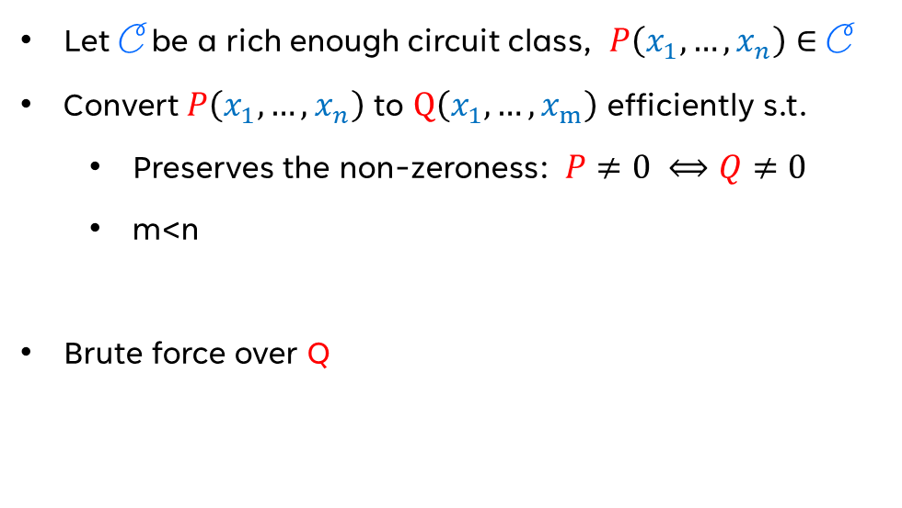
Derandomization: variable reduction
Let C be a rich enough circuit class, $P\left(x_{1},…,x_{n}\right)∈$ C
Convert $P\left(x_{1},…,x_{n}\right)$ to $Q\left(x_{1},…,x_{m}\right)$ efficiently s.t.
Preserves the non-zeroness: $P≠0 ⟺Q≠0$
m<n
Brute force over Q

Slide 133
Hardness to derandomization

Slide 134

Hardness to derandomization
Let $P\left(x_{1},…,x_{n},y\right)∈$ C , non-zero

Slide 135
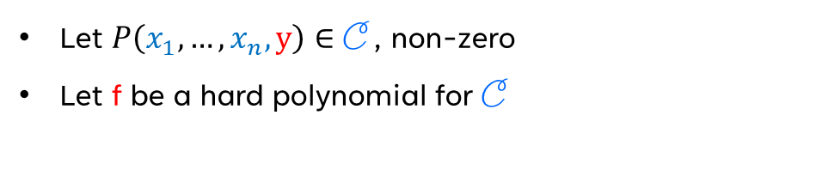
Hardness to derandomization
Let $P\left(x_{1},…,x_{n},y\right)∈$ C , non-zero
Let f be a hard polynomial for C

Slide 136
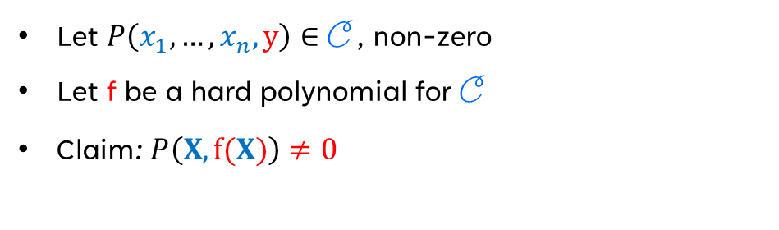
Hardness to derandomization
Let $P\left(x_{1},…,x_{n},y\right)∈$ C , non-zero
Let f be a hard polynomial for C
Claim: $P\left(X,f(X)\right)≠0$

Slide 137
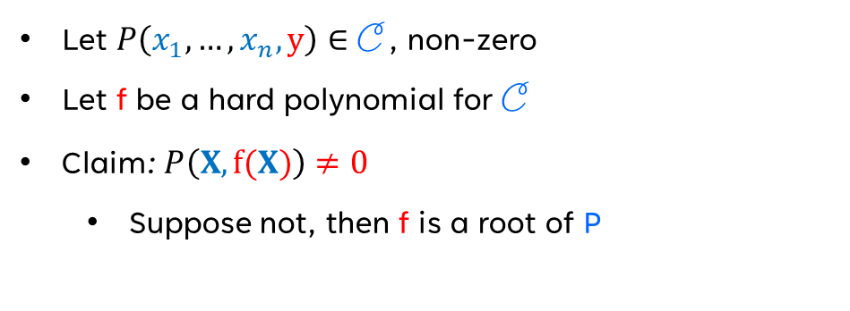
Hardness to derandomization
Let $P\left(x_{1},…,x_{n},y\right)∈$ C , non-zero
Let f be a hard polynomial for C
Claim: $P\left(X,f(X)\right)≠0$
Suppose not, then f is a root of P

Slide 138
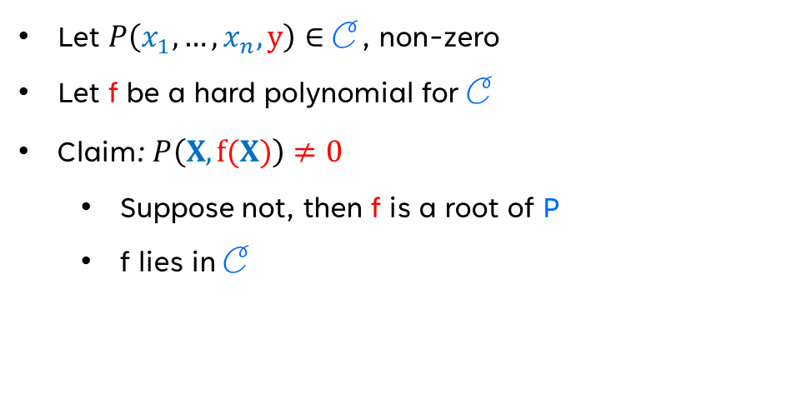
Hardness to derandomization
Let $P\left(x_{1},…,x_{n},y\right)∈$ C , non-zero
Let f be a hard polynomial for C
Claim: $P\left(X,f(X)\right)≠0$
Suppose not, then f is a root of P
f lies in C

Slide 139
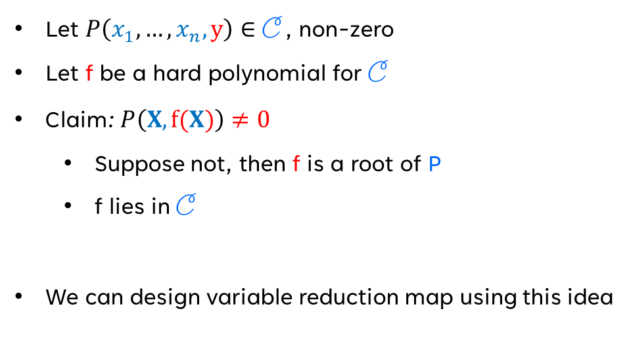
Hardness to derandomization
Let $P\left(x_{1},…,x_{n},y\right)∈$ C , non-zero
Let f be a hard polynomial for C
Claim: $P\left(X,f(X)\right)≠0$
Suppose not, then f is a root of P
f lies in C
We can design variable reduction map using this idea

Slide 140
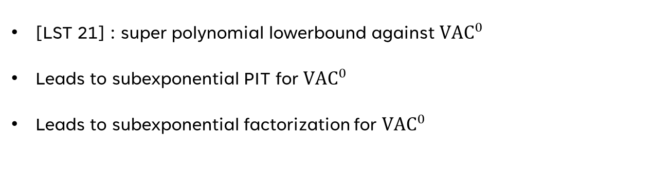
Hardness to derandomization
[LST 21] : super polynomial lowerbound against ${VAC}^{0}$
Leads to subexponential PIT for ${VAC}^{0}$
Leads to subexponential factorization for ${VAC}^{0}$

Slide 141
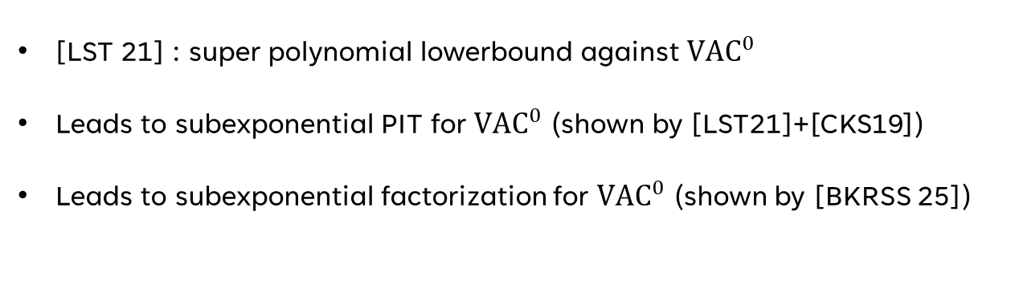
Hardness to derandomization
[LST 21] : super polynomial lowerbound against ${VAC}^{0}$
Leads to subexponential PIT for ${VAC}^{0}$ (shown by [LST21]+[CKS19])
Leads to subexponential factorization for ${VAC}^{0}$ (shown by [BKRSS 25])

Slide 142
Symmetric polynomials
Analyzing of Blaser-Jindal in Furstenberg style

Slide 143
Symmetric Polynomials

Slide 144
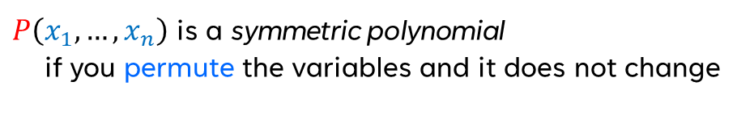
Symmetric Polynomials
$P\left(x_{1},…,x_{n}\right)$ is a symmetric polynomial
if you permute the variables and it does not change

Slide 145
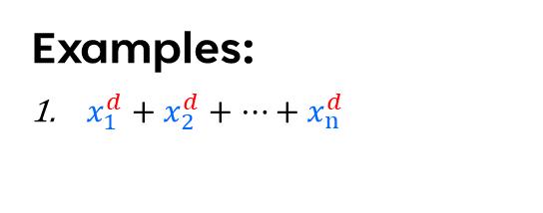
Symmetric Polynomials
Examples:
$x_{1}^{d}+x_{2}^{d}+…+x_{n}^{d}$
$P\left(x_{1},…,x_{n}\right)$ is a symmetric polynomial
if you permute the variables and it does not change

Slide 146
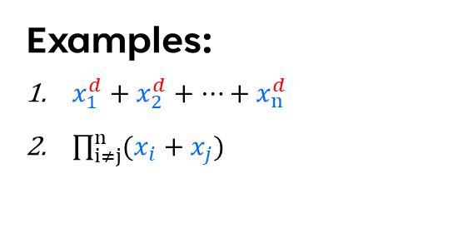
Symmetric Polynomials
Examples:
$x_{1}^{d}+x_{2}^{d}+…+x_{n}^{d}$
$\prod_{i≠j}^{n}{(x_{i}+x_{j})}$
$P\left(x_{1},…,x_{n}\right)$ is a symmetric polynomial
if you permute the variables and it does not change

Slide 147
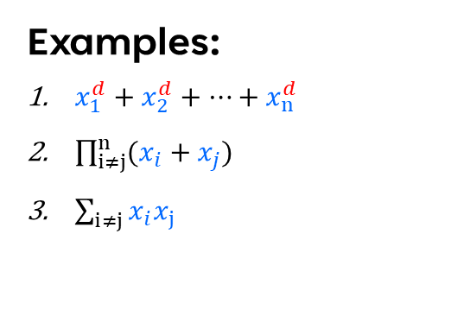
Symmetric Polynomials
Examples:
$x_{1}^{d}+x_{2}^{d}+…+x_{n}^{d}$
$\prod_{i≠j}^{n}{(x_{i}+x_{j})}$
$\sum_{i≠j}{x_{i}x_{j}}$
$P\left(x_{1},…,x_{n}\right)$ is a symmetric polynomial
if you permute the variables and it does not change

Slide 148
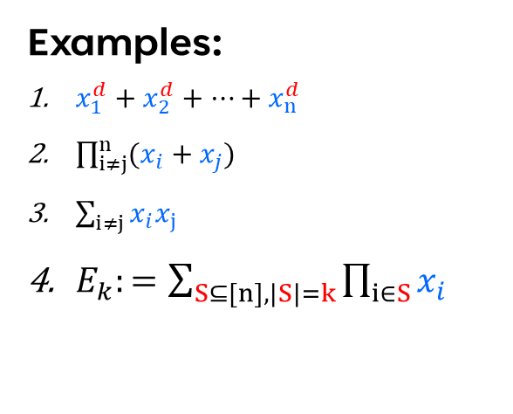
Symmetric Polynomials
Examples:
$x_{1}^{d}+x_{2}^{d}+…+x_{n}^{d}$
$\prod_{i≠j}^{n}{(x_{i}+x_{j})}$
$\sum_{i≠j}{x_{i}x_{j}}$
$E_{k}:=\sum_{S⊆[n], |S|=k}{\prod_{i∈S}{x_{i} }}$
$P\left(x_{1},…,x_{n}\right)$ is a symmetric polynomial
if you permute the variables and it does not change
Deg k Elementary symmetric polynomial

Slide 149

Symmetric Polynomials
Examples:
$x_{1}^{d}+x_{2}^{d}+…+x_{n}^{d}$
$\prod_{i≠j}^{n}{(x_{i}+x_{j})}$
$\sum_{i≠j}{x_{i}x_{j}}$
$E_{k}:=\sum_{S⊆[n], |S|=k}{\prod_{i∈S}{x_{i} }}$
$P\left(x_{1},…,x_{n}\right)$ is a symmetric polynomial
if you permute the variables and it does not change
Fundamental Theorem:
If $P\left(x_{1},…,x_{n}\right)$ is a symmetric polynomial , then there is a unique polynomial $Q\left(y_{1},…,y_{n}\right)$ s.t.
$$P\left(x_{1},…,x_{n}\right)=Q\left(E_{1},…,E_{n}\right)$$
Deg k Elementary symmetric polynomial

Slide 150
Symmetric Polynomials
Examples:
$x_{1}^{d}+x_{2}^{d}+…+x_{n}^{d}$
$\prod_{i≠j}^{n}{(x_{i}+x_{j})}$
$\sum_{i≠j}{x_{i}x_{j}}$
$E_{k}:=\sum_{S⊆[n], |S|=k}{\prod_{i∈S}{x_{i} }}$
$P\left(x_{1},…,x_{n}\right)$ is a symmetric polynomial
if you permute the variables and it does not change
Fundamental Theorem:
If $P\left(x_{1},…,x_{n}\right)$ is a symmetric polynomial , then there is a unique polynomial $Q\left(y_{1},…,y_{n}\right)$ s.t.
$$P\left(x_{1},…,x_{n}\right)=Q\left(E_{1},…,E_{n}\right)$$
Deg k Elementary symmetric polynomial
Blaser-Jindal: If P is in VP, then so is Q

Slide 151

Symmetric Polynomials
Examples:
$x_{1}^{d}+x_{2}^{d}+…+x_{n}^{d}$
$\prod_{i≠j}^{n}{(x_{i}+x_{j})}$
$\sum_{i≠j}{x_{i}x_{j}}$
$E_{k}:=\sum_{S⊆[n], |S|=k}{\prod_{i∈S}{x_{i} }}$
$P\left(x_{1},…,x_{n}\right)$ is a symmetric polynomial
if you permute the variables and it does not change
Fundamental Theorem:
If $P\left(x_{1},…,x_{n}\right)$ is a symmetric polynomial , then there is a unique polynomial $Q\left(y_{1},…,y_{n}\right)$ s.t.
$$P\left(x_{1},…,x_{n}\right)=Q\left(E_{1},…,E_{n}\right)$$
Deg k Elementary symmetric polynomial
Blaser-Jindal: If P is in VP, then so is Q
Our result: True for
VF and $VAC^{0}$

Slide 152
Resultant computation

Slide 153

Resultant computation
Let f(z) and g(z) be two univariate polynomials over F
Let $\{α_{i}\}$ and $\{β_{j}\}$ are the roots of f and g respectively

Slide 154

Resultant computation
Let f(z) and g(z) be two univariate polynomials over F
Let $\{α_{i}\}$ and $\{β_{j}\}$ are the roots of f and g respectively
Define $Res(f,g)=∏(α_{i}−β_{j})$

Slide 155

Resultant computation
Let f(z) and g(z) be two univariate polynomials over F
Let $\{α_{i}\}$ and $\{β_{j}\}$ are the roots of f and g respectively
Define $Res(f,g)=∏(α_{i}−β_{j})$
Goal: Given f and g as monomials, compute the resultant (in $AC^{0}$)

Slide 156

Resultant computation
Let f(z) and g(z) be two univariate polynomials over F
Let $\{α_{i}\}$ and $\{β_{j}\}$ are the roots of f and g respectively
Define $Res(f,g)=∏(α_{i}−β_{j})$
Goal: Given f and g as monomials, compute the resultant (in $AC^{0}$)
Note $Res(f,g)$ is bi symmetric on $\{α_{i}\}$ and $\{β_{j}\}$

Slide 157

Resultant computation
Let f(z) and g(z) be two univariate polynomials over F
Let $\{α_{i}\}$ and $\{β_{j}\}$ are the roots of f and g respectively
Define $Res(f,g)=∏(α_{i}−β_{j})$
Goal: Given f and g as monomials, compute the resultant (in $AC^{0}$)
Note $Res(f,g)$ is bi symmetric on $\{α_{i}\}$ and $\{β_{j}\}$
Note Esym on $\{α_{i}\}$ and $\{β_{j}\}$ are the coefficients in f and g

Slide 158

Resultant computation
Let f(z) and g(z) be two univariate polynomials over F
Let $\{α_{i}\}$ and $\{β_{j}\}$ are the roots of f and g respectively
Define $Res(f,g)=∏(α_{i}−β_{j})$
Goal: Given f and g as monomials, compute the resultant (in $AC^{0}$)
Note $Res(f,g)$ is bi symmetric on $\{α_{i}\}$ and $\{β_{j}\}$
Note Esym on $\{α_{i}\}$ and $\{β_{j}\}$ are the coefficients in f and g
Hence $Res(f,g)$ has constant depth circuit over the coefficients

Slide 159
GCD computation

Slide 160
GCD computation
Let f(z) and g(z) be two univariate polynomials over polynomially large field F (given as coefficients)

Slide 161

GCD computation
Let f(z) and g(z) be two univariate polynomials over polynomially large field F (given as coefficients)
We can compute $GCD(f,g)$ in $AC^{0}$ (algebraic circuit with PIT gate)

Slide 162
GCD computation
[Andrews-Wigderson 24] showed these for large characteristics
We can show it for large fields (arbitrary characteristics)
Let f(z) and g(z) be two univariate polynomials over polynomially large field F (given as coefficients)
We can compute $GCD(f,g)$ in $AC^{0}$ (algebraic circuit with PIT gate)

Slide 163
Fields with positive characteristics

Slide 164

F with characteristics p
Closure under factorization results hold for large characteristics
Irreducible factors with multiplicity < p
Le $f$ be a factor with multiplicity $p^{l}e$
We can compute $f^{p^{l}e}$ in similar way

Slide 165
Open Problems

Slide 166

Open Problems
From a circuit computing $f^{p},$ find a circuit for $f$ (even general circuit is not known)
Hardness vs randomness in low characteristics
Closure result for sparse polynomials
Design efficient factorization algorithm for Sparse polynomials

Slide 167
Thank you
Questions?

