Slide 1
Getting Started with the Oracle Server

Slide 2
Objectives
After completing this lesson, you should be able to do the following:
  Identify common database administration tools available to a DBA
  Identify the features of the Oracle Universal Installer
  Use SQL*Plus to interact and manipulate an Oracle database
  List the main components of Oracle Enterprise Manager

Slide 3
Database Administration Tools
Tool
Description
Oracle Universal Installer (OUI)
Used to install, upgrade, or remove software components
Oracle Database Configuration Assistant
A graphical user interface tool that interacts with the OUI, or can be used independently, to create, delete, or modify a database
SQL*Plus
A utility to access data in an Oracle database
Oracle Enterprise Manager
A graphical interface used to administer, monitor, and tune one or more databases
Notes:
Database Administration Tools
The tools listed are covered in this course, but they are only a subset of the utilities supplied by Oracle.

Slide 4
Oracle Universal Installer
  Used to install, upgrade, or remove software components, and create a database
  Based on a Java engine
  Features include
    Automatic dependency resolution
    Allows for Web-based installations
    Tracking inventory of component and suite installations
    Deinstallation of installed components
    Support for multiple Oracle homes
    Support for globalization technology
Notes:
Oracle Universal Installer
The Java-based Oracle Universal Installer offers an installation solution for all Java-enabled platforms, allowing for a common installation flow and user experience independent of the platform.
The Universal Installer
Detects dependencies among components and performs an installation accordingly
Can be used to point to a URL where a release or staging area was defined and install software remotely over HTTP
Can be used to remove products installed. The deinstallation actions are the “undo” of installation actions.
Maintains an inventory of all the Oracle homes on a target machine, their names, products, and the versions of the products installed on them
Detects the language of the operating system and runs the installation session in that language
Can be run in interactive mode or silent mode. Oracle Universal Installer is run in silent (or non-interactive) mode using a response file.

Slide 5
Starting the Universal Installer
  To start Oracle Universal Installer on UNIX:
  To start Oracle Universal Installer on NT:
$ ./runInstaller
Start > Programs > Oracle Installation Products > Universal Installer
Notes:
Starting the Universal Installer
UNIX
The installation program is called runInstaller and is located in the oracle\oui\install directory.
On UNIX do not run the Installer as a root user.
NT
The installation program is called setup.exe and is located in the Program Files/Oracle/oui/install directory.
Note: See your operating system–specific Oracle documentation for information about installing Oracle Server on your platform.

Slide 6
Non-Interactive Installation Using Response Files
  Allows for no user interaction
  Response files:
    Templates must be edited.
    Text files contain variables and values.
    Parameters are customized.
  To start Universal Installer in non-interactive mode:
./runInstaller -responsefile myrespfile -silent
Notes:
Non-Interactive Installation Using Response Files
Non-interactive installation is performed when no user action is intended or if nongraphical terminals are used for installation.
Installation parameters are customized using a response file. A response file is a text file containing variables and values used by Oracle Universal Installer during the installation process. Example of installation parameters include values for ORACLE_HOME and installation types (that is, Typical or Custom Install).
The user first must copy and edit the response file to specify the components to install.
UNIX
Response file templates are available in the stage/response directory. On UNIX systems, enter the following at the command line in the directory where the Universal Installer is installed:
./runInstaller -responsefile filename [-silent] [-nowelcome]
NT
Response file templates are available in the Response directory on the CD-ROM. To start Oracle Universal Installer and specify the response file, enter the following command at the command line in the directory where the Universal Installer is installed:
setup.exe –responsefile filename [-silent]
Note: This is not character mode.

Slide 7
Notes:
Non-Interactive Installation Using Response Files
Example: Launch the Oracle Universal Installer in non-interactive mode.
UNIX
./runInstaller –responsefile FILENAME [-SILENT] [-NOWELCOME]
where:
FILENAME: Identifies the response file
SILENT: Runs Oracle Universal Installer in silent mode
NOWELCOME: Does not display the Welcome window. If using SILENT, this parameter is not necessary
Sample Response File for UNIX
[General]
RESPONSEFILE_VERSION=1.7.0
[Session]
UNIX_GROUP_NAME="dba"
FROM_LOCATION="/u01/stage/products.jar"
ORACLE_HOME="/u01/app/oracle/ora9i"
ORACLE_HOME_NAME="Ora9i"
TOPLEVEL_COMPONENT={"oracle.server", "9.0.1.1.1"}
SHOW_COMPONENT_LOCATIONS_PAGE=false
SHOW_SUMMARY_PAGE=false
SHOW_INSTALL_PROGRESS_PAGE=false
SHOW_REQUIRED_CONFIG_TOOL_PAGE=false
SHOW_OPTIONAL_CONFIG_TOOL_PAGE=false
SHOW_END_SESSION_PAGE=false
NEXT_SESSION=true
SHOW_SPLASH_SCREEN=true
SHOW_WELCOME_PAGE=false
SHOW_ROOTSH_CONFIRMATION=true
SHOW_EXIT_CONFIRMATION=true
INSTALL_TYPE="Typical”
s_GlobalDBName="u01.us.oracle.com"
s_mountPoint="/u01/app/oracle/ora9i/dbs"
s_dbSid="db09"
b_createDB=true

Slide 8
Notes:
Non-Interactive Installation Using Response Files (continued)
Sample Response File (continued)
The General section specifies the version number of the response file.
The Sessions section lists various dialogs of the Universal Installer. Some of the dialogs include:
FROM LOCATION: Specifies the location of the source of the products to be installed
ORACLE_HOME: Value for ORACLE_HOME
ORACLE_HOME_NAME: Value for ORACLE_HOME_NAME
SHOW INSTALL PROGRESS: The installation progress page that appears during the installation phase
SHOW ROOTISH CONFIRMATION: Set to TRUE if the confirmation dialog to run the root.sh script needs to be shown
SHOW EXIT CONFIRMATION: Set to TRUE if the confirmation when exiting the installer needs to be shown
The success or failure of a silent installation is generated in a file called silentInstall.log.
UNIX
This file will be generated in the /tmp directory.
NT
This file will be generated in the directory specified by the TEMP variable.
Note: Refer to the operating system–specific installation guide for complete details about setting up a response file.

Slide 9
Oracle Database Configuration Assistant
You use the Oracle Database Configuration Assistant to:
  Create a database
  Configure database options
  Delete a database
  Manage templates
Notes:
Oracle Database Configuration Assistant
Creating a database using Oracle Database Configuration Assistant is covered in the “Creating a Database” lesson.

Slide 10
Database Administrator Users
  Users SYS and SYSTEM are created automatically
    During database creation
    Granted the DBA role
  User SYS
    Owner of the database data dictionary
    Default password: change_on_install
  User SYSTEM
    Owner of additional internal tables and views used by Oracle tools
    Default password: manager
Notes:
Database Administrator Users
Extra privileges are necessary to execute administrative duties on the Oracle server, such as creating users. Two database user accounts, SYS and SYSTEM, are created automatically with the database and granted the DBA role. That is, a predefined role that is created automatically with every database. The DBA role has all database system privileges.
SYS
When a database is created, the user SYS, identified initially by the password change_on_install, is created. SYS owns the vitally important data dictionary. When connecting as SYS it should be made as SYSDBA or SYSOPER. If you attempt to connect without SYSDBA or SYSOPER privileges, you will receive the error: ORA-28009 connecting to SYS should be SYSDBA or SYSOPER.

Slide 11
Notes:
Database Administrator Users (continued)
SYSTEM
When a database is created, the user SYSTEM is also automatically created. SYSTEM is identified initially by the password, manager. Additional tables and views owned by the user SYSTEM are also created. They contain administrative information used by Oracle tools.
Additional Database Administrator Users
Additional users may be created depending on the mode of database creation, that is, manually or by using Database Configuration Assistant. You should create at least one additional administrator username to use when performing daily administrative tasks.
Default Passwords for SYS and SYSTEM
For security reasons, the default passwords of SYS and SYSTEM should be changed immediately after database creation.
Note: Beginning with Oracle9i Release 2, the Database Configuration Assistant will prompt you to specify a password, other than the default, for SYS and SYSTEM. In addition, when creating a database using the SQL*Plus CREATE DATABASE command, the users SYS and SYSTEM can be identified with passwords other than the default. If passwords are not identified within the CREATE DATABASE command, the default passwords will be used.

Slide 12
SQL*Plus
  An Oracle tool providing:
    Capability to interact with and manipulate the database
    Ability to start up and shut down the database, create and run queries, add rows, modify data, and write customized reports
  A subset of the standard SQL language with specific add ons
  Connecting to SQL*Plus:
sqlplus /nolog
connect / as sysdba
Connected to an idle instance.
Notes:
SQL*Plus
SQL*Plus is an Oracle command-line tool used to run the standard SQL (Structured Query Language) suite of commands. SQL is a functional language that you use to communicate with Oracle to retrieve, add, update, or modify data in the database.

Slide 13
Oracle Enterprise Manager
  Serves as a centralized systems management tool for DBAs
  A tool to administer, diagnose, and tune multiple databases
  A tool to administer multiple network nodes and services from many locations
  Use to share tasks with other administrators
  Provides tools for administering parallel servers and replicated databases
Notes:
Oracle Enterprise Manager
The Oracle Enterprise Manager is a unified management framework consisting of a Java-based console, a suite of tools and services, and a network of management servers and intelligent agents. It includes both hierarchical tree and graphical representations of the objects and their relationships in the system.
The common services, including job scheduling and management, event management, database discovery and management, service discovery and management, all provide a complete framework for the Oracle Enterprise Manager.
In addition, Oracle Enterprise Manager includes integrated applications that allow you to perform both routine and advanced administration tasks. They include optional packs such as Diagnostics Pack, Tuning Pack, and Change Management Pack, and other applications such as Oracle Net Manager, Spatial Index Advisor, and Text Manager.

Slide 14


Oracle Enterprise Manager: Architecture
Oracle Management
Server
Agent
Oracle
server
Console
Agent
Repository
Oracle
server
Oracle Management
Server
Oracle
server
Notes:
Oracle Enterprise Manager: Architecture
Oracle Enterprise Manager utilizes a three-tier architecture, which includes:
First tier: Console clients and integrated tools provide a graphical interface for administrators.
Second tier: Oracle Management Server and a database repository provide a scalable middle tier for processing system management tasks.
Third tier: Intelligent agents installed on each node monitor its services and execute tasks from the Management Server.
Because not all situations need to implement Oracle Enterprise Manager as a three-tier system, Oracle Enterprise Manager is also available in a two-tier architecture, which connects directly to the databases. The console-launched stand-alone allows a single person to use one or more applications without requiring an Oracle Management Server or intelligent agent.
You use a stand-alone console if you want to perform basic administrative tasks that do not require the job, event, or group system.

Slide 15
Notes:
Oracle Enterprise Manager: Architecture (continued)
Console
The first tier comprises clients such as consoles and management applications, which present graphical user interfaces to administrators for all management tasks. The first tier depends on the second tier Oracle Management Server for the bulk of its application logic.
Note: As of Oracle9i, connection to the console can be done as stand-alone. Prior to Oracle9i, all connections to the console were made through an Oracle Management Server.
Oracle Management Server
The second tier component of Oracle Enterprise Manager is the Oracle Management Server (OMS). The OMS is the core of the Oracle Enterprise Manager framework and provides administrative user accounts, processes functions such as jobs and events, and manages the flow of information between the console (first tier) and the managed nodes (third tier).
The OMS uses a repository to store all system data, application data, information about the state of the managed nodes, and information about any system-managed packs.
Oracle Enterprise Manager Repository
The repository is a set of tables, created when you set up the OMS. The OMS uses the repository as its persistent back-end store. If necessary, more than one OMS can be used. Multiple OMSs share a repository and provide reliability and fault tolerance.
Nodes
The third tier consists of managed nodes, which contain targets such as databases and other managed services. Residing on each node is an Oracle intelligent agent, which communicates with the OMS and performs tasks sent by consoles and client applications.
Only one intelligent agent is required per node.
An intelligent agent functions independently from the database as well as the console and Oracle Management Server. By running independently of other components, intelligent agents can perform such tasks as starting up and shutting down a database and staying operational if another part of the system is down. The ID for the intelligent agent is dbsnmp.

Slide 16
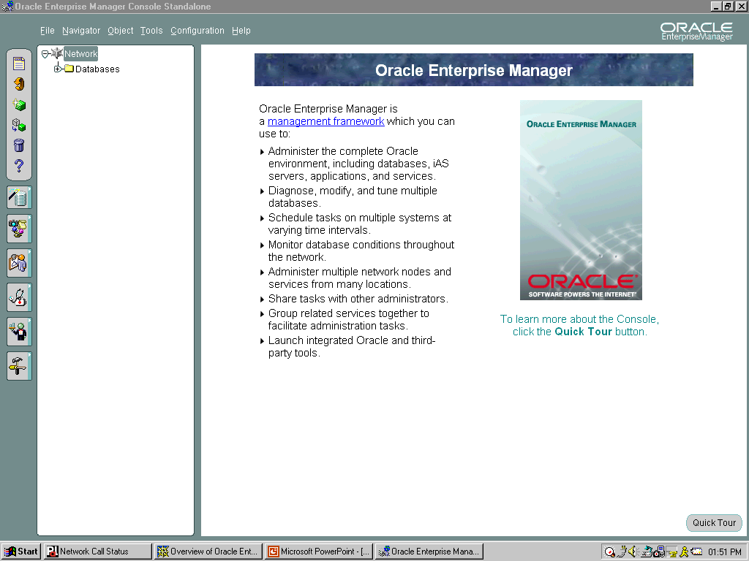

Console
  Central launching point
  Can be run in a thin or fat client
  Can be launched stand-alone or via an OMS
Notes:
Console
The console provides a graphical interface for administrators and a central launching point for all management applications and tools. In addition, SQL*Plus Worksheet can be launched from the console.
The console can be run either in thin mode through the Web or as a fat client. Thin clients use a Web browser to connect to a server where console files are installed, whereas fat clients require console files to be installed locally.
The console can be launched either in stand-alone mode or by connecting to Oracle Management Server.
Note: This course is not intended to give you details about Oracle Enterprise Manager, the console, or Oracle Management Server. For complete details about using Oracle Enterprise Manager refer to the Oracle Enterprise Manager 9i course.

Slide 17
Notes:
How to Start the Oracle Enterprise Manager Console
Example: Start Oracle Enterprise Manager Console.
1. Launch the console:
Start > Programs > Oracle-OraHome92 > Enterprise Manager Console
2. Start the console by selecting one of the options:
Login to the Oracle Management Server
Launch standalone
3. Click OK.

Slide 18
Summary
In this lesson, you should have learned to:
  Identify database administration tools
  Identify the features of the Oracle Universal Installer
  Use SQL*Plus to interact and manipulate the database
  Identify the main components of Oracle Enterprise Manager

Slide 19
Practice 2 Overview
This practice covers the following topics:
  Connecting to SQL*Plus
  Connecting to Enterprise Manager Console

Slide 20
Notes:
Practice 2: Getting Started with the Oracle Server
This practice is instructor led. Your instructor will provide you with login accounts and walk you through logging in to your account. Write the information provided by your instructor below.
Host name: _________________________________
SID name: __________________________________
1 Connect to SQL*Plus as SYSDBA.
Hint
Connect to your account using instructions provided by your instructor.
Start SQL*Plus.
Connect as the user SYS.
2 Using SQL*Plus, run the following query to verify that the connection to the database has been made.
3 Launch Oracle Enterprise Manager in stand-alone mode.
Navigate to Start > Programs > Oracle-OraHome92 > Enterprise Manager Console.
Select Launch standalone option.
Select OK.
$ sqlplus /nolog
SQL*Plus: Release 9.2.0.1.0 - Production on Mon Aug 5 10:52:10 2002
Copyright (c) 1982, 2002, Oracle Corporation. All rights reserved. .
SQL> CONNECT / AS SYSDBA
Connected.
SQL> SELECT * FROM DUAL;
D
-
X

Slide 21
Notes:
Practice 2: Getting Started with the Oracle Server (continued)
4 If you are in an Oracle classroom you must perform the following four steps that are particular to the Oracle classroom setup:
a. Click the omsconfig file update icon on the desktop.
Enter the name of the UNIX server your class is using. Your instructor will provide the server name. Enter it exactly as it is given to you. This is a case-sensitive entry.
b. Open an MSDOS window.
c. At the command prompt enter: oemctl start oms. Wait for the message:
"The Oracle92_homeManagementServer service was started successfully."
Close the MSDOS window.
Launch Oracle Enterprise Manager using Oracle Management Server.
Start the OEM Console and select the Login to the Oracle Management Server option. Log in as follows:
Administrator: sysman Note: Case is important.
Password: oem_temp Note: Case is important.
When prompted, change the password to oracle. Note: Case is important.
Management Server: (Instructor supplied)
Navigate to Navigator > Discover Nodes from the main menu after the OEM. Console is opened. The Discovery Wizard dialog box will appear.
Select Next.
Enter the name of the node you want to manage: that is, designated database server host name. (Instructor supplied)
Click Next.
Select Finish after discovery is complete.
Click OK. Note: Alert the instructor if discovery is not successful.
Expand the Database folder.
Double click your designated database provided by your instructor.
Enter the connection information:
User: sys
Password: secure
As: SYSDBA
Set the node credentials for running jobs.
Navigate to Configuration > Preferences from the main menu
Select the Preferred Credentials page.
Scroll down and select the entry for your designated database.
Supply the following:
Username: (Instructor supplied)
Password: (Instructor supplied)
Confirm Password.
Role: SYSDBA
Click OK.

Slide 22
Notes:
Practice 2: Getting Started with the Oracle Server (continued)
5 Start SQL*Plus Worksheet.
SQL*Plus Worksheet can be started within the Oracle Enterprise Manager Console using the following navigation:
Navigate to Tools > Database Applications > SQL*Plus Worksheet
SQL*Plus Worksheet can also be started from the Windows NT menu by doing the following:
Navigate to Start > Programs > Oracle-OraHome92 > Application Development > SQLPlus Worksheet
Connect directly to the database defined by the instructor, enter:
Username
Password
Service
Connect as: SYSDBA
Click OK.
Note: Each time you log in as a different user (within SQL*Plus Worksheet), the service name must be included in the connection string.

