Slide 1
Networking Overview

Slide 2
Objectives
After completing this lesson, you should be able to do the following:
  Explain the solutions in Oracle9i that can be used to manage complex networks
  Describe Oracle networking add-on solutions

Slide 3
Network Environment Challenges
  Configuring the network environment
  Maintaining the network
  Tuning, troubleshooting, and monitoring the network
  Implementing security in the network
  Integrating legacy systems
Notes:
Network Environment Challenges
Configuring the Network Environment
To implement a successful networking environment consider the following questions:
What type of network are you configuring? Is it a small network with a few clients, or a large network with many clients and many servers?
Are you using a single protocol or multiple protocols?
Is the network static or expanding?
What configuration options do you have?
Are there user-friendly tools available to configure the network?
Is your network strictly client/server or is it multi-tiered?
Maintaining the Network
How much network maintenance is required for your enterprise?
Will you add clients and servers to your network?
Do you anticipate frequent upgrades?

Slide 4
Notes:
Network Environment Challenges (continued)
Tuning, Troubleshooting, and Monitoring the Network
Does your network include the needed tools?
How large a workload do you anticipate?
Number of users
Number of transactions
Number of nodes
Location of nodes
Implementing Security in the Network
Do you need to secure your network environment?
Is secure and sensitive information being transmitted over the network?
What tools are available for implementing security?
Do you anticipate Internet access to your servers?
Integrating Legacy Systems
How will your legacy systems interact with your networking environment?
Note: Performing an up-front analysis that answers questions like these helps you choose the appropriate network strategy from the beginning.

Slide 5


Simple Network: Two-Tier
Network
Client
Server
  Network connects client and server
  Client and server speak the same language or protocol
Notes:
Two-Tier Networks
In a two-tier network, a client communicates directly with a server. This is also known as a client-server architecture. A client-server network is an architecture that involves client processes that request services from server processes. The client and server communicate over a network using a given protocol, which must be installed on both the client and the server.
A common error in client-server network development is to prototype an application in a small, two-tier environment and then scale up by adding more users to the server. This approach can result in an ineffective system, as the server becomes overburdened. To properly scale to hundreds or thousands of users, it may be necessary to implement an N-tier architecture, which introduces one or more servers or agents between the client and the server.

Slide 6
Simple to Complex Network: N-Tier
Network
Network
Client
Middle tier
Server
  Client can be a thin client or a PC
  Middle tier can contain applications and services
  Server holds actual data
Notes:
N-Tier Networks
In an N-tier architecture, the middle-tier agent can provide:
Translation services (as in adapting a legacy application on a mainframe to a client-server environment or acting as a bridge between protocols)
Scalability services (as in acting as a transaction-processing monitor to balance the load of requests between servers)
Network agent services (as in mapping a request to a number of different servers, collating the results, and returning a single response to the client)

Slide 7

Complex Network
TCP/IP SSL
TCP/IP SSL
TCP/IP
TCP/IP
Named Pipes
TCP/IP
Notes:
Complex Network Issues
Networks should improve communication rather than impede distributed operations. In a more complex network environment, several issues must be addressed:
Different hardware platforms that run different operating systems
Multiple protocols used on these platforms
Different syntax between different but connected applications
Different geographical locations in which the connected applications reside
A well-designed complex network can support a large-scale distributed system.

Slide 8

Oracle9i Networking Solutions
  Connectivity
  Directory Services
  Scalability
  Security
  Accessibility
Notes:
Oracle Network Solutions
Oracle provides a full suite of products and tools to address almost any networking need. Connectivity issues are addressed by a wide range of protocols that are supported by Oracle Net Services. Oracle Internet Directory (OID) is tightly integrated with Oracle9i. OID is a Lightweight Directory Access Protocol (LDAP), Version 3 compliant directory service and fulfills requests for everything from net service names to user credentials to policies. You can use Oracle Connection Manager and Oracle Shared Server, to enable Oracle to support huge user demands. Security needs are addressed by Oracle’s support of third-party encryption and data integrity products and authentication adapters. Oracle supports industry or de facto standard security products rather than proprietary products. Oracle also supports the integration of non-Oracle databases through Oracle Heterogeneous Services.

Slide 9
Connectivity: Key Features of
Oracle Net Services
  Protocol independence
  Comprehensive platform support
  Integrated GUI administration tools
  Multiple configuration options
  Tracing and diagnostic toolset
  Basic security
Notes:
Connectivity: Oracle Net Services Key Features
Oracle Net Services includes key features to address the changes occurring from the growth in distributed environments. These changes include increasing user access to data stores, creating more easily configured and administered environments, and enhancing user authentication to securely identify users.

Slide 10

Connectivity: Oracle Net Services
Administration and configuration
Oracle Net
Oracle Net
Client
Protocol
Protocol
Server
Any platform
Any platform
Notes:
Oracle Net Services
Oracle Net Services provides the industry’s broadest support for network transport protocols, including TCP/IP, TCP/IP with Secure Sockets Layer (SSL), and Named Pipes. All data conversion using Oracle Net Services is transparent to the user and the application. This enables Oracle Net Services to operate across different types of computers, operating systems, and networks to transparently connect any combination of PC, UNIX, legacy, and other systems without expensive changes to the existing infrastructure.
Oracle Net Services provides mechanisms which reduce the need for configuration in simple environments. Configuration utilities provide access to the full spectrum of Oracle Net Services functionality. For simple environments, Oracle Net Services’ default settings provide a transparent name resolution adapter. This eliminates the need for generating configuration files. For more complicated environments, Oracle Net Services employs the Oracle Internet Directory to store connection information in a centralized repository.
Oracle Net Services addresses Internet connectivity through integration of standard solutions such as Remote Authentication Dial-In User Service (RADIUS) and Lightweight Directory Access Protocol (LDAP) with legacy systems.

Slide 11

Connectivity: Database Connectivity with HTTP
Web browser
HTTP
Oracle9i
Notes:
Database Connectivity with HTTP
Connections to the Oracle server are not limited to Oracle Net Services alone; clients can establish connections by using Internet protocols such as Hypertext Transfer Protocol (HTTP). Using these Internet protocols, you can run applications from within a Web browser to connect directly to an Oracle9i database. Internet technologies such as Internet File System, Enterprise JavaBeans (EJB), and the Internet standard Secure Sockets Layer (SSL) protocol provide added security to network connections.

Slide 12
Directory Services: Directory Naming
  Process of resolving a network alias using an LDAP-compliant directory server
  Clients must be configured to use the LDAP compliant server
Notes:
Directory Naming
LDAP is an Internet standard for directory services. LDAP has emerged as a critical infrastructure component for network security and as a vital platform for enabling integration among applications and services on the network. It simplifies management of directory information considerably by providing the following:
A well-defined standard interface to a single, extensible directory service, such as the Oracle Internet Directory
Rapid development and deployment of directory-enabled applications
An array of programmatic interfaces that enables seamless deployment of Internet-ready applications

Slide 13
Directory Services: Oracle
Internet Directory
  Oracle’s LDAP compliant directory service
  Provides the following features:
    Integrates tightly with Oracle9i
    Simplifies network administration
    Provides a secure and reliable directory structure
Notes:
Oracle Internet Directory
The Oracle Internet Directory (OID) complies with LDAP, Version 3. It provides the following features:
Integrates with Oracle8i and Oracle9i databases, making it easy for you to administer users and systems
Provides a scalable, cross-platform directory structure for reliable, secure Internet computing
Enables OID-based directories to stay synchronized even when distributed
Integrates existing public key certificates, wallets, and access privileges
Maintains routing policies, system management objects, and quality of service issues
Enables service resellers that lease lines from carrier-class providers to segregate directories with customer information from their providers while sharing the infrastructure information required to provide quality service
Note: Configuration of Oracle Internet Directory is discussed in the Oracle Net Services: Advanced Administration course.

Slide 14
Scalability: Oracle Shared Server
  Enables a large number of users to connect to a database simultaneously
  Database resources are shared resulting in efficient memory and processing usage
  Connections are routed via a dispatcher
  Server processes are not dedicated to each client
  Server processes serve client processes as needed
Notes:
Oracle Shared Server
The Oracle Shared Server architecture has been designed for user scalability. By enabling efficient server-side resource sharing, the Oracle Shared Server allows a large number of users to connect simultaneously to a database server.
Dispatcher
The dispatcher is a process that handles the management of the connections to the valuable server processes. A dispatcher can support multiple client connections concurrently.
Server processes
Shared servers handle the retrieving and saving of data to the database and any other CPU processing that the application needs.
The Result
This task distribution in the Oracle Shared Server is very efficient and enables large user scalability. It also leads to very good connection time and throughput.
Note: Oracle Shared Server was known as Oracle Multithreaded Server (MTS) in versions before Oracle9i.

Slide 15
Scalability: Oracle Connection Manager
Oracle Connection Manager offers:
  Multiplexing of connections
  Cross-protocol connectivity
  Network access control
Notes:
Oracle Connection Manager
Oracle Connection Manager is a gateway process and control program that is configured and installed on a middle tier. Oracle Connection Manager can be configured for the following features:
Multiplexing
Oracle Connection Manager can handle several incoming connections and transmit them simultaneously over a single outgoing connection. You can use multiplexing to provide access to the server to more users. The configuration is offered only in a TCP/IP environment.
Cross-protocol Connectivity
Using this feature, a client and a server can communicate with different network protocols.
Network Access Control
Using Oracle Connection Manager, designated clients can connect to certain servers in a network based on the TCP/IP protocol.

Slide 16
Notes:
Oracle Connection Manager (continued)
Benefits of Connection Manager
Supports more users on the end tier if you use a middle tier to deploy Oracle Connection Manager and provides for better use of resources and scalability
Enables cross-protocol communication
Can act as an access control mechanism
Can act as a proxy server if your firewall does not interact with Oracle Net

Slide 17
Scalability: Oracle Connection Manager
1
2
3
Oracle Connection
Manager
Server
Notes:
Connection Multiplexing
The example in the slide shows how Oracle Connection Manager acts as a multiplexer to funnel data from many clients to one server.
1. The initial connection from a client to a server is established by connecting to Oracle Connection Manager.
2. Oracle Connection Manager establishes the connection to the server.
3. When additional clients request connections to the server through Oracle Connection Manager, they use the same connection that Oracle Connection Manager used for the initial connection.

Slide 18
Security: Advanced Security
  Encryption
    Encodes between network nodes
    DES, RSA, 3DES
  Authentication
    Authenticates users through third-party services and Secure Sockets Layer (SSL)
    Kerberos, Radius, CyberSafe
  Data Integrity
    Ensures data integrity during transmission
    MD5, SHA
Notes:
Oracle Advanced Security
Oracle Advanced Security provides data privacy, integrity, authentication, and single
sign-on.
Authentication ensures that users are authenticated appropriately.
Encryption ensures that the data transmitted between nodes remains private.
Data Integrity ensures that data is not modified or tampered with during transmission.
Single sign-on enables users to authenticate to multiple servers using a single username/password combination.
Note: Oracle Advanced Security is a product that is licensed separately.

Slide 19

Advanced Security Encryption
Corporate earnings are
up 45% this quarter
Corporate earnings are
up 45% this quarter
1
3
Oracle Advanced Security
Installed
Oracle Advanced Security
Installed
Decrypt
Client
Server
2
Encrypt
fdh37djf246gs’b[da,\ssk
Notes:
Example: Encryption Using Advanced Security
The example in the slide shows one of the major tasks of a secure transmission through a network. To ensure such a transmission, Oracle Advanced Security must be installed and configured on both the client side and the server side.
After Advanced Security is configured, data in all transmissions over Oracle Net Services can be encrypted as follows:
1. Textual information is sent from the client side. One layer of the network on the client side encrypts the information before it is transmitted over the network link.
2. Encrypted data, potentially including checksumming with each package sent is transmitted over the network link.
3. On the server side, the message is decrypted, and checksums can ensure that the data arrives in the correct order without tampering. Only the server that holds the correct key can decrypt the information and verify the checksumming sequence of the data.

Slide 20
Security: Oracle Net Services and Firewalls
  Oracle works with key firewall vendors to provide firewall support
  Oracle Net Firewall Proxy Kit allows firewall vendors to provide connection support for Oracle environments
  Oracle Net Firewall Proxy is based on Oracle Connection Manager
  Oracle supports two categories of firewalls:
    Proxy-based firewalls
    Stateful packet inspection firewalls
Notes:
Oracle Net Services and Firewalls
Oracle works with key firewall vendors to provide support specifically for database network traffic. With the availability of the Oracle Net Firewall Proxy Kit, firewall partners are able to provide the support in Oracle installations that is necessary to deploy truly distributed Internet and intranet applications.
Proxy-based Firewalls
The Oracle Net Application Proxy is based on the Oracle Connection Manager. It allows firewalls to proxy for and inspect Oracle Net traffic. In the application proxy approach, information flows through the firewall, but no outside packets do. Application proxies are typically the only way to forward data across the two network interfaces of a dual-subnetted host. The gateway acts a data relay between inside hosts and outside hosts, as defined by the security policy.
Stateful Inspection-based Firewalls
These firewalls filter and inspect TCP/IP packets, and it is possible to configure the firewall to allow Oracle Net traffic. By inspecting IP header information and by understanding the various higher-level protocols supported, this type of firewall is able to perform IP-level filtering while at the same time monitoring and catering for application specific actions such as port redirection requests.

Slide 21
Accessibility: Heterogeneous Services
  Enables access of legacy data as if it resides in a single, local relational database
  Enables Oracle procedure calls to access non-Oracle systems, services, or APIs
Notes:
Heterogeneous Services
Heterogeneous Services provide seamless integration between the Oracle server and environments other than Oracle. Heterogeneous Services enable you to do the following:
Use Oracle SQL to transparently access data stored in non-Oracle data-stores like Informix, DB2, SQL Server, and Sybase
Use Oracle procedure calls to transparently access non-Oracle systems, services, or application programming interfaces (APIs), from your Oracle distributed environment
A Heterogeneous Service agent is required to access a particular non-Oracle system.
Benefit
Heterogeneous Services enable integration with foreign data sources.
Note: Configuration of Heterogeneous Services is discussed in the Oracle Net Services: Advanced Administration course.

Slide 22
Accessibility: External Procedures
  Functions written in a 3GL language that can be called from PL/SQL
  Allows the developer more flexibility than SQL or PL/SQL provide
  Listener can listen for external procedure calls
  Connections to external procedure can be configured during or after server installation
Notes:
External Procedures
Oracle support of external procedures allows the developer more development choices than standard SQL or PL/SQL provide. The listener can be configured to listen for external procedure calls. When a PL/SQL or SQL application calls an external procedure, the listener launches a network session-specific process called extproc. Through the listener service, PL/SQL passes the following information to extproc:
Shared library name
External procedure name
Parameters (if necessary)
The extproc program then loads the shared library and invokes the external procedure.

Slide 23
Oracle Net Services Configuration and Administration Tools
  Oracle Net Manager
    Used for configuring and managing Oracle Net
    Client- or server-based tool
    Integrated with Oracle Enterprise Manager
  Oracle Net Configuration Assistant
  Oracle Net Control utilities
    Listener Control utility
    Oracle Connection Manager Control utility
    Oracle Names Control utility
Notes:
Oracle Net Services Configuration and Administration Tools
Oracle Net Manager is a graphical user interface tool that combines configuration abilities with Oracle Names component control to provide an integrated environment for configuring and managing Oracle Net. It can be used on either the client or server. Oracle Net Manager is also integrated with Oracle Enterprise Manager.
Oracle Net Configuration Assistant is provided primarily to configure basic network components during installation. It can also be run after installation in stand-alone mode to configure naming method usage, the listener, net service names in the tnsnames.ora file, and directory server usage.
Note: The graphical user interface tools may require an X Window System or X Window emulator on some platforms.
Oracle Net provides the following tools to help you start, stop, configure, and control each network component:
Listener Control utility
Oracle Connection Manager Control utility
Oracle Names Control utility

Slide 24
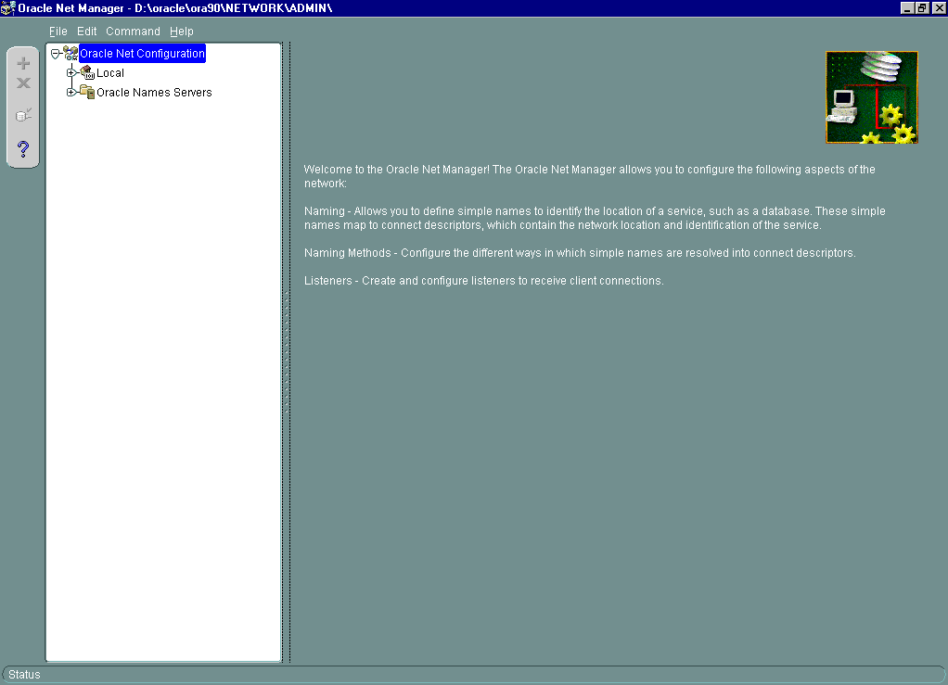
Oracle Net Manager
Notes:
Oracle Net Manager
Oracle Net Manager combines configuration abilities with component control to provide an integrated environment for configuring and managing Oracle Net.
You can use Oracle Net Manager to configure and manage the Oracle networking environment. The following Oracle Net features and components are available to configure and manage with Oracle Net Manager:
Service Naming: You can create or modify network descriptions for database services in a tnsnames.ora file, directory server, or an Oracle Names server.
Listener: You can create or modify a listener, a process on the server that receives and responds to client connection requests for a database service.
Profile: You can create or modify a profile, a collection of parameters that determine how the client connects to the Oracle network. You can specify parameters for naming methods, logging, tracing, external naming parameters, and Oracle Advanced Security.
Oracle Names Server: You can create, modify configuration settings for, or control an Oracle Names server.

Slide 25
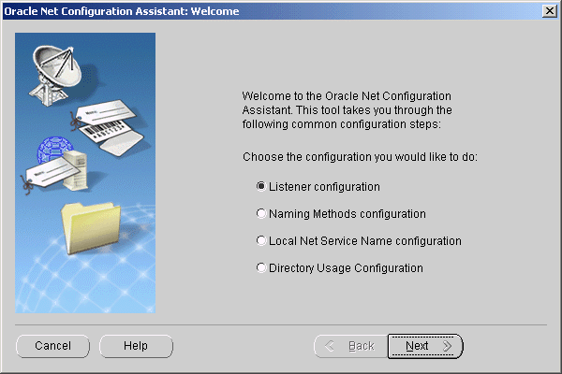
Oracle Net Configuration Assistant
Notes:
Oracle Net Configuration Assistant
Oracle Net Configuration Assistant is provided primarily to configure basic network components during installation, including:
Listener names and protocol addresses
Naming methods the client will use to resolve connect identifiers
Net service names in a tnsnames.ora file
Directory server access
Oracle Net Configuration Assistant runs automatically during software installation, as described in your Oracle installation guide.
It can also be run after installation in stand-alone mode to configure naming method usage, the listener, net service names in the tnsnames.ora file, and directory server usage.
To start Oracle Net Configuration Assistant:
On UNIX, execute netca from the $ORACLE_HOME/bin directory.
On Windows, select Start > Programs > Oracle - HOME_NAME > Network Administration > Oracle Net Configuration Assistant.

Slide 26
Summary
In this lesson, you should have learned how to:
  Explain Oracle’s solutions for managing complex networks:
    Oracle Net Services
    HTTP Connectivity
    Oracle Internet Directory
    Oracle Shared Server
    Connection Manager
  Describe Oracle’s add-on solutions:
    Oracle Advanced Security
    Heterogeneous Services

