Slide 1
Basic Oracle Net Server
Side Configuration

Slide 2
Objectives
After completing this lesson, you should be able to do the following:
  Identify how the listener responds to incoming connections
  Describe Dynamic Service Registration
  Configure the listener by using Oracle Net Manager
  Control the listener by using the Listener Control Utility
  Configure the listener for HTTP connections

Slide 3




The Listener Process
Client
Server
Listener
tnsnames.ora
sqlnet.ora
listener.ora
Notes:
Characteristics of the Listener Process
The database server receives an initial connection from a client application through the listener.
The listener is a process running on a node that listens for incoming connections on behalf of a database or a number of databases. The following are the characteristics of a listener:
A listener process can listen for more than one database
Multiple listeners can listen on behalf of a single database to perform load balancing
The listener can listen for multiple protocols
The default name of the listener in Oracle Net is LISTENER
The name of the listener must be unique per listener.ora file
Note: Oracle9i databases require an Oracle9i listener. Earlier versions of the listener are not supported. However, it is possible to use an Oracle9i listener with databases created with an earlier version of Oracle.
Using Oracle Enterprise Manager
The Listeners page under the Nodes folder in the Navigator displays listener properties for a node selected in the Navigator. Information displayed includes a list of all databases monitored by the listener as well as the TNS address of the listener. You can determine the operational status of the listener by clicking Listener Status.

Slide 4
Connection Methods
When a connection request is made by a client to a server, the listener performs one of the following:
  Spawns a server process and bequeaths (passes) the connection to it
  Hands off the connection to a dispatcher in an Oracle Shared Server configuration
  Redirects the connection to a dispatcher or server process
Notes:
Connection Methods
Spawn and Bequeath
The listener passes or bequeaths the connection to a spawned process. This method is used in a dedicated server configuration only.
Direct Hand-Off
The listener will hand off a connection to a dispatcher when an Oracle Shared Server is used. This method is not possible with dedicated server processes.
Redirected (Message)
A connection may be redirected by the listener to a dispatcher if a Shared Server is used.
Note: Each of the connection types is covered in more detail later in the lesson.
Transparency of Direct Hand Off and Redirect
Whether a connection session is bequeathed, handed off, or redirected to an existing process, the session is transparent to the user. It can be detected only by turning on tracing and analyzing the resulting trace file.

Slide 5
Spawn and Bequeath Connections
Client
Server
3
Dedicated
Server Process
1
2
Listener
Notes:
Spawn and Bequeath Connections
The listener may spawn dedicated server processes as connection requests are received and bequeath (or pass) the connections to the server processes. The use of this method is dependant on the ability of the underlying operating system to support inheritance of network endpoints. When the listener forks a dedicated server process and bequeaths the connection to the server process, it is called a bequeath session. The following sequence of events occurs:
1. The listener receives a client connection request.
2. The listener starts a dedicated server process, and the dedicated server inherits the connection request from the listener.
3. The client is now connected directly to the dedicated server.
If, because of the operating system or protocol, a connection cannot be passed between two different processes on the same machine, a redirect must take place instead.
Note: When a client disconnects, the clients’ dedicated server process closes.

Slide 6
Notes:
Spawn and Bequeath Connections (continued)
Windows Platform Considerations
Windows does not implicitly support inheritance of network endpoints. To do this, the registry entry USE_SHARED_SOCKET must be set to TRUE to allow multiple connections to use a single socket. When the value is FALSE (default), bequeath connections are not possible so a redirect session is initiated instead.
If the USE_SHARED_SOCKET entry is set to TRUE, Windows can initiate bequeath connections but there are some caveats to consider. If a number of connections are initiated and for some reason the listener is stopped, the listener will not be able to be restarted until the connections are cleared. This is because the existing connections are using the same port number that the listener needs to listen on. This is a limitation with Microsoft’s implementation of TCP/IP using Windows Sockets API (WINSOCK2).

Slide 7
Direct Hand-Off Connections
Shared
Server
Process
3
Dispatcher
1
2
Listener
Shared
Server
Process
Notes:
Direct Hand-Off Connections
The listener uses the dispatcher as a type of service handler to which it can direct client requests. When a client request arrives, the listener performs one of the following actions:
Hands the connection request directly to a dispatcher.
Issues a redirect message to the client, containing the protocol address of a dispatcher. The client then terminates the network session to the listener and establishes a network session to the dispatcher, by using the network address provided in the redirect message.
The listener uses direct hand off whenever possible. Redirect messages are used, for example, when dispatchers are remote to the listener.
The sequence of events is as follows:
1. The listener receives a client connection request.
2. The listener hands the connect request directly to the dispatcher.
3. The client is now connected to the dispatcher.

Slide 8
Redirected Session
Client
Server
Server or
dispatcher
process
6
5
3
port
4
2
1
port
Listener
Notes:
The Redirected Session
When conditions do not support the establishment of a bequeath or direct hand-off connection, a redirect session will be established. The following steps outline the mechanics of this type of connection:
1. The client establishes a connection to the listener by using the configured protocol and sends the listener a connect packet.
2. The listener checks that the SID is defined. If it is, the listener will spawn a new thread or process to service the new connection. An IPC connection is then established between the listener and the new process or thread.
3. The new process or thread selects a new TCP/IP port from the list of free user-defined ports and passes this information back to the listener.
4. The listener inserts this new port into a redirect packet and sends it back to the client and the original TCP socket between the client and the listener is then reset.
5. A new TCP connection is established to the redirect address specified in the redirect packet and a connect packet is then forwarded to the dedicated server process.

Slide 9
Notes:
The Redirected Session (continued)
6. The dedicated server process can now finally accept the incoming connection and forwards an ACCEPT message back to the client.
If a redirect session is established with shared servers, a new process may not necessarily be spawned as stated in step 2 if there is capacity remaining on the shared servers that are running.

Slide 10
Service Configuration and Registration
The listener can be configured in two ways:
  Dynamic service registration
    Does not require configuration in listener.ora file
    The listener relies on the PMON process
  Static service configuration
    Used for Oracle8 and earlier releases
    Requires listener.ora configuration
    Required for Oracle Enterprise Manager and other services
Notes:
Configuring the Listener
Dynamic Service Registration
An Oracle9i instance uses service registration to inform the listener about its database services. Service registration relies on the PMON process to register instance information with the listener. PMON also informs the listener about the current state and load of the instance and Shared Server dispatchers.
If Oracle9i JVM is installed, HTTP listening endpoints can be registered dynamically with the listener.
When an instance is started, initialization parameters about the listener are read from the initialization parameter file by which PMON registers information with the listener. If a listener is not up when the instance starts, PMON will not register information with the listener. PMON will continue attempting to contact the listener. The listener will reject any connections made to an unregistered service.
Static Service Registration
You must configure the listener.ora file for Oracle8 instances.
Note: The static configuration is also required for Oracle Enterprise Manager (OEM) and other services such as external procedures and Heterogeneous Services.

Slide 11
Notes:
Configuring the Listener (continued)
Benefits of Dynamic Service Registration
The listener.ora file does not require the SID_LIST_LISTENER_NAME parameter that specifies information on the databases served by the listener. This parameter is still required if the management tool you are using requires it.
Connect-time failover is enabled.
Connection load balancing is enabled for shared servers.

Slide 12
Static Service Registration:
The listener.ora File
Default settings for the listener.ora file with Oracle software installation:
  Listener name LISTENER
  Port 1521
  Protocols TCP/IP and IPC
  SID name Default instance
  Host name Default host name
Notes:
The listener.ora File
You must use the listener.ora file to configure the listener for static service registration. The listener.ora file must reside on the machine or node on which the listener is to reside.
The listener.ora file contains configuration information as follows:
The listener name
The listener address
Databases that use the listener
Listener parameters

Slide 13
Static Service Registration:
The listener.ora File
1. LISTENER =
2. (ADDRESS_LIST =
3. (ADDRESS= (PROTOCOL= TCP)(Host= stc- sun02)(Port= 1521)))
4. SID_LIST_LISTENER =
5. (SID_LIST =
6. (SID_DESC =
7. (ORACLE_HOME= /home/oracle)
(GLOBAL_DBNAME = ORCL.us.oracle.com)
9. (SID_NAME = ORCL)))
Notes:
listener.ora File Contents
The default listener.ora file contains the following parameters:
1. The name of the listener. The default name is LISTENER.
2. The ADDRESS_LIST parameter contains a block of addresses at which the listener listens for incoming connections. Each of the addresses defined in this block represents a different way by which a listener receives a connection.
3. The TCP address identifies incoming TCP connections from clients on the network attempting to connect to port 1521. The clients use the port defined in their tnsnames.ora file to connect to this listener. Based on the SID_LIST defined for this listener, the listener specifies the database to which to connect. Please note that is possible to configure multiple listeners here as long as they have unique names and unique ports on the node where they are configured. Each listener configured will have its own SID_LIST but a single database can be serviced by multiple listeners.
4. A listener can listen for more than one database on a machine. The SID_LIST_listener_name block or parameter is where these SIDs are defined.
5. The SID_LIST parameter is defined if more than one SID is defined.

Slide 14
Notes:
listener.ora File Contents (continued)
6. The SID_DESC parameter must exist for each defined SID.
7. The ORACLE_HOME identifies the Oracle home location of the service. This enables the listener to identify the location of an Oracle executable file.
8. The parameter GLOBAL_DBNAME identifies the global database name of the database, a name comprised of the database name and database domain. The global database name is of the form database_name.database_domain. Consider, for example, ORCL.us.oracle.com where the database name portion, ORCL, is a simple name you want to call your database. The database domain portion, us.oracle.com, specifies the database domain in which the database is located, making the global database name unique. This parameter must be embedded under SID_DESC and should match the value of the SERVICE_NAMES parameter in the initialization parameter file.
9. The SID_NAME parameter defines the name of the SID on behalf of which the listener accepts connections.

Slide 15
Notes:
listener.ora Parameters
Note: Default values are shown in parentheses following the parameter name.

Slide 16
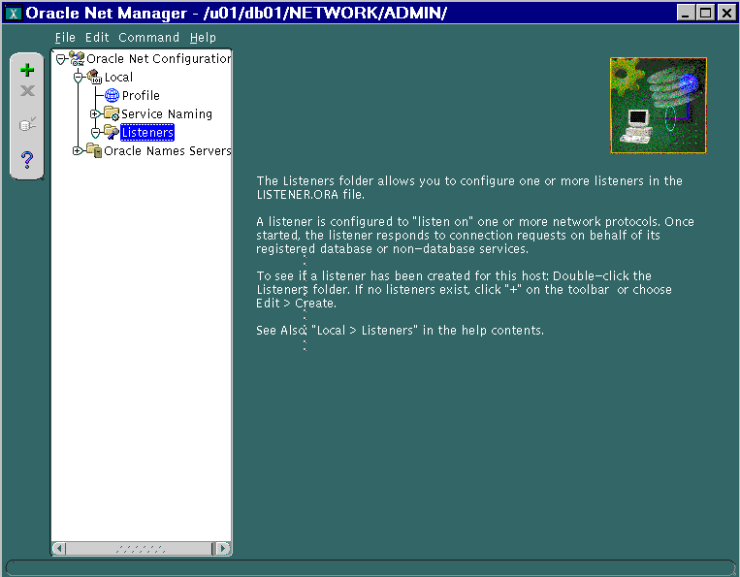
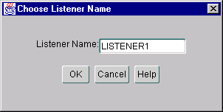
Static Service Registration:
Create a Listener
Notes:
Creating an Additional Listener
During the installation of an Enterprise Edition or Standard Edition on the server, Oracle Net Configuration Assistant automatically configures a listener with a name of LISTENER that has a TCP/IP protocol address for the Oracle database. If you need to create an additional listener, follow the steps outlined below to configure additional listeners in the listener.ora file using Oracle Net Manager:
1. In the navigator pane, expand Oracle Net Configuration > Local > Listeners.
2. Select Create from the Edit menu.
3. Enter a listener name in the Listener Name field in the dialog box that appears.
4. Select Listening Locations from the drop-down list for your listener.
5. Click Add Address.
6. Change or enter information in the Protocol, the Host, and Port fields as necessary.
7. Select Save Network Configuration from the File menu of Oracle Met Manager.
Note: In the Local folder you can configure network elements in configuration files located in ORACLE_HOME/network/admin on Windows. Other directories can be specified by selecting Open Network Configuration from the File menu.

Slide 17
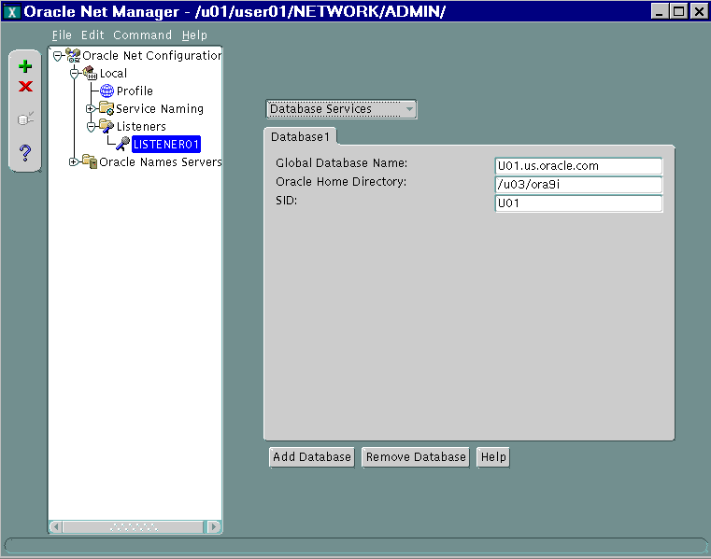
Configuring Services
Notes:
Configuring Database Services
1. Select Database Services from the drop-down list for your listener.
2. Click Add Database.
3. Enter the global database name, the Oracle home directory, and the SID in the appropriate fields.
4. Select Save Network Configuration from the File menu of Oracle Net Manager.

Slide 18
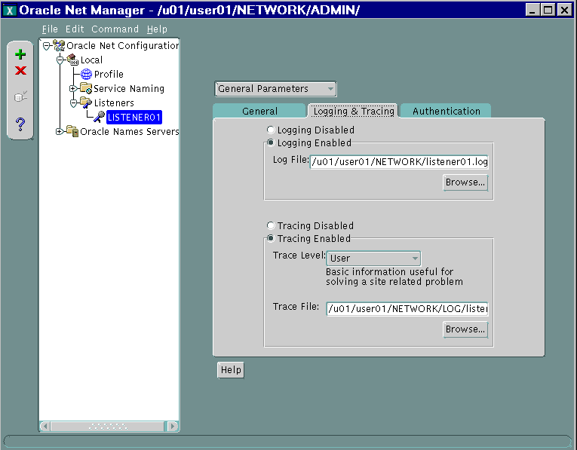
Logging and Tracing
Notes:
Configuring Listener Logging and Tracing
1. Select General Parameters from the pull-down menu within Net Manager for your listener.
2. Click the Logging & Tracing tab.
3. To enable logging, select the Logging Enabled option button.
4. Enter the path and filename for a log file.
5. Select Save Network Configuration from the File menu.
6. Repeat the preceding steps for tracing.
Note: Be aware that logging and especially tracing can use large amounts of disk space and should be monitored. Tracing should only be used if needed.

Slide 19
Dynamic Service Registration:
Configure Registration
To ensure that service registration is functional, the following initialization parameters must be configured:
  SERVICE_NAMES
  INSTANCE_NAME
Notes:
Configuring Service Registration
Dynamic service registration is used by Oracle9i or Oracle8i instances. The registration is performed by the PMON process of each database instance that has the required configuration in the database initialization parameter file. Dynamic service registration does not require any configuration in the listener.ora file.
Dynamic service registration is configured in the database initialization file. Listener configuration must be synchronized with the information in the database initialization file.
The following initialization parameters must be configured for service registration to work:
SERVICE_NAMES: Specifies one or more names for the database service to which this instance connects. You can specify multiple service names in order to distinguish among different uses of the same database.
INSTANCE_NAME: Specifies the instance name. In a single-instance database system, the instance name is usually the same as the database name.
Examples
SERVICE_NAMES=sales.us.oracle.com
INSTANCE_NAME=salesdb

Slide 20
Dynamic Service Registration:
Registering Information with the Listener
  By default, PMON registers with a local listener on the server on the default local address of TCP/IP, port 1521
  PMON can register with a non default listener if:
    LOCAL_LISTENER initialization parameter is defined
    LISTENERS attribute of the DISPATCHERS initialization parameter is defined for Oracle Shared Server
Notes:
Service Registration
By default, the PMON process registers service information with its local listener on the default local address of TCP/IP, port 1521.
Using a Nondefault Listener
You can force PMON to register with a local listener on the server that does not use TCP/IP or use port 1521 by configuring the LOCAL_LISTENER parameter in the initialization parameter file as follows:
LOCAL_LISTENER=listener_alias
listener_alias must be resolved to the listener protocol address through a naming method such as tnsnames.ora. An example entry in the tnsnames.ora follows:
listener_name=
(DESCRIPTION=
(ADDRESS=(PROTOCOL=tcp)(HOST=sales-server)(PORT=1421)))

Slide 21
Configure the Listener for
Oracle9i JVM: HTTP
  The listener can be configured to accept connections from clients using HTTP.
  Use Static Listener Registration if the database is Oracle8i or an earlier version, even if Oracle9i listener is used.
  If both the listener and the database are Oracle9i, configuration occurs dynamically during service registration.
Notes:
Statically Configuring the Listener for HTTP
Connections to Oracle9i JVM require TCP/IP or TCP/IP with SSL listening protocol addresses. If both the listener and database are Oracle9i, configuration occurs dynamically during service registration. If the database is Oracle8i or earlier, configure listening addresses statically using the following procedure, even if an Oracle9i listener is used.
1. Start Oracle Net Manager.
2. In the navigator pane, expand Local > Listeners.
3. Select an existing listener.
4. From the list in the right pane, select Listening Locations.
5. Select Add Address. A new address tab appears.
6. Select the TCP/IP or TCP/IP with SSL protocol from the Protocol list.
7. Enter the host name of the database in the Host field.
8. Enter port 2481 in the Port field if the chosen protocol is TCP/IP, or enter port 2482 in the Port field if the chosen protocol is TCP/IP with SSL.
9. Select Statically dedicate this address for JServer connections.

Slide 22
Notes:
Statically Configuring the Listener for HTTP (continued)
10. Select File > Save Network Configuration.
The listener.ora is updated with the following:
listener=
(DESCRIPTION_LIST=
(DESCRIPTION=
(ADDRESS=(PROTOCOL=tcp)(HOST=server1)(PORT=2481))
(PROTOCOL_STACK=
(PRESENTATION=GIOP)
(SESSION=raw))))

Slide 23
Listener Control Utility (LSNRCTL)
Listener Control Utility commands can be issued from the command-line or from the LSNRCTL prompt.
  UNIX command-line syntax:
  Prompt syntax:
  Control a non-default listener:
$ lsnrctl <command name>
LSNRCTL> <command name>
LSNRCTL> set current_listener listener02
Notes:
Listener Control Utility
When the lsnrctl command is issued, the command will work against the default listener LISTENER unless the SET LISTENER command is executed. Another way to control different listeners is to use the listener name as a command modifier:
$ lsnrctl start listener02
Windows Command Line Syntax
On Windows, use the following command to start the Listener Control utility:
C:\> lsnrctl <command name>

Slide 24
LSNRCTL Commands
Use the following commands to control the listener:
  Starting the listener:
  Stopping the listener:
$lsnrctl START listener_name
$lsnrctl STOP listener_name
Notes:
LSNRCTL Commands
Starting the Listener
You can use the START command to start the listener from the Listener Control utility. Any manual changes to the listener.ora file must be made when the listener is shut down. The argument for the START command is the name of the listener, and if no argument is specified, the current listener is started. If a current listener is not defined, LISTENER is started.
LSNRCTL> START listener_name or
$lsnrctl start listener_name
On Windows NT, the listener can also be started through the Control Panel:
1. Double-click the Services icon in the Control Panel window.
2. Select the Oraclehome_nameTNSListener service (the service name if you are using the default listener name LISTENER) or Oraclehome_nameTNSListenerlsnr, where lsnr is the nondefault listener name.
3. Click Start to start the service.
4. In the Services window, click Close.

Slide 25
Notes:
LSNRCTL Commands (continued)
Stopping the Listener
The STOP command stops the listener. The listener must be running to stop it properly. If a password is configured, the SET PASSWORD command must be used before the STOP command can be used. The password must be set from within the LSNRCTL prompt; it cannot be set from the operating system command line. It is good practice to send a warning message to all network users before stopping a listener.
LSNRCTL> STOP [listener_name] or
$ lsnrctl stop [listener_name]
Additional LSNRCTL Commands
Note: You can also obtain the status of a listener through the Oracle Enterprise Manager Console.

Slide 26
LSNRCTL SET and SHOW Modifiers
  Change listener parameters with SET:
  Display the values of parameters with SHOW:
LSNRCTL> SET trc_level ADMIN
LSNRCTL> SHOW trc_directory
Notes:
SET and SHOW Modifiers
The SET modifier is used to change listener parameters in the Listener Control utility environment.
The SHOW modifier is used to display the values of the parameters set for the listener.

Slide 27
Notes:
SET and SHOW Modifiers (continued)
Note: The SHOW command has the corresponding parameters of the SET command except SET PASSWORD.

Slide 28
Summary
In this lesson, you should have learned how to:
  Configure the listener by using Oracle Net Manager
  Control the listener by using the Listener Control Utility
  Configure the listener for HTTP connections

Slide 29
Practice 3 Overview
This practice covers the following topics:
  Configuring a non-default LISTENER
  Starting and stopping your listener
  Viewing the LISTENER log file

Slide 30
Notes:
Practice 3: Basic Oracle Net Server Side Configuration
1. Create a listener listenernn(n) (nn(n) will be a two or three digit number provided by your instructor) using Oracle Net Manager. The listener must be configured for the server as specified by the instructor. The listener must be configured for the TCP/IP protocol only and must listen for incoming connections on the port provided by the instructor.
Note: If Oracle9i software is available on the student PC, the listener configuration file will be created on the client PC using Oracle Net Manager and, in later steps, transferred through FTP or a similar file transfer application to the server.
If Oracle9i client software is not available on your PC, a listener.ora file must be created on the server. Sample networking files can be found in your $HOME/STUDENT/LABS directory. The sample files have .sam extensions. Copy $HOME/STUDENT/LABS/listener.sam to $TNS_ADMIN/listener.ora and edit the file using vi.
$ cd $TNS_ADMIN
$ cp $HOME/STUDENT/LABS/listener.sam listener.ora
2. If you have created the listener.ora file on your PC, then use FTP (ASCII mode) to transfer it to your $TNS_ADMIN directory on the Unix server. The file on your PC client will be in <ORACLE_HOME>\NETWORK\ADMIN. You will need to edit the file to change the log directory location.
Verify the configuration details in your file.
Start your listener by issuing lsnrctl start listenernn from the operating system prompt. If you encounter difficulties, use the lsnrctl command output and the listener log file to troubleshoot.
If your instance is started, shut it down and then restart it.
6. View the contents of the listener log file. Is the instance registered? Why not?

