Slide 1
Naming Method Configuration

Slide 2
Objectives
After completing this lesson, you should be able to do the following:
  Describe the difference between host naming and local service name resolution
  Use Oracle Net Configuration Assistant to configure:
    Host Naming method
    Local naming method
    Net service names
  Perform simple connection troubleshooting

Slide 3
Overview of Naming Methods
  Naming methods are used by a client application to resolve a connect identifier to a connect descriptor when attempting to connect to a database service.
  Oracle Net provides five naming methods:
    Host naming
    Local naming
    Directory naming
    Oracle Names
    External naming
Notes:
Naming Methods: Overview
Oracle Net provides five naming methods:
Host naming: Enables users in a TCP/IP environment to resolve names through their existing name resolution service
Local naming: Locates network addresses by using information configured and stored on each individual client's tnsnames.ora file
Directory naming: Resolves a database service or net service name to a connect descriptor, stored in a central directory server
Oracle Names: Oracle directory service made up of a system of Oracle Names servers that provide name-to-address resolution for each service on the network
External naming: Uses a supported third-party naming service
For a small organization with only a few databases, use host naming to store names in an existing names resolution service, or local naming to store names in tnsnames.ora file on the clients.
For large organizations with several databases, use directory naming to store names in a centralized LDAP-compliant directory server.
In this lesson you will learn more about host naming and local naming.

Slide 4
Host Naming
Clients can connect to a server using a host name under the following conditions:
  Connecting to an Oracle database service using Oracle Net Services Client software
  Client and server are connecting using TCP/IP protocol
  Host names are resolved through an IP address translation mechanism such as DNS or a local /etc/hosts file
  No advanced features such as Oracle Connection Manager or security options are used
Notes:
Host Naming Method
The host naming method provides the following advantages:
Requires minimal user configuration. The user need only provide the name of the host to establish a connection.
Eliminates the need to create and maintain a local names configuration file (tnsnames.ora).
Eliminates the need to understand Oracle Names or Oracle Internet Directory administration procedures.
Host naming can only be used to identify one SID per node although other SIDs can be identified by using other naming methods.
Multiple global names can be aliased to the same IP address in the hosts file and host naming can be used to connect to any of these databases even if they are on the same node.

Slide 5




Host Naming: Client Side
Client
Server
TCP/IP
…
names.directory_path = (HOSTNAME)
sqlnet.ora
listener.ora
Notes:
Client-Side Requirements
If you are using the host naming method, you must have TCP/IP installed on your client machine. In addition you must install Oracle Net Services and the TCP/IP protocol adaptor.
The host name is resolved through an IP address translation mechanism such as Domain Name Services (DNS), Network Information Services (NIS), or a centrally maintained TCP/IP host file. This should be configured from the client side before attempting to use the host naming method.

Slide 6
Host Naming: Server Side
Client
Server
TCP/IP
1521
SID_LIST_LISTENER =
(SID_LIST =
(SID_DESC =
(GLOBAL_DBNAME = stc-sun02.us.oracle.com)
(ORACLE_HOME = /u03/ora9i/rel12)
(SID_NAME = TEST)
sqlnet.ora
listener.ora
Notes:
Server-Side Requirements
If you are using the host naming method, you must have TCP/IP installed on your server as well as your client. You also need to install Oracle Net Services and the TCP/IP protocol adaptor on the server side.
In Oracle8i and Oracle9i information about the database is automatically registered with the listener, including the global database name when one of the following is true:
The default listener named LISTENER running on TCP/IP on port 1521 is running
The LOCAL_LISTENER parameter is set in the initialization file
In earlier versions, database information is registered with the listener through the listener.ora file. You must statically configure the SID_LIST_listener_name section to include the GLOBAL_DBNAME parameter. The global database name is comprised of the database name and database domain name. You can obtain the GLOBAL_DBNAME value from the SERVICE_NAMES parameter, or from the DB_NAME and DB_DOMAIN parameters in the initialization parameter file.
The host name must match the connect string you specify from your client. The additional information included is the database to which you want to connect.

Slide 7
Host Naming: Example
  listener.ora file:
  Connecting from the client:
SID_LIST_LISTENER =
(SID_LIST =
(SID_DESC =
(GLOBAL_DBNAME = stc-sun02.us.oracle.com)
(ORACLE_HOME = /home1/user461/oracle)
(SID_NAME = TEST)
sqlplus system/manger@stc-sun02.us.oracle.com
Notes:
Host Naming: Example
If all of the requirements are met on the client and server side, you can issue the connection request from the client, and this connects you to the instance TEST as follows:
sqlplus system/manager@stc-sun02.us.oracle.com
SQL*Plus:Release 9.2.0.1.0-Production on Thu Jun 27 11:18:39 2002
(c) Copyright 1982, 2002 Oracle Corporation. All rights reserved.
Connected to:
Oracle9i Enterprise Edition Release 9.2.0.1.0 – 64bit Production
SQL>

Slide 8
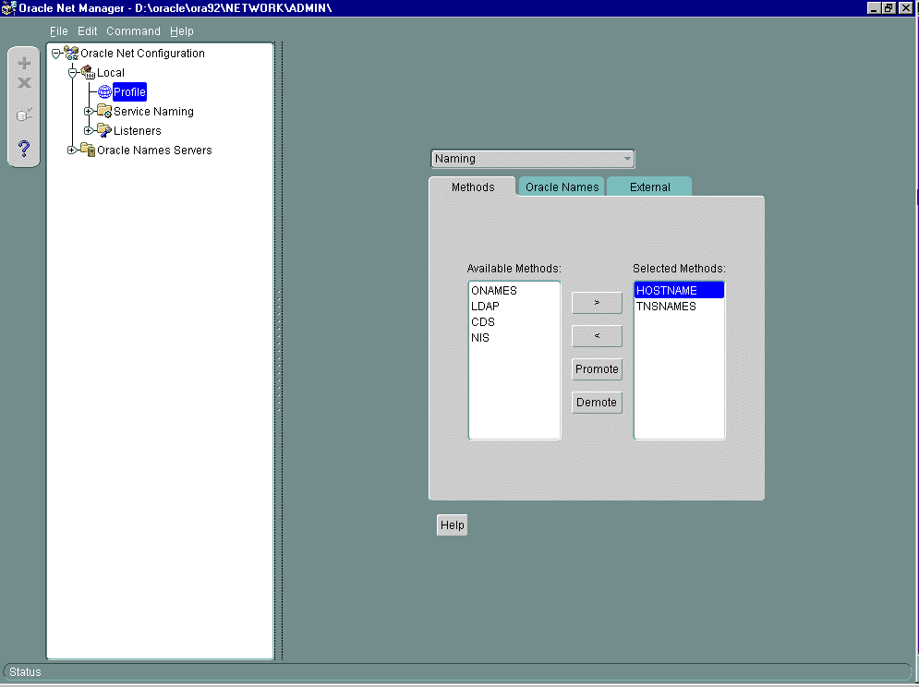
Configuring Host Naming
Using Net Manager
Notes:
Configuring Host Naming Using Oracle Net Manager
You can use Oracle Net Manager to configure host naming as follows:
1. In the navigator pane, expand Local > Profile.
2. From the list in the right pane, select Naming.
3. Click the Methods tab.
4. From the Available Methods list, select HOSTNAME, and then click the right-arrow button.
5. From the Selected Methods list, select HOSTNAME, and then click Promote to move the selection to the top of the list.
6. Choose File > Save Network Configuration.
The NAMES.DIRECTORY_PATH parameter is updated in the sqlnet.ora file as follows:
NAMES.DIRECTORY_PATH=(hostname, tnsnames)

Slide 9

Local Naming
Client
Server
sqlnet.ora
tnsnames.ora
listener.ora
Notes:
Local Naming Method
Advantages of local naming:
Provides a relatively straightforward method for resolving service name addresses
Resolves service names across networks running different protocols
Can easily be configured by using a graphical configuration tool
The local naming method requires net service names be stored in the tnsnames.ora file. You can add net service names by using Oracle Net Manager.

Slide 10
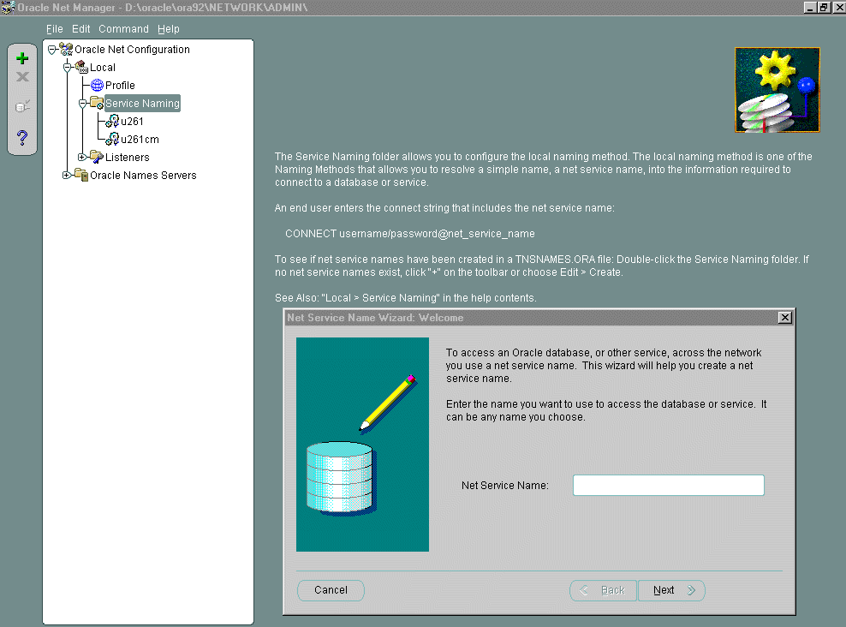
Configuring the tnsnames.ora File
Using Net Manager
Notes:
Configuring the tnsnames.ora File Using Oracle Net Manager
You can use Oracle Net Manager to configure net service names in the tnsnames.ora file as follows:
1. In the navigator pane, expand Local > Service Naming.
2. Click plus (+) from the toolbar, or choose Edit > Create from the menu bar.
The Welcome page of the Net Service Name Wizard appears.
3. Enter any name in the Net Service Name field.
4. Click Next.
The Protocol page appears.

Slide 11
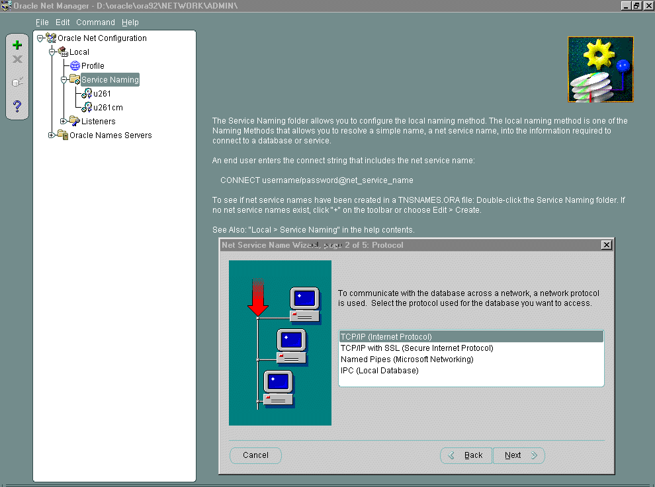
Configuring the tnsnames.ora File
Using Net Manager
Notes:
Configuring the tnsnames.ora File Using Oracle Net Manager (continued)
Continue to configure the tnsnames.ora file as follows:
5. Select the protocol on which the listener is configured to listen. Note that this protocol must also installed on the client.
6. Click Next.
The Protocol Settings page appears.

Slide 12
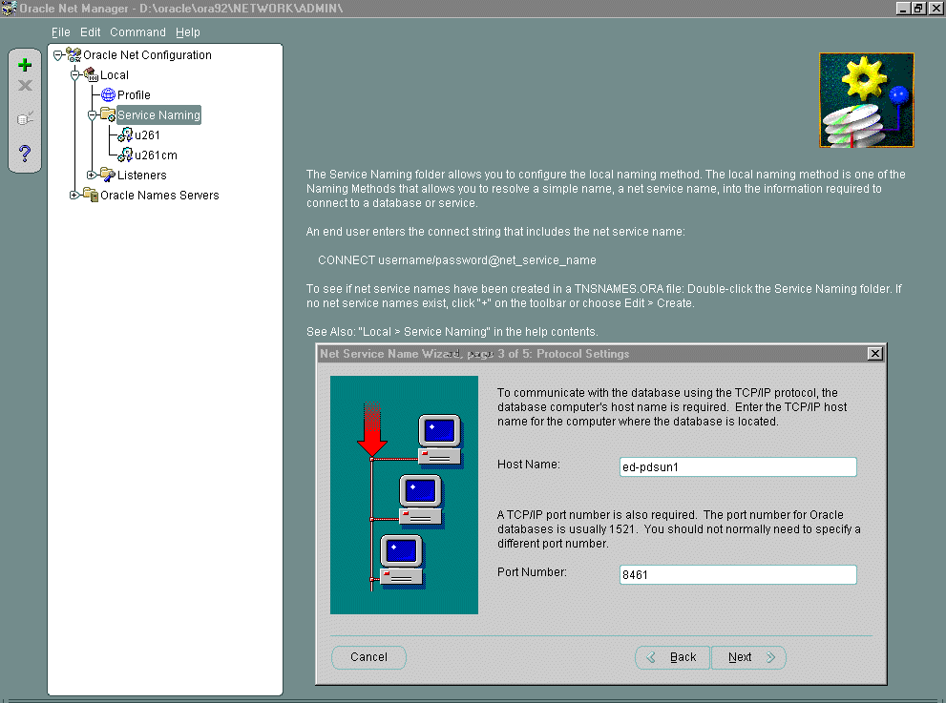
Configuring the tnsnames.ora File
Using Net Manager
Notes:
Configuring the tnsnames.ora File Using Oracle Net Manager (continued)
Continue to configure the tnsnames.ora file as follows:
7. Enter the appropriate parameter information for the selected protocol in the fields provided.
8. Click Next.
The Service page appears.

Slide 13
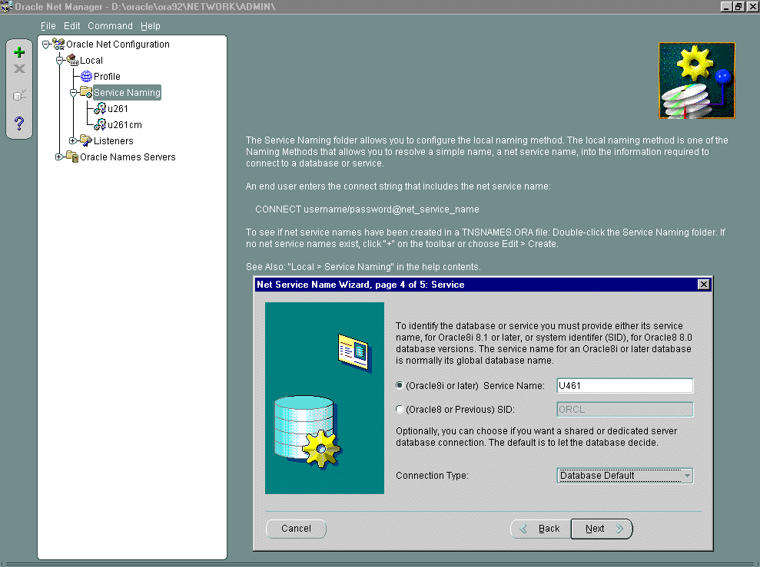
Configuring the tnsnames.ora File
Using Net Manager
Notes:
Configuring the tnsnames.ora File Using Oracle Net Manager (continued)
Continue to configure the tnsnames.ora file as follows:
9. Select a release, enter a destination service, and optionally, select a database connection type.
If the destination service is an Oracle9i or Oracle8i database, then select Oracle8i or later, and enter a service name in the Service Name field. If the destination service is an Oracle, release 8.0 database, then select Oracle8 or Previous, and enter an Oracle System Identifier for an instance in the Database SID field.
You should use the default setting of Database Default for the connection type . If Shared Server is configured in the initialization parameter file, you can select Dedicated Server to force the listener to spawn a dedicated server, bypassing shared server configuration. If Shared Server is configured in the initialization parameter file and you want to guarantee the connection always uses shared server, select Shared Server.
10. Click Next.
The Test page appears.

Slide 14
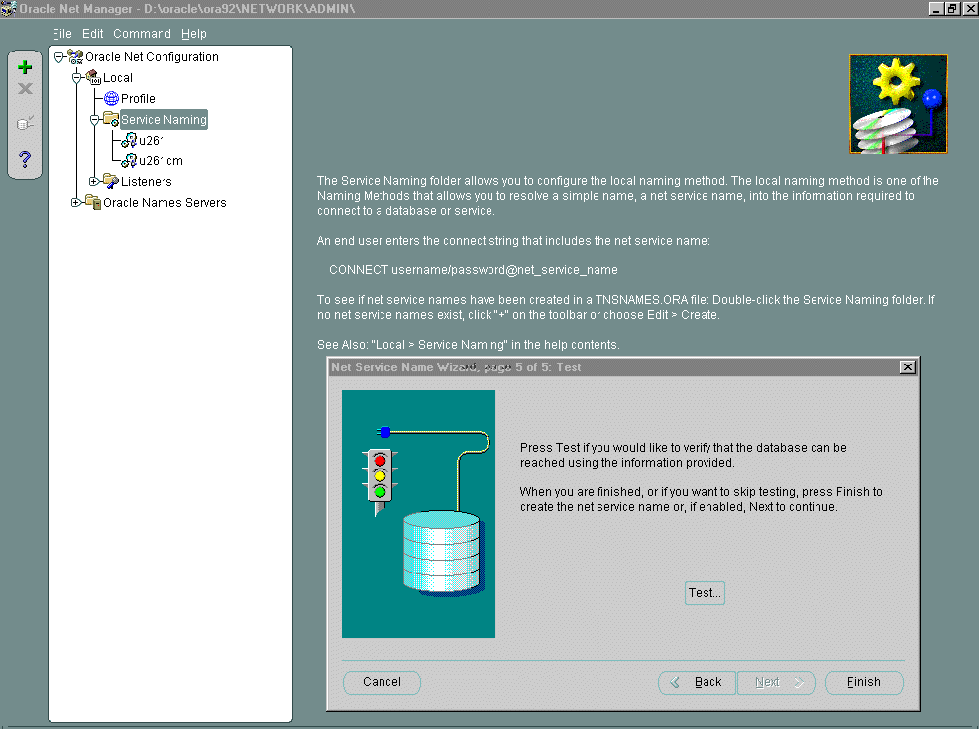
Configuring the tnsnames.ora File
Using Net Manager
Notes:
Configuring the tnsnames.ora File Using Oracle Net Manager (continued)
Continue to configure the tnsnames.ora file as follows:
11. Click Test to verify that the net service name works, or click Finish to save your configuration and dismiss the Net Service Name Wizard.
12. Click Finish to dismiss the Net Service Name Wizard.

Slide 15
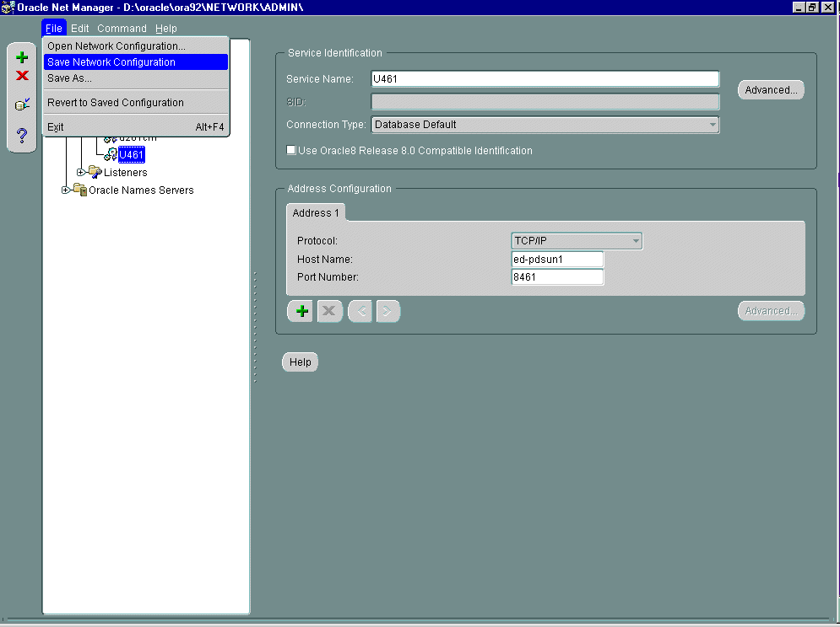
Configuring the tnsnames.ora File
Using Net Manager
Notes:
Configuring the tnsnames.ora File Using Oracle Net Manager (continued)
Complete the configuration of the tnsnames.ora file as follows:
13. Select Save Network Configuration from the File menu of Oracle Net Manager.

Slide 16
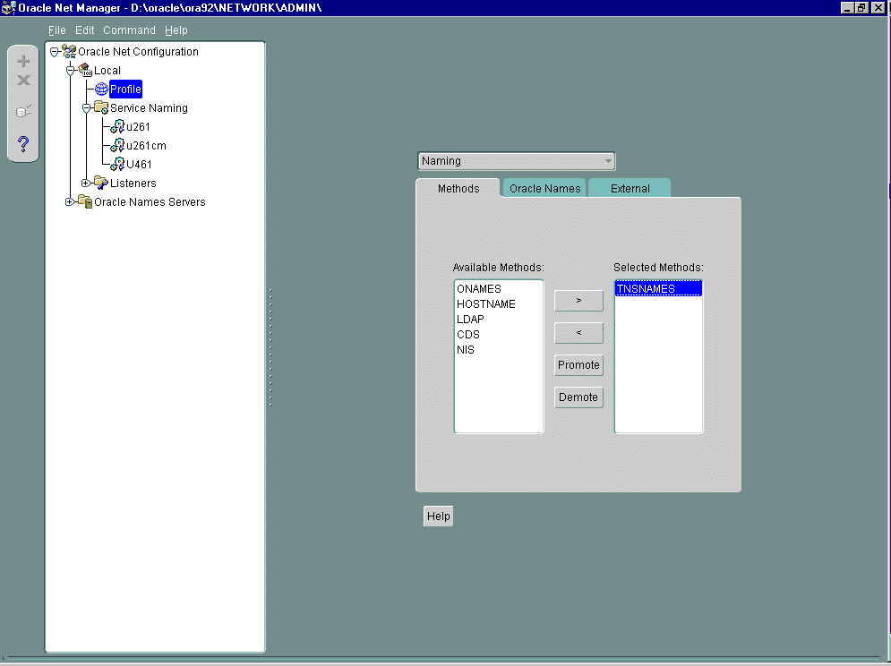
Configuring the Local Naming Method
Using Net Manager
Notes:
Configuring the Local Naming Method Using Oracle Net Manager (continued)
You can use Oracle Net Manager to configure the local naming method as follows:
1. In the navigator pane, expand Local > Profile.
2. From the list in the right pane, select Naming.
3. Click the Methods tab.
4. From the Available Methods list, select TNSNAMES, and then click the right-arrow button.
5. From the Selected Methods list, select TNSNAMES, and then use the Promote button to move the selection to the top of the list.
6. Choose File > Save Network Configuration.
The NAMES.DIRECTORY_PATH parameter is updated in the sqlnet.ora file as follows:
NAMES.DIRECTORY_PATH=(tnsnames)

Slide 17
Generated Files: tnsnames.ora
# TNSNAMES.ORA Network Configuration
# File:D:\oracle\ora92\NETWORK\ADMIN\tnsnames.ora
# Generated by Oracle configuration tools.
U461 =
(DESCRIPTION =
(ADDRESS_LIST =
(ADDRESS =
(PROTOCOL = TCP)(HOST = ed-pdsun1)(PORT = 8461))
)
(CONNECT_DATA =
(SERVICE_NAME = U461)
)
)
Notes:
The tnsnames.ora File
The tnsnames.ora file is used to store net service names. The default location is $ORACLE_HOME/network/admin on UNIX and %ORACLE_HOME%\network\
admin on Windows.

Slide 18
Notes:
The tnsnames.ora File (continued)
The content of the tnsnames.ora is as follows:

Slide 19
Generated Files: sqlnet.ora
# SQLNET.ORA Network Configuration File: D:\oracle\ora92\NETWORK\ADMIN\sqlnet.ora
# Generated by Oracle configuration tools.
NAMES.DIRECTORY_PATH= (TNSNAMES)
Notes:
The sqlnet.ora File
The sqlnet.ora file controls the behavior of Oracle Net Services.
The default location is $ORACLE_HOME/network/admin on UNIX and %ORACLE_HOME%\network\admin on Windows. The default location can be overridden by defining the TNS_ADMIN environment variable.
The NAMES.DIRECTORY_PATH parameter controls how Oracle Net Services resolves net service names into connect descriptors. Multiple methods can be represented as a comma-separated list enclosed by parentheses. Net services attempts to resolve net service names using each method listed working from left to right.
Once the naming methods and net service names have been configured and tested successfully, you can connect to the server from the client by using any Oracle client tool.

Slide 20
Troubleshooting the Client Side
The following error codes are related to problems on the client side:
ORA-12154 “TNS:could not resolve service name”
ORA-12198 “TNS:could not find path to destination”
ORA-12203 “TNS:unable to connect to destination”
ORA-12533 “TNS:illegal ADDRESS parameters”
ORA-12541 “TNS:no listener”
Notes:
Troubleshooting
The following describes common errors and how they can be resolved.
ORA-12154: “TNS:could not resolve service name”
Cause: Oracle Net Services cannot locate the connect descriptor that is specified in the tnsnames.ora configuration file.
Action
1. Verify that a tnsnames.ora file exists and that it is accessible.
2. Verify that the tnsnames.ora file is in the location specified by the TNS_ADMIN environment variable.
3. In your tnsnames.ora file, verify that the service name that is specified in your connection string is mapped to a connect descriptor in the tnsnames.ora file. Also, verify that there are no syntax errors in the file.
4. Verify that there are no duplicate copies of the sqlnet.ora file.
5. If you are connecting from a login dialog box, verify that you are not placing an at symbol (@) before your connection service name.

Slide 21
Notes:
Troubleshooting (continued)
ORA-12198: “TNS:could not find path to destination” and
ORA-12203: “TNS:unable to connect to destination”
Cause: The client cannot find the desired database.
Action
1. Verify that you have correctly entered the service name of the database that you want to reach.
2. Verify that the service name ADDRESS parameters in the connect descriptor of your TNSNAMES.ORA file are correct.
3. Verify that your TNSNAMES.ORA file is stored in the directory defined in the TNS_ADMIN environment variable.
4. Verify that the listener on the remote node has started and is running. If not, start the listener by using the Listener Control utility.
5. If you are connecting from a login dialog box, verify that you are not placing an at symbol (@) before your connection service name.
ORA-12533: “TNS:illegal ADDRESS parameters”
Cause: The protocol-specific parameters in the ADDRESS section of the designated
connect descriptor in your tnsnames.ora file are incorrect.
Action: For more information about protocol-specific keywords, refer to the Oracle
operating system documentation for your platform.
ORA-12541: TNS:no listener
Cause: The listener on the remote node cannot be contacted.
Action: Verify that the listener on the remote node has been started. You can check its
status with the STATUS command of the Listener Control utility and start it with the
START command if necessary.

Slide 22
Summary
In this lesson, you should have learned how to:
  Describe the difference between host naming and local service name resolution
  Use Oracle Net Manager to configure:
    Host naming method
    Local naming method
    Net service names
  Perform simple connection troubleshooting

Slide 23
Practice 4 Overview
This practice covers the following topics:
  Local Naming configuration
  Configuration of net service names
  Testing the configuration

Slide 24
Notes:
Practice 4: Naming Method Configuration
1. Use Oracle Net Manager to configure your client to use the local naming method. Select TNSNAMES as the only naming method. If you are unsure of the name of your client, please ask the instructor how to obtain the name.
Manual Configuration
If Oracle9i is not available on your PC client, manually configure and test the client connection from the UNIX host. Change directories to $TNS_ADMIN and copy $HOME/STUDENT/LABS/sqlnet.sam and $HOME/STUDENT/LABS/tnsnames.sam to sqlnet.ora and tnsnames.ora respectively. Edit them with vi.
2. View the contents of the sqlnet.ora and tnsnames.ora files that you have created with Oracle Net Manager. How is the information that you provided recorded in these files?
If you have manually edited the files, test that the service is reachable using tnsping.
4. Connect to the server as system/manager using SQL*Plus and verify that you are connected to the correct instance by querying the V$INSTANCE view.

